Slide 1

Lab4: User Mode
ZJU Sys3 @Saure/Cao Yu
Apr.27 2026
Notes:
特权级已经是上个学期理论课的内容了，所以还是用几页 PPT 帮大家复习一下。

Slide 2
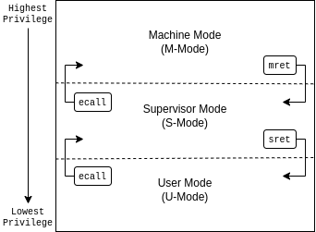
Why Privilege Levels?
Privilege levels are used to provide protection between different components of the software stack, and attempts to perform operations not permitted by the current privilege mode will cause an exception to be raised. These exceptions will normally cause traps into an underlying execution environment.
OpenSBI
OS
Application
Image source: https://www.cs.mu.edu/\~brylow/cosc3250/Spring2023/Projects/Project5.html
Notes:
这张PPT来自去年助教宝林gg

Slide 3
Some Question
(trap) How to keep state of the lower privilege mode?
(return-from-trap) How to restore state of the lower privilege mode?
How to pass information between different privilege mode?
OpenSBI
OS
Application
Image source: https://www.cs.mu.edu/\~brylow/cosc3250/Spring2023/Projects/Project5.html
Notes:
这些问题我们在实现中断处理的时候已经解决了。这次的一些不同就是多了虚拟内存和新的特权模式U-mode ，还需要管理两个栈。

Slide 4
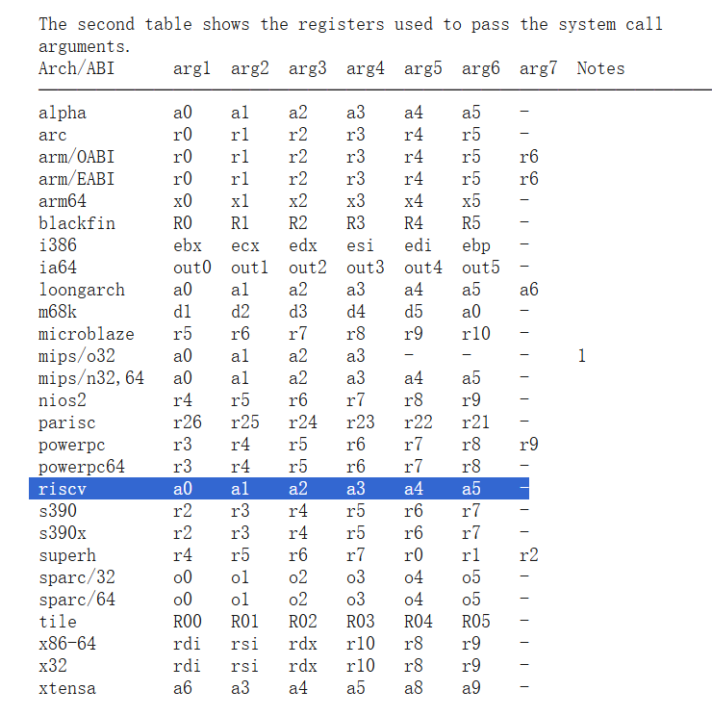
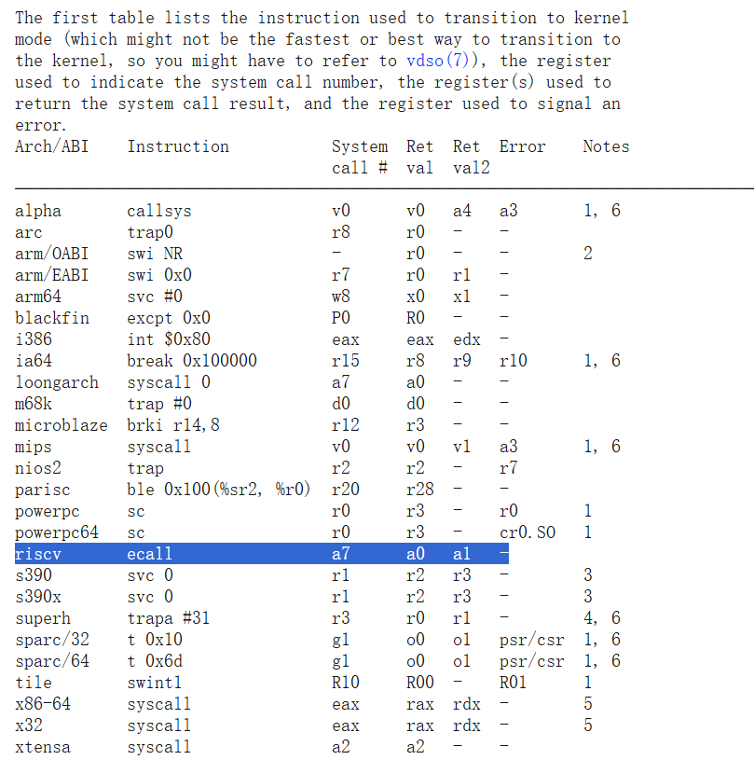
System Calls(1)
Image source: https://www.kernel.org/doc/man-pages/

Slide 5
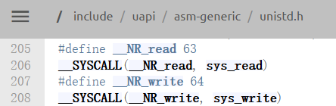

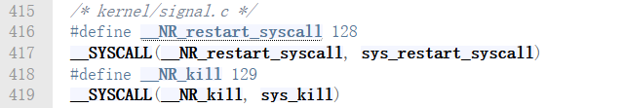
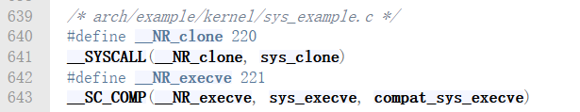
System Calls(2)
Image source: https://www.kernel.org/doc/man-pages/

Slide 6
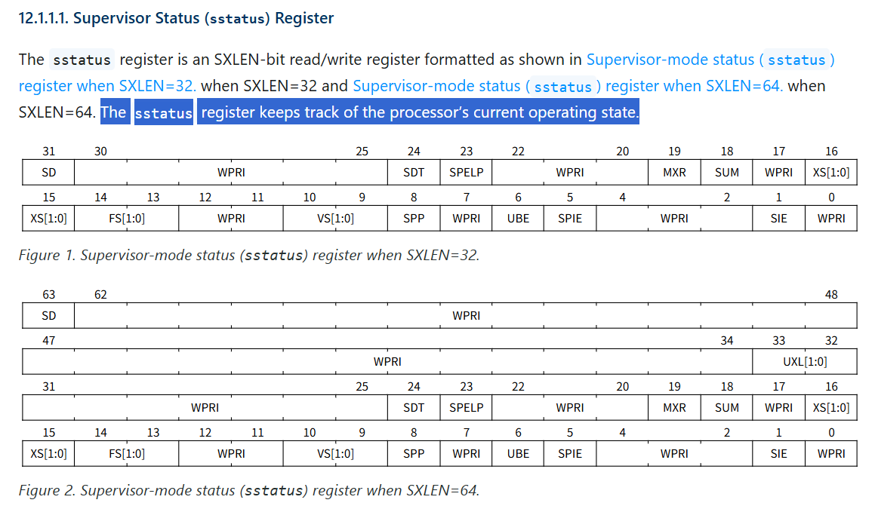
一些寄存器设置： sstatus/sstatus.SUM/sstatus.SPP
https://docs.riscv.org/reference/isa/priv/supervisor.html#sstatus

Slide 7
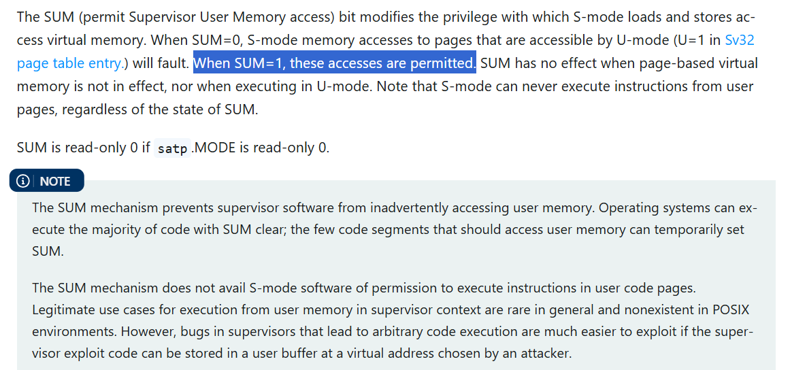
一些寄存器设置： sstatus/sstatus.SUM/sstatus.SPP
https://docs.riscv.org/reference/isa/priv/supervisor.html#sstatus

Slide 8
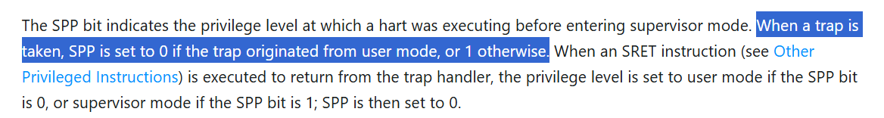
一些寄存器设置： sstatus/sstatus.SUM/sstatus.SPP
https://docs.riscv.org/reference/isa/priv/supervisor.html#sstatus

Slide 9
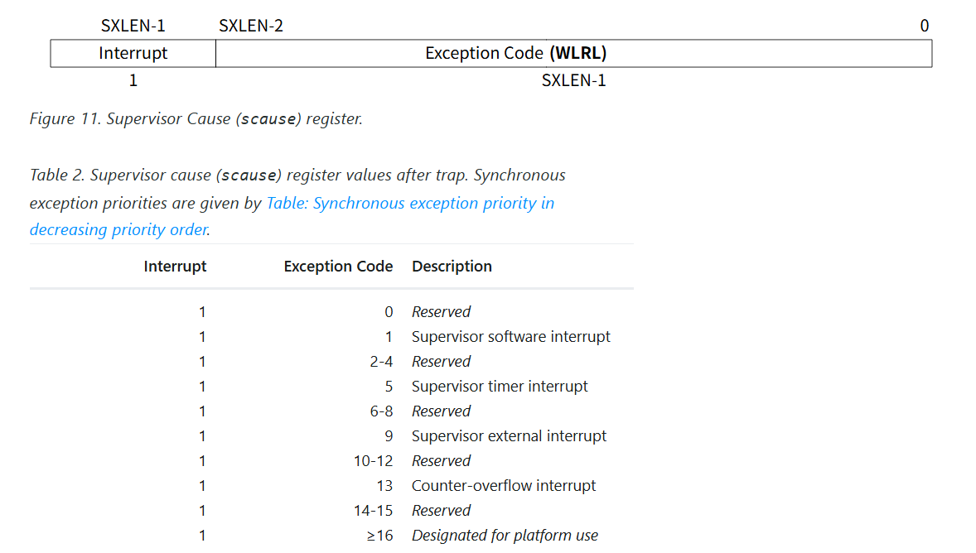
一些寄存器设置： scause(1)
https://docs.riscv.org/reference/isa/priv/supervisor.html#scause

Slide 10
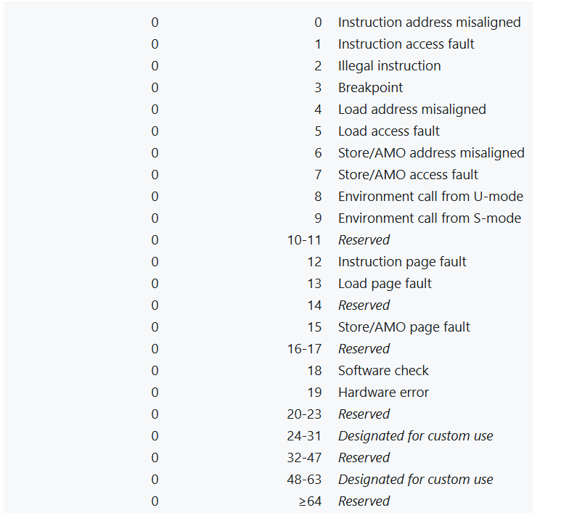
一些寄存器设置： scause(2)
https://docs.riscv.org/reference/isa/priv/supervisor.html#scause

Slide 11
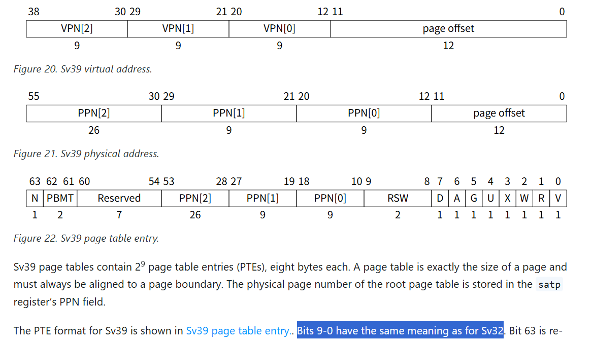
权限设置： PTE
https://docs.riscv.org/reference/isa/priv/supervisor.html#translation

Slide 12
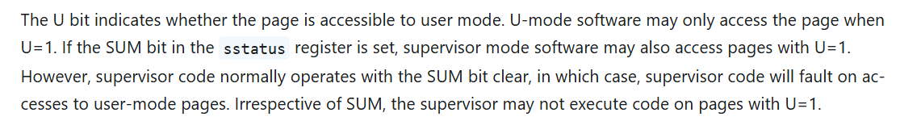
权限设置： PTE.U
https://docs.riscv.org/reference/isa/priv/supervisor.html#translation

Slide 13
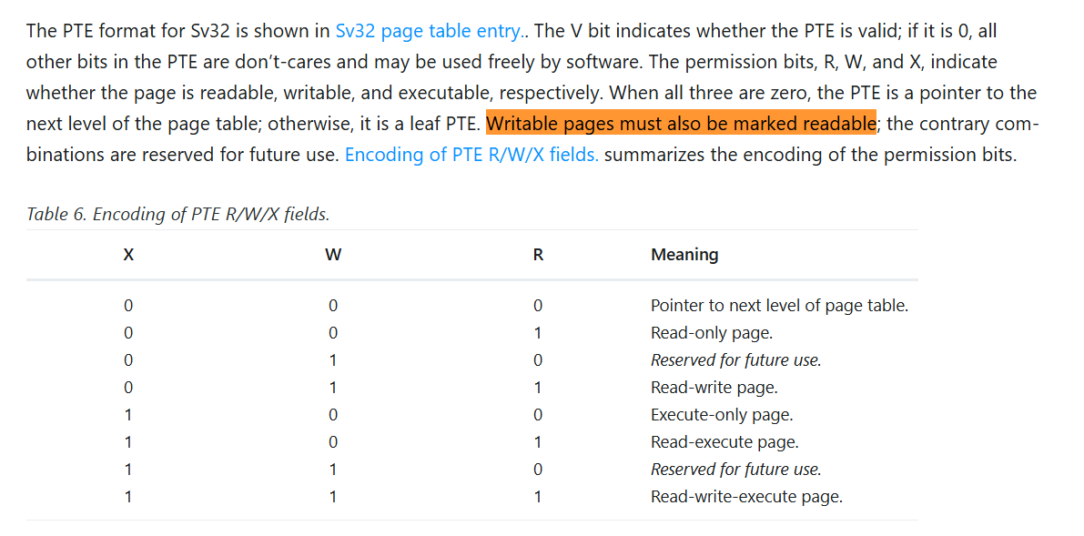
PTE.X/W/R: 一个彩蛋
《Reserved for future use.》（确信）
https://docs.riscv.org/reference/isa/priv/supervisor.html#translation

