Slide 1

Lab5: Page Fault & Fork
ZJU Sys3 @z3phyr / Lou Siyu
May.6 2026

Slide 2
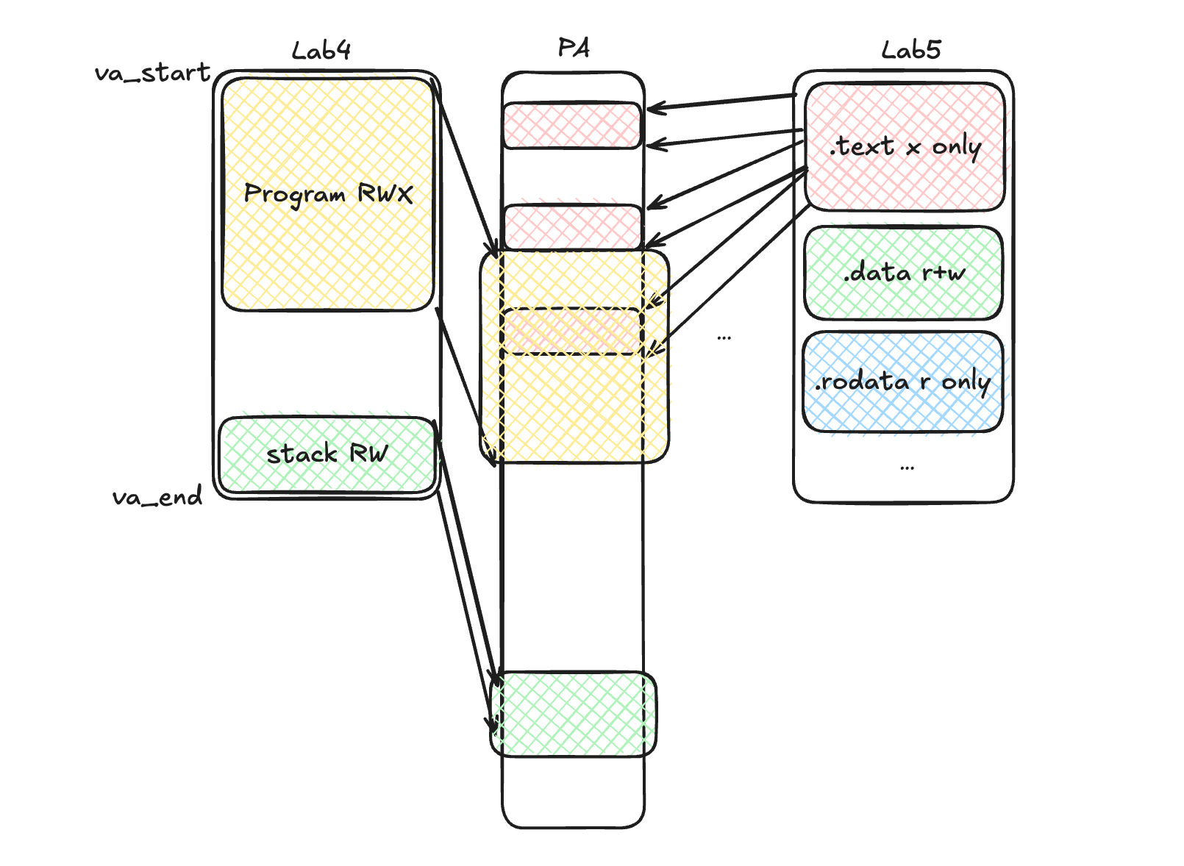
What does Lab5 solve？
Lab4 :
task_init Pre-map user program and user stack
with program RWX and stack RW
Problem？
large user program occupies too much physical memory
coarse granularity of permission division, .text writable, .data executable, low security
...
Solution: Demand Paging
Notes:
lab4 是怎么处理用户态程序的？
无文件系统->物理内存模拟磁盘，把uapp.o 嵌入kernel data段
每一个用户态进程初始化时，分配uapp大小的物理页，建立一个映射（当然还有用户态栈）
主要解决第一个问题
第二个问题可以通过ELF loading 解决（非lab5内容，可自行尝试解决）

Slide 3
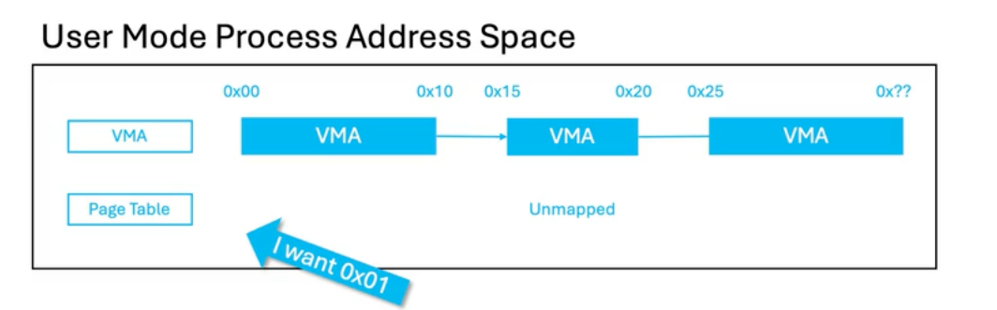
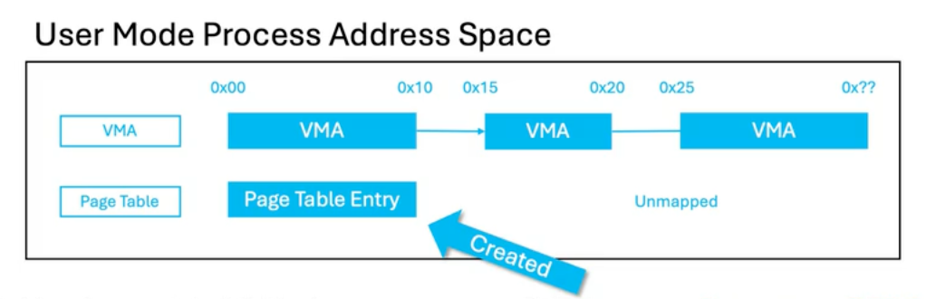
Demand Paging
页表初始为空，只加载需要用到的页，其余内容仍在磁盘中。若后续访问到未被载入的页时，MMU在硬件上触发缺页异常，内核的异常处理程序去加载对应的页，建立映射，用户态继续执行
Problem？
“由于demand paging引入的缺页异常”
vs
“非法地址访问的缺页异常”
Their handler should be different, how to distinguish?
Solution: VMA
Notes:
正常OS：磁盘；lab：用户程序内容暂存在 _suapp ~ _euapp， 第一次访问时再复制到新物理页

Slide 4
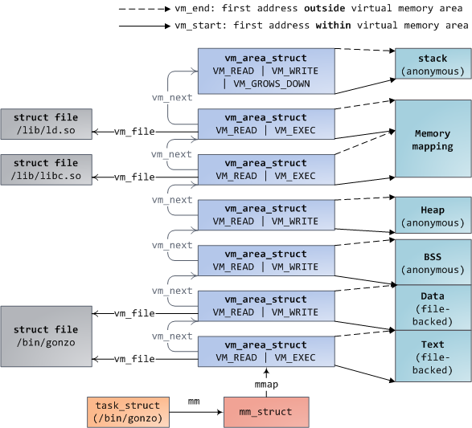
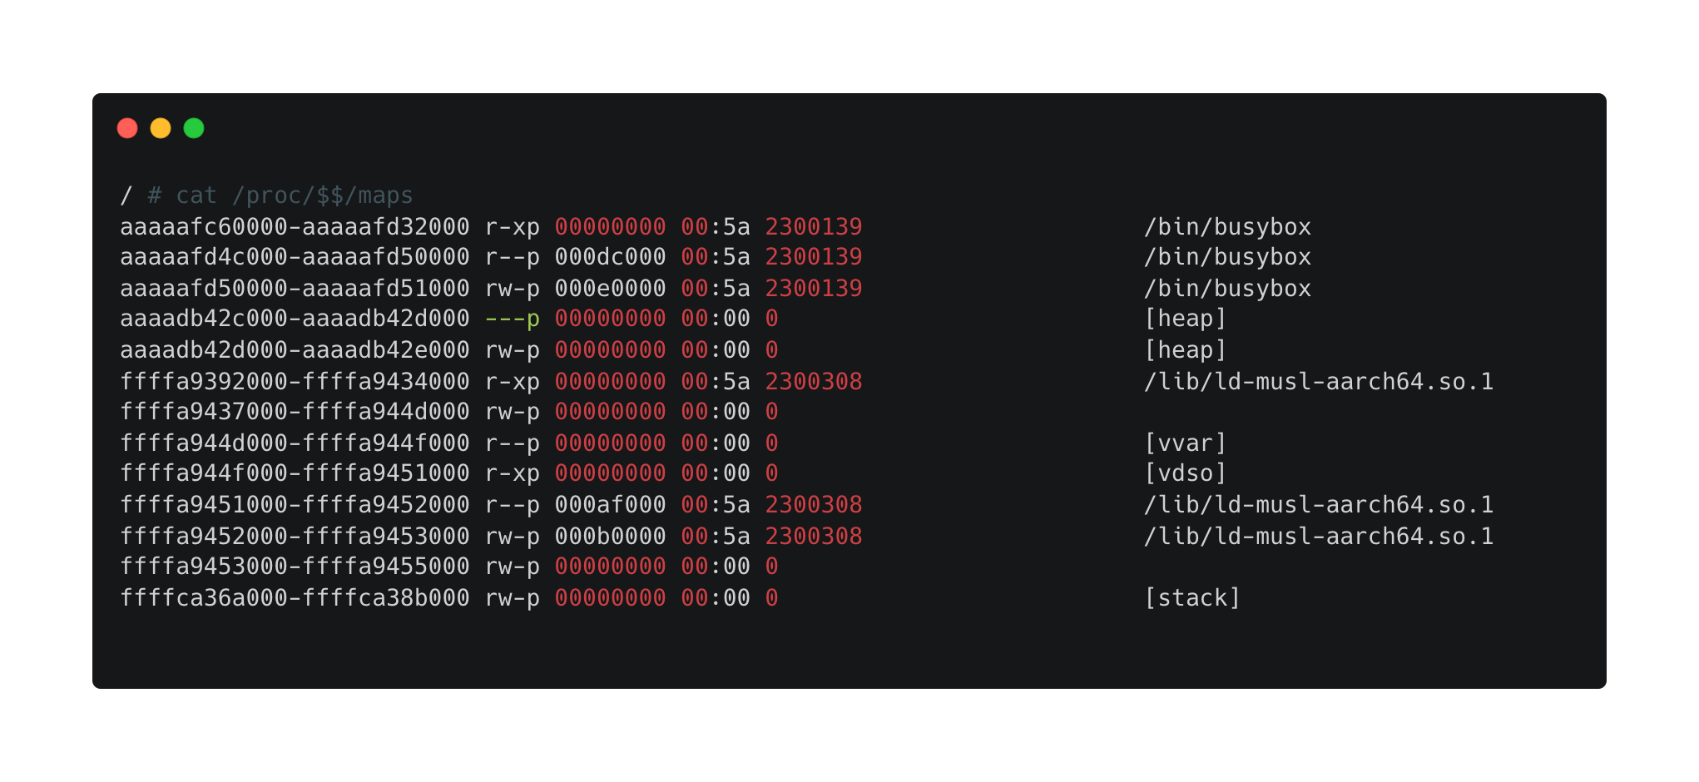
VMA (Virtual Memory Area)
per process
file-backed / anonymous
created when init
created by mmap / stack growth ...
distinguish legal/illegal page faults
used by find_vma() in page fault handler

Slide 5
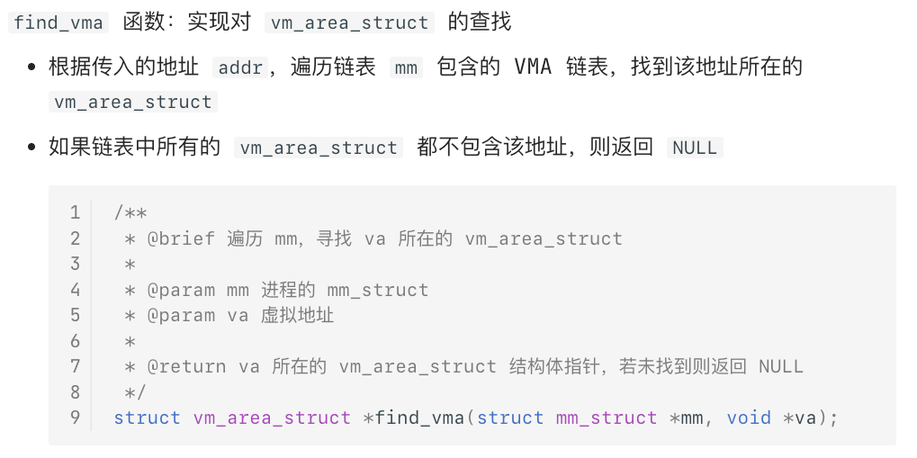
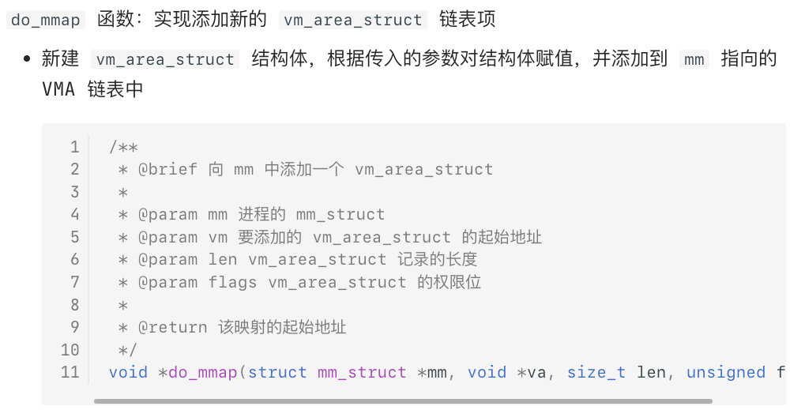
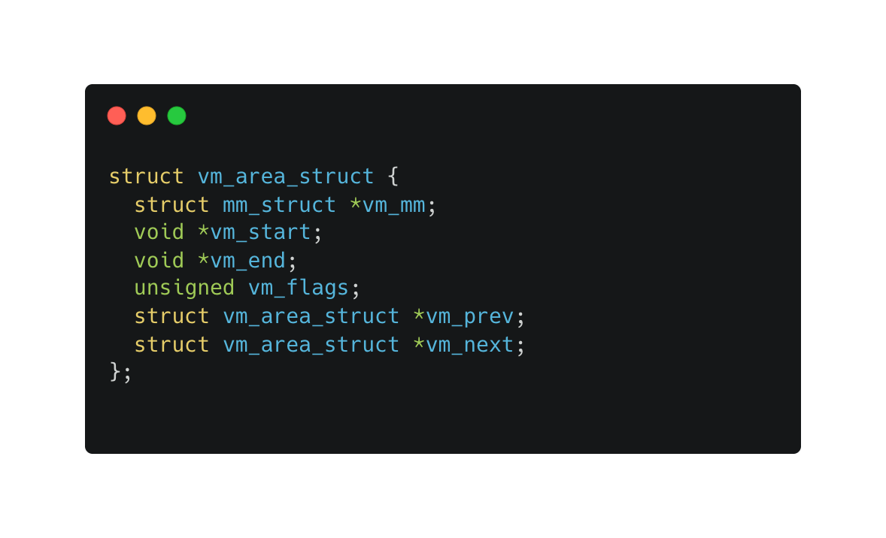
Data Structure
Your Task: Implement vm_area_struct
Doubly linked list
Supported operations：
find_vma
do_mmap
Your Task: create VMA for all tasks when init
tip: VMA flags ≠ PTE flags

Slide 6
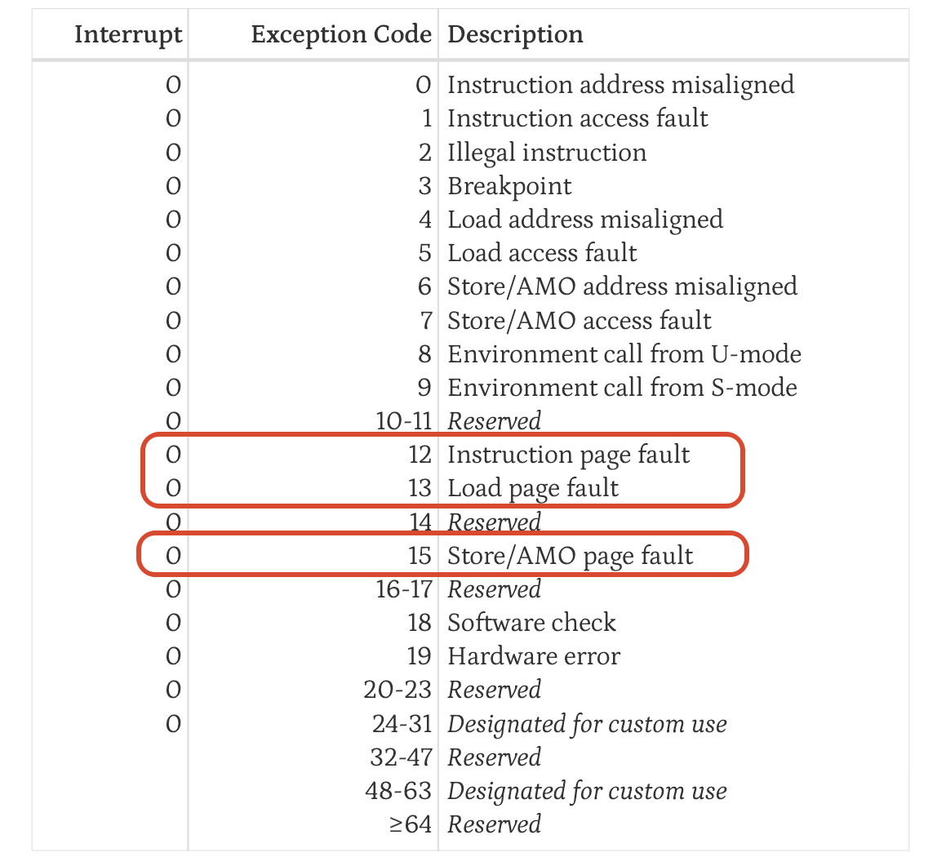
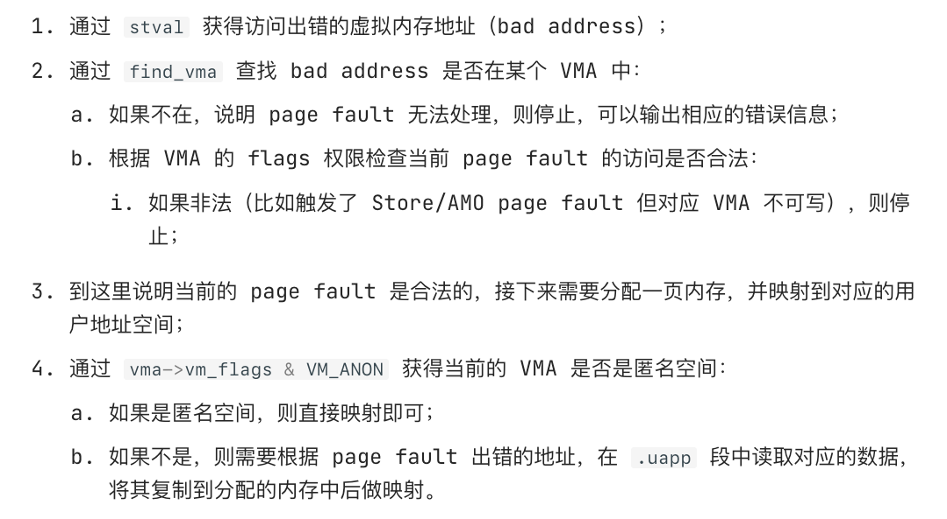
RISC-V Page Fault Handling
scause hints Page Fault Types:
12: Instruction page fault (execution)
13: Load page fault (read)
15: Store/AMO page fault (write)
sepc hints faulting instruction PC
stval hints Page Fault Address
Your Task: Implement do_page_fault
Notes:
区分spec, stval 中的地址
CSR的设置由硬件完成

Slide 7
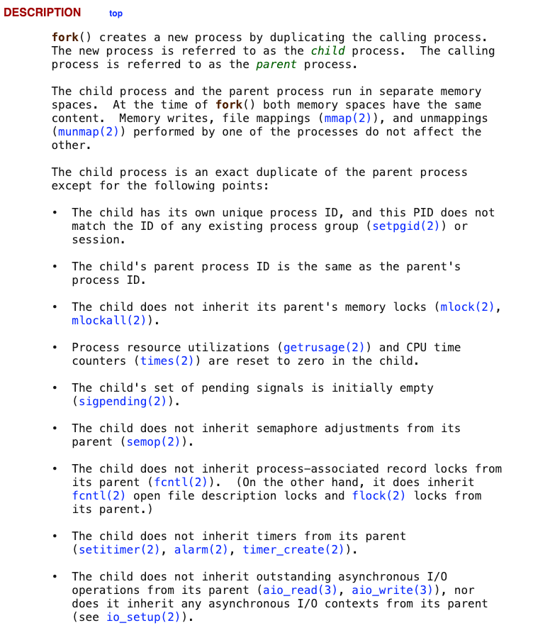
Fork Syscall
fork semantics
parent returns child pid
child returns 0
both continue after fork()
both memory spaces have the same content
kernel needs to copy
task_struct + kernel stack
thread context / pt_regs
mm_struct / VMA list
user page table
syscall entry
if regs->a7 == __NR_clone, call sys_clone( )
sys_clone → do_fork

Slide 8
do_fork: what to do in detail?
Kernel State
allocate one page for child task_struct + kernel stack
copy parent task page
assign child pid
set child counter = 0
set child thread.ra = ret_from_fork
set child thread.sp = copied kernel stack position
set child pt_regs->a0 = 0
parent returns child pid
User State
copy mm , VMA linked list (deep copy)
copy page table (empty or copy with CoW)
Why Child process returns from ret_from_fork?
Parent Process and Child Process have the Same State
Parent: do_fork -> sys_clone -> trap_handler -> _traps -> $sepc
Child: __switch_to -> ret_from_fork -> ... -> $sepc
Notes:
每个用户态进程的内核页表部分都是一样的。用户态页表有不同的实现：由于记录了VMA，可以从空开始一步一步由PF创建；也可以引入CoW，直接共享父页表内容

Slide 9
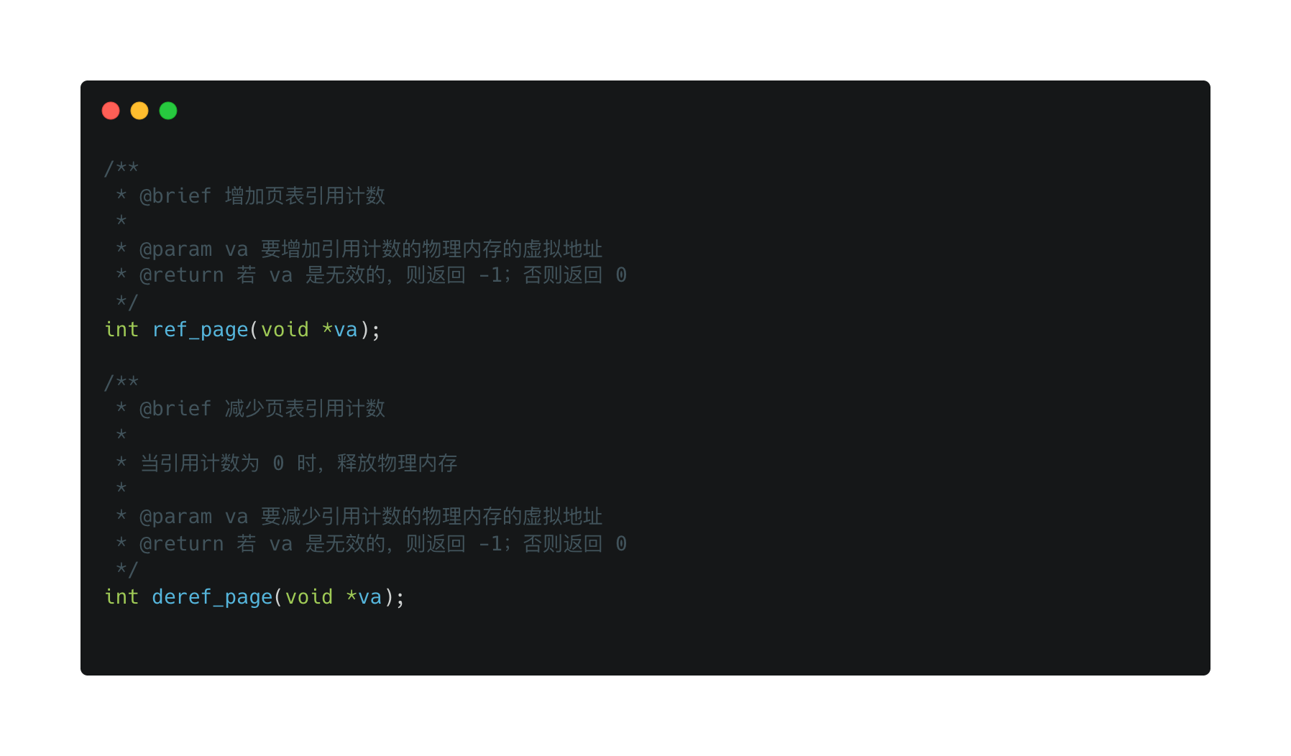
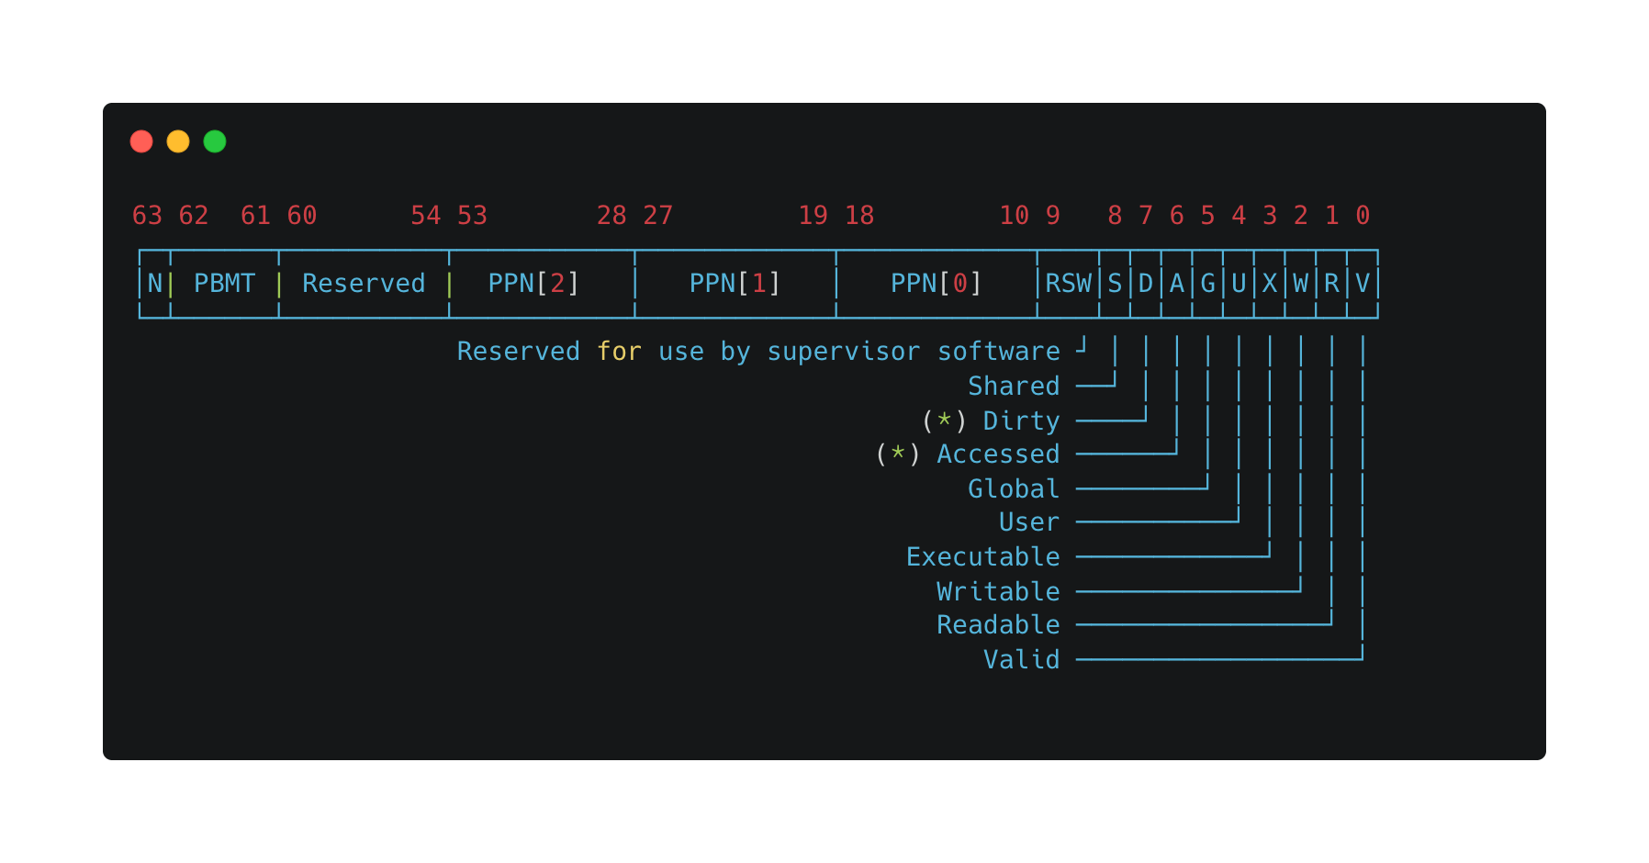
Copy On Write
Why CoW (Copy On Write) ? What’s the insight?
Read-only memory does not need to be copied.
How to implement?
add ref count and new API in physical memory management
maintain ref counts when handling fork and page fault
add shared bit in PTE
change writable pages to read-only and shared when fork
When a referenced party needs to write, create a new page table entry and allocate a new page, then call deref_page()
When a referenced party needs to write, If it’s the last one using the page, just change shared page back to writable
Your Task: Implement fork syscall with CoW
tip: Both parent and child PTEs must be changed to R+S

Slide 10
Testing
PFH1:
• first instruction → Instruction page fault
• first stack write → Store/AMO page fault
• new code page → Instruction page fault
PFH2:
• space crosses page boundaries
• every new 4 KiB page may trigger Store/AMO PF
FORK1 / FORK2:
• parent and child have independent var
• child inherits stack / data contents at fork time
FORK3:
• 3 forks → up to 8 user execution flows
• draw process tree and CoW sharing relation
FORK4:
• parent and child Fibonacci sequences evolve independently
Your Final Task: Pass All the Tests

