Slide 1
Knowledge organization of NA
Chapter 5:
Initial value problem
Euler, Runge-kutta, multi-step
Chapter 8: approximation
Orthogonal polynomials
Least squares
Chebyshev polynomial
Chapter 6&7:
Direct Matrix Solver
Iterative Matrix Solver
Chapter 4:
Numerical differentiation
Numerical integration
Chapter 1:
Mean value theorem
Taylor expansion
Roundoff error
Chapter 2:
Solution of equations with one variable
Chapter 3: interpolation
Lagrange polynomial
Piecewise polynomial
Interpolation and approximation
Basic Knowledge
Solution of Equations
1/12

Slide 2
What do we analyze for in NA?
Chapter 5:
Initial value problem
Euler, Runge-kutta, multi-step
Chapter 8: approximation
Orthogonal polynomials
Least squares
Chebyshev polynomial
Chapter 6&7:
Direct Matrix Solver
Iterative Matrix Solver
Chapter 4:
Numerical differentiation
Numerical integration
Chapter 1:
Mean value theorem
Taylor expansion
Roundoff error
Chapter 2:
Solution of equations with one variable
Chapter 3: interpolation
Lagrange polynomial
Piecewise polynomial
Interpolation and approximation
Basic Knowledge
Solution of Equations
Convergence + Stability
Error
1/12

Slide 3


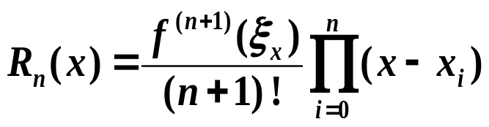
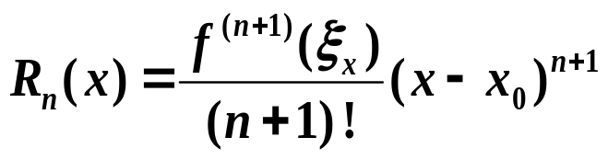
How many kinds of errors we analyze in NA?
Roundoff errors due to computer arithmetic Chap 1
The error between current solution and true solution used in convergence in iterative equation solver: , Chapter 2,7
Truncation error used in interpolation and approximation, Chapter 3,4,8,5.
Lagrange polynomial
Taylor expansion

