Slide 1

Chapter 2 Solutions of Equations in
One Variable
Find a root of f (x) = 0
☑ 2.1 The Bisection Method
Theorem: (Intermediate Value Theorem)
If f ∈ C[a, b] and K is any number between f(a) and f(b), then there exists a number p ∈ (a, b) for which f(p) = K.
Discussion 4: When to stop?
a
p₁
p
a
b
b
p₂
1/16

Slide 2

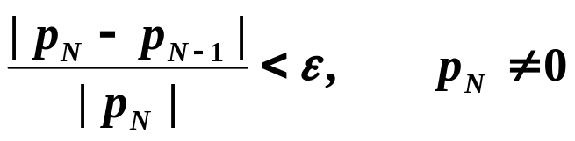

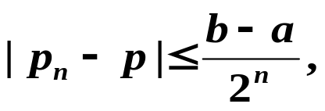
Chapter 2 Solutions of Equations in One Variable -- The Bisection Method
☞
There exist sequences
{ p_{N} } that diverge while
| p_{N} – p_{N – 1} | < ε
☞
☞
ε
p
p_{N}
Theorem: Suppose that f ∈ C[a, b] and f(a) · f(b) < 0. The Bisection method generates a sequence { p_{n} } (n = 0, 1, 2, …) approximating a zero p of f with
when n ≥ 1.
Proof: p.52
2/16

Slide 3
Chapter 2 Solutions of Equations in One Variable -- The Bisection Method
Algorithm: Bisection
To find a solution to f (x) = 0 given the continuous function f on the interval
[ a, b ], where f (a) and f (b) have opposite signs.
Input: endpoints a, b; tolerance TOL; maximum number of iterations N_{max}.
Output: approximate solution p or message of failure.
Step 1 Set i = 1;
FA = f (a) ;
Step 2 While ( i ≤ N_{max}) do steps 3-6
Step 3 Set p = a + ( b – a ) / 2 ; /* compute p_{i} */
FP = f (p) ;
Step 4 If ( FP == 0 ) or ( b − a ) / 2 < TOL then Output (p);
STOP; /* successful */
Step 5 Set i ++;
Step 6 If sign(FA) · sign(FP) > 0 then set a = p ; FA = FP ;
Else set b = p ; /* update a_{i}, b_{i} */
Step 7 Output (Method failed after N_{max} iterations); /* unsuccessful */
STOP.
Why not
p = ( a + b ) / 2 ?
Why not
FA · FP > 0?
3/16
Notes:
(a+b)/2 (5.9+5.8) = 11.7 11.7 两位有效数字 12 12/2 = 6

Slide 4

Chapter 2 Solutions of Equations in One Variable -- The Bisection Method
① Simple, only requires a continuous f ;
② Always converges to a solution.
① Slow to converge, and a good intermediate approximation can be inadvertently discarded;
② Cannot find multiple roots and complex roots.
Note:
Practically, we can sketch a graph of f(x) before applying the bisection method. Or use a subroutine to partition the interval into several sub-intervals [a_{k}, b_{k}] so that f (a_{k})·f (b_{k}) < 0 even when
f (a)·f (b) > 0.
HW: p.54 #13, 15
4/16

Slide 5

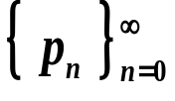
Chapter 2 Solutions of Equations in One Variable -- Fixed-Point Iteration
☑ 2.2 Fixed-Point Iteration
equivalent
f (x) = 0
x = g (x)
Root of f (x)
Fixed-point of g (x)
Start from an initial approximation p₀ and generate the sequence
by letting p_{n} = g( p_{n – 1} ), for each n ≥ 1. If the sequence
converges to p and g is continuous, then
Idea
So basically we are done! I can’t believe it’s so simple!
What’s the problem?
Oh yeah? Who tells you that the method is convergent?
5/16

Slide 6
Chapter 2 Solutions of Equations in One Variable -- Fixed-Point Iteration
y
y = x
y
y = x
t₁
t₀
y=g(x)
✓
t₀
✓
y=g(x)
Discussion 5: Which ones are convergent and why?
t₁
x
x
p₀
p₁
p
p₀
p
p₁
y
y = x
y
y = x
y=g(x)
y=g(x)
t₀
❒
❒
t₀
t₁
t₁
x
x
p₁
p₀
p
p₀
p
p₁
6/16

Slide 7


Chapter 2 Solutions of Equations in One Variable -- Fixed-Point Iteration
Theorem: (Fixed-Point Theorem)
Let g ∈ C[a, b] be such that g(x) ∈ [a, b], for all x in [a, b]. Suppose, in addition, that g’ exists on (a, b) and that a constant 0 < k < 1 exists with
|g’(x)| ≤ k for all x ∈ (a, b). Then, for any number p₀ in [a, b], the sequence defined by p_{n} = g( p_{n – 1} ), n ≥ 1, converges to the unique fixed point p in [a, b].
⬧
⬧
⬧
Proof:
a. Let f(x) = g(x) – x.
Discussion 6: How many points must we prove? Please list them out.
The Intermediate Value Theorem implies that f has a root, and hence g has a fixed point.
b. Prove by contradiction:
Suppose p and q are both fixed points of g in [a, b] and p ≠ q. The Mean Value Theorem implies that a number ξ exists between p and q with g(p) – g(q) = g’(ξ) (p – q).
= p
= q
(1 – g’(ξ)) (p – q) = 0
Contradiction!
Hence the fixed point is unique.
7/16

Slide 8


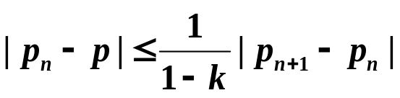
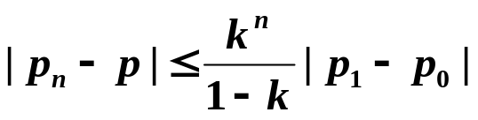
Chapter 2 Solutions of Equations in One Variable -- Fixed-Point Iteration
Proof (continued):
c.
g(x) ∈ [a, b], for all x in [a, b]
p_{n} is defined for all n ≥ 0
0
Corollary: If g satisfies the hypotheses of the Fixed-Point Theorem, then bounds for the error involved in using p_{n} to approximate p are given by (for all n ≥ 1)
and
Discussion 7: What does the above corollary tell us? Why do we need two different inequalities?
Can be used
to control the
accuracy
The
the value of k, the faster
the convergence.
smaller
8/16

Slide 9
Chapter 2 Solutions of Equations in One Variable -- Fixed-Point Iteration
Algorithm: Fixed-Point Iteration
Find a solution to p = g(p) given an initial approximation p₀.
Input: initial approximation p₀; tolerance TOL; maximum number of
iterations N_{max}.
Output: approximate solution p or message of failure.
Step 1 Set i = 1;
Step 2 While ( i ≤ N_{max}) do steps 3-6
Step 3 Set p = g(p₀); /* compute p_{i} */
Step 4 If | p − p₀ | < TOL then Output (p); /* successful */
STOP;
Step 5 Set i ++;
Step 6 Set p₀ = p ; /* update p₀ */
Step 7 Output (The method failed after N_{max} iterations); /* unsuccessful */
STOP.
9/16

Slide 10




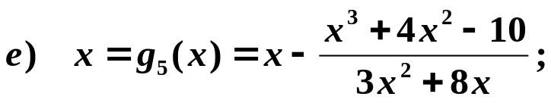
Chapter 2 Solutions of Equations in One Variable -- Fixed-Point Iteration
Example: Find the unique root of the equation x³ + 4x² – 10 = 0 in [1, 2]. Using the following equivalent fixed-point forms with p₀ = 1.5, which one is the best? (The root is approximately 1.365230013.)
❒
❒
✓
✓

But why?
✓
OK in [1, 1.5].
k ≈ 0.66
k ≈ 0.15
HW:
p.64 #3, p.65 #19
10/16

Slide 11
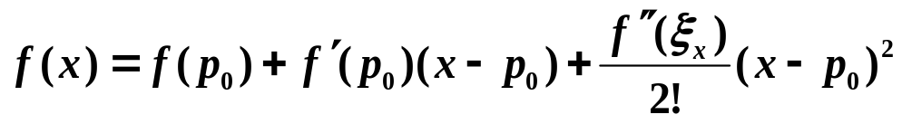
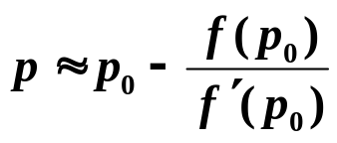

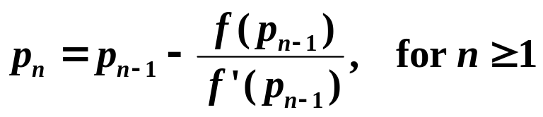
Chapter 2 Solutions of Equations in One Variable – Newton’s Method
☑ 2.3 Newton’s Method (Newton-Raphson Method)
Idea: Linearize a nonlinear function using Taylor’s expansion.
Let p₀ ∈ [a, b] be an approximation to p such that f ’(p₀) ≠ 0. Consider the first Taylor polynomial of f (x) expanded about p₀ :
where ξ_{x} lies between p₀ and x .
Assume that | p − p₀| is small, then (p − p₀)² is much smaller. Then:
y
linear
p
x
p₀
11/16

Slide 12
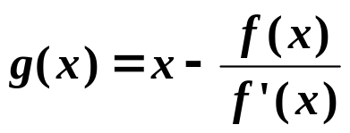
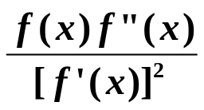
Chapter 2 Solutions of Equations in One Variable – Newton’s Method
Theorem: Let f ∈ C²[a, b]. If p ∈[a, b] is such that f(p) = 0 and f ’(p) ≠ 0, then there exists a δ > 0 such that Newton’s method generates a sequence { p_{n} } (n = 1, 2, …) converging to p for any initial approximation
p₀ ∈ [p – δ, p + δ].
Proof: Newton’s method is just p_{n} = g( p_{n – 1} ) for n ≥ 1 with
✓
a. Is g(x) continuous in a neighborhood of p?
f ’(p) ≠ 0 and is continuous
f ’(x) ≠ 0 in a neighborhood of p
✓
b. Is g’(x) bounded by 0 < k < 1 in a neighborhood of p?
g’(x) =
g’(p) =
0
f ”(x) is continuous
g’(x) is small and is continuous in a neighborhood of p
12/16

Slide 13
Chapter 2 Solutions of Equations in One Variable – Newton’s Method
Proof (continued):
✓
c. Does g(x) map [p – δ, p + δ] into itself?
| g(x) – p |
= | g(x) – g(p) | = | g’(ξ) | | x – p | ≤ k | x – p | < | x – p |
< δ
Note: The convergence of Newton’s method depends on the selection of the initial approximation.
✗
✓
p₀
p₀
p₀
p
13/16

Slide 14

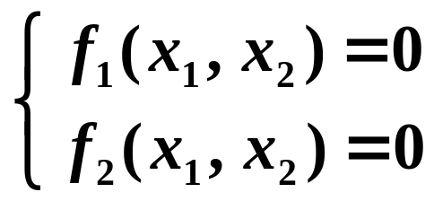
Chapter 2 Solutions of Equations in One Variable – Newton’s Method
Research topic 2:
Please extend Newton's method to solve systems of nonlinear equations. Start from a simple case of 2 variables and 2 equations:
14/16

Slide 15
Chapter 2 Solutions of Equations in One Variable – Newton’s Method
Research topic 3:
Self-study Secant Method.
Try to answer the following questions:
What is the advantage of Secant Method comparing to Newton's Method?
What are the disadvantages?
15/16

Slide 16
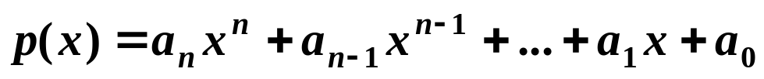
Chapter 2 Solutions of Equations in One Variable – Newton’s Method
Lab 02. Root of a Polynomial
Time Limit: 1 second; Points: 3
A polynomial of degree n has the common form as
Your task is to write a program to find a root of a given polynomial in a given interval.
16/16

