Slide 1
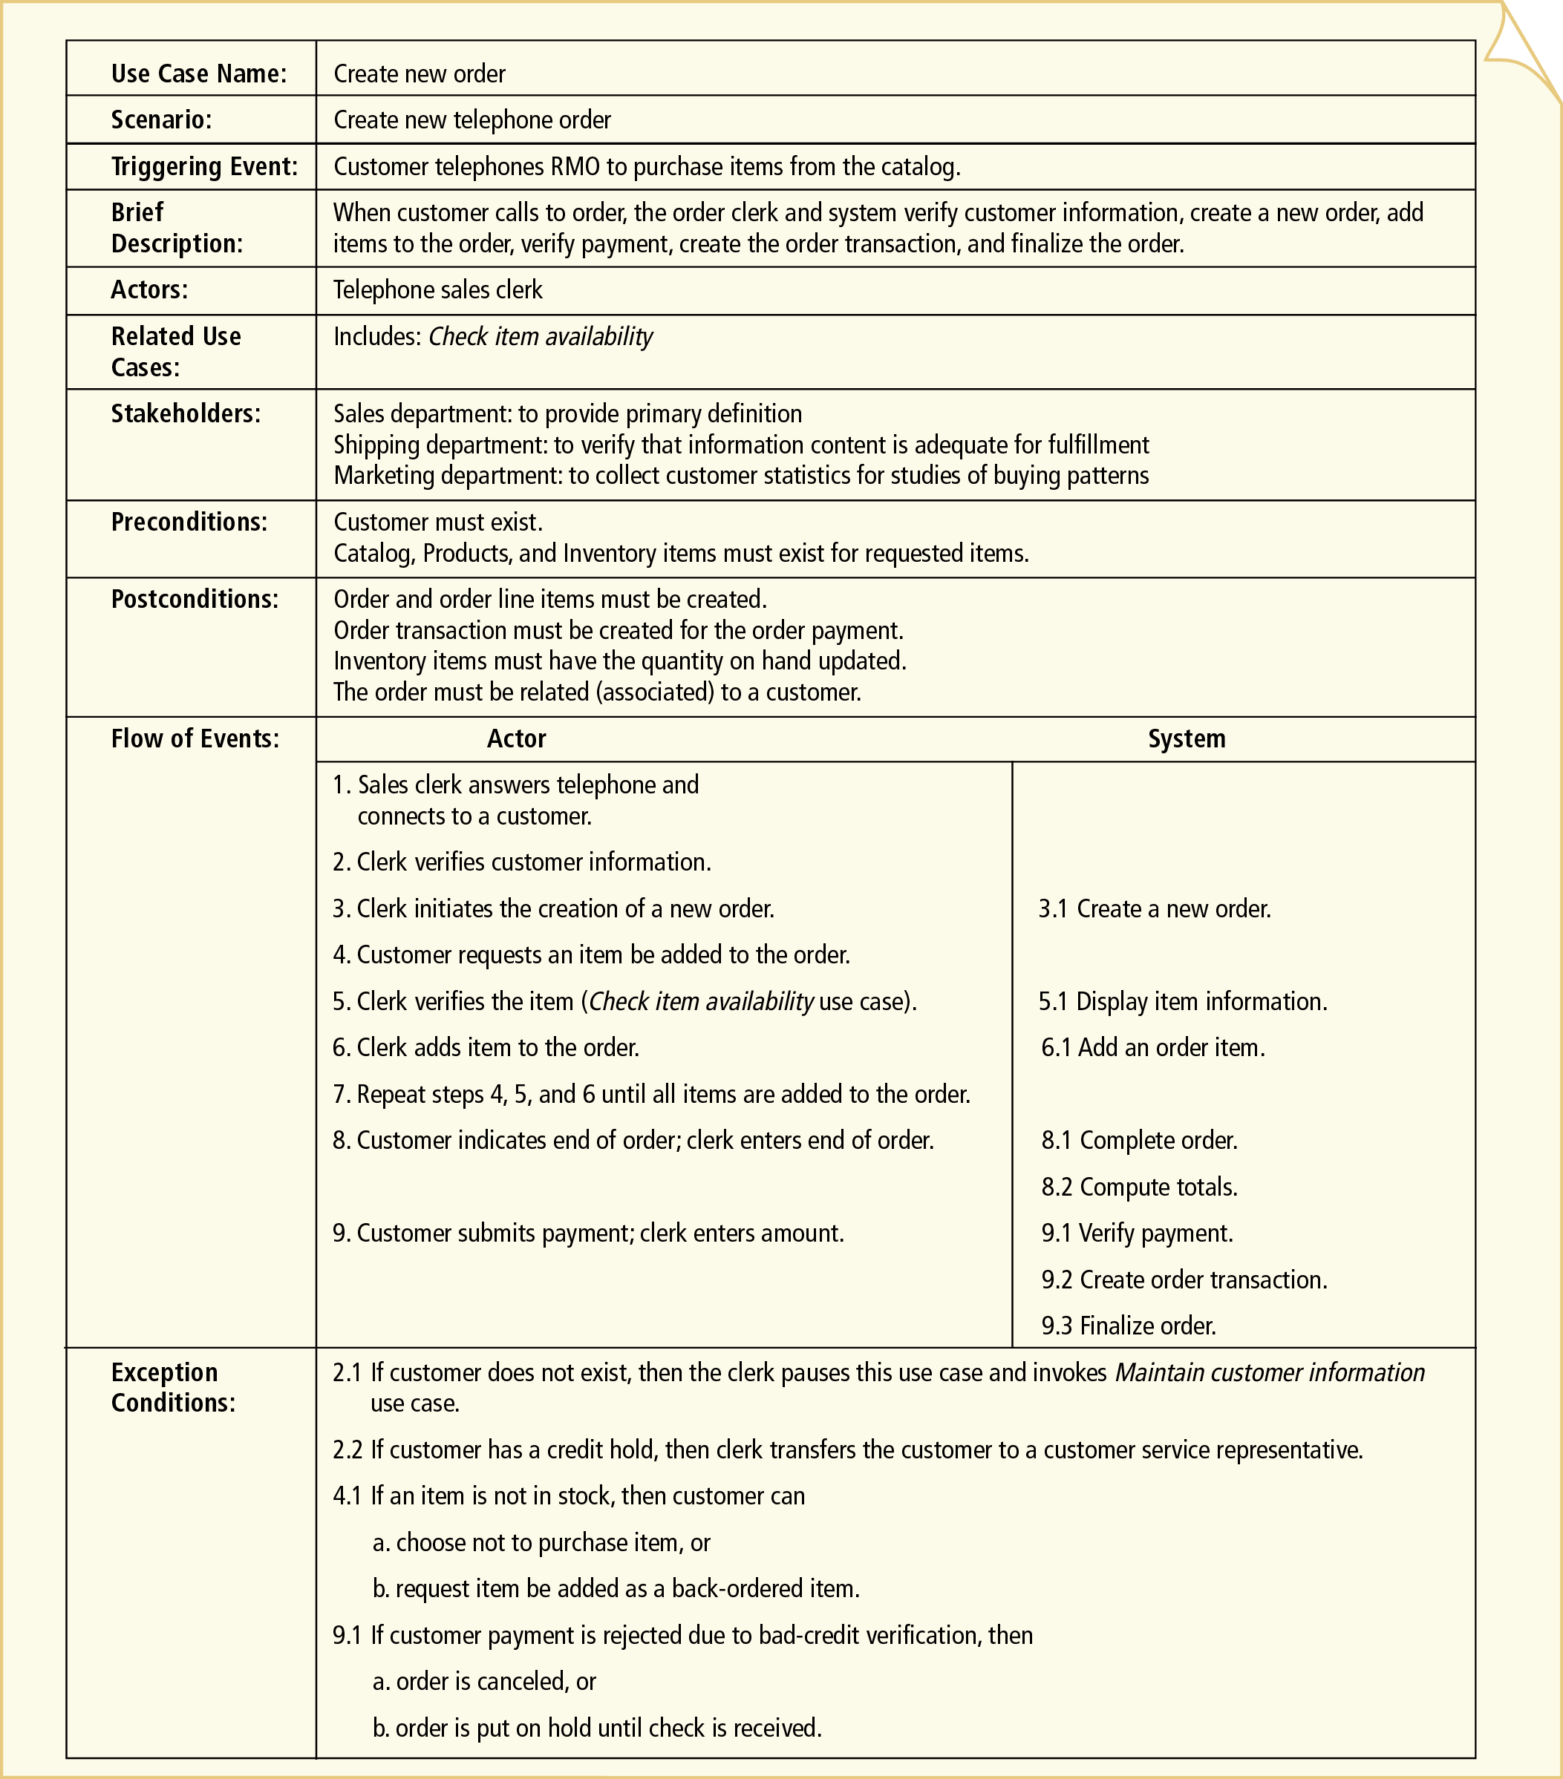
Basic Flow
Describe the most common flow
Should not list any conditional cases
IS2102 Requirements Analysis and Design
Notes:
1

Slide 2
Basic Flow (List form)
2. Flow of Events
Basic Flow:
2.1 The system displays a list of resolved cases that have not been reviewed.
2.2 The user selects a case.
2.3 The system validates that the case is payable. (12.1)
2.4 The system determines the payment amount. (12.1)
2.5 The system marks the case as payable.
2.6 The system records the payment amount.
2.7 The system checks the Cash fund records to ensure that adequate funds exist.
2.8 The system records the fact that the case has been reviewed.
…
IS2102 Requirements Analysis and Design
Notes:
2

Slide 3
Basic Flow Example
System use case: Review Case Report – a task that enables a user to review a case report and disburse funds against cases that qualify for payments
2. Flow of Events
Basic Flow:
2.1 The system displays a list of resolved cases that have not been reviewed.
2.2 The user selects a case.
2.3 The system validates that the case is payable. 2.4 The system determines the payment amount. 2.5 The system marks the case as payable.
2.6 The system records the payment amount.
2.7 The system checks the Cash fund records to ensure that adequate funds exist.
2.8 The system records the fact that the case has been reviewed.
…
Notes:
Use-Case Writing Guidelines Put into MS Word pg 109-110
The trick to keeping things simple is to handle variations in a separate area of the document rather than in one all-encompassing section.
First, you document a normal, typical interaction in a section called “Basic Flow”.
Next, you describe alternative success scenarios in an “Alternate Flows” section.
Finally, you describe error handling in an “Exceptional Flows” section.

Slide 4

Basic Flow
Describe the most common flow
Should not list any conditional cases
What if we want to show the conditional cases?
IS2102 Requirements Analysis and Design
Notes:
4

Slide 5
Triggering Event
The event that will trigger this use case
IS2102 Requirements Analysis and Design
Notes:
Gây ra
5

Slide 6
Brief Description
Give a more complete description to supplement the Trigger Event
IS2102 Requirements Analysis and Design
Notes:
6

Slide 7
Actors
The actor that will execute the use case (i.e. the person/system that will be doing this use case)
IS2102 Requirements Analysis and Design
Notes:
7

Slide 8
Related Use Cases
IS2102 Requirements Analysis and Design
Notes:
8

Slide 9
Stakeholders
Parties that will be interested in this use case (actors can be considered as part of the list)
IS2102 Requirements Analysis and Design
Notes:
9

Slide 10
Preconditions
This defines the state of the system before this use case can be executed
IS2102 Requirements Analysis and Design
Notes:
10

Slide 11
Postconditions
This defines the state of the system after this use case is executed
(Note: this is not the return result)
IS2102 Requirements Analysis and Design
Notes:
11

