Slide 1
Hong Kong Institute of Vocational Education Department of Information Technology ITE3902 Smartphone Apps Fundamentals Assignment
Mini Games Proposal
Groupmate
TAM Chi Ho (IT114105/2D/TY)
CHU King Yin Ken (IT114105/2D/TY)
CHEUNG Shing Hong (IT114105/2D/TY)
WONG Lok Man (IT114105/2D/TY)

Slide 2
CONTENT
Introduction
User Interface
Functions
Technology
Project Management

Slide 3
Introduction
The Mini Games are designed for player to have a short relax time after busy day. We design Four mini game.
Game
AB Number Guessing
Breakout
Tic-Tac-Toe
Whac-A-Mole
Game Rules Instructions

Slide 4
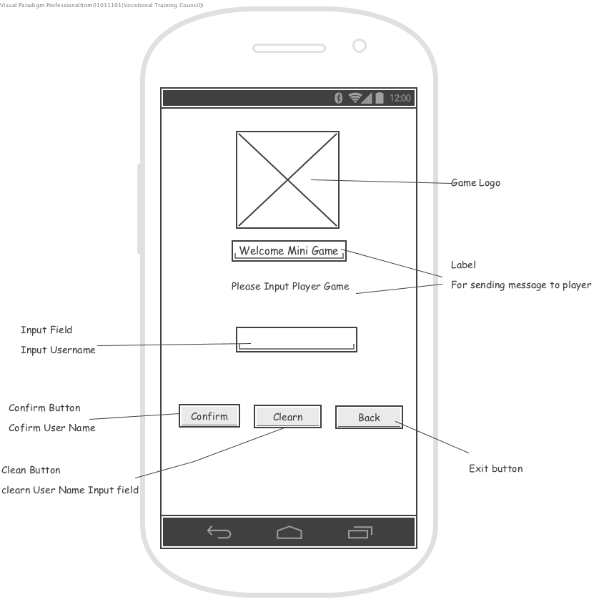
User Interface

Slide 5
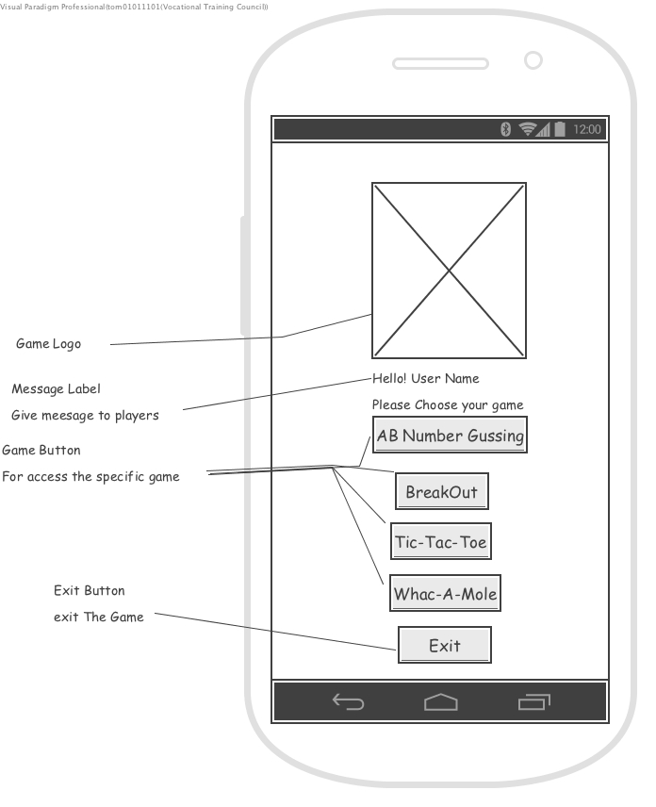
User Interface

Slide 6
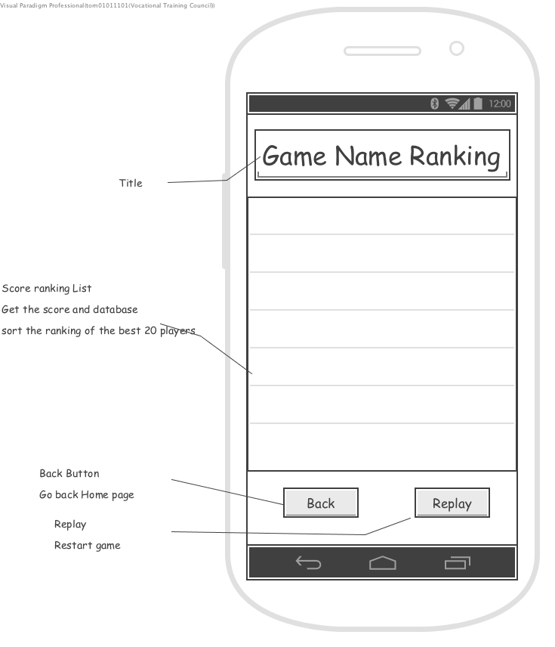
User Interface

Slide 7
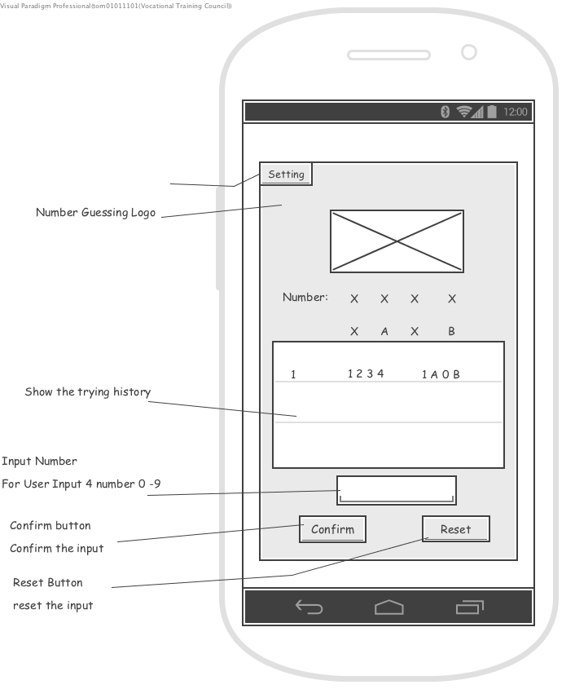
User Interface

Slide 8
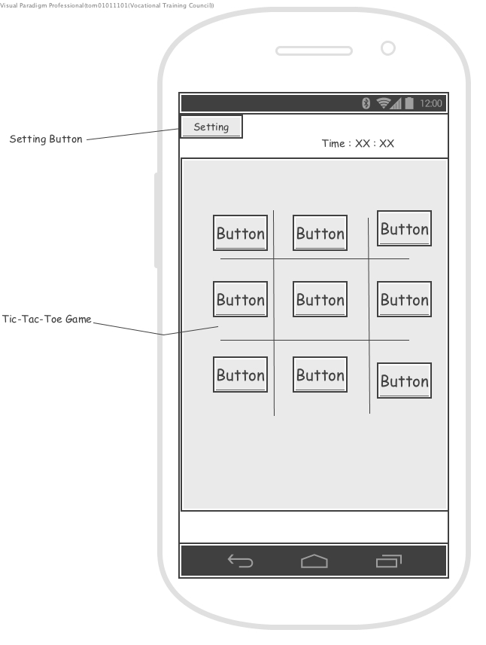
User Interface

Slide 9
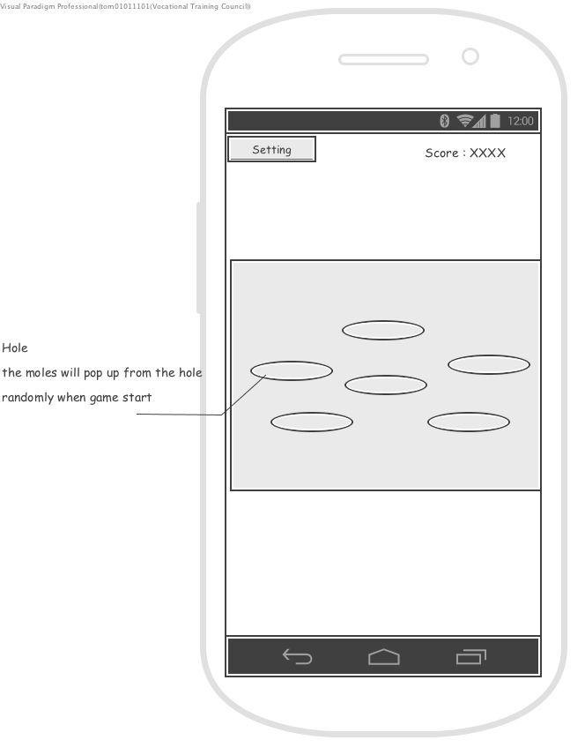
User Interface

Slide 10
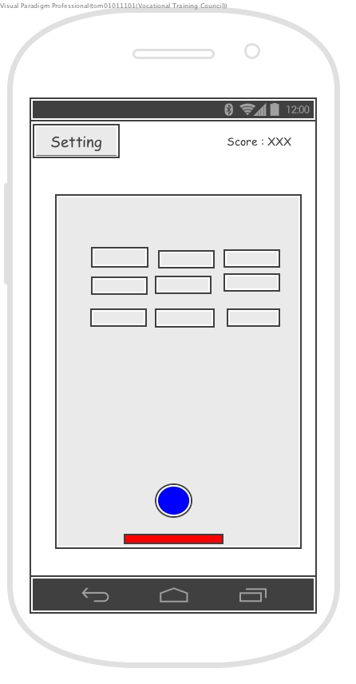
User Interface

Slide 11
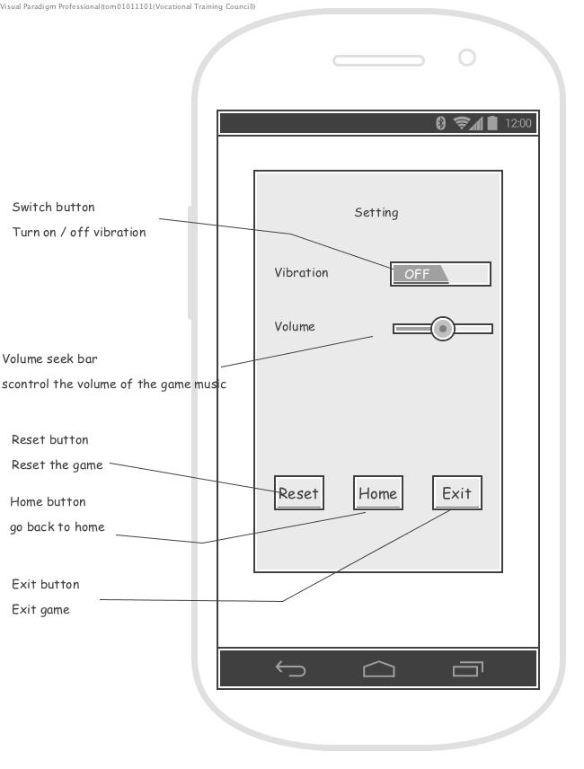
User Interface

Slide 12
Functions
Score Ranking Function
Menu Function
Reset Function
Go back Function
Set Player Name Function
Setting Function

Slide 13
Technology
App inventor
Firebase
Accelerometer Sensor

Slide 14
Project Management
Member Responsibility
Project Schedule
Gantt Chat

Slide 15
Member Responsibility
Project Management
Documentation
System Design
Program Implementation
Testing and Debugging
User Interface Design

Slide 16
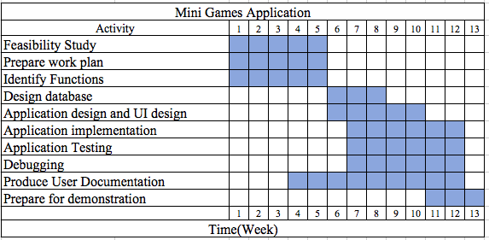
Gnatt Chart

Slide 17
The End

