Slide 1

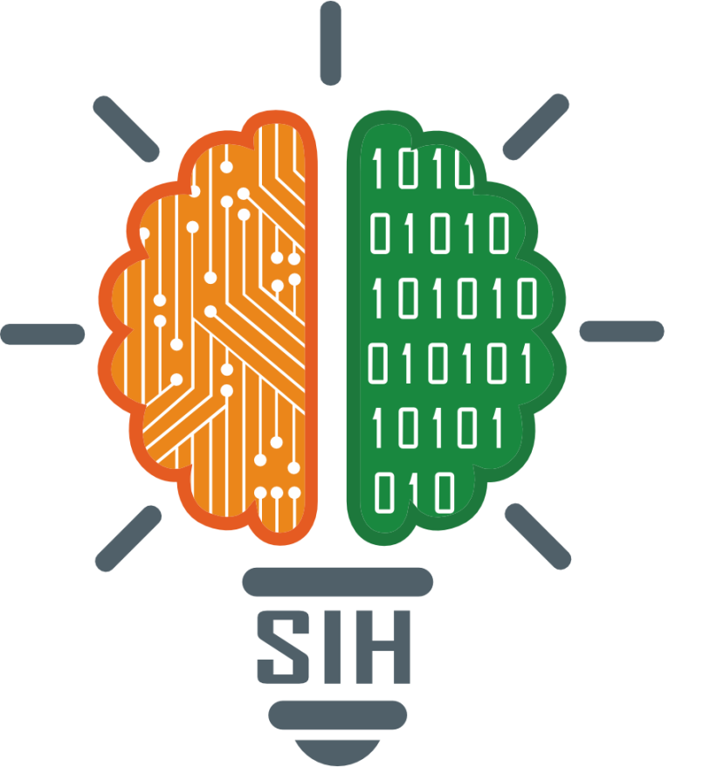
SMART INDIA HACKATHON 2025
TITLE PAGE
Problem Statement ID – SIH25070
Problem Statement Title- Secure Data Wiping for Trustworthy IT
Theme- Miscellaneous
PS Category- Software
Team ID- 88887
Team Name (Registered on portal)- Data Morphs

Slide 2
IDEA TITLE
Data
Morphs
Solution
Problem Resolution
Develop a secure, cross-platform data wiping application (Windows, Linux, Android, Offline ISO/USB).
One-click interface for easy use by the general public.
Tamper-proof wipe certificate (PDF + JSON, digitally signed).
Supports hidden storage erasure (HPA, DCO, SSD sectors).
Third-party verifiable and aligned with NIST SP 800-88 standards.
Eliminates fear of data breaches → users can recycle devices without risk.
Reduces hoarding of unused IT assets (₹50,000+ crore locked value).
Simplifies data sanitization → no need for complex or expensive tools.
Ensures trust, transparency, and compliance in e-waste recycling workflows.
Unique Value Proposition (UVP)
First open, verifiable, and user-friendly data wiping tool in India.
Proof of erasure builds confidence among individuals, enterprises, and recyclers.
Cross-platform + offline support → usable anytime, anywhere.
Drives safe e-waste management and strengthens India’s circular economy.

Slide 3
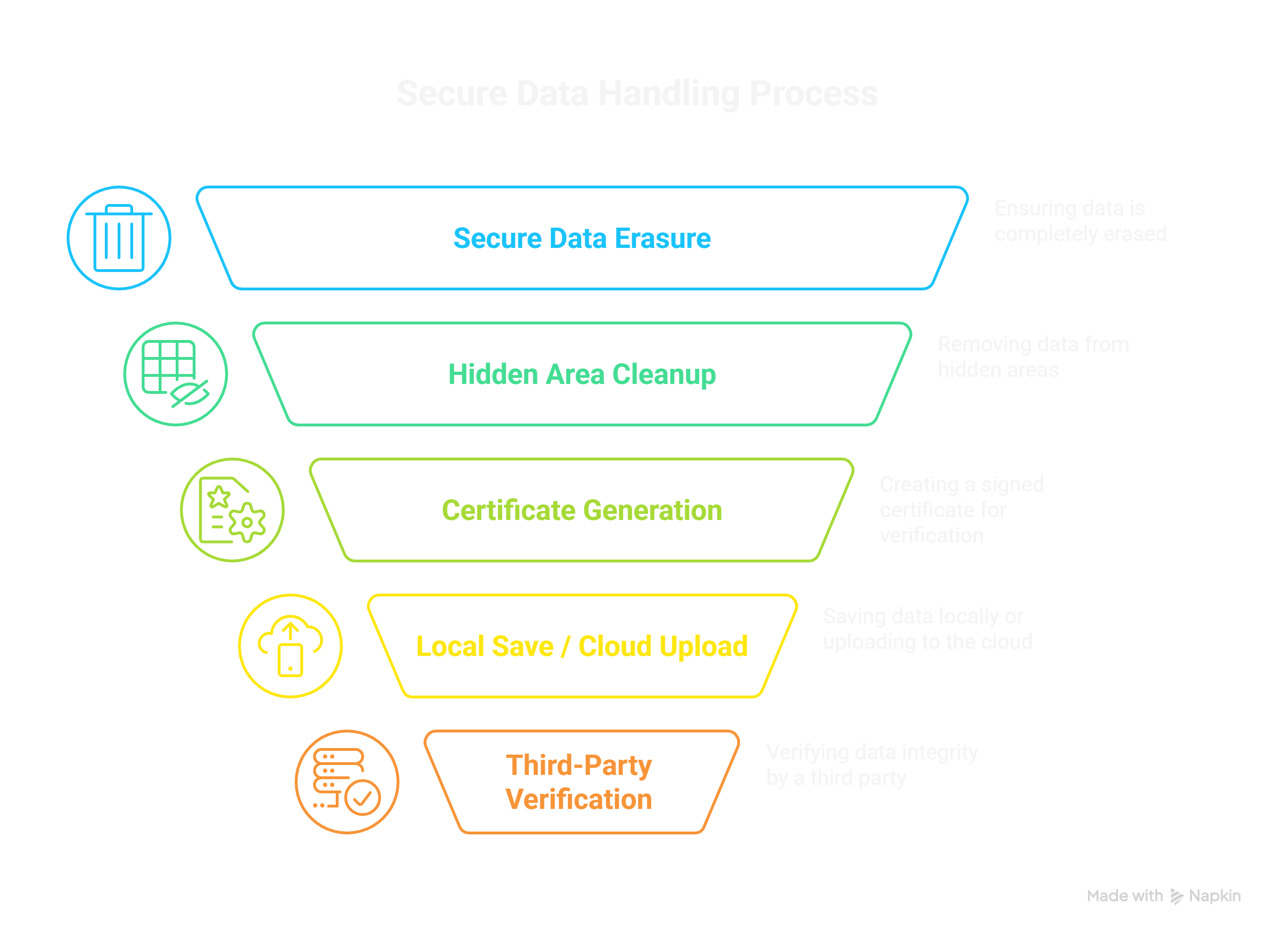
TECHNICAL APPROACH
Data Morphs
Technical Approach Prototype
Algorithm Development: Implements NIST SP 800-88 and DoD wipe standards, covering HDDs, SSDs, and hidden areas (HPA/DCO), ensuring complete and compliant erasure.
Mobile App Development: Cross-platform app for Windows, Linux, Android, with a simple one-click interface and offline ISO/USB support for devices without OS.
Encryption & Security: Generates digitally signed, tamper-proof certificates using RSA/ECC, with encrypted logs and integrity checks for trust and compliance.
Cloud Services: Provides a verification portal for wipe certificates, with secure storage, audit trails, and enterprise integration for large-scale use.
Product Status
Implemented: Core wipe algorithms, prototype desktop app, basic certificate generation.
In Progress: Mobile app UI, ISO/USB boot support, cloud verification backend.
Planned: Enterprise integration and large-scale pilot testing.

Slide 4
FEASIBILITY AND VIABILITY
Data Morphs
Analysis of Idea
Challenges & Risks
Technically possible using secure wipe standards (NIST, DoD).
Works across platforms: Windows, Linux, Android, Offline ISO/USB.
Meets real need: users fear data breaches, so assets are hoarded.
Economically viable: unlocks value of unused IT assets.
Environment friendly: promotes safe e-waste recycling.
Scalable: can serve individuals, recyclers, enterprises.
Trustworthy: verifiable certificates build confidence.
Aligns with national goals: supports India’s circular economy initiatives.
Different hardware types (HDD, SSD, Android)
Low user awareness and adoption
Building trust and compliance proof
Managing cloud and scalability
Strategies
Modular algorithms for all devices
Simple one-click interface + awareness efforts
Tamper-proof certificates with signatures
Scalable cloud backend with APIs

Slide 5
IMPACT AND BENEFITS
Data Morphs
Benefits of the Solution
Potential on Target Audience
General Users: Can safely recycle old laptops, smartphones, and other devices without worrying about personal or sensitive data being recovered.
Enterprises & Organizations: Enables secure disposal of IT assets, reducing storage costs and legal compliance risks.
Recyclers & IT Asset Disposal Firms: Provides verifiable, tamper-proof proof of data erasure, building trust with clients.
Government & NGOs: Supports e-waste management initiatives and policies, encouraging sustainable and circular economy practices.
Builds User Confidence: One-click, secure wiping ensures data is permanently erased.
Reduces Asset Hoarding: Unlocks the value of unused IT devices, preventing millions of rupees of IT assets from being locked away.
Promotes Safe E-Waste Management: Prevents environmental hazards caused by improper disposal of electronic devices.
Supports Circular Economy: Recycled devices can be reused, refurbished, or safely dismantled, contributing to a sustainable lifecycle.
Transparent & Auditable: Digitally signed certificates allow third-party verification, enhancing trust and compliance.

Slide 6
RESEARCH AND REFERENCES
Data Morphs
Forti, V., Baldé, C.P., Kuehr, R., Bel, G. (2020). The Global E-Waste Monitor 2020: Quantities, flows, and circular economy potential. United Nations University. Supports understanding of the e-waste problem and the need for device recycling.
National Institute of Standards and Technology (NIST, 2014). Guidelines for Media Sanitization (SP 800-88 Rev.1). Provides standards for secure and verifiable data wiping, forming the basis of the solution’s algorithms.
Department of Defense (DoD 5220.22-M, 1995). National Industrial Security Program Operating Manual. Guidelines for overwriting data to ensure irrecoverable erasure, used in the solution design.
Bhattacharya, J., Sharma, S. (2019). E-Waste Generation and Management in India: Challenges and Opportunities. Journal of Environmental Management, 232, 121–131. Highlights India-specific e-waste challenges that the solution addresses.
Manhart, A., et al. (2017). Circular Economy in Electronics: Enabling Secure Data Erasure and Asset Reuse. Resources, Conservation & Recycling, 124, 156–165. Supports the solution’s goal of safe reuse and refurbishment of IT devices.
Singh, A., Gupta, R. (2021). Secure Mobile Data Wiping Techniques for Consumer Devices. International Journal of Information Security, 20(3), 345–359. Informs the mobile app design and cross-platform functionality of the solution.
Cui, J., et al. (2018). Data Sanitization and Verification Methods for Recycled IT Assets. Journal of Cleaner Production, 196, 1234–1245. Supports implementation of tamper-proof wipe certificates and verification systems.

