Slide 1

Introduction to OpenMP
Part2. Core Features
人工智能学院
缪青海
miaoqh@ucas.ac.cn

Slide 2
Content
Getting started with OpenMP
Core features of OpenMP
Work with OpenMP
Advanced topics on OpenMP

Slide 3
Core features of OpenMP
Creating threads
  the Pi program
Synchronization
  Pi program revisited
Parallel Loops
  making the Pi program simple

Slide 4
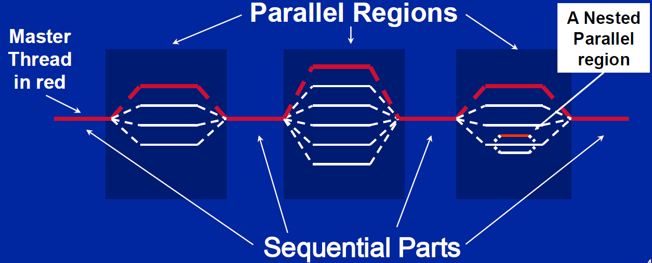
OpenMP Programming Model
Fork-Join Parallelism:
  主线程（Master thread）根据需要生成一个线程组。
  逐步增加并行性，直到达到性能目标。

Slide 5
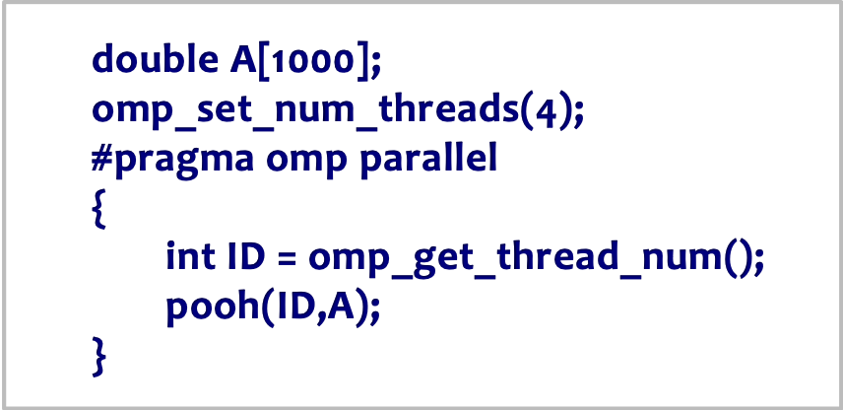
Thread Creation: Parallel Regions
在OpenMP 中使用parallel construct创建线程.
For example, create 4 thread parallel region:
  Each thread calls pooh(ID,A) for ID = 0 to 3

Slide 6
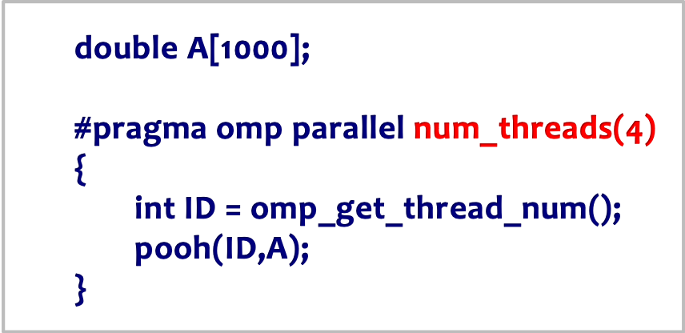
Thread Creation: Parallel Regions
在OpenMP 中使用parallel construct创建线程.
For example, create 4 thread parallel region:
  Each thread calls pooh(ID,A) for ID = 0 to 3

Slide 7
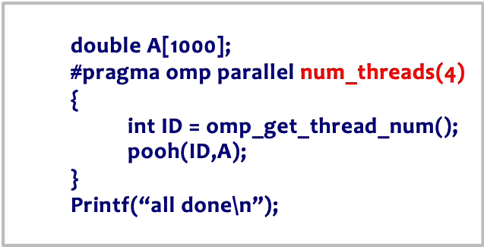
Thread Creation: Parallel Regions
每个线程冗余地执行相同的代码。
double A[1000];
A single
copy of A is
shared
between all
threads.
omp_set_num_threads(4)
pooh(0,A)
pooh(1,A)
pooh(2,A)
pooh(3,A)
printf(“all done\n”);

Slide 8
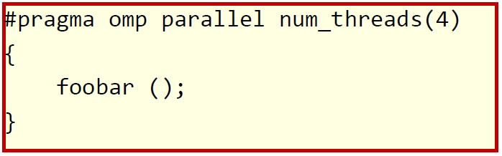
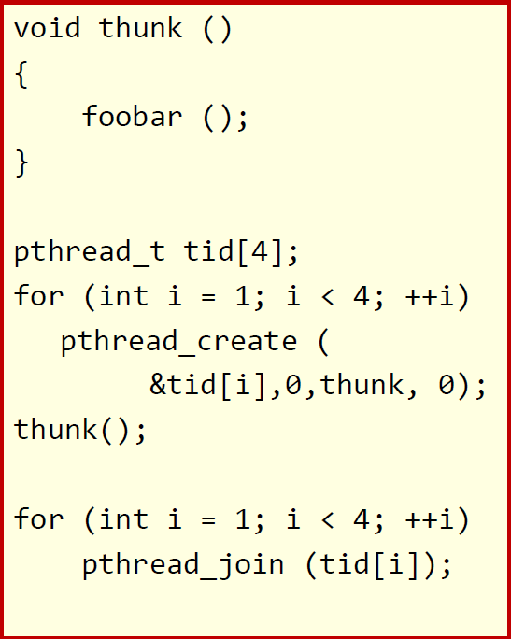
what the compiler does
所有已知的 OpenMP 实现都使用线程池，因此每个并行区域不会承担线程创建和销毁的全部开销。
Only three threads are created
because the last parallel section will be invoked from the parent thread.

Slide 9
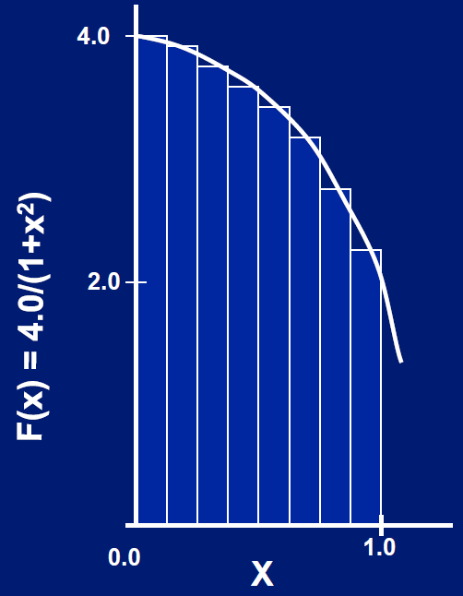
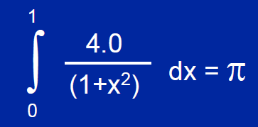
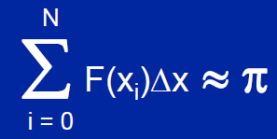
Test1: PI by Numerical Integration
数学上可以通过下式计算圆周率:
用求和近似积分:
每个间隔i的中点位置，构建的矩形的宽为Δx 高为 F(xi).
arctan’(x) = 1/(1+x^2) arctan(1) = ?
Notes:
arctan(1) = pi / 4

Slide 10
Test 1: Serial PI Program
  static long num_steps = 100000;
  double step;
  int main ()
  {
  int i; double x, pi, sum = 0.0;
  step = 1.0/(double) num_steps;
  for (i=0;i< num_steps; i++){
  x = (i+0.5)*step;
  sum = sum + 4.0/(1.0+x*x);
  }
  pi = step * sum;
  }
Code: test1_Pi/pi.c

Slide 11
Test1 aim
使用parallel construct创建一个并行版本的圆周率计算程序。
注意变量的属性:
  Shared versus private variables.
运行时库函数:
  int omp_get_num_threads();
  int omp_get_thread_num();
  double omp_get_wtime();
Number of threads in the team
Thread ID or rank
Time in Seconds since a fixed
point in the past

Slide 12
Test1-1: A simple parallel PI Program
  #include <omp.h>
  static long num_steps = 100000; double step;
  #define NUM_THREADS 2
  int main ()
  {
  int i, nthreads; double pi, sum[NUM_THREADS];
  step = 1.0/(double) num_steps;
  omp_set_num_threads(NUM_THREADS);
  #pragma omp parallel
  {
  int i, id,nthrds; double x;
  id = omp_get_thread_num();
  sum[id]=0.0
  nthrds = omp_get_num_threads();
  if (id == 0) nthreads = nthrds;
    for (i=id; i< num_steps; i= i+nthrds){
    x = (i+0.5)*step;
    sum[id] += 4.0/(1.0+x*x);
    }
  }
  for(i=0, pi=0.0; i<nthreads; i++) pi += sum[i] * step;
  }
Promote scalar to an
array dimensioned by
number of threads to
avoid race condition.
Only one thread copy value, avoid writing conflicts to a address.
trick in SPMD to create a cyclic distribution of loop iterations.

Slide 13
Test1-1 : Algorithm strategy
SPMD (Single Program Multiple Data) 设计模式:
  在P个处理单元上运行相同的程序，其中P可以是任意大的数值。
  使用rank … 即编号从0 到 (P-1) ID … 来从任务集中选择和管理共享数据结构.
在并行编程历史上最常用的模式.
  Code:
    test1_Pi/solutions/ pi_spmd_simple.c

Slide 14
Test1-1 : Results
CPU:
  Intel Core i5 1.7 Ghz
Memory:
  4G DDR3 1.333 Ghz
OS:
  Ubuntu18.04
Complier:
  gcc
threads | Time(s)
1 | 1.86
2 | 1.03
3 | 1.08
4 | 0.97
??

Slide 15
Test1-1 : False sharing
伪共享：
  在并行编程中，当多个线程更新存储在同一缓存行（ cache line ）中的独立变量时发生的现象。
  虽然这些变量在逻辑上是独立的，但它们在 CPU 的内存层级中共享相同的物理cache line 。
  即使线程之间没有直接访问或修改对方的变量， cache line也会频繁失效和更新，这导致性能下降。

Slide 16
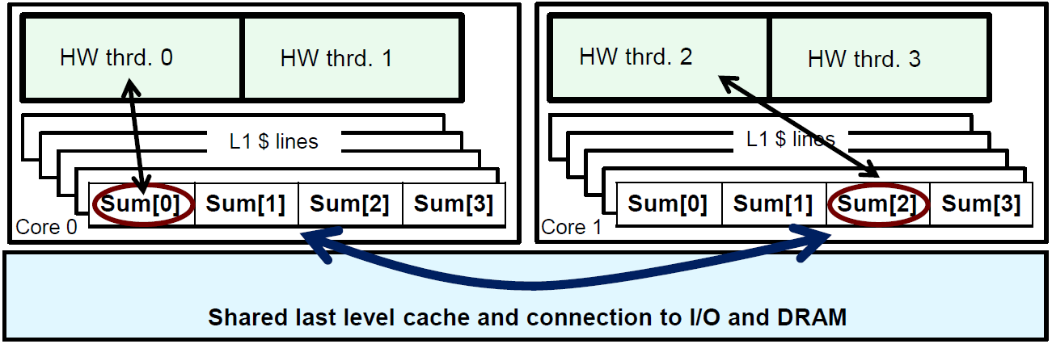
Test1-1 : Cache line
cache line是可以加载到缓存中的最小数据单元。
现代处理器使用分层内存系统，数据以固定大小的单位（cache line）从主内存提取到高速缓存中。如果两个或多个变量存储在同一个缓存行中，它们在缓存中会被视为一个整体。
如果变量是cache line的一部分并且一个线程更新它，则整个cache line将被标记为“脏”，即使同一行中的其他变量没有被修改。

Slide 17
Test1-1 : Cache line
并行更新：
  当多个线程同时更新存储在同一缓存行中的变量时：每个线程对其变量的写操作会使其他线程中的该缓存行失效。
  这会触发缓存一致性协议（如 MESI 协议），以确保所有核心对内存的视图一致，从而导致不必要的内存流量和延迟。
  性能影响： 缓存行的频繁失效和重新加载会降低并行性的优势，导致延迟增加和吞吐量下降。

Slide 18
Test1-1 : False sharing
Why such poor scaling? False sharing!
一个数组，每个元素由不同的线程更新：
int data[64];
#pragma omp parallel for
for (int i = 0; i < 64; i++) {
data[i] = i * 2;
}
如果 data[] 的多个元素恰好位于同一缓存行中，即使线程在更新不同的索引，缓存行仍会被反复失效和重新加载。

Slide 19
Test1-1 : False sharing
Why such poor scaling? False sharing!
如果将标量改为为数组以支持创建 SPMD 程序，数组元素在内存中是连续存储的，因此会共享缓存行……这会导致较差的可扩展性。
对数组进行填充PAD，以确保使用的元素位于不同的缓存行上。
  sum[NUM_THREADS];

Slide 20
Test1-1 : A simple parallel PI Program
  #include <omp.h>
  static long num_steps = 100000; double step;
  #define PAD 8 // assume 64 byte L1 cache line size
  #define NUM_THREADS 2
  int main ()
  {
  int i, nthreads; double pi, sum[NUM_THREADS][PAD];
  step = 1.0/(double) num_steps;
  omp_set_num_threads(NUM_THREADS);
  #pragma omp parallel
  {
  int i, id,nthrds; double x;
  id = omp_get_thread_num();
  nthrds = omp_get_num_threads();
  if (id == 0) nthreads = nthrds;
  for (i=id, sum[id]=0.0; i< num_steps; i= i+nthrds){
    x = (i+0.5)*step;
    sum[id][0] += 4.0/(1.0+x*x);
    }
  }
  for(i=0, pi=0.0; i<nthreads; i++) pi += sum[i][0] * step;
  }
Pad the array so each sum value is in a different cache line.

Slide 21
Test1-1 : is padding necessary?
Padding方案的问题：
  对数组进行填充需要深入了解缓存架构。
  如果换到一个缓存行大小不同的机器上，程序性能可能会降低，甚至运行崩溃。
  必须有更好的方法来处理伪共享问题。

Slide 22
Core features of OpenMP
Creating threads
  the Pi program
Synchronization
  Pi program revisited
Parallel Loops
  making the Pi program simple

Slide 23
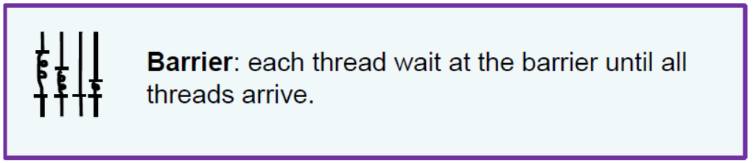
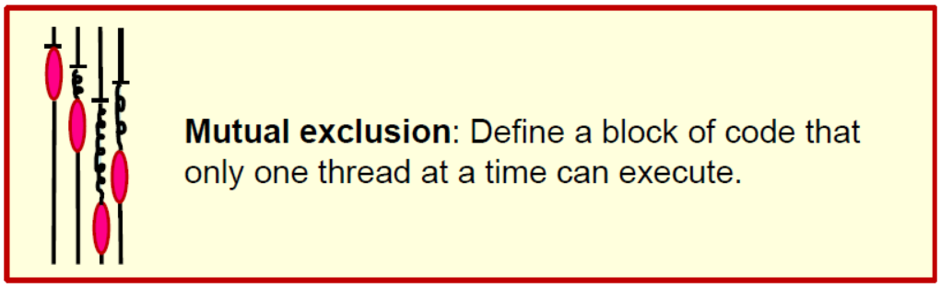
Synchronization
同步：Bringing one or more threads to a well defined and known point in their execution.

Slide 24
Synchronization
High level synchronization:
  – critical
  – atomic
  – barrier
  – ordered
Low level synchronization
  – flush
  – locks (both simple and nested)
Synchronization 的主要用途：
impose order constraints
protect access to shared data.

Slide 25
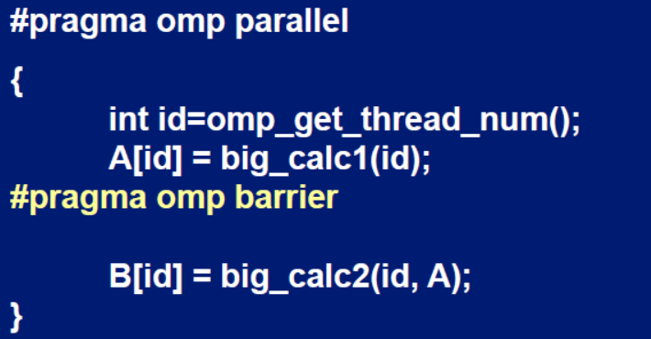
Synchronization: Barrier
Barrier: Each thread waits until all threads arrive.

Slide 26
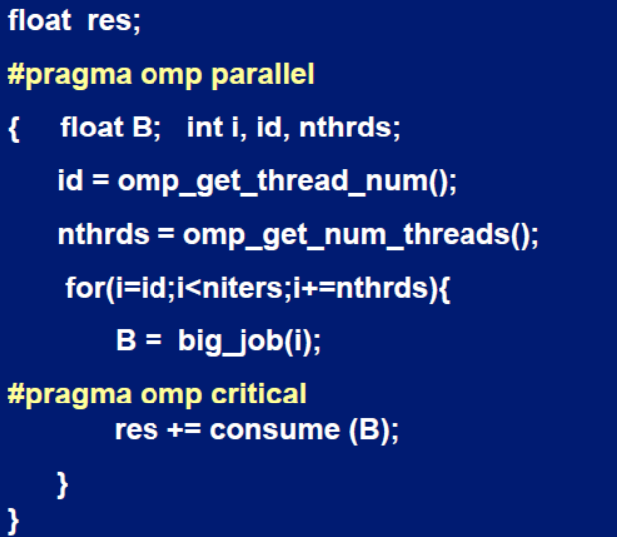
Synchronization: Critical
Mutual exclusion: Only one thread at a time can enter a critical region.
Threads wait their turn – only one at a time calls consume()

Slide 27
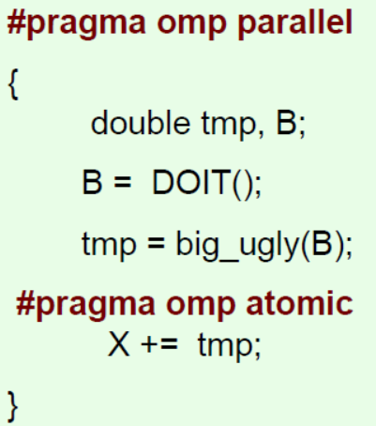
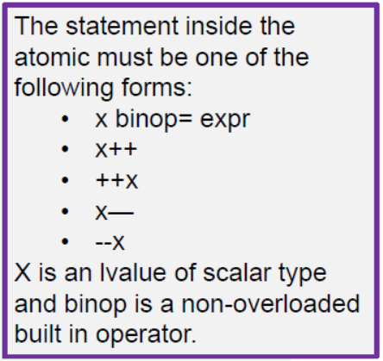
Synchronization: Atomic (basic form)
Atomic provides mutual exclusion but only applies to the update of a memory location.

Slide 28
Test1-2
Test1-1 使用一个数组为每个线程创建其部分和sum的存储空间。
如果数组元素恰好共享一个缓存行，这就会导致伪共享。
  – Non-shared data in the same cache line so each update invalidates the cache line … in essence “sloshing independent data” back and forth between threads.
在test1-1基础上修改 “pi program” ，避免使用sum 数组导致的false sharing.
  Code: test1_Pi/solutions/ pi_spmd_final.c

Slide 29
Test1-1: A simple parallel PI Program
  #include <omp.h>
  static long num_steps = 100000; double step;
  #define NUM_THREADS 2
  int main ()
  {
  int i, nthreads; double pi, sum[NUM_THREADS];
  step = 1.0/(double) num_steps;
  omp_set_num_threads(NUM_THREADS);
  #pragma omp parallel
  {
  int i, id,nthrds; double x;
  id = omp_get_thread_num();
  nthrds = omp_get_num_threads();
  if (id == 0) nthreads = nthrds;
    for (i=id, sum[id]=0.0; i< num_steps; i= i+nthrds){
    x = (i+0.5)*step;
    sum[id] += 4.0/(1.0+x*x);
    }
  }
  for(i=0, pi=0.0; i<nthreads; i++) pi += sum[i] * step;
  }
Promote scalar to an
array dimensioned by
number of threads to
avoid race condition.
Recall
Only one thread copy value, avoid writing conflicts to a address.
trick in SPMD to create a cyclic distribution of loop iterations.

Slide 30
Test1-2
#include <omp.h>
static long num_steps = 100000; double step;
#define NUM_THREADS 2
void main ()
{ double pi; step = 1.0/(double) num_steps;
omp_set_num_threads(NUM_THREADS);
#pragma omp parallel
{
int i, id,nthrds; double x, sum;
id = omp_get_thread_num();
nthrds = omp_get_num_threads();
if (id == 0) nthreads = nthrds;
id = omp_get_thread_num();
nthrds = omp_get_num_threads();
for (i=id, sum=0.0;i< num_steps; i=i+nthreads){
x = (i+0.5)*step;
sum += 4.0/(1.0+x*x);
}
#pragma omp critical
pi += sum * step;
}
}
Using a critical section to remove impact of false sharing
Create a scalar local to each thread to accumulate partial sums.
No array, so no false sharing.
Must protect summation into pi in a critical region so updates don’t conflict.

Slide 31
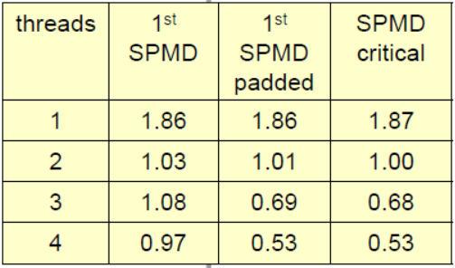
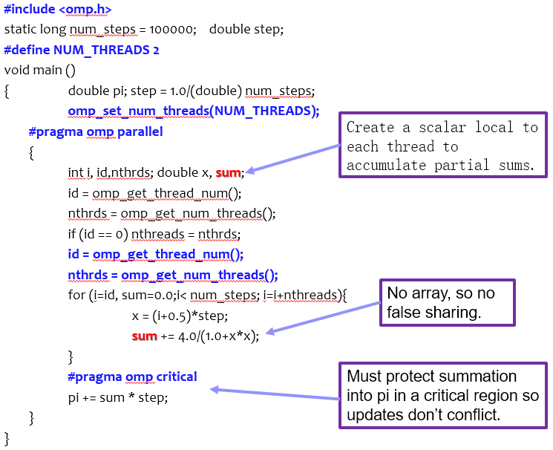
Test1-2: results

Slide 32
#include <omp.h>
static long num_steps = 100000; double step;
#define NUM_THREADS 2
void main ()
{ double pi; step = 1.0/(double) num_steps;
omp_set_num_threads(NUM_THREADS);
#pragma omp parallel
{
int i, id,nthrds; double x, sum;
id = omp_get_thread_num();
nthrds = omp_get_num_threads();
if (id == 0) nthreads = nthrds;
id = omp_get_thread_num();
nthrds = omp_get_num_threads();
for (i=id, sum=0.0;i< num_steps; i=i+nthreads){
x = (i+0.5)*step;
sum += 4.0/(1.0+x*x);
}
sum = sum*step;
#pragma atomic
pi += sum;
}
}
Using an atomic to remove impact of false sharing
Create a scalar local to each thread to accumulate partial sums.
No array, so no false sharing.
Must protect summation into pi so updates don’t conflict.

Slide 33
Core features of OpenMP
Creating threads
  the Pi program
Synchronization
  Pi program revisited
Parallel Loops
  making the Pi program simple

Slide 34
SPMD vs. Worksharing
一个并行构造本身创建了一个SPMD（单程序多数据）程序……即，每个线程冗余地执行相同的代码。
我们如何在线程组内的线程之间分割代码路径？
  worksharing
    – Loop construct
    – Sections/section constructs
    – Single construct
    – Task construct

Slide 35
Loop Worksharing constructs
The loop worksharing construct splits up loop iterations among the threads in a team
#pragma omp parallel
{
#pragma omp for
for (i=0; i<N; i++){
NEAT_STUFF(i);
}
}
The variable i is made “private” to each thread by default.
You could do this explicitly with a “private(i)” clause

Slide 36
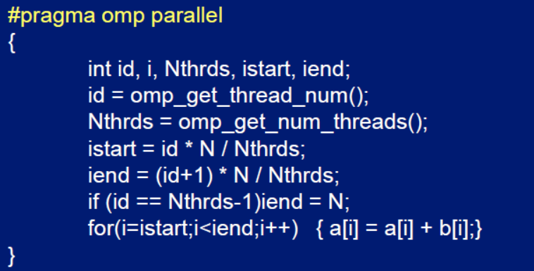

Loop Worksharing constructs
Serial
OpenMP parallel region
OpenMP parallel
region and a
worksharing for
construct

Slide 37
Loop Worksharing constructs
The schedule clause：调度子句
影响循环迭代如何映射到线程上：
  schedule(static [,chunk])
    – 将大小为“chunk”的迭代块分配给每个线程。
  schedule(dynamic[,chunk])
    – 每个线程从队列中抓取“chunk”个迭代，直到所有迭代都已被处理。

Slide 38
Loop Worksharing constructs
The schedule clause：调度子句
  schedule(guided[,chunk])
    – 线程动态地抓取迭代块。块的大小从大开始，随着计算的进行逐渐缩小到“chunk”大小。
  schedule(runtime)
    – 调度和块大小从OMP_SCHEDULE环境变量（或运行时库）中获取。
  schedule(auto)
    – 调度留给运行时来选择（不必是上述任何一种）。

Slide 39
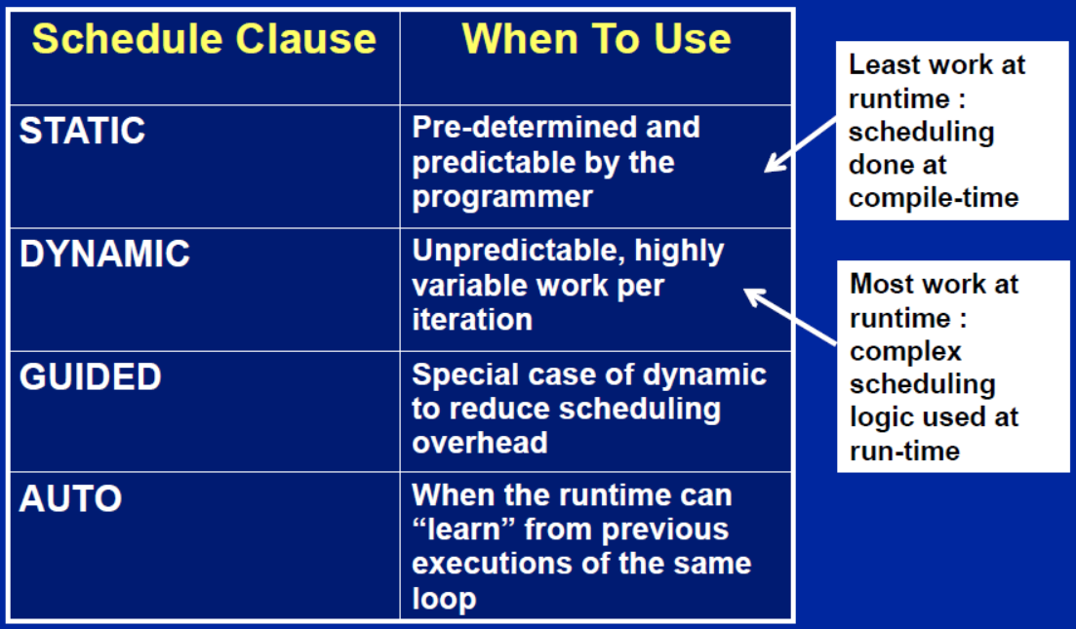
Loop Worksharing constructs
The schedule clause：when to use?

Slide 40
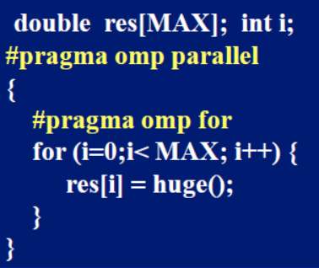
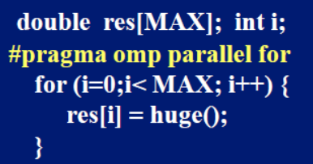
Loop Worksharing constructs
OpenMP shortcut:
  Combined parallel/worksharing construct
简洁紧凑

Slide 41
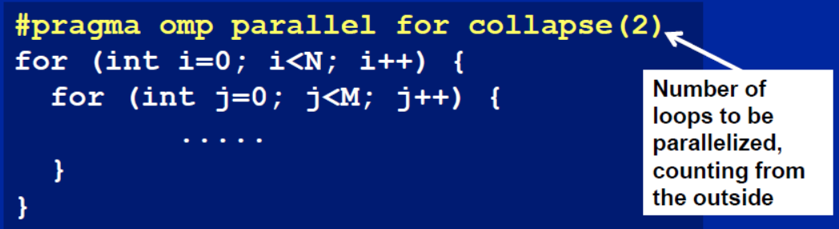
Nested loops
对于完全嵌套的矩形循环，我们可以使用collapse子句并行化嵌套中的多个循环：
转换为长度为NxM 的单一循环再并行化.

Slide 42
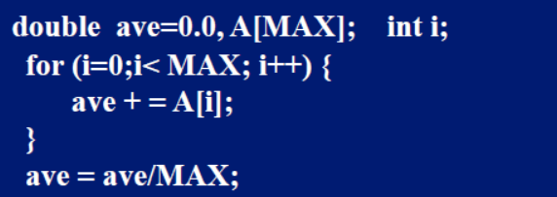
Reduction
How do we handle this case?
将值合并到单一的累加变量（ave）中……循环迭代之间存在真正的依赖关系，这种依赖关系不能轻易地被消除。
非常常见的情形 … 称为“规约” （reduction）.
大多数并行编程环境中都包含了对规约操作的支持。

Slide 43
Reduction
OpenMP reduction clause:
  reduction (op : list)
在parallel/work-sharing construct内部:
  - 会为每个列表变量创建一个局部副本，并根据“op”（例如“+”对应0）进行初始化。
  - 更新操作发生在局部副本上。
  - 局部副本被规约成一个单一的值，并与原始的全局值合并。

Slide 44
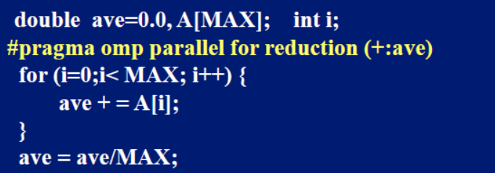
Reduction
OpenMP reduction clause:
  reduction (op : list)
“list”中的变量必须在并行区域内共享。

Slide 45
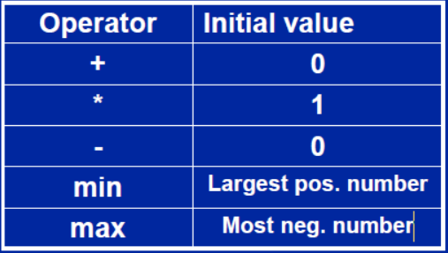
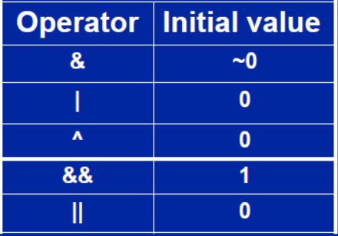
Reduction: operands/initial-values

Slide 46
Test1-3: Pi with loops
返回到串行的pi程序，并使用循环构造（ loop construct ）来并行化它。
目标是对串行程序所做的更改最少。

Slide 47
Serial PI Program
  static long num_steps = 100000;
  double step;
  int main ()
  {
  int i; double x, pi, sum = 0.0;
  step = 1.0/(double) num_steps;
  for (i=0;i< num_steps; i++){
  x = (i+0.5)*step;
  sum = sum + 4.0/(1.0+x*x);
  }
  pi = step * sum;
  }

Slide 48
Test1-3 : Pi with loop and reduction
  #include <omp.h>
  static long num_steps = 100000;double step;
  int main ()
  {
  int i; double x, pi, sum = 0.0;
  step = 1.0/(double) num_steps;
    #pragma omp parallel
    {
    double x;
    #pragma omp for reduction(+:sum)
    for (i=0;i< num_steps; i++){
    x = (i+0.5)*step;
    sum = sum + 4.0/(1.0+x*x);
    }
    }
  pi = step * sum;
  }
Create a team of threads
a scalar local to each thread
setting up a
reduction into sum.
Code: test1_Pi/solution/pi_loop.c

Slide 49
references
Tim Mattson, A “Hands-on” Introduction to OpenMP, Intel Corp.
Mark Bull, Parallel Programming with OpenMP, EPCC, University of Edinburgh, UK.
迟学斌等，并行计算与实现技术，科学出版社。

