Slide 1

Introduction to MPI
Part4. Advanced Topics
人工智能学院
缪青海
miaoqh@ucas.ac.cn

Slide 2
Content
  Remote Memory Access
  MPI Parallel I/O

Slide 3
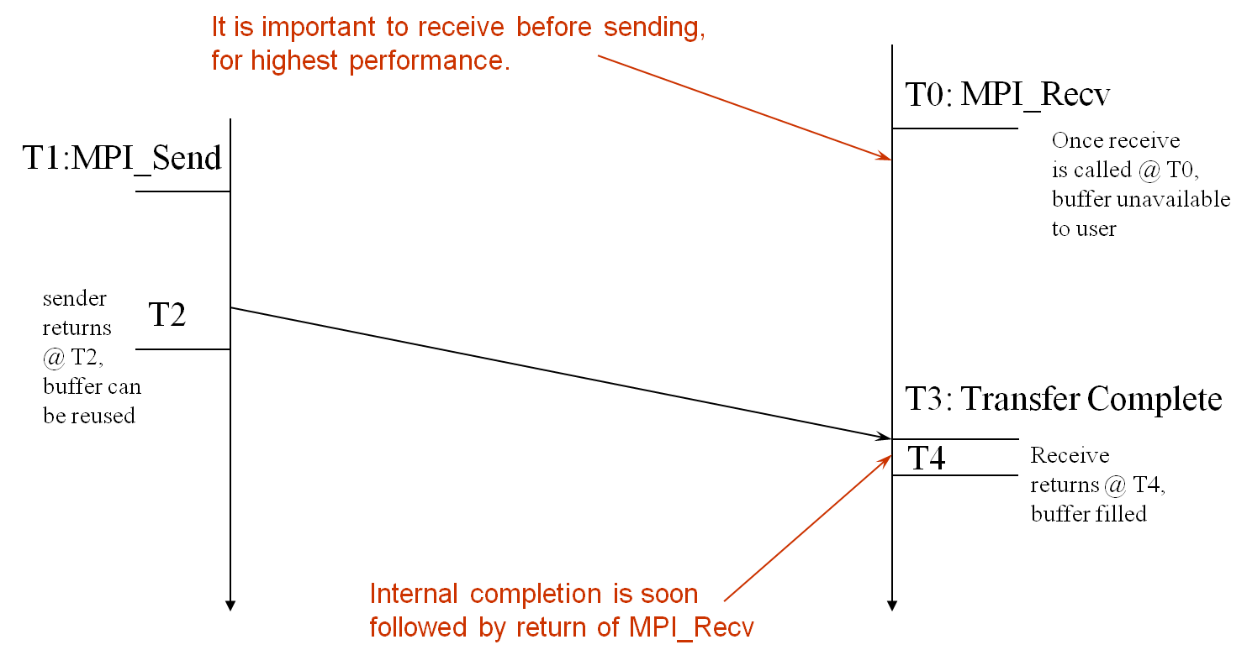
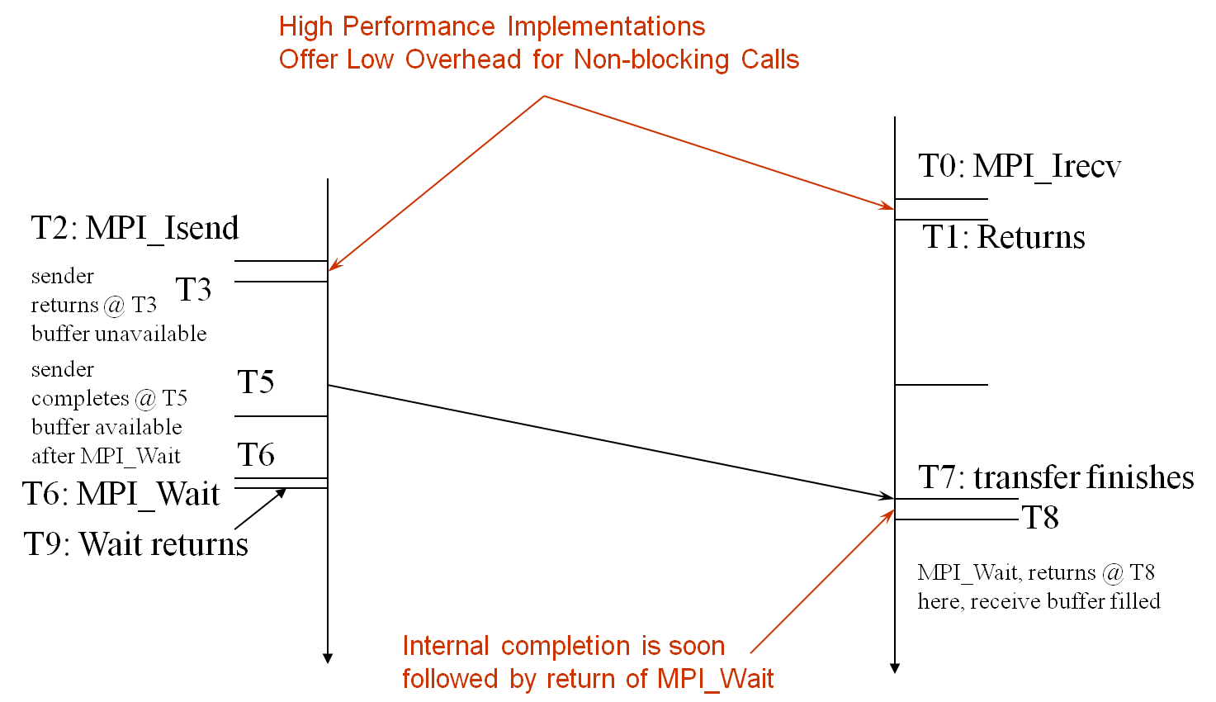
MPI Communication
time
time
Blocking
Non-Blocking
双边通信的两种合作模式比较

Slide 4
One-sided Communication
单边通信基本思想:
  将数据移动与进程同步解耦
  能够移动数据而不需要远程进程同步:
    每个进程将其内存的一部分暴露给其他进程
    其他进程可以直接从这部分内存中读取或写入。

Slide 5
One-sided Communication
Process 0
Process 1
Process 2
Process 3
Remotely
Accessible
Memory
Private
Memory
Remotely
Accessible
Memory
Private
Memory
Remotely
Accessible Memory
Private
Memory
Remotely
Accessible Memory
Private
Memory
Private
Memory
Private
Memory
Private
Memory
Private
Memory

Slide 6
One-sided Communication
Process 0
Process 1
Process 2
Process 3
Remotely
Accessible
Memory
Remotely
Accessible
Memory
Remotely
Accessible Memory
Remotely
Accessible Memory
Private
Memory
Private
Memory
Private
Memory
Private
Memory

Slide 7
One-sided Communication
Process 0
Process 1
Process 2
Process 3
Global Address Space
Remotely
Accessible
Memory
Remotely
Accessible
Memory
Remotely
Accessible Memory
Remotely
Accessible Memory
Private
Memory
Private
Memory
Private
Memory
Private
Memory

Slide 8
One-sided Communication
Process 0
Process 1
Process 2
Process 3
Global Address Space
Remotely
Accessible
Memory
Remotely
Accessible
Memory
Remotely
Accessible Memory
Remotely
Accessible Memory
Private
Memory

Slide 9
Two-sided Communication Example
Memory
Processor
Processor
Memory
Memory
Segment
Memory
Segment
Memory
Segment
Memory
Segment
Memory
Segment
Send
Recv
Send
Recv
MPI implementation
MPI implementation

Slide 10
One-sided Communication Example
Memory
Processor
Processor
Memory
Memory
Segment
Memory
Segment
Memory
Segment
Memory
Segment
Send
Recv
Send
Recv
MPI implementation
MPI implementation

Slide 11
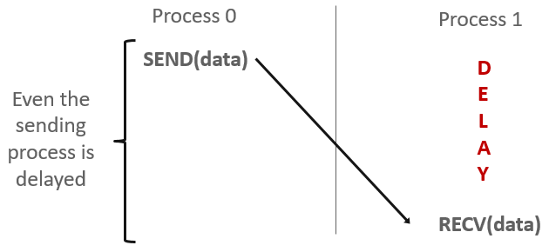
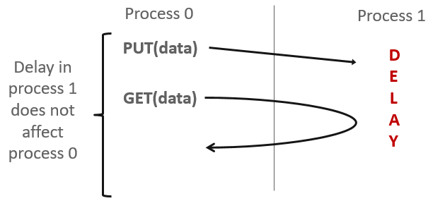
Comparing One-sided and Two-sided
双边通信
单边通信

Slide 12
Keys in MPI RMA
如何创建远程可访问内存？
远程内存的读写与更新
数据同步
内存模型

Slide 13
Creating Public Memory
默认情况下，进程使用的任何内存都只能在本地访问
  X = malloc(100);
一旦分配了内存，用户必须进行显式 MPI 调用来将内存区域声明为可远程访问
  MPI 中远程可访问内存术语是“窗口”“window”
  由一组进程共同创建一个“窗口”

Slide 14
Creating Public Memory
一旦一块内存区域被声明为可远程访问，意味着:
  窗口中的所有进程都可以读取/写入数据到该远程内存
  而无需明确与目标进程同步。

Slide 15
Window creation models
4个窗口创建模型：
  MPI_WIN_CREATE
    已分配一个缓冲区，希望可以进行远程访问
  MPI_WIN_ALLOCATE
    创建一个缓冲区并直接使其可远程访问
  MPI_WIN_CREATE_DYNAMIC
    目前还没有缓冲区，但将来会有一个
    希望动态地向窗口添加/删除缓冲区
  MPI_WIN_ALLOCATE_SHARED
    希望同一节点上的多个进程共享一个缓冲区

Slide 16
MPI_WIN_CREATE
int MPI_Win_create(void *base, MPI_Aint size,
int disp_unit, MPI_Info info,
MPI_Comm comm, MPI_Win *win)
在RMA window中开放一个内存区域：
  仅窗口中显示的数据可通过 RMA 操作访问.
Arguments:
  base - pointer to local data to expose
  size - size of local data in bytes (nonnegative integer)
  disp_unit - local unit size for displacements, in bytes (positive integer)
  info - info argument (handle)
  comm - communicator (handle)
  win - window (handle)

Slide 17
Example with MPI_WIN_CREATE
int main(int argc, char ** argv)
{
int *a; MPI_Win win;
MPI_Init(&argc, &argv);
/* create private memory */
MPI_Alloc_mem(1000*sizeof(int), MPI_INFO_NULL, &a);
/* use private memory like you normally would */
a[0] = 1; a[1] = 2;
/* collectively declare memory as remotely accessible */
MPI_Win_create(a, 1000*sizeof(int), sizeof(int),
MPI_INFO_NULL, MPI_COMM_WORLD, &win);
/* Array ‘a’ is now accessibly by all processes in
* MPI_COMM_WORLD */
MPI_Win_free(&win);
MPI_Free_mem(a);
MPI_Finalize(); return 0;
}
Notes:
Say that this should be avoided like the pest ☺

Slide 18
MPI_WIN_ALLOCATE
int MPI_Win_allocate(MPI_Aint size, int disp_unit,
MPI_Info info, MPI_Comm comm, void *baseptr,
MPI_Win *win)
在 RMA 窗口中创建可远程访问的内存区域
  仅窗口中显示的数据可通过 RMA 操作访问.
Arguments:
  size - size of local data in bytes (nonnegative integer)
  disp_unit - local unit size for displacements, in bytes (positive integer)
  info - info argument (handle)
  comm - communicator (handle)
  baseptr - pointer to exposed local data
  win - window (handle)

Slide 19
Example with MPI_WIN_ALLOCATE
int main(int argc, char ** argv)
{
int *a; MPI_Win win;
MPI_Init(&argc, &argv);
/* collectively create remote accessible memory in a window */
MPI_Win_allocate(1000*sizeof(int), sizeof(int), MPI_INFO_NULL,
MPI_COMM_WORLD, &a, &win);
/* Array ‘a’ is now accessible from all processes in
* MPI_COMM_WORLD */
MPI_Win_free(&win);
MPI_Finalize(); return 0;
}

Slide 20
MPI_WIN_CREATE_DYNAMIC
int MPI_Win_create_dynamic(MPI_Info info, MPI_Comm comm,
MPI_Win *win)
先创建 RMA 窗口，稍后再附加数据
Initially “empty”
  应用程序可以通过调用 MPI_Win_attach/detach 动态地将内存附加到该窗口或从该窗口分离内存。
  仅当附加了内存区域后，应用程序才可以访问此窗口上的数据。
Window 起始地址是 MPI_BOTTOM
  位移是相对于 MPI_BOTTOM 的段地址
  调用attach后必须告诉其他进程位移

Slide 21
Example with MPI_WIN_CREATE_DYNAMIC
int main(int argc, char ** argv)
{
int *a; MPI_Win win;
MPI_Init(&argc, &argv);
MPI_Win_create_dynamic(MPI_INFO_NULL, MPI_COMM_WORLD, &win);
/* create private memory */
a = (int *) malloc(1000 * sizeof(int));
/* use private memory like you normally would */
a[0] = 1; a[1] = 2;
/* locally declare memory as remotely accessible */
MPI_Win_attach(win, a, 1000*sizeof(int));
/* Array ‘a’ is now accessible from all processes */
/* undeclare remotely accessible memory */
MPI_Win_detach(win, a); free(a);
MPI_Win_free(&win);
MPI_Finalize(); return 0;
}

Slide 22
Data movement
MPI 提供在远程可访问的内存区域中读取、写入和原子修改数据的能力：
  MPI_PUT
  MPI_GET
  MPI_ACCUMULATE
  MPI_GET_ACCUMULATE
  MPI_COMPARE_AND_SWAP
  MPI_FETCH_AND_OP

Slide 23
Data movement: Put
MPI_Put(void * origin_addr, int origin_count,
MPI_Datatype origin_datatype, int target_rank,
MPI_Aint target_disp, int target_count,
MPI_Datatype target_datatype, MPI_Win win)
Target Process
Move data from origin, to target
为origin和target分别提供数据描述三元组
RMA
Window
Local
Buffer
Origin Process

Slide 24
Data movement: Get
MPI_Get(void * origin_addr, int origin_count,
MPI_Datatype origin_datatype, int target_rank,
MPI_Aint target_disp, int target_count,
MPI_Datatype target_datatype, MPI_Win win)
Move data to origin, from target
Target Process
RMA
Window
Local
Buffer
Origin Process

Slide 25
Atomic Data Aggregation: Accumulate
MPI_Accumulate(void * origin_addr, int origin_count,
MPI_Datatype origin_datatype, int target_rank,
MPI_Aint target_disp, int target_count,
MPI_Datatype target_dtype, MPI_Op op, MPI_Win win)
原子更新操作，类似于 put
  使用 op 参数作为组合器，将原始数据和目标数据规约到目标缓冲区
  仅限预定义操作，无用户定义操作
target/origin 数据类型type必须匹配
Op = MPI_REPLACE
  Implements f(a,b)=b
  Atomic PUT
Target Process
+=
RMA
Window
Local
Buffer
Origin Process

Slide 26
Atomic Data Aggregation: Get Accumulate
MPI_Get_accumulate(void *origin_addr, int origin_count,
MPI_Datatype origin_dtype, void *result_addr,
int result_count, MPI_Datatype result_dtype,
int target_rank, MPI_Aint target_disp,
int target_count, MPI_Datatype target_dype,
MPI_Op op, MPI_Win win)
Atomic read-modify-write
  Op = MPI_SUM, MPI_PROD, MPI_OR, MPI_REPLACE, MPI_NO_OP, …
  Predefined ops only
结果存储在 target buffer
  数据类型必须匹配
  Atomic get with MPI_NO_OP
  Atomic swap with MPI_REPLACE
Target Process
+=
RMA
Window
Local
Buffer
Origin Process

Slide 27
Atomic Data Aggregation: CAS and FOP
MPI_Compare_and_swap(void *origin_addr,
void *compare_addr, void *result_addr,
MPI_Datatype datatype, int target_rank,
MPI_Aint target_disp, MPI_Win win)
MPI_Fetch_and_op(void *origin_addr, void *result_addr,
MPI_Datatype datatype, int target_rank,
MPI_Aint target_disp, MPI_Op op, MPI_Win win)
CAS: 如果目标值等于比较值，则进行原子交换
FOP: MPI_Get_accumulate的简化版本
  所有缓冲区共享一个预定义数据类型
  无计数参数（始终为 1）
  更简单的接口允许硬件优化

Slide 28
Ordering of Operations in MPI RMA
无法保证 Put/Get 操作的顺序
同时对一个内存位置发起多个 Put 操作，结果未定义（undefined）
并发调用Put/Accumulate后，执行Get 是未义（undefined）
  都可能是垃圾（garbages）

Slide 29
Ordering of Operations in MPI RMA
对同一位置的并发累加操作的结果，按照发生的顺序定义
  Atomic put: Accumulate with op = MPI_REPLACE
  Atomic get: Get_accumulate with op = MPI_NO_OP
默认情况下，进程中的累加操作按照顺序执行
  用户可以告诉 MPI 实现，不需要排序作为优化提示
  也可以设定使用特定的顺序: RAW (read-after-write), WAR, RAR, or WAW

Slide 30
RMA Synchronization Models
RMA data access model
  何时允许某一进程读取/写入远程可访问的内存？
  进程 X 写入的数据何时可供进程 Y 读取？
  RMA 同步模型定义了这些语义
MPI提供三种同步模型:
  Fence (active target)
  Post-start-complete-wait (generalized active target)
  Lock/Unlock (passive target)
数据访问发生在“周期”（epochs）内
  -访问周期（Access epochs）：包含由源进程发出的操作集合
  -暴露周期（Exposure epochs）：允许远程进程更新目标窗口
  - 周期定义了操作的顺序和完成语义
  - 同步模型提供了建立周期的机制 E.g., starting, ending, and synchronizing epochs

Slide 31
Fence: Active Target Synchronization
MPI_Win_fence(int assert, MPI_Win win)
集体同步模型
- 在窗口中所有进程上启动和结束访问周期和暴露周期
- “win”组中的所有进程执行 MPI_WIN_FENCE来开启一个周期
- 每个进程都可以发出 PUT/GET 操作以读写数据
- 所有进程再次执行 MPI_WIN_FENCE 来关闭该周期
- 所有操作在第二次栅栏同步时完成
Target
Origin
Fence
Fence
Get
Fence
Fence

Slide 32
Stencil Computation by RMA Fence
RMA window
PUT
Target buffers
Origin buffers
PUT
PUT
PUT

Slide 33
PSCW: Generalized Active Target Synchronization
MPI_Win_post/start(MPI_Group grp, int assert, MPI_Win win)
MPI_Win_complete/wait(MPI_Win win)
类似于FENCE，但源和目标明确指定通信对象
- 目标（Target）：暴露周期
  - 使用 MPI_Win_post 打开
  - 使用 MPI_Win_wait 关闭
- 源（Origin）：访问周期
  - 使用 MPI_Win_start 打开
  - 使用 MPI_Win_complete 关闭
- 所有同步操作可能会阻塞，以强制执行 P-S/C-W 顺序
- 进程可以同时作为源和目标
Target
Origin
Post
Start
Get
Complete
Wait

Slide 34
Lock/Unlock: Passive Target Synchronization
Active Target Mode
Passive Target Mode
Post
Lock
Start
Get
Get
Complete
Unlock
Wait
Passive mode: 被动模式：单边的异步通信
Target 目标不参与通信操作
类似共享内存的模型

Slide 35
Passive Target Synchronization
MPI_Win_lock(int locktype, int rank, int assert, MPI_Win win)
MPI_Win_unlock(int rank, MPI_Win win)
开始/结束被动模式周期
  目标进程无需执行相应的 MPI 调用
  可以对不同进程启动多个被动目标周期
  不允许对同一进程并发启动多个周期（会影响线程）
锁类型
  SHARED：其他使用共享锁的进程可以同时访问
  EXCLUSIVE：不允许其他进程同时访问
Notes:
XIN: Concurrent epochs to same process not allowed (affects threads)??

Slide 36
Advanced Passive Target Synchronization
MPI_Win_lock_all(int assert, MPI_Win win)
MPI_Win_unlock_all(MPI_Win win)
MPI_Win_flush/flush_local(int rank, MPI_Win win)
MPI_Win_flush_all/flush_local_all(MPI_Win win)
Lock_all: 共享锁，对所有其他进程启动被动目标周期
  Expected usage is long-lived: lock_all, put/get, flush, …, unlock_all
Flush: 远程完成对目标进程的 RMA 操作
  Flush_all：远程完成对所有进程的 RMA 操作
  完成后，目标进程或其他进程可以读取数据
Flush_local: 本地完成对目标进程的 RMA 操作
  Flush_local_all 本地完成对所有进程的 RMA 操作

Slide 37
同步模式使用要点
RMA通信相较于发送/接收具有更低的开销
  双边通信：需要匹配、排队、缓冲以及处理意外接收等操作
  单边通信：无需匹配，无需缓冲，始终准备接收
优势：
  利用高速互连（例如 InfiniBand）提供的 RDMA 功能实现高效通信

Slide 38
同步模式使用要点
Active mode: 批量同步
  示例：交换幽灵单元（ghost cell exchange）
Passive mode: 异步数据移动
  适用于数据集较大，需要多个节点的内存
  还适用于数据访问和同步模式动态变化的场景
  常见用例：分布式共享数组
Passive target locking mode被动目标锁定模式
  Lock/unlock：适用于需要独占周期的情况
  Lock_all/unlock_all：适用于仅需要共享周期的情况

Slide 39
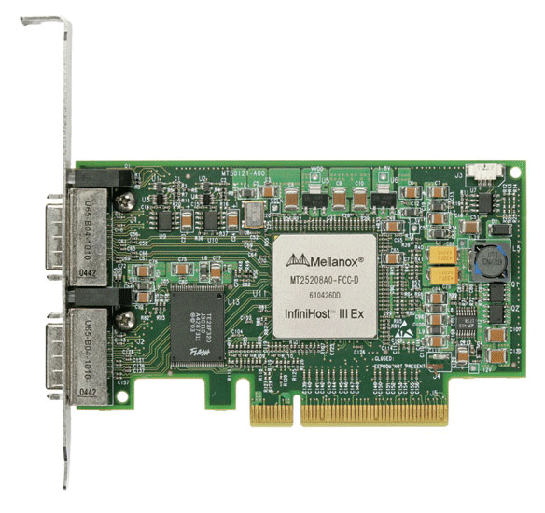
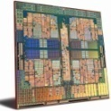
MPI RMA Memory Model
PI-3 提供了两种内存模型：
  分离模型和统一模型
MPI-2：分离模型
  存在逻辑上的公共副本（public copy）和私有副本（private copy）
  MPI 提供软件一致性以维护窗口副本之间的同步
  具有极高的可移植性，可用于不支持硬件一致性的系统
MPI-3：新统一模型
  窗口只有一个副本
  系统必须提供一致性保障
  是分离模型语义的超集
  例如，允许本地/远程访问同时进行
  提供硬件性能的最大潜力访问能力
Public
Copy
Unified
Copy
Private
Copy
Notes:
SEPARATE window model: two copies
Public copy: shared memory in shared memory machines or main memory in distributed memory machines,
Private copy: fast buffers, local caches to each processes
Example: Intel SCC, NEC SX machine
Go to ”Insert (View) | Header and Footer" to add your organization, sponsor, meeting name here; then, click "Apply to All"

Slide 40
MPI RMA Memory Model (separate windows)
Same source
Same epoch
Diff. Sources
X
Public
Copy
X
Private
Copy
load
store
store
Very portable, compatible with non-coherent memory systems
Limits concurrent accesses to enable software coherence
Notes:
Needs memory synchronization in MPI software,
Can be logically think as:
MPI_Win_lock: copy data from public copy to private copy
MPI_Win_unlock: copy data from private copy to public copy, if there are modification on private copy
Last case: copy back data will overwrite the new value written by MPI_PUT

Slide 41
MPI RMA Memory Model (unified windows)
Same source
Same epoch
Diff. Sources
X
Unified
Copy
load
store
store
Allows concurrent local/remote accesses
Concurrent, conflicting operations are allowed (not invalid)
  Outcome is not defined by MPI (defined by the hardware)
Can enable better performance by reducing synchronization

Slide 42
MPI RMA Operation Compatibility (Separate)
 | Load | Store | Get | Put | Acc
Load | OVL+NOVL | OVL+NOVL | OVL+NOVL | NOVL | NOVL
Store | OVL+NOVL | OVL+NOVL | NOVL | X | X
Get | OVL+NOVL | NOVL | OVL+NOVL | NOVL | NOVL
Put | NOVL | X | NOVL | NOVL | NOVL
Acc | NOVL | X | NOVL | NOVL | OVL+NOVL
This matrix shows the compatibility of MPI-RMA operations when two or more processes access a window at the same target concurrently.
OVL – Overlapping operations permitted
NOVL – Nonoverlapping operations permitted
X – Combining these operations is OK, but data might be garbage
Notes:
local STOREs combines with PUT/ACC, result is garbage,
For all others, as long as memory locations are not conflict, combination of operations is permitted,
Only in three situations, conflict operations are allowed:
Atomic (ACC)
Sequential (LOAD/STORE)
Read-only (GET, LOAD)
Go to ”Insert (View) | Header and Footer" to add your organization, sponsor, meeting name here; then, click "Apply to All"

Slide 43
MPI RMA Operation Compatibility (Unified)
 | Load | Store | Get | Put | Acc
Load | OVL+NOVL | OVL+NOVL | OVL+NOVL | NOVL | NOVL
Store | OVL+NOVL | OVL+NOVL | NOVL | NOVL | NOVL
Get | OVL+NOVL | NOVL | OVL+NOVL | NOVL | NOVL
Put | NOVL | NOVL | NOVL | NOVL | NOVL
Acc | NOVL | NOVL | NOVL | NOVL | OVL+NOVL
This matrix shows the compatibility of MPI-RMA operations when two or more processes access a window at the same target concurrently.
OVL – Overlapping operations permitted
NOVL – Nonoverlapping operations permitted
Notes:
Go to ”Insert (View) | Header and Footer" to add your organization, sponsor, meeting name here; then, click "Apply to All"

Slide 44
Content
  Remote Memory Access
  MPI Parallel I/O

Slide 45
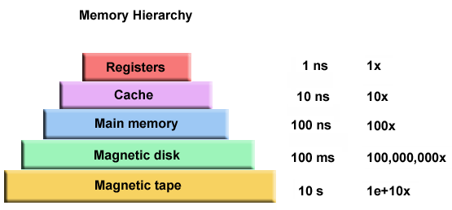
Performance of I/O

Slide 46
Traditional I/O
传统方法：
  每个进程写入一个单独的文件
    通常需要额外的后处理步骤
    如果没有后处理，重启时必须使用相同数量的处理器
  结果发送到主进程，由主进程收集结果并写入磁盘
  每个处理器自行计算文件中的位置并单独写入

Slide 47
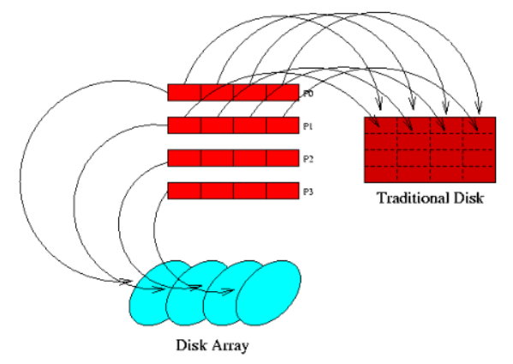
What is parallel I/O
多个进程访问单个文件

Slide 48
What is parallel I/O
MPI I/O approaches
  MPI-I/O 是对原始 MPI 标准的一组扩展
    这是一个接口规范：
    不包含实现细节。
  提供文件操作和数据访问的例程
  对 MPI-I/O 例程的调用在众多架构上具有可移植性

Slide 49
Why use parallel I/O
通常，数据存储和文件访问都是不连续的
  幽灵Ghost单元导致不连续的数据访问
  块或循环分布导致不连续的文件访问
希望使用尽可能少的 I/O 调用访问数据和文件

Slide 50
Why use parallel I/O
许多用户没有时间去了解 I/O 优化的复杂性。
使用并行 I/O 可以简化编码
  单次读/写操作与多次读/写操作
与传统方法相比，并行 I/O 可能带来显著的性能提升

Slide 51
Terms and Definitions
Displacement
  - 从文件开头开始的字节数
etype
  - 文件内的数据访问单元
filetype
  - 用于表达文件访问模式的数据类型
file view
  - 定义文件的访问模式，例如设定文件的哪些部分对进程可见

Slide 52
Terms and Definitions
Offset
  - 相对于当前视图的文件中的位置，以 etype 的数量表示
file pointers
  – 由MPI 维护的文件指针（内部偏移量）
  单个文件指针 - 位于打开文件的进程本地
  共享文件指针 - 由打开文件的进程组共享（和操作）

Slide 53
FILE MANIPULATION
MPI_FILE_OPEN( MPI_Comm comm, char *filename, int mode,
MPI_Info info, MPI_File *fh, ierr )
在通信器 Comm 中打开每个处理器上由文件名标识的文件，collective operation
每个处理器必须使用相同的模式值（mode）并引用相同的文件
info用于提供有关访问模式的提示

Slide 54
DERIVED DATATYPES & VIEWS
派生数据类型不是 MPI-I/O 的一部分
  它们在与 MPI-I/O 配合使用时被广泛应用
文件类型（filetype）实际上是一种表示文件访问模式的数据类型；文件类型用于设置文件视图。

Slide 55
CONCLUSIONS
MPI-I/O 可能显著提高 I/O 性能
用户只需付出很少的努力即可实现此改进
  编程更简单，对 I/O 例程的调用更少
  由于 API 简单，程序维护更简单

Slide 56
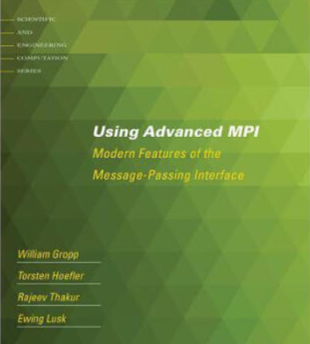
Reference Book
For more advanced features
Using Advanced MPI
  RMA
  Parallel I/O
  Dynamic process management
  …
http://www.mcs.anl.gov/research/projects/mpi/usingmpi/

