Slide 1
Quality Assessment

Slide 2
Framework
photos
Feature extraction
Deep Learning Feature
SVM classifier
Good or Bad?

Slide 3
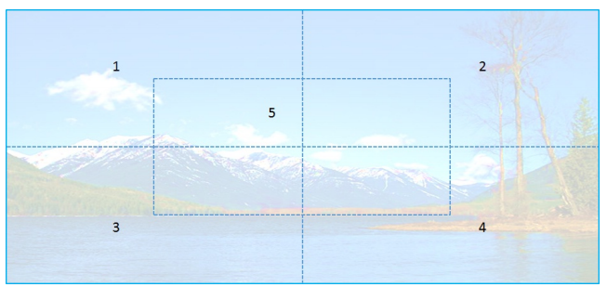
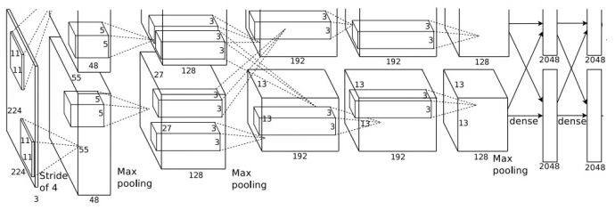
Deep learning Features^{[1]}
4096 x 5
(1)
(2)
(3)
(1) Separate the image into five regions;
Fed each patch to the DCNN^{[2]} that trained on ILSVRC^{[3]} and get the 4096-d feature vector from
the last hidden layer;
(3) Concatenate all five 4096-d feature vectors as the Deep Learning features.

Slide 4
Classifier
We Use the SVM classifier to predict the quality of the photos.
Input:
Image feature vector(deep learning feature or hand-craft feature)
Output:
Label: Good(Quality score in [0.5,1]) / Bad(Quality score in [0,0.5])
Quality score: [0, 1], higher quality with higher score.

Slide 5
Dataset^{[2]}
AVA dataset | #good photos | #bad photos
Training set | 9654 | 9654
Test set | 9654 | 9654
Total | 19308 | 19308

Slide 6
Performance
Method | Accuracy
Deep Learning Feature | 83.5%
We use 5-fold cross-validation to train the SVM classifier on the training set, then use the classification accuracy on the test set as the only performance metric.
$$Accuracy=\frac{\#true predicted photos}{\#all test photos}$$

Slide 7
References
[1] Z. Dong, X. Shen and X. M. Tian. Photo quality assessment with DCNN that understands images well. In IEEE International Conference on Multimedia Modeling, 2014, accepted.
[2] A. Krizhevsky, I. Sutskever, and G. E. Hinton. Imagenet classification with deep convolutional neural networks. In NIPS, 2012.
[3] J. Deng, A. Berg and L. Fei-Fei. Large scale visual recognition challenge 2012. www.image-net.org/challenges/LSVRC. 2012.
[4] N. Murray, L. Marchesotti, and F. Perronnin. AVA: A largescale database for aesthetic visual analysis. In CVPR, pages 2408–2415. IEEE, 2012.

