Slide 1

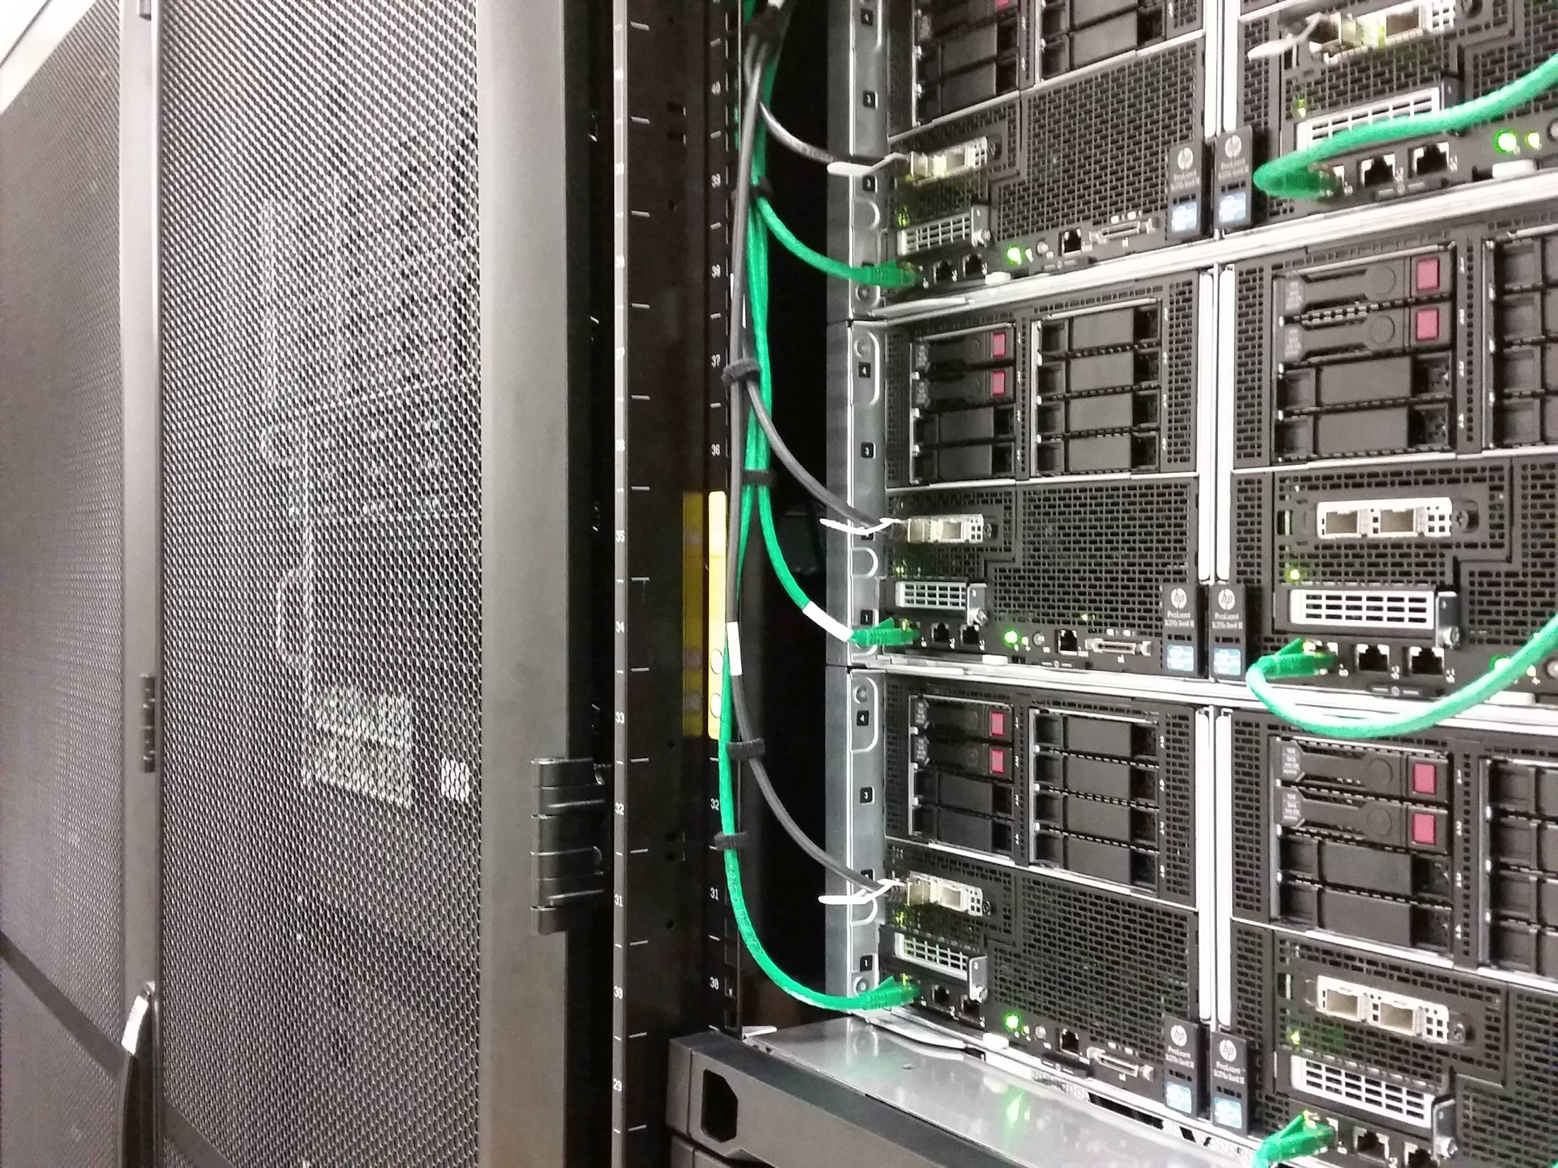
2017 HPC @UofA
Introduction to Phoenix
Robert Qiao/ ITS Research Services / 2017
1
Notes:
1
1

Slide 2
Objectives:
Understanding Phoenix
Submission of the first job
Account management
Robert Qiao/ ITS Research Services / 2017
Notes:
2

Slide 3
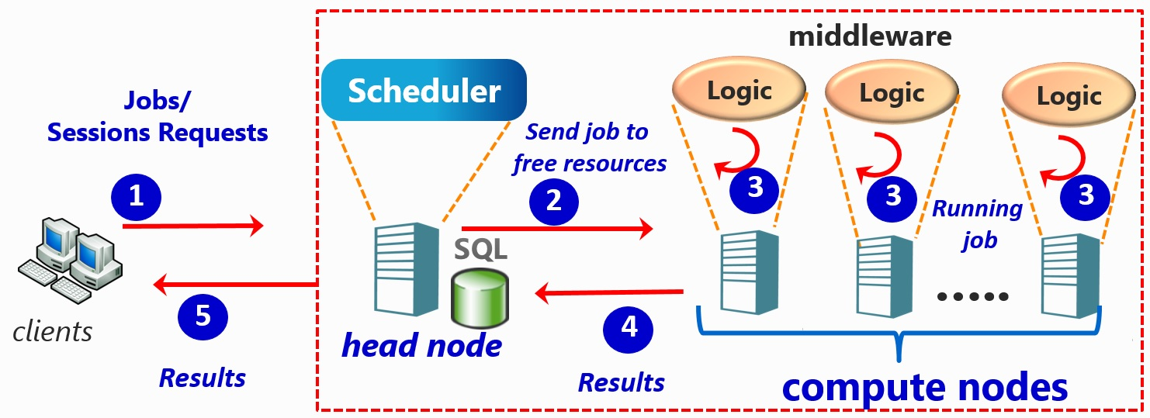
Phoenix Components
Robert Qiao/ ITS Research Services / 2017
Notes:
3

Slide 4
Phoenix Specifications
5120 cores in 160 nodes – 32 cores each
125 GB each
144 K80 GPUs
High speed internal network
Robert Qiao/ ITS Research Services / 2017
Notes:
4

Slide 5
Head vs Computing Node
Head node
Login on
File transfer
Compiling
Prepare environment
Quick executions
Job submission
Simple pre-post processing (ideally to be done on your local workstation)
Computing node
No direct access to
Execute jobs
Highest computing power
Robert Qiao/ ITS Research Services / 2017
Notes:
5

Slide 6
The scheduler
(slurm)
Control available resources
Assign priority according fair-share system
Control job execution
Be clever with your job requirements
99% of longer waiting times are due to bad requests
10 hours if you program needs only 1
32 GB if you program works with 1GB
Many nodes/cores if your code is NOT PARALLEL
Common Mistakes
Robert Qiao/ ITS Research Services / 2017
Notes:
6

Slide 7
SLURM Fairshare algorithm
Each account has a numerical allocation (in SU)
Scheduler compares relative usage vs allocation
If usage < allocation, job priority is increased
If usage > allocation, job priority is decreased
Higher priority jobs run first
Other factors can also affect when a job starts
Job only starts if all required resources are available
E.g. wall-time, CPUs, GPUs, memory requested
Important to match resource request to job requirement!
Robert Qiao/ ITS Research Services / 2017

Slide 8
Speed Up
Robert Qiao/ ITS Research Services / 2017

Slide 9
Storage:
$HOME (/home/aXXXXXXX)
Account configurations
Important things (backup)
Small quota ~ 5-10GB
Robert Qiao/ ITS Research Services / 2017
Notes:
9

Slide 10
Storage:
FASTDIR
/fast/users/aXXXXXXX
Inputs and outputs files
Executables
Jobs
Must be your working folder
Robert Qiao/ ITS Research Services / 2017
Notes:
10

Slide 11
Tutorials and Fun
Robert Qiao/ ITS Research Services / 2017
Notes:
11

Slide 12
What to expect from this Tut?
Log on Phoenix from command line
Transfer files to and from Phoenix
Submit jobs
Managing my account
Robert Qiao/ ITS Research Services / 2017
Notes:
12

Slide 13
Tutorial #1a – How to connect to Phoenix
SSH client to login
Copy software from: https://goo.gl/u4TW34
Windows:
Bitvise
Putty
Linux/OSx:
ssh
Head node:
phoenix.adelaide.edu.au
ssh aXXXXXXX@phoenix.adelaide.edu.au
Robert Qiao/ ITS Research Services / 2017
Notes:
13

Slide 14
Tutorial #1b – How to transfer files to Phoenix
SCP client for file transferring:
Windows:
Bitvise
WinSCP
Filezilla
Linux/OSx:
scp
Head node:
phoenix.adelaide.edu.au
From your computer to Phoenix:
scp FILES aXXXXXXX@phoenix.adelaide.edu.au:/fast/users/aXXXXXXX
From Phoenix to your computer:
scp aXXXXXXX@phoenix.adelaide.edu.au:/fast/users/aXXXXXXX .
Robert Qiao/ ITS Research Services / 2017
Notes:
14

Slide 15
exequiel@exequiel-ws098:~$ ssh a1634120@phoenix.adelaide.edu.au
Last login: Tue May 17 17:29:46 2016 from civeng247.civeng.adelaide.edu.au
[a1634120@l01 ~]$
[a1634120@l01 ~]$ pwd
/home/a1634120
Robert Qiao/ ITS Research Services / 2017
Notes:
15

Slide 16
Tutorial #1c – linux commands
I want to | Linux command
List files | ls
Know where I am | pwd
Copy files | cp
Delete files | rm
Create a folder | mkdir
Delete a folder | rmdir
Move to a folder | cd
Display file content | cat; more; less
Edit a text file | vi; nano
Define a variable | VAR=VALUE
Export a variable | export VAR=VALUE
Check shell | echo $SHELL; echo $0
Robert Qiao/ ITS Research Services / 2017
Notes:
16

Slide 17
Tutorial #2 – Modules
Modules system features:
Easy way to use installed software
Automatic dependencies
You could install your own software as personal modules!
Robert Qiao/ ITS Research Services / 2017
Notes:
17

Slide 18
Modules commands
Command | Description
avail | List modules
load | Load modules
unload | Unload modules
swap | Changing versions
purge | Fresh start (unload all)
list | List of loaded modules
show | Show detail of a module
Robert Qiao/ ITS Research Services / 2017
Notes:
18

Slide 19
Modules commands
Command | Example
avail | module avail matlab
load | module load Python/2.7.11-foss-2016uofa
unload | module unload R/3.3.0-foss-2016uofa
swap | module swap matlab/2016b matlab/2016a
purge | module purge
list | module list
show | module show matlab/2016b
Robert Qiao/ ITS Research Services / 2017
Notes:
19

Slide 20
Tutorial #2a – Changing shell
$ echo $SHELL
$ module load uofa_util
$ phoenix-shell -s /bin/bash
Robert Qiao/ ITS Research Services / 2017
Notes:
20

Slide 21
Software on Phoenix
Compilers:
C/C++ (GNU and Intel)
Fortran (GNU, Intel and PGI)
C# (mono)
Python
Matlab
Java
R
Perl
Robert Qiao/ ITS Research Services / 2017

Slide 22
Modules for Bioinformatics
Blast
Bowtie
CENSOR
Cufflinks
MUSCLE
QIIME
Tophat
Velvet
Robert Qiao/ ITS Research Services / 2017

Slide 23
Modules for Engineering
Abaqus (Finite element analysis)
Ansys (Engineering simulation)
CST (3D electromagnetic EDA solutions)
Ls-dyna (Finite element)
Gurobi (optimisation)
Theano (Fast computing)
Comsol (Multiphysics)
GSLIB (Geostatistics)
Robert Qiao/ ITS Research Services / 2017

Slide 24
Toolchains
Set of compiler + libraries:
FOSS:
GNU compiler
FFTW (Fast Fourier transform)
Open BLAS (BLAS + LAPACK)
ScaLAPACK (HPC and distributed LAPACK)
OpenMPI (distributed)
Robert Qiao/ ITS Research Services / 2017

Slide 25
Toolchains
Set of compiler + libraries:
Intel:
Intel compilers (C/C++/Fortran)
MKL (Mathematical libraries)
OpenMPI (distributed computing)
Robert Qiao/ ITS Research Services / 2017

Slide 26
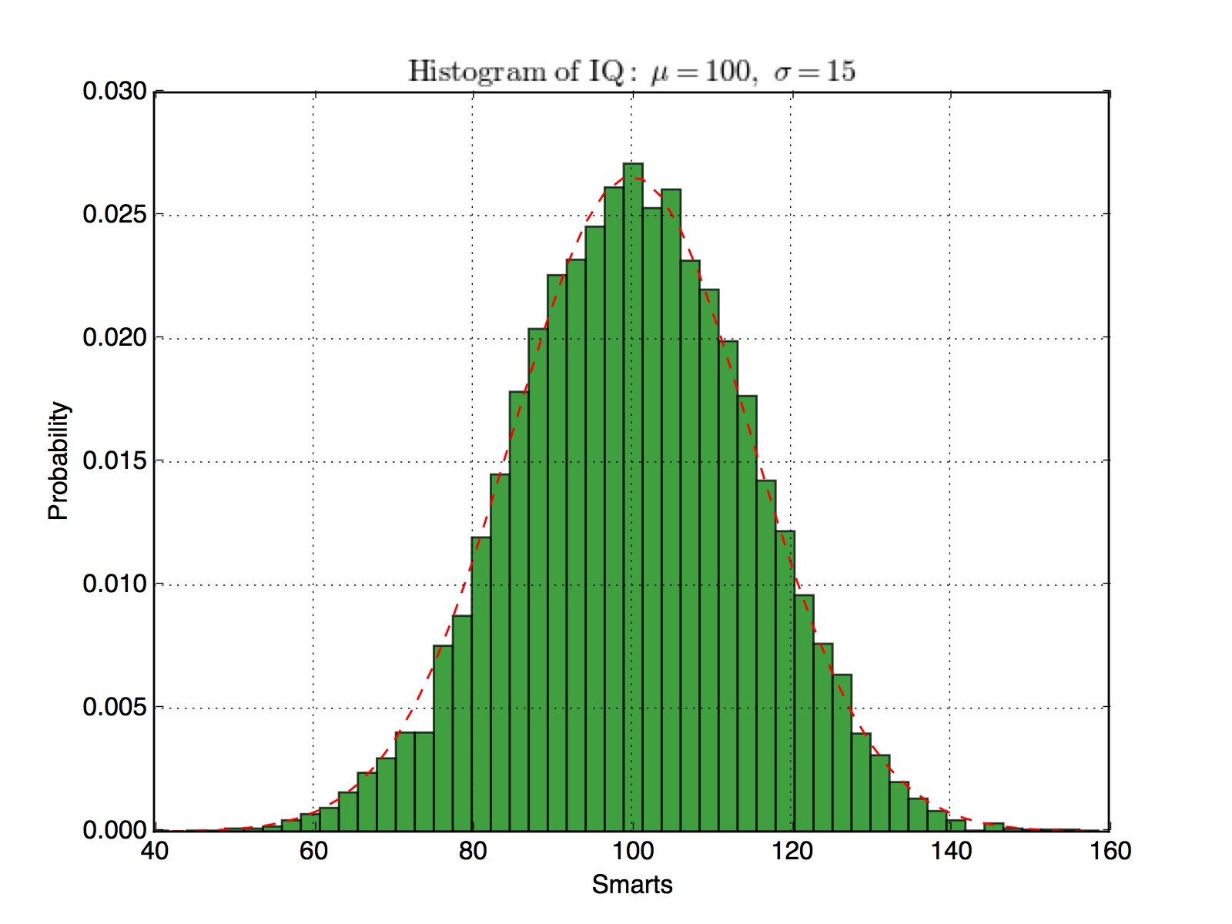
Tutorial #3 – Python program
Robert Qiao/ ITS Research Services / 2017
Notes:
26

Slide 27
Tutorial #3 – Steps
Make a folder in your $HOME
Copy from /apps/examples/python the python program “histo.py”
Find and load Python/2.7.11
Execute the script
Copy the histogram to your PC from Phoenix and compare
Robert Qiao/ ITS Research Services / 2017
Notes:
27

Slide 28
Tutorial #3 – Preparing for Job submission
Find all modules you need
Setup inputs and outputs folders
Define some environmental variables
A quick execution on head node
If all is ok, write a script with steps 1-4
Logoff-logon and re-run script (repeatability)
Robert Qiao/ ITS Research Services / 2017
Notes:
28

Slide 29
Borrow and adapt a simple script from our wiki:
https://wiki.adelaide.edu.au/hpc
Or just copy it from /apps/examples/python
Robert Qiao/ ITS Research Services / 2017
Notes:
29

Slide 30
Tutorial #4 – Job submission and monitoring
#!/bin/bash
#SBATCH -p batch
#SBATCH -N 1
#SBATCH -n 1
#SBATCH --time=00:01:00
#SBATCH --mem=5MB
# Notification configuration
#SBATCH --mail-type=ALL
#SBATCH --mail-user=firstname.lastname@adelaide.edu.au
module load Python/2.7.11-foss-2016uofa
python histo.py
Robert Qiao/ ITS Research Services / 2017
Notes:
30

Slide 31
Tutorial #4 – Job submission
[a1634120@l01 ~]$ sbatch job.sh
Submitted batch job 797573
[a1634120@l01 ~]$ squeue
[a1634120@l01 ~]$ squeue -u a1634120
[a1634120@l01]$ rceff 797573
Job ID: 1828107
Cluster: phoenix
User/Group: a1634120/a1634120
State: COMPLETED (exit code 0)
Cores: 1
CPU Utilized: 00:00:02
CPU Efficiency: 66.67% of 00:00:03 core-walltime
Memory Utilized: 1.02 MB
Memory Efficiency: 20.47% of 5.00 MB
Robert Qiao/ ITS Research Services / 2017
Notes:
31

Slide 32
Tutorial #5 – Job monitoring
I want to | Linux command
Submit | sbatch
Cancel a job | scancel JOB_ID
Get job info | sacct -j JOB_ID
Get my jobs in the queue | squeue –u axxxxxxx
Get job info | scontrol show job JOB_ID
Get efficiency info | rceff JOB_ID
Get share info | sshare –u axxxxxxx
Robert Qiao/ ITS Research Services / 2017
Notes:
32

Slide 33
Tutorial #6 – disk usage
a1634120@l03 ~]$ rcdu
===========================================================
Disk usage for Exequiel Manuel Sepulveda Escobedo (a1634120)
---------------------------------------------------------------------------
/home : 224.47 GB of 226.55 GB ( 99.1% )
/fast : 92.55 GB of 4.29 TB ( 2.2% )
===========================================================
[a1634120@l03 ~]$
Robert Qiao/ ITS Research Services / 2017
Notes:
33

Slide 34
https://wiki.adelaide.edu.au/hpc
hpcsupport@adelaide.edu.au
Walk-up sessions:
2nd and 4th Tuesday 10:00 – 12:00 Learning Innovation Studio
Robert Qiao/ ITS Research Services / 2017
Notes:
34

