Slide 1
Earning Money from your Mobile Apps
Phoenix mobile user group
February 12, 2018
Michael F Collins, III

Slide 2
Biography
25 years of professional software development
C#, C, C++, Objective-C, Swift, Java, JavaScript, Go, Python, Ruby, Elixir, Erlang
Technical Client Director for Neudesic, LLC (since May 2008)
Studied Computer Engineering at California State University, Sacramento
Previously worked at JDA Software, Sogeti USA, Kaiser Foundation Health Plan, PeopleSoft, and others.
1 wife, 3 children (1 boy and two girls), and 3 dogs (2 boys and 1 girl)
Twitter: @mfcollins3
LinkedIn: https://www.linkedin.com/in/michaelfcollins3/
GitHub: mfcollins3

Slide 3
Agenda
Product Development Tenets
App Store Economics
Single purchase vs subscription
How to price your application
Ratings and Public Perception
Providing “Pro” Features

Slide 4
Product Development Tenets
Ship often
Keep quality high
Solicit and respond to feedback
David Starr. So Long And Thanks for all the Manifestos. Visual Studio Magazine. June 2013
https://visualstudiomagazine.com/articles/2013/06/01/so-long-and-thanks-for-the-all-the-manifestos.aspx?m=2
Notes:
Tenet: any opinion, principle, doctrine, dogma, etc., especially one held as true by members of a profession, group, or movement.

Slide 5









App Store Economics

Slide 6


Single-Purchase Apps

Slide 7

Single-Purchase Apps

Slide 8
Single-Purchase Apps
No recurring revenue
No support for upgrades
“Permanent PRO Upgrade” Hell

Slide 9
Subscriptions
They’re not the future, they’re the NOW!
Recurring revenue stream
No upgrades necessary
Fair to new users

Slide 10
Subscriptions
Ship often
Keep quality high

Slide 11
Application Pricing
App Store takes 30%!
15% after the first year
60-day grace period

Slide 12
Application Pricing
Understand your costs
Cloud services (AWS, Azure, Google)
API-based services (weather, financial, messaging, video)
Commercial SDKs (PSPDFKit, others)
One-time cost or per-user-month?
Open-Source Frameworks

Slide 13
Application Pricing
Set your price so that your net revenue is enough to keep you interested
Be realistic on your user goals and market
GitHub has 31,000,000 registered users
1,000,000 users is 3%
100,000 users is 0.3%
10,000 users is 0.03%
1,000 users is 0.003%
100 users is 0.0003%

Slide 14

Example Application

Slide 15
Example Application
Cognito for user authentication
S3 for storage
MediaConvert for transcoding audio and video
DynamoDB for database
Lambda for server APIs

Slide 16
AWS Cognito
1-50,000: Free
50,000—100,000: $0.00550
100,001-1,000,000: $0.00460
* monthly active users

Slide 17
AWS S3
$0.023/GB-month

Slide 18
AWS MediaConvert
$0.015/minute for HD video
$0.003/minute for audio

Slide 19
AWS Lambda
$0.20 per million requests
First million free
$0.00001667 per GB-s
First 400,000 GB-s free

Slide 20
AWS DynamoDB
$0.25/GB-month for storage
First 25GB free
$1.25 per million write request units (1K)
$0.25 per million read request units (4K)

Slide 21
Pricing Worksheet

Slide 22
Pricing summary
100 users (0.003%)
$0.99 —> ($108.60) per month ($-1,303.20/year)
$1.99 —> ($38.60) per month ($-463.20/year)
$2.99 —> $31.40 per month ($376.80/year)
$4.99 —> $171.40 per month ($1,670.66/year)
$9.99 —> $521.40 per month ($6,256.80/year)

Slide 23
Subscription Pricing
Communicate with customers about how you price
Remind them about the services they use and the costs involved
Remind them that the App Store does not support upgrades
Remember it’s your job/right to earn a profit!

Slide 24
Ratings and Reviews
Solicit and respond to feedback
Ratings affect your app’s visibility in the App Store.
Take them seriously
Respond to reviews, especially critical reviews

Slide 25
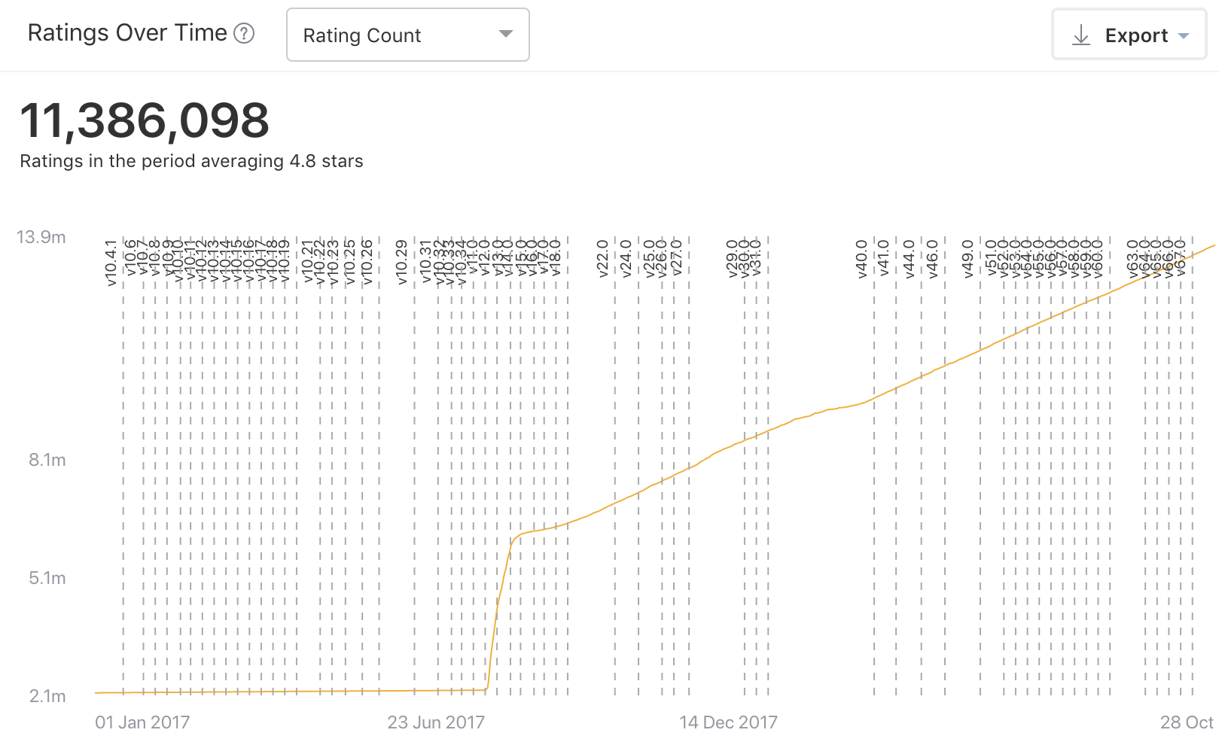

Slide 26
Solicit and Respond to Feedback
Keep critical or negative reviews off of the App Store
Offer alternative channels to report problems and get help
GitHub repo
Slack channel
Discourse or forum website
Respond to negative reviews and direct users to your alternative help resources
Nullify negative reviews

Slide 27
Solicit Feedback
Ask for positive ratings and reviews
iOS: use SKStoreReviewController
Ask the user for a review after completing an in-app purchase
Ask for a review on a subscription renewal
Ask for a review at big application milestones

Slide 28
Review Demo

