Slide 1
Jetpack compose
Rachelle timm
Notes:
Hi everyone, thank you for attending this presentation!

Slide 2
About me
Senior Consultant at Neudesic
Kotlin enthusiast
Android/Mobile developer
Notes:
My name is Rachelle Timm. I am a senior consultant here at Neudesic, doing a lot of mobile development work. My current project is an Android Native project, written with Java with the hope that we will move over to Kotlin some day.

Slide 3
Agenda
What is Jetpack?
Looking at how jetpack works vs traditional development
Building a new project with Jetpack
Incorporating Jetpack into an existing project
Notes:
Let’s take a look at what we’ll be exploring in this session. Today we will be talking about what Jetpack is, how jetpack works versus traditional UI development, what building a new project looks like with jetpack, and then finally how we incorporate Jetpack into an existing project. This will be more of a high level overview of what jetpack is, since it’s still in a beta stage and all items are subject to change.

Slide 4
Tools you’ll need
Latest Version of Android Studio Preview
Kotlin plugin for android
Patience
Notes:
There will be a couple of tools you’ll need to have a successful project with Jetpack Compose
Android Studio Preview is a must because JetPack Compose is still in beta, this is a separate program from Android Studio
JetPack Compose runs with the Kotlin Plugin, so make sure it’s installed on Android Studio/Android Studio Preview
Due to the fact it’s still in beta, exceptions are not helpful and to prevent your head banging against the wall due to frustration, JetPack requires patience. A lot of it.
Also, an understanding of Android Development would be beneficial.

Slide 5
What is Jetpack?
Notes:
Before we dig into Jetpack, for those who do not know what Jetpack is, it’s a new way of developing UI with Android. Let me show you a sample project that comes built in with Android Studio Preview.
Here, in the same project, we’re exposed to some new syntax. As you can see, it’s also written in Kotlin. We also see some new annotations, notably the Composable Notation and the Preview notation. The Composable notation is the heart of the JetPack compose framework. Wherever composable is defined, that tells the compiler that this piece of code is actually a part of UI. If we do not add that composable notation, we may have some unintended results.
The preview annotation lets us see the UI in a somewhat ”hot reload” style
Fun fact, if we want to call composable functions, we must first call it from a composable!

Slide 6
How does compose differ from traditional UI?
Notes:
Now that we’ve had a very short introductory lesson in Jetpack and now that we have seen a sample example of Jetpack from Android Studio, let’s take a look at how UI development is different from the traditional UI development we have today. Let’s start off with what we use today.

Slide 7
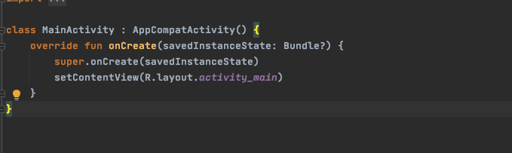
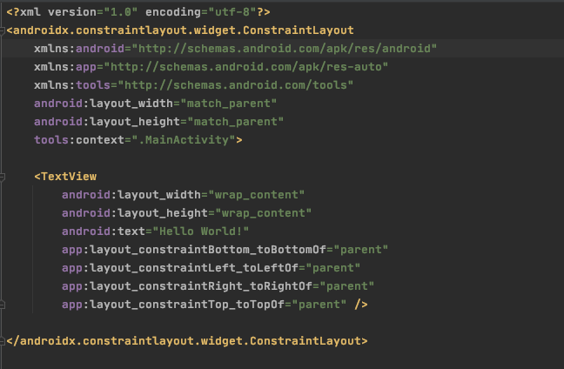
Notes:
Typically, we have two components when building a UI in a more traditional setting:
First, we have an XML file where we define our UI, how it looks like, styles, text, etc
Then, we have either an Activity or a Fragment where we create the view. In this case, it’s an Activity and we are required to call setContentView. If we do not call this, no UI is shown.
In fragments, we have something similar, the system will call the onCreateView method in order to create the UI.
Seems like a lot of steps, no? That’s what we’re used to! We do this hundreds of times that we could do it in our sleep.
Now, let’s take a look at compose and see how they’re different!

Slide 8
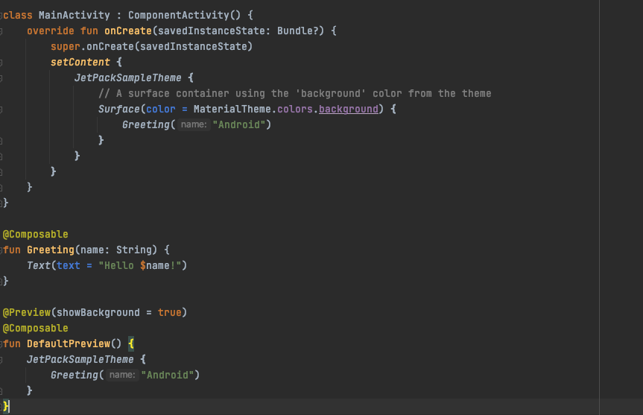
Notes:
A couple things that we notice right off the bat:
No XML view, everything is now contained within the Activity!
You’ll see a couple of new annotations, Preview and Composable
You’ll also see that we declare the theme that we want to use here, right after setContent
You’ll see it’s hard to tell what’s different, but let’s look at a more advanced example of compose. I’ll show you first what the app looks like with regular UI and how we can model that in compose.
This will be based on an older project that I’ve previously worked on, a To Do app.

Slide 9


Building a new Project with Jetpack
Notes:
Now that we have seen a simple example of the differences in UI, let’s look at how we can build a brand new project with compose.
Items you’ll need:
Android Studio Preview – it only works with the preview/canary version of android studio until it is stable
Kotlin plugin
VERY IMPORTANT! Depending on the version of compose you choose, your kotlin version MUST BE COMPATIBLE! Otherwise, nothing will work and you’ll endure many headaches and wonder why you wanted to do this to begin with.
Alrighty, let’s open up android studio so we can see how to build a demo project.

Slide 10
Incorporating Jetpack into an existing project
Notes:
Now that we’ve seen that we can create a new project with compose, how can we incorporate it into an existing project?
The level of difficulty of this totally depends on the structure of your current and existing project. If your project is in Java, it can work, but in addition to adding all the gradle dependencies for compose, you’ll also need to all the dependencies for kotlin.
I highly recommend creating a new jetpack compose project and taking a look at the dependencies they have and copy them over, just to make your life easier.

Slide 11
Compose dependencies
In the top level build.gradle (under your project folder)
You’ll need:
Under ext:
compose_version (set to what version pleases you – I’m using 1.0.0-beta08 – the latest)
Under dependencies:
Kotlin plugin (org.jetbrains.kotlin:kotlin-gradle-plugin) (I’m using latest since it’s compatible – 1.5.10)

Slide 12
Compose dependencies
In the App level build.gradle (under your app folder)
Under android:
A composeOptions block with the two dependencies:
kotlinCompilerExtensionVersion composeVersion
kotlinCompilerVersion ‘1.4.32’ – again, this is compatible with the version I’m using
Under dependencies you’ll need a slew of dependencies:
"androidx.compose.ui:ui:$compose_version”
"androidx.compose.material:material:$compose_version”
"androidx.compose.ui:ui-tooling:$compose_version”
'androidx.activity:activity-compose:1.3.0-beta01’
And more
Notes:
Now let’s see if we can put this into practice!

Slide 13
Questions?

Slide 14
Thank you!

