Slide 1
Intro to: Kotlin Multiplatform Mobile
TJ Murphy | Consultant 2

Slide 2
About Me
Consultant with Neudesic
Full Stack Developer

Slide 3

Agenda
Tools Needed
What is KMM
How Does it work?
Advantages
Disadvantages
Example Code

Slide 4
Environment Set Up
Android Studio – 4.2 or higher
Kotlin plugin
Kotlin Multiplatform Mobile plugin
Xcode – 11.3 or higher
Install JDK – I use 16

Slide 5
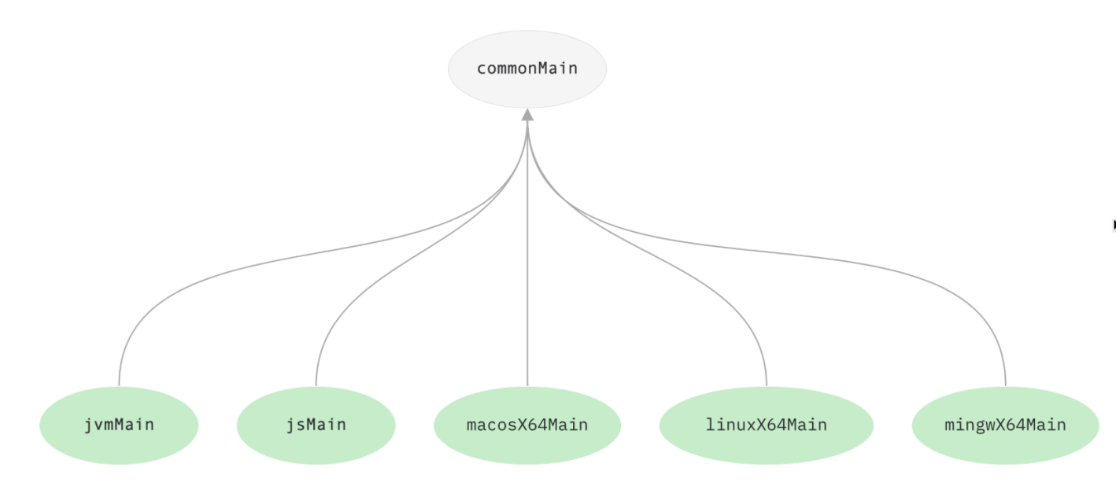
KMM
is an SDK for cross-platform mobile development
With KMM you can share parts of your application between Android and IOS

Slide 6
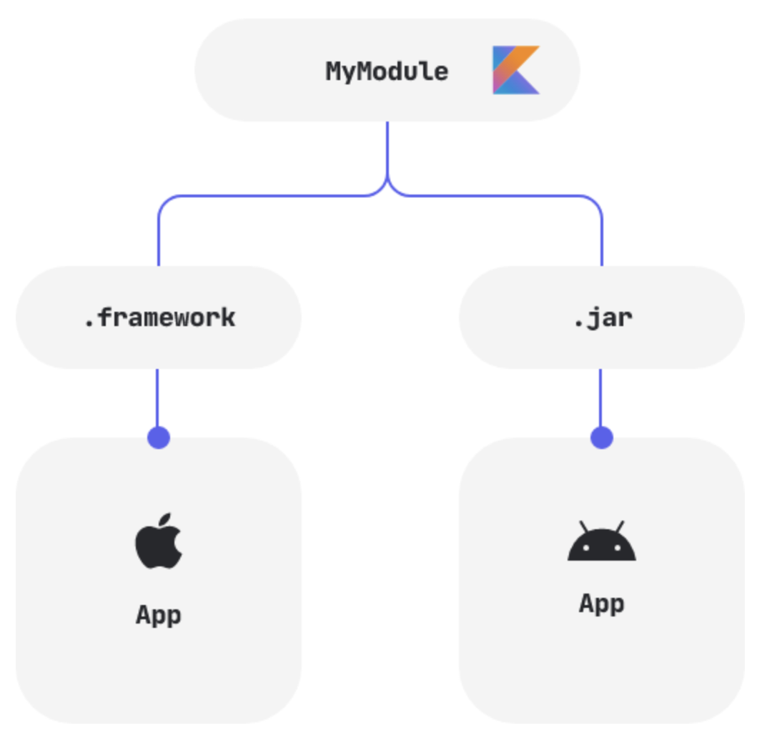
How does it work
Kotlin Native is a technology for compiling Kotlin code to native binaries, which can run without a virtual machine
Shared code, written in Kotlin, is compiled to JVM bytecode for Android with Kotlin/JVM and to native binaries for iOS with Kotlin/Native
Notes:
Limitations of using all iOS and Android features – Whenever a task cannot be solved in the shared code or whenever you want to use specific native features, you can use the expect/actual pattern to seamlessly write platform-specific code.
Performance issues – Shared code written in Kotlin is compiled to different output formats for different targets: to Java bytecode for Android and to native binaries for iOS. Thus, there is no additional runtime overhead when it comes to executing this code on platforms, and the performance is comparable to native apps.
Legacy code problems – No matter how large your project is, your existing code will not prevent you from integrating KMM. You can start writing cross-platform code at any moment and connect it to your iOS and Android Apps as a regular dependency, or you can use the code you’ve already written and simply modify it to be compatible with iOS.

Slide 7
Advantages
Access to Native code and APIs and libraries
Shared business logic
Kotlin language features like coroutines
Kotlin Libraries
Ktor
SQLDelight
Notes:
Shared business logic
for applications with more complex business logic this could help cut down development time.
Used by Cash App
Ktor - asynchronous HTTP client
SQLDelight - used for caching

Slide 8
Disadvantages
UI code cannot be shared
Relatively new
Must compete with other Cross Platform tools
Notes:
Relatively new
Not as large of a following so small presences on stack overflow
Althought the documentation is good it is not as extensive as other things like flutter and xamerin
Must compete with other platforms
-Like flutter and Reactive Native that allow the user to write all the code once

Slide 9
Time to look at Code

Slide 10
Thanks for coming
Helpful Links in the Git Repo

