Slide 1

Phoenix Mobile User Group
Schedule:
Last Wednesday of the month 6 - 7:30 PM
Meetup:
https://www.meetup.com/phoenix-mobile-user-group/
GitHub:
https://github.com/PhoenixMobileUserGroup
Contacts:
Shane Foley: Shane.Foley@neudesic.com
Sam Morton: Sam.Morton@neudesic.com
Today:
The Flutter Packages That Improve App Experience
Next Time:
TBD

Slide 2
The Flutter Packages That Improve App Experience
March 2024

Slide 3





Presentation Contents
https://github.com/PhoenixMobileUserGroup/2024.03.27_TheFlutterPackagesThatImproveAppExperience

Slide 4

Bio (Shane Foley)
Educations
Arizona State University (BS in Computer Science)
Neudesic (2017– Present)
Application Innovation
Interests
Video Games, Cars/Motorcycles, Skiing, Fitness
LinkedIn
https://www.linkedin.com/in/shane-charles-foley/

Slide 5
What are packages?
Modular Units of Code
Packages in Flutter are modular units of code that encapsulate functionality.
Code Reusability
They enable developers to reuse code across different projects, reducing redundancy and maintaining consistency.
Dependency Management
Flutter's Pub system manages dependencies specified in the pubspec.yaml file, allowing easy integration of external packages.
Community Contributions
A vibrant community contributes various packages on platforms like pub.dev, extending Flutter's capabilities.

Slide 6
Where to find Flutter packages?
Pub.dev
https://pub.dev/packages
Flutter Package of the Week
https://www.youtube.com/watch?v=giV9AbM2gd8&list=PLjxrf2q8roU23XGwz3Km7sQZFTdB996iG&pp=iAQB
Flutter Gems
https://fluttergems.dev/

Slide 7
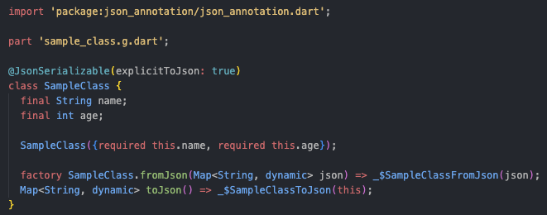
json_serializable + json_annotation
Package:
https://pub.dev/packages/json_serializable
https://pub.dev/packages/json_annotation
What it is used for:
JSON Conversions
Example:

Slide 8
DEMO

Slide 9
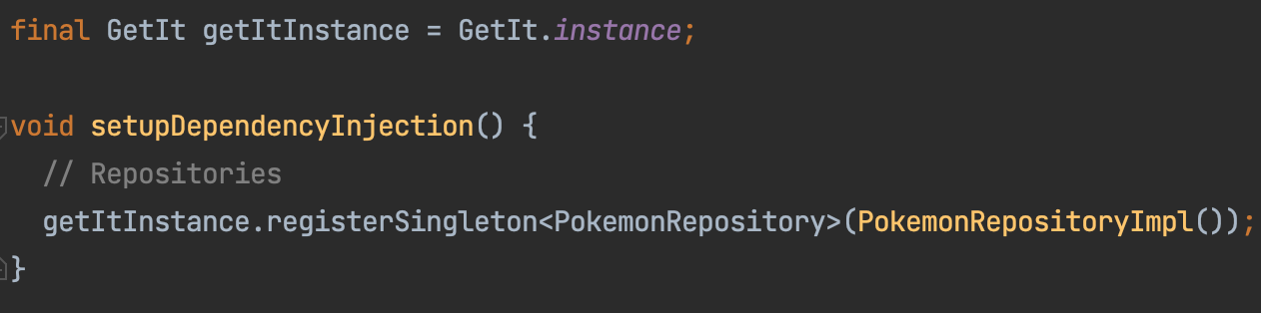
get_it
Package:
https://pub.dev/packages/get_it
What it is used for:
Dependency Injection
Example:

Slide 10
DEMO

Slide 11
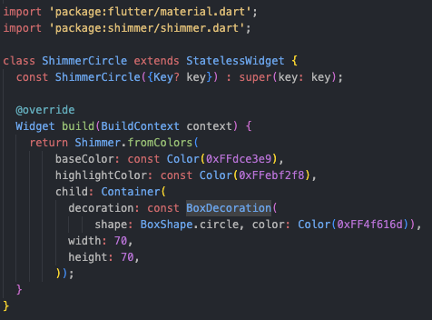
shimmer
Package
https://pub.dev/packages/shimmer
What it is used for:
Shimmer loading effects
Example:

Slide 12
Demo

Slide 13

Raffle

Slide 14
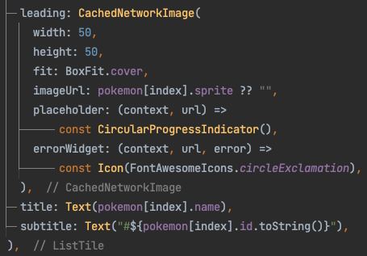
cached_network_image
Package:
https://pub.dev/packages/cached_network_image
What it is used for
Caching images
Example:

Slide 15
Demo

Slide 16
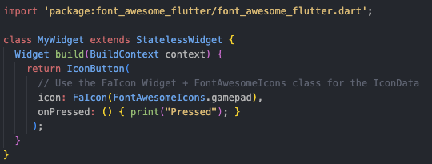
font_awesome_flutter
Package:
https://pub.dev/packages/font_awesome_flutter
What it is used for:
Application icons
Example:

Slide 17
Demo

Slide 18
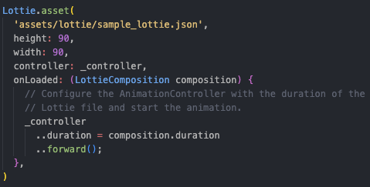
lottie
Package:
https://pub.dev/packages/lottie
What it is used for
Animations
Animations:
https://lottiefiles.com/featured
Example:

Slide 19
Demo

Slide 20
Questions

