Slide 1



CSSE 374 Software Design Introduction to Observer Design Pattern
Shawn Bohner
Steve Chenoweth
Mark Hays
Notes:
Above – Here I am Friday sporting bicycles, and thinking how once upon a time this was a preferred way to communicate things. Packages were delivered, and so were newspapers and telegraph messages. The Observer Pattern is a way to deliver data to interested parties.

Slide 2
What’s up today?
Reading Quiz Reflections
Reflecting on Lab 1-2
Introduction to Observer Pattern
Observer – “Live Coding” Example
Start Lab 2-1 on Observer Design Pattern
Notes:
A sketch of today’s class

Slide 3
Lab 1-2 Reflections
Did it make sense to you?
Where could you use it in your term project?
Composition over Inheritance
Programming to an Interface
Notes:
Your continuing to think about how to use the pattern – that’s the real learning.

Slide 4
Gang of Four Design Patterns
Behavioral
Strategy
Observer
Interpreter
Template Method
Chain of Responsibility
Command
Iterator
Mediator
Memento
State
Visitor
Creational
Factory Method
Abstract Factory
Builder
Prototype
Singleton
Structural
Adapter
Bridge
Composite
Decorator
Façade
Flyweight
Proxy
Notes:
We are going to do key ones of these, in depth, as we go through 374.
Plenty of other references to them, out on the Internet.

Slide 5

You’ve now read about it! Why would the Observer Design Pattern be so useful?
Think for 15 seconds…
Turn to a neighbor and discuss it for a minute

Slide 6
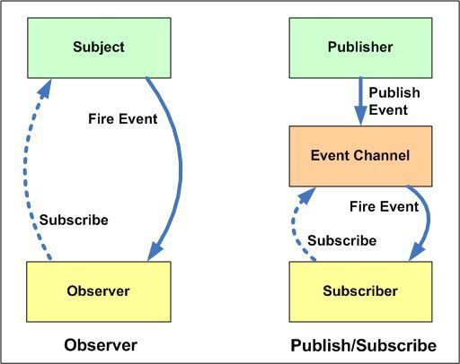
Observer Design Pattern
Used when there is one-to-many relationship between objects such as if one object is modified, its dependent objects are to be notified automatically.
Essential
Observer
More Sophisticated
Notes:
Probably familiar with “Publish and Subscribe” which is a complex form of Observer and often called out as a Design Pattern itself.
Sometimes the “subscribe” is kind of automatic – like when an object is created, and saves it’s creator’s ID to do call-backs.

Slide 7
Refreshing Display
How do we refresh the GUI display when the domain layer changes without coupling the domain layer back to the UI layer?
Model-View Separation
Notes:
How do you update GUI when a Sale total changes without directly coupling both? The pattern for this would be an Observer!
An observer (e.g., a GUI) needs to know about state changes in a publisher (e.g. a domain object) without direct coupling between objects
Solution:
Subscribers implement a ‘Listener’ interface
Publishers dynamically register listeners
Publishers automatically notify listeners when event occurs
Publishers coupled to generic interface instead of concrete object

Slide 8
Observer Design Pattern
Problem: Object(s) want to be informed about events or state changes for other object(s).
How do we do this while maintaining low coupling from the subject objects to the observing objects?
How do we have a design that scales as you add more subjects and observers?
Solution: Define an observer interface that the subject objects can implement.
Observers register with the subject object.
The Subject object notifies all of its observers.
Notes:
This goes back to the GoF style of writing patterns. There has to be a Problem it solves, or you don’t use it!

Slide 9
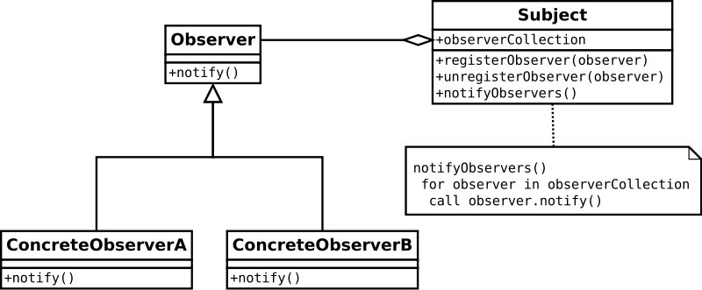
Observer: Behavioral Pattern
Observer pattern is a 1 to many pattern used to notify and update all dependents automatically when an object changes.
Notes:
observer pattern (a subset of the publish/subscribe pattern) is a design pattern in which an object, called the subject, maintains a list of its dependents, called observers, and notifies them automatically of any state changes, usually by calling one of their methods. It is mainly used to implement distributed event handling systems.

Slide 10
Sale has a List of Listeners
Notes:
More examples you can read on your own…
SaleFrame1 registers with Sale for key events (visible to SaleFrame1)
Sale notifies all Listeners by calling publishPropertyEvent(…)
SaleFrame1 reacts only if its interested in a particular type of event

Slide 11
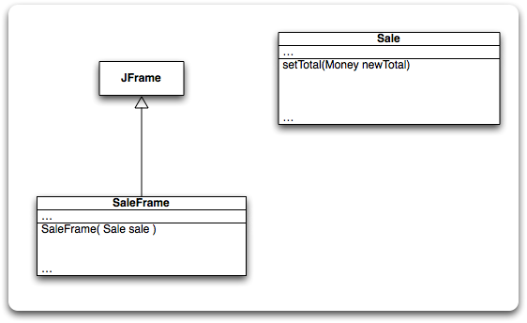
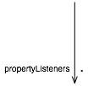

Example: Update SaleFrame when Sale’s Total Changes
total = newTotal;
publishPropertyEvent(“sale.total”, total)
propertyListeners.add(lis);
for(PropertyListener pl : propertyListeners) pl.onPropertyEvent(this, name, value);
sale.addPropertyListener(this);
…
if (name.equals(“sale.total”)) totalTextField.setText(value.toString());
Notes:
Based on Figure 26.22. Multi-stage build to follow steps on p. 465.
• Create listener interface
• Make SaleFrame implement interface
• Give Sale a list of listeners and a method for adding them
• addPropertyListener method does what you expect
• SaleFrame constructor register the frame as a listener on the Sale
• add publishPropertyEvent method to Sale
• setTotal publishes a property event
• publishPropertyEvent loops over all the listeners, announcing the event
• for any events that it is interested in, the SaleFrame updates the GUI display

Slide 12
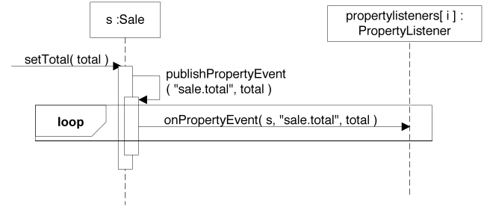
Example: Update SaleFrame when Sale’s Total Changes (continued)

Slide 13
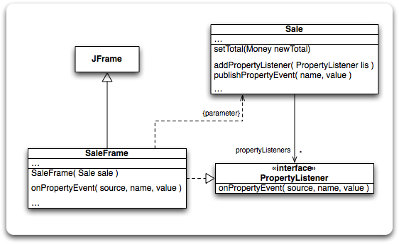
Example: Update SaleFrame when Sale’s Total Changes (continued)
Is UI coupled to domain layer?
Is domain layer coupled to UI?
Notes:
Answers: yes, no (Sale is just coupled to PropertyListener, which provides a stable interface for any possible observers)
Q6: With what sorts of variations does Observer help us deal? [changes in object state, events, changes in attributes…]
Q7: Why do Observers need “listeners”? [observers detect change and listeners are used sense the change in the object properties]

Slide 14

Observer: Not just for GUIs watching domain layer…
GUI widget event handling
Example: JButton startButton = new JButton(“Start”); startButton.addActionListener(new Starter());
Publisher: startButton
Subscriber: Starter instance
Notes:
Q8: Besides UI views observing changes to the model layer, what is another common use of the Observer pattern? [In GUI frameworks, like Java and .NET, “actionListeners” are observers of GUI widgets.]

Slide 15
Today’s “Live coding” Design Studio – Stage 1
Our engineers need a Number Conversion App for decimal, hexadecimal, octal, and binary. Let’s Talk about what it does…
Obtain a number (decimal)
When number detected in decimal input:
Display a Hexidecimal representation
Display an Octal representation
Display a Binary representation
Break up into Groups, and go the whiteboard to design NuConApp using observer pattern
Notes:
We’ll let you do this on the white board, like last week.
Outline what Number Conversion App does
Bring up an example (example: Windows calculator or Mark’s simple example code) to demo functionality
Break up into groups of 3-4 students and to to the whiteboard to design this NuConApp!

Slide 16
NuConApp Stage - 1
NuConApp …
+main() : void
<<abstract>>
Observer +subject : subject
+update() : void
Subject
-observers : List<observer>
-number : int
+getNum() : void
+setNum() : void
+attach() : void
+notify() : void
HexObserver
+subject : subject
+update() : void
OctalObserver
+subject : subject
+update() : void
BinaryObserver
+subject : subject
+update() : void
Notes:
These design ideas are for your reference, after you do your own.

Slide 17
NuConApp Stage 1 Code
Back to the white board… From this design, draft the key code elements to realize the design
Careful about the notification mechanism so it could be extended

Slide 18
NuConApp: Subject Class…
import java.util.ArrayList; import java.util.List;
public class Subject {
private List<Observer> observers = new ArrayList<Observer>();
private int state;
public int getState() {
return state;
}
public void setState(int state) {
this.state = state;
notifyAllObservers();
}
public void attach(Observer observer){
observers.add(observer);
}
public void notifyAllObservers(){
for (Observer observer : observers) {
observer.update();
} } }

Slide 19
NuConApp: Observer Abstract Class
public abstract class Observer {
protected Subject subject;
public abstract void update();
}

Slide 20
NuConApp: Hex Observer Class
public class HexObserver extends Observer {
public HexObserver(Subject subject) {
this.subject = subject;
this.subject.attach(this);
}
@Override
public void update() {
System.out.println( ”Hexadecimal String: " + Integer.toHexString(subject.getState()));
}
}

Slide 21
NuConApp: Octal Observer Class
public class OctalObserver extends Observer {
public OctalObserver(Subject subject) {
this.subject = subject;
this.subject.attach(this);
}
@Override
public void update() {
System.out.println( ”Octal String: " + Integer.toOctalString(subject.getState()));
}
}

Slide 22
NuConApp: Binary Observer Class
public class BinaryObserver extends Observer {
public BinaryObserver(Subject subject) {
this.subject = subject;
this.subject.attach(this);
}
@Override
public void update() {
System.out.println( "Binary String: " + Integer.toBinaryString(subject.getState()));
}
}

Slide 23
NuConApp: Main
public class ObserverPatternDemo {
public static void main(String[] args) {
Subject subject = new Subject();
new HexaObserver(subject);
new OctalObserver(subject);
new BinaryObserver(subject);
System.out.println("First state change: 15");
subject.setState(15); System.out.println("Second state change: 10"); subject.setState(10);
}
}

Slide 24
NuConApp Executed…
. . .
First state change: 15
Hex String: F
Octal String: 17
Binary String: 1111
Second state change: 10
Hex String: A
Octal String: 12
Binary String: 1010

Slide 25
2-1 Design Studio – Stage 2
Engineers feedback that the input is also Hex, Octal, and Binary; so they need the NuConApp to have input from any of the inputs.
Obtain number (decimal, hex, octal, or binary)
When number detected in one of inputs:
Display Decimal, Hex, Octal and Binary representations
Groups go back to the whiteboard to design NuConApp with the updated requirement
Notes:
Bring up an example (example: Windows calculator or Mark’s simple example code) to demo this updated functionality
Back to the whiteboard to design this updated NuConApp!

Slide 26
NuConApp Stage - 2
NuConApp …
+main() : void
<<interface>>
Observer +subject: Subject
+update() : void
<<interface>> Subject
-observers:List<observer>
-number : int
+attach() : void
+notify() : void
DecObserver
+subject: Subject
+update() : void
DecNumber
-number : int
+getState() : void
+setState() : void
BinaryObserver
+subject: Subject
+update() : void
BinaryNumber
-number : Binary
+getState() : void
+setState() : void
OctalNumber
-number : Octal
+getState() : void
+setState() : void
OctalObserver
+subject: Subject
+update() : void
HexObserver
+subject: Subject
+update() : void
HexNumber
-number : Hex
+getState() : void
+setState() : void

Slide 27
2-1 Design Studio – Stage 3
Engineers indicated that the console input on NuConApp is tedious and we are not in 1980s. So, we need to use a GUI interface.
Obtain number (decimal, hex, octal, or binary) via a Graphical User Interface and display it as such.
When number is change in one of input fields on the Decimal, Hex, Octal or Binary displays, update the other three automatically
Groups go back to the whiteboard to design NuConApp with the updated requirement
Notes:
Recall the Windows calculator or Mark’s simple example code demonstrated earlier using a rudimentary GUI display.
Back to the whiteboard to design this GUI capability into NuConApp!

Slide 28
Lab 2-1
Review Lab 2-1 Assignment
Load Lab2-1.zip from Moodle into a workspace using instructions in Folder
Start working on it
At least one of our TA’s has Monday hours…

