Slide 1

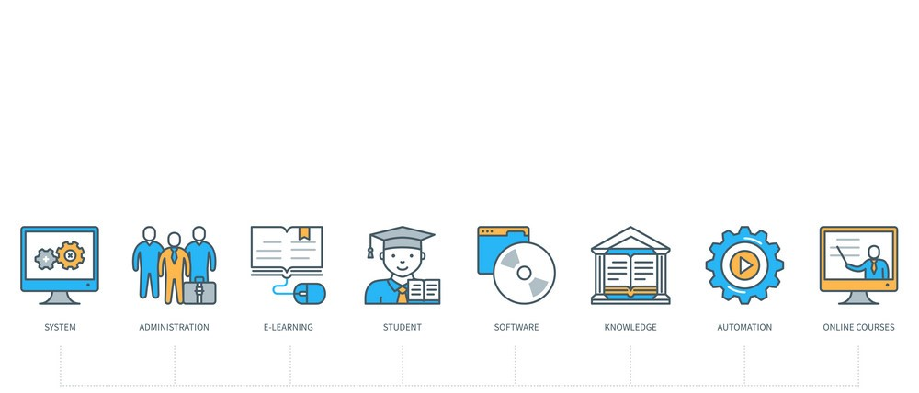
Learning Management System
Team Challengers

Slide 2
What is learning management system?
An LMS is a platform for digital learning.
L — Learning. With a learning management system, you can create a single source of online courses and training materials.
M — Management. You can manage courses and learners, and even improve your own efficiency.
S — System. Computer system, to be exact. An LMS automates the most boring and tedious work, such as grading, processing statistics, analytics, and preparing reports.
In other words, an LMS is like your own online university.

Slide 3
Why Should use LMS?
Saves time
Saves money
Allows your learners to prioritise their workload
Delivers better engagement and retention
Consistent and flexible
Gives you valuable data
Reduces staff turnover

Slide 4
The Benefits of an LMS system
For Businesses
For Learners
Reduces Training Costs.
Cut down the time for training/onboarding.
Maintain unified standards of work among partners and affiliates.
Create individual learning plans.
Measure training effectiveness.
Can access to learning content anytime and anywhere.
Stay on top of required training.
Increase knowledge engagement.
Improve work performance.
Boost knowledge retention.

Slide 5
The Cons of an LMS system
Administrative costs and setup time – Learning how to implement an LMS system may take a considerable amount of time. Converting all of your instructors to e-learning will require a transitional period.
Requires IT and programming knowledge – Unfortunately, a massive drawback to having a learning management system is that your organization will need coding and IT skills to customize the platform to suit your training needs.
May lack features – Many learning management systems use a "freemium" model in which only a limited amount of features are available to you. To gain full access to the system, you may have to pay a subscription cost. Typically paid features include additional support and a reporting system.

Slide 6
LMS Features:
There’s no universal agreement on the full feature se of a standard LMS, but in general, you can break down all LMS requirements into basic and advanced features:
User Management
Course Management / Module Management
Batch Management
Progress Tracking

Slide 7

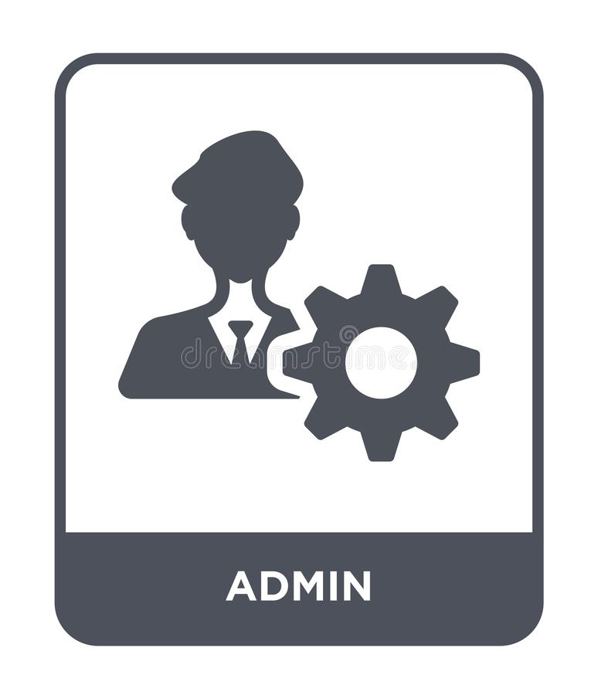



Our LMS Process Summery:
Manage Students
Manage Batches
Learning Course
Manage Teachers
Grading Students
Manage Courses
Schedule Courses

Slide 8
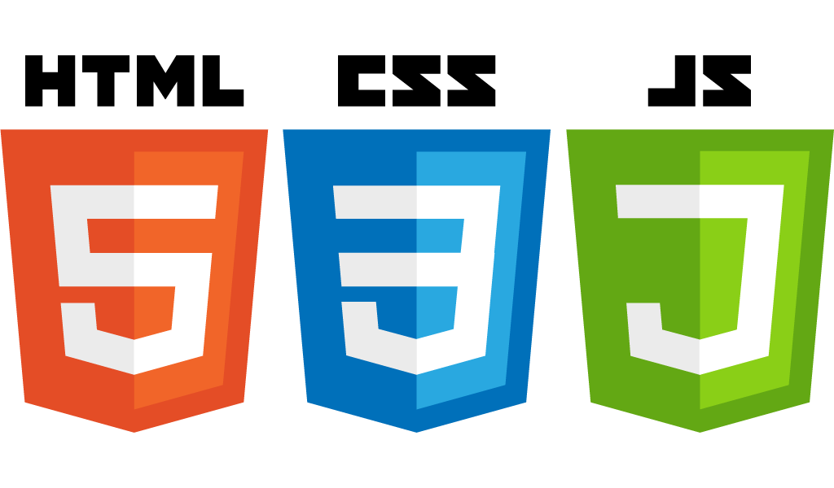

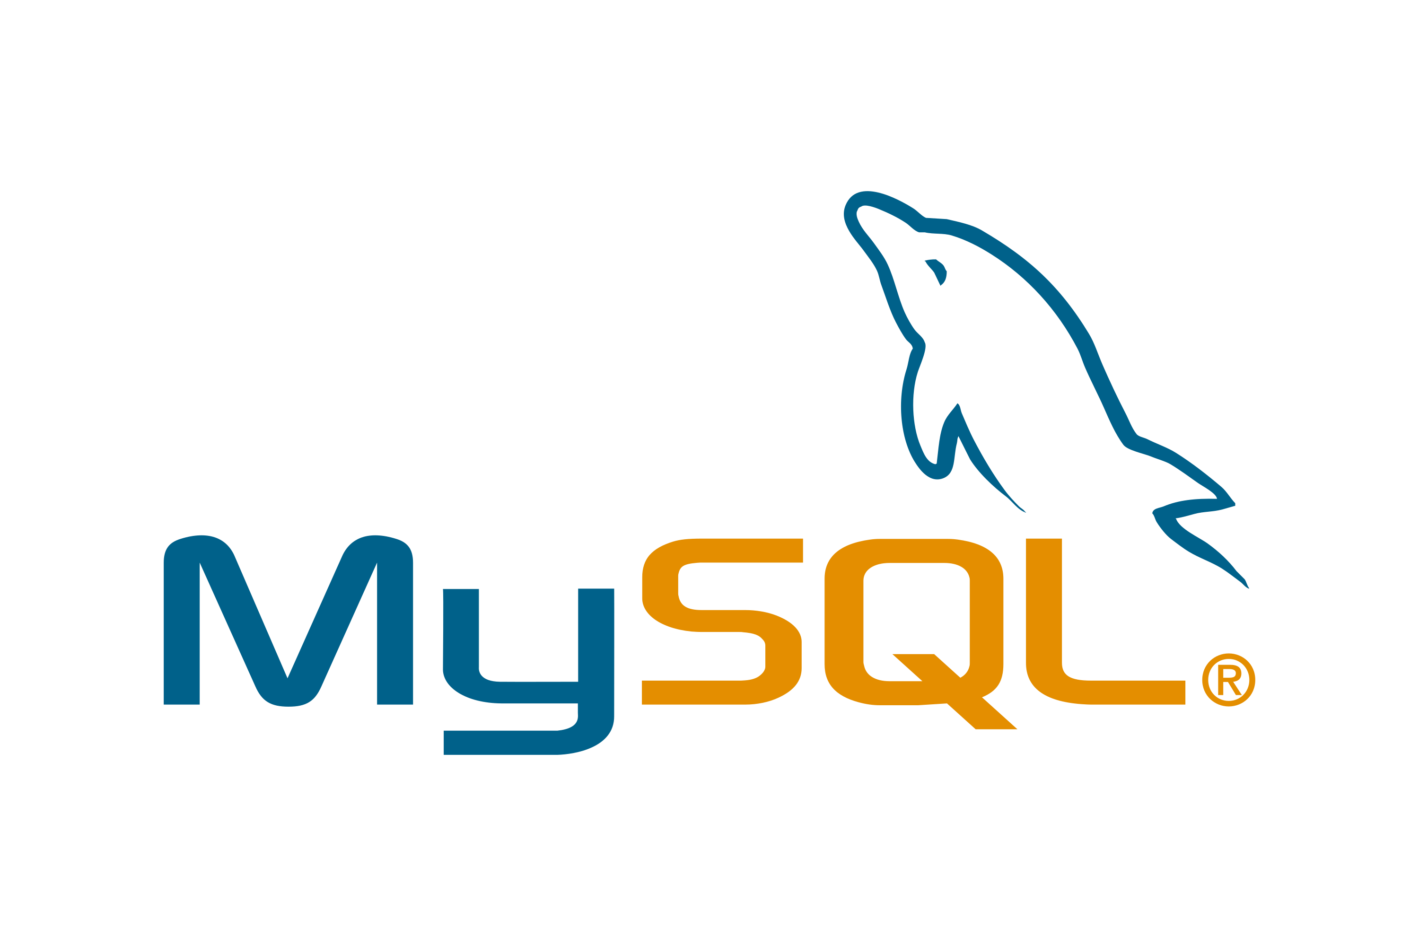




Technology used
Frontend
HTML
CSS
Javascript
Bootstrap
Thymeleaf
Backend
Java Spring Boot Framework
Spring Data JPA
Spring Security
MySql
Junit Test

Slide 9
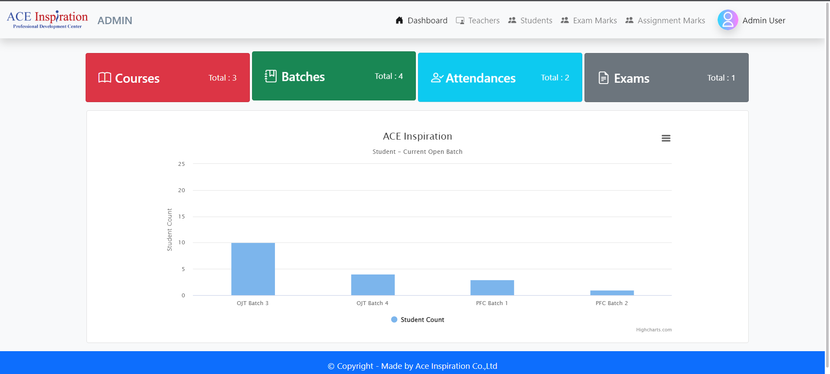
LMS of Ace Inspiration

Slide 10
Thank you!
Let’s See Our LMS System.

