Slide 1

Learning Management System
Team Challengers
Supervisors
Teacher
Daw Mo Yee Lwin
Daw May Zwei
Daw Mo Yee Lwin

Slide 2




Team Members
Thet Aung Zan
Phone Khaing Hein
Swam Thu Marn
Phyu Phyu Thin

Slide 3
What is learning management system?
An LMS is a platform for digital learning.
L — Learning. With a learning management system, you can create a single source of online courses and training materials.
M — Management. You can manage courses and learners, and even improve your own efficiency.
S — System. Computer system, to be exact. An LMS automates the most boring and tedious work, such as grading, processing statistics, analytics, and preparing reports.
In other words, an LMS is like your own online university.

Slide 4
The Benefits of an LMS system
For Businesses
Reduces Training Costs.
Cut down the time for training/onboarding.
Create individual learning plans.
Measure training effectiveness.
Reduces Staff Turnover
Tracking Students Data

Slide 5
The Benefits of LMS system
For Learners
Can access to learning content anytime and anywhere.
Increase knowledge engagement.
Improve work performance.
Can know Learning Process.

Slide 6
LMS Features in Our project:
There’s no universal agreement on the full feature set of a standard LMS, but in general, we can define all LMS requirements.
User Management
Course Management / Module Management
Batch Management
Progress Tracking

Slide 7
LMS Functions in Our project:
Our LMS includes the following functions.
User Roles (Admin, Teacher, Student)
Batches
Courses and Modules with Videos and Resource Files
Exams
Assignments
Attendances
Group Chat
Comment

Slide 8





Our LMS Process Summery:
Manage Students
Manage Batches
Learning Course
Manage Teachers
Grading Students
Manage Courses
Manipulate and Schedule Courses

Slide 9
Documentation in Our LMS project:
Our Team made the following documents for the LMS project.
Basic Design
Detail Design
Data Flow Diagram
Database Design

Slide 10
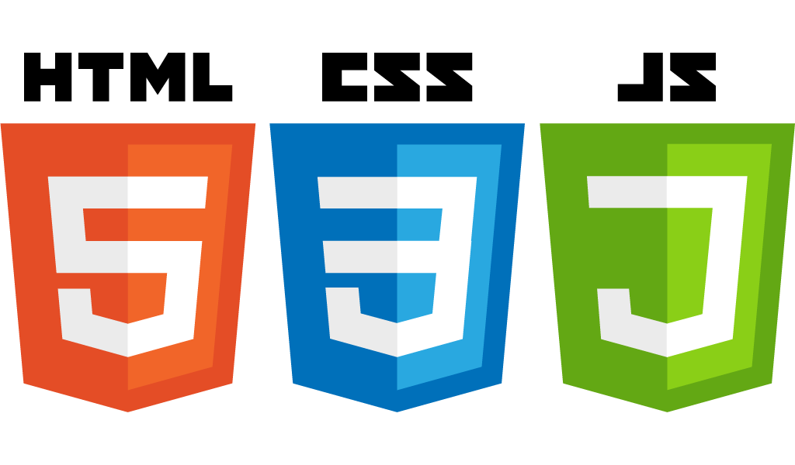








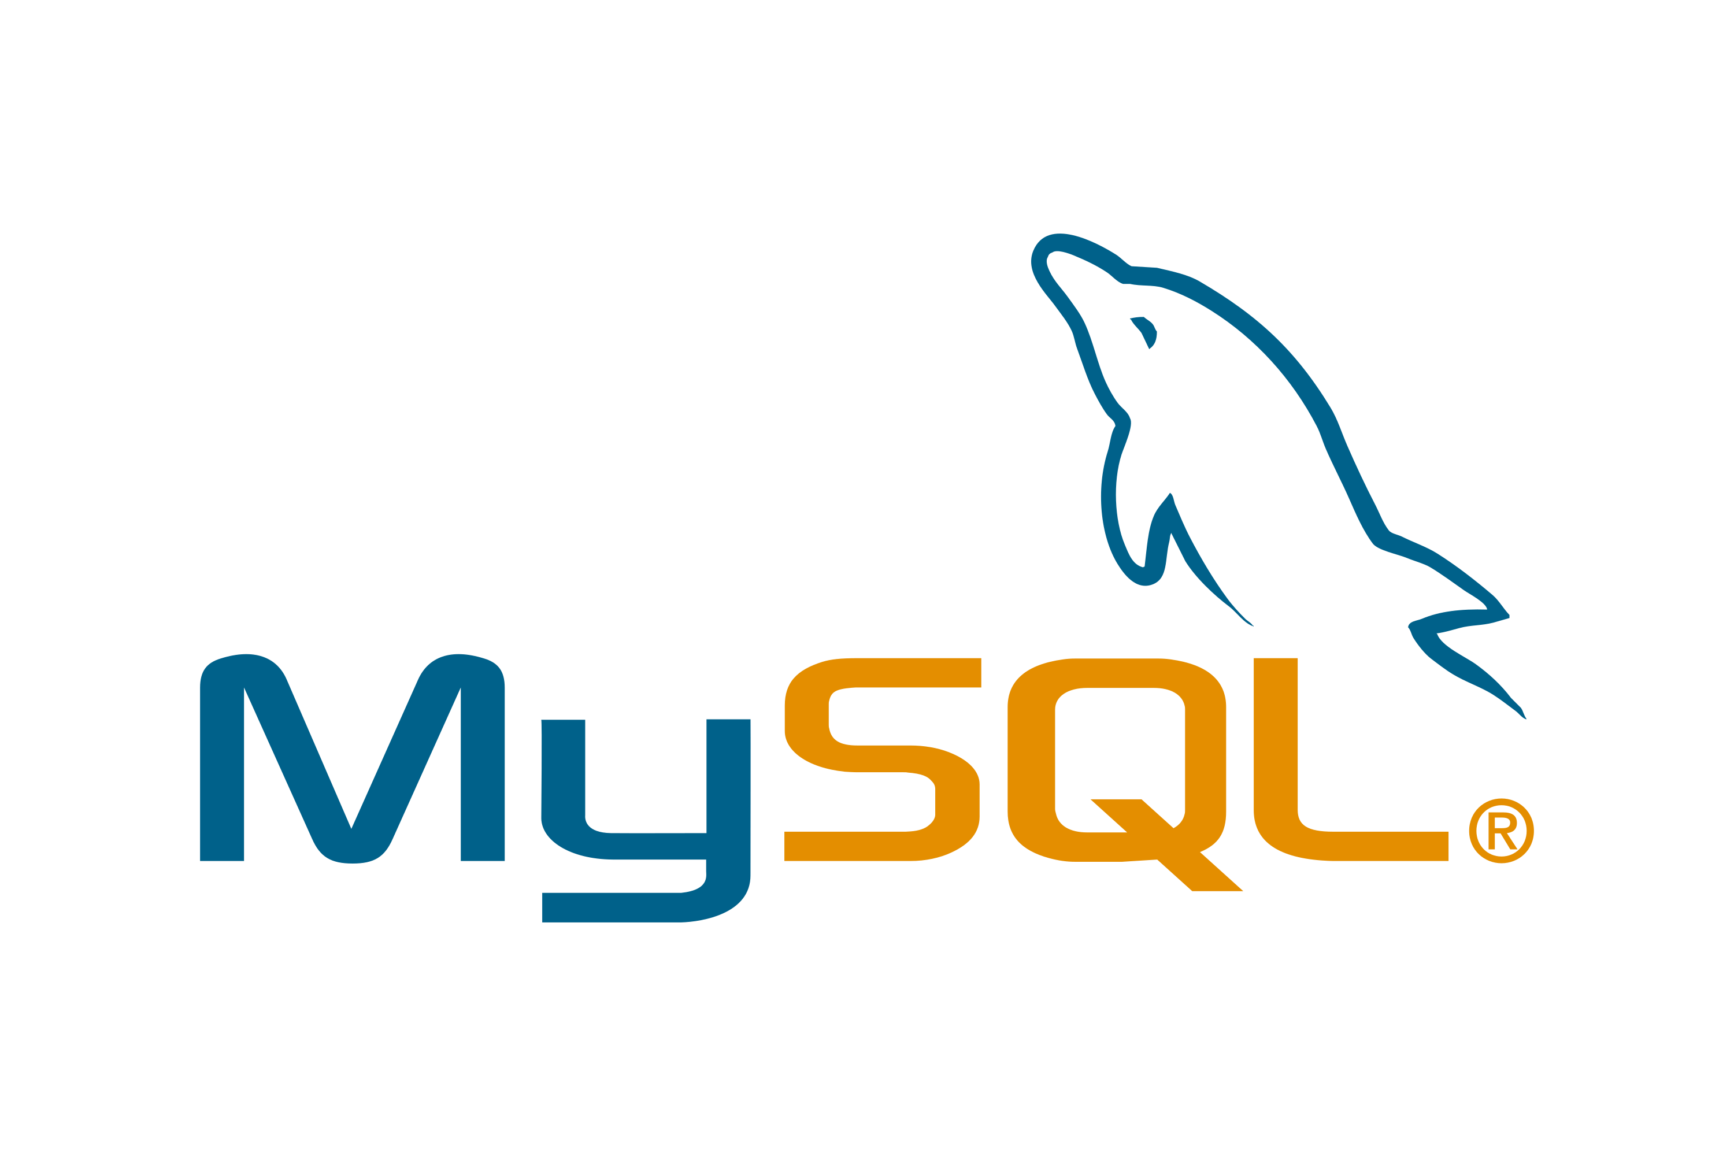

Technology used
Frontend
HTML
CSS
Javascript / jquery / view
Bootstrap
Thymeleaf
Backend
Java Spring Boot Framework
Spring Data JPA
Spring Security
MySql
Junit Test
Jasper Report

Slide 11
Let’s See Our LMS System.

Slide 12
Future plan of our LMS project:
File Import
Notification in Chat and Comment
Video Live Teaching
Add File Upload and Video call in Chat
Add multiple types in Exam Form
Private Chat
Export Certificate

Slide 13
Thank you!
Please ask questions what you want to know about our project.

