Slide 1

Lalala
Ryan Bravdica, Cristian Mendivil, Chad Kessler
Nick Sugarman, Thomas Vu

Slide 2





Tools/Ratings
GitHub 3.5/5
Repository used for project
DB Browser for SQLite 5/5
Application used to create database
Unity 2.5/5
Program used to create game
Trello 3/5
Project tracker
Slack 5/5
Team communication

Slide 3
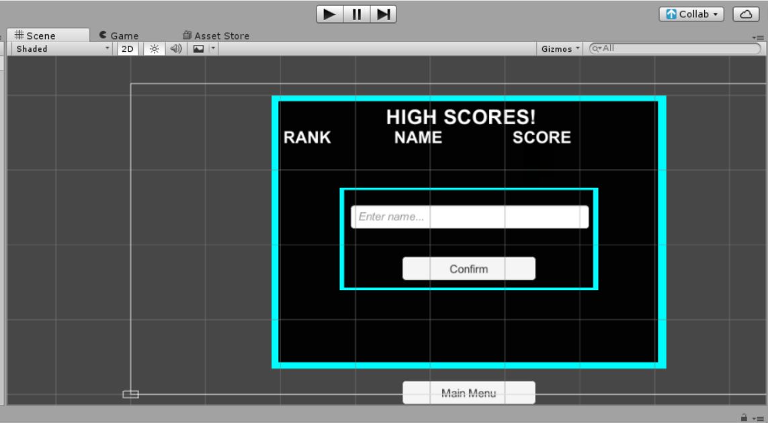
Methodology
Pair programming
Waterfall

Slide 4
Expected Tools
Trello
GitHub
SQLite
Doxygen
Unity

Slide 5
Challenges
Learning Unity
A lot of youtube tutorials
Trial and error
Teamwork
Unity Collab
Trial and error
Communication with team
We better at communicating as the semester progressed
Weekly meetings
Getting database to work with build
Trial and error
Learning more about Unity

Slide 6
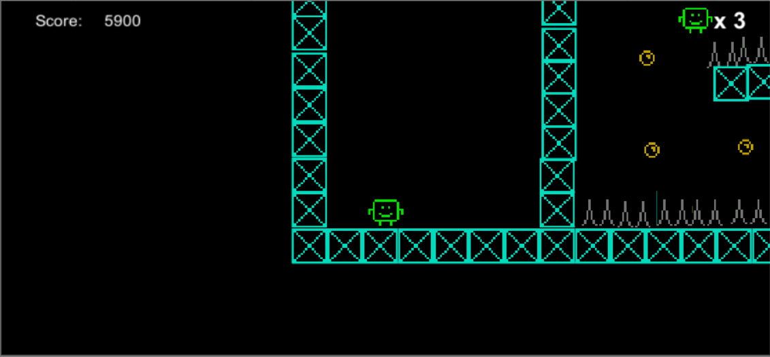
Demo

