Slide 1
DFIOS · SET490 · FA26
Demand forecasting and inventory service-level control with machine learning
A five-stage pipeline on M5 data: from raw data, through Ensemble and C³-OUT training, to benchmarking against baselines.
Team SE_18 · FPT University Da Nang
Supervisor: Dr. Nguyễn Gia Trí ·
October 2026
Notes:
Good morning. This report walks through the DFIOS pipeline in the order the work was done: data, preprocessing, training, evaluation. The main numbers come from the supervisor-reviewed C3-OUT detailed report; anything we ran ourselves is labelled.

Slide 2
REVIEW 1 · RESPONSES TO COMMENTS
Review 1: four comments, our position, and what we changed
Comment (LongNQ9)
Position
Response and fix
See
Data: which source? Any new data built or integrated?
Partly agree
Source: public M5 dataset (Walmart, via Kaggle): 30,490 item × store series, 1,941 days, 3 tables. No new raw data was collected; we built derived data on it: 53 features, ABC×XYZ groups, rolling forecasts, and a synthetic test set with known forecast defects.
Slides 9–17
Novelty: a real contribution, or only existing ML algorithms?
Partly agree
The forecasting models (LightGBM, XGBoost, TFT) are existing algorithms, compared under one protocol. Our own design is C³-OUT, a calibration layer for any model, with a long-run service guarantee (Theorem 1). Group service gap ≤ 0.0027 vs 0.006–0.069 for a fixed quantile.
Slides 20–24, 28
Users and scope: who uses the system, in which business?
Agree
Users: inventory and replenishment managers of SME retailers (mini-marts, grocery chains) that have POS sales data but still reorder by spreadsheet. Scope: daily item × store demand, weekly orders, several stores.
Slide 3
No business case study; build the software processing flow.
Agree
Case study on a real store, Walmart CA_1 (2,942 items, May 2013 – May 2016): only C³-OUT delivers the A/B/C targets 0.97 / 0.95 / 0.90 (achieved about 0.97 / 0.95 / 0.89). Processing flow: next slide.
Slides 3, 32
DFIOS · SE_18 · FPT University Da Nang · SET490
2
Notes:
Purpose: answer the four points raised by LongNQ9 in Review 1 before the main content.
1) Data. M5 Forecasting (Walmart, Kaggle; Makridakis et al., 2022). We did not collect new raw data. We built derived data: 53 features, ABC×XYZ groups, rolling-origin forecasts, and a synthetic set (10 seeds × 900 SKUs × 730 days) whose forecast defects are known by construction.
2) Novelty. Partly agree: the forecasting models are existing algorithms. The team's own design is C³-OUT, a calibration layer that wraps any model, with Theorem 1 extending adaptive conformal inference (Gibbs & Candès, 2021) to delayed feedback. Evidence: group gap ≤ 0.0027 in runs without boundary hits vs 0.006–0.069 for a fixed quantile (C3OUT_bao_cao_chi_tiet, sections 5.4, 6.2). On our own Ensemble vs the DFIOS formula at τ = 0.95: gap 0.0463 → 0.0010, cost −6.19% (team run, 30 Sep 2026).
3) Users and scope: SME retail inventory managers with POS data and spreadsheet reordering (Report 1, sections 1.3–1.4).
4) Case study: Walmart store CA_1, 2,942 items, 24 May 2013 – 22 May 2016 (PDF section 5.8, Tables 16–17). Flow: next slide.

Slide 3
REVIEW 1 · SOFTWARE PROCESSING FLOW
Processing flow: from store data to an approved order, with a feedback loop
1
2
3
4
5
6
Import data
Check data
Forecast nightly
Group items
Compute orders
Approve orders
MANAGER
SYSTEM
SYSTEM
SYSTEM
SYSTEM · C³-OUT
MANAGER
Sales, prices and calendar from POS or CSV, in one 3-table schema
Missing days and prices, leakage check, quality report
Ensemble forecasts the next 28 days for every item × store
ABC by revenue × XYZ by weekly CV: 9 groups, each with a service target
Every R = 7 days: S = ⌈Q̂(τ_{g}) · e^{θ}⌉, one θ per group; order = S − inventory position
Review the recommended quantities, adjust if needed, confirm
After d reviews: observed stockouts per group update θ_{g}; the forecast model is not retrained
Case study run on a real store (Walmart CA_1, 2,942 items)
Same flow in the single-store prototype: ABC×XYZ classes → forecasts from 4 statistical models, best chosen on validation → 26-week backtest of 6 ordering options → recommendation by the manager’s A/B/C targets → order plan for the next week.
DFIOS · SE_18 · FPT University Da Nang · SET490
3
Notes:
Walk the flow left to right, then the feedback loop.
Steps 1 and 6 are done by the store manager; steps 2 to 5 run automatically as scheduled jobs. The forecast model is trained once and frozen; the only quantity updated in operation is θ per group.
Delay d = ⌈(L + R)/R⌉; with L = 3, R = 7, d = 2 reviews (Chapter 4, Eq. 2).
Case study box: the same workflow implemented in the prototype c3out_webapp and run on CA_1 (PDF section 5.8): ABC×XYZ, route (c) forecasts from four statistical models with selection on validation, 26-week backtest of 6 options, recommendation by the manager's targets, order plan for the next period, closed loop at every review. Selected model on CA_1: ETS(A,N,N); critical ratio 0.986.

Slide 4
AGENDA
The report follows the five stages of the pipeline
0
Overview
The problem, the goals, the five-stage pipeline
1
Collect Data
The M5 dataset: 3 tables, 30,490 series, why it fits
2
Preprocessing
From raw tables to 53 features; preparing for C³-OUT
3
Training
3A: forecasting Ensemble · 3B: C³-OUT service controller
4
Evaluation
Benchmark against baselines: accuracy, service, cost
5
Deploy + Test
Planned, not done: mentioned only in the Pipeline slide
DFIOS · SE_18 · FPT University Da Nang · SET490
4
Notes:
Four deep-dive stages, plus an overview first. Stage 5 (deploy and test) is only mentioned in the pipeline slide because it is planned, not done.

Slide 5
OVERVIEW · THE PROBLEM
A good forecast is not enough: someone has to decide how much to order
1 · Forecast
2 · Order decision
3 · The gap
The model outputs a demand distribution over the L + R day window (L: lead time, R: review period).
Order-up-to policy: S = the τ-quantile of window demand; order q = max(0, S − IP). τ is the service promise (CSL: probability of no stockout in a cycle).
Real CSL equals τ only if the forecast distribution is perfectly calibrated. In practice forecasts are too narrow or biased, so delivered service drifts from the target.
0.0275
→
0.0012
The fix does not replace the forecaster: it only adds a closed-loop calibration block after it.
group gap |CSL − τ| of a fixed quantile (τ = 0.95; L = 3, R = 7; mean of 8 models)
same setting, after adding the C³-OUT calibration loop
DFIOS · SE_18 · FPT University Da Nang · SET490
5
Notes:
The forecast says what demand may be. The order decision adds a service promise: with what probability do we not run out? A fixed quantile of the forecast only delivers that promise if the forecast is perfectly calibrated. In our experiments it was off by 0.0275 on average at a 0.95 target; C3-OUT brings it to 0.0012.
Source: C³-OUT detailed report (SE_18), Section 1 and Table 8.

Slide 6
OVERVIEW · GOALS
Three goals, each with its own yardstick
1
2
3
Forecast accurately
Hit the service target
Evaluate honestly
Multi-horizon (1 to 28 days) demand forecasts for 30,490 M5 series with an ML ensemble.
Bring each product group’s real CSL to its target τ, for any forecasting model.
Compare with strong baselines, including tuned ones; report where we do not win.
Yardstick: WRMSSE, MASE
Yardstick: group gap |CSL − τ|
Yardstick: cost, confidence intervals
Scope and what we do not claim
M5 holds sales, not true demand (censored when stocked out); inventory and lost sales are simulated.
Stage 5 (deploy and test) is a plan; there are no live operating results yet.
DFIOS · SE_18 · FPT University Da Nang · SET490
6
Notes:
Each goal maps to a stage. Goal 1 is the Ensemble, goal 2 is C3-OUT, goal 3 is the benchmark. We also say up front what we do not claim: no live deployment yet, and M5 sales are only a proxy for demand.
Source: Capstone Project Register FA26 and Report 2 (SE_18); metrics per the C³-OUT detailed report, Section 4.5.

Slide 7
OVERVIEW · PIPELINE
The AI pipeline has five stages
1
2
3
4
5
Collect Data
Preprocessing
Training
Evaluation
Deploy + Test
3 M5 CSV files
Raw tables to features
3A Ensemble · 3B C³-OUT
Benchmark vs baselines
Planned
30,490 series, 1,941 days
53 features; ABC×XYZ groups
Forecast, then calibrate service
WRMSSE, CSL, cost
Not done yet
Two tiers inside stages 3 and 4
Tier 1 · Forecast (3A)
Tier 2 · Service control (3B)
Ensemble of LightGBM + XGBoost + LSTM + TFT forecasting sales 1 to 28 days ahead. Measured by WRMSSE.
C³-OUT takes quantiles from any model and calibrates a per-group multiplier. Measured by CSL gap and cost.
DFIOS · SE_18 · FPT University Da Nang · SET490
7
Notes:
Five stages. Stages 1 to 4 are done and are the content of this report. Stage 5 is drawn dashed on purpose: it is a plan. A prototype web app exists for the single-store case, but it is not a production deployment.
Source: Tier1_Backend_Handover, C³-OUT detailed report (Section 5.8: the c3out_webapp prototype).

Slide 8
1
STAGE 1 · COLLECT DATA
The M5 dataset
Which data is real and rich enough to test an inventory policy?
3 tables · hierarchy · data characteristics · why M5
DFIOS · SE_18 · FPT University Da Nang · SET490
8
Notes:
Stage one is about the data. We describe what is in the three files, how they join, what the data looks like, and why it suits an inventory problem.

Slide 9
STAGE 1 · M5
M5 has three tables, almost 6.9 million rows in total
30,490
1,941
3,049
series (item × store)
days: 2011-01-29 to 2016-05-22
items, 10 stores, 3 states
Table
Shape
Describes
Holds
sales_train_evaluation
30,490 × 1,947
Daily sales of each series
6 ID columns (id, item, dept, cat, store, state) + 1,941 columns d_1…d_1941 of units sold
calendar
1,969 × 14
Calendar of each day
date, wm_yr_wk, weekday, month, year, d; events (event_name/type_1, _2); SNAP flags for CA, TX, WI
sell_prices
6,841,121 × 4
Weekly selling price
store_id, item_id, wm_yr_wk, sell_price (min 0.01; median 3.47; max 107.32)
DFIOS · SE_18 · FPT University Da Nang · SET490
9
Notes:
M5 is public Walmart retail data. Three tables: daily sales per product-store, a calendar with events, and weekly prices. The counts here were computed by us from the raw files, not copied from a paper.
Source: computed by the team directly from M5 sales_train_evaluation.csv, calendar.csv, sell_prices.csv.

Slide 10
STAGE 1 · M5
Each series is an item × store pair; the three tables join on three keys
Hierarchy
How the three tables join
Level
Values (series)
sales
d
calendar
Category (3)
FOODS 14,370 · HOUSEHOLD 10,470 · HOBBIES 5,650
id, item_id, store_id, d_1…d_1941
d, date, wm_yr_wk, events, snap_*
Department (7)
FOODS_3 8,230 · HOUSEHOLD_1 5,320 · HOUSEHOLD_2 5,150 · HOBBIES_1 4,160 · FOODS_2 3,980 · FOODS_1 2,160 · HOBBIES_2 1,490
item_id + store_id
wm_yr_wk
State (3)
CA 12,196 · TX 9,147 · WI 9,147
Store (10)
CA_1–4 · TX_1–3 · WI_1–3
sell_prices
store_id, item_id, wm_yr_wk, sell_price
Item (3,049)
3,049 × 10 stores = 30,490 series
Price can be NaN: the item was not on sale that week. 77.1% of series start selling after day d_1.
DFIOS · SE_18 · FPT University Da Nang · SET490
10
Notes:
Left: the hierarchy. 3,049 items sold in 10 stores gives 30,490 series. Right: how the tables join. Sales to calendar through the day id d, calendar to prices through the Walmart week id, and prices to sales through item and store.
Source: computed by the team from the raw M5 files; join keys follow the column layout of the 3 files.

Slide 11
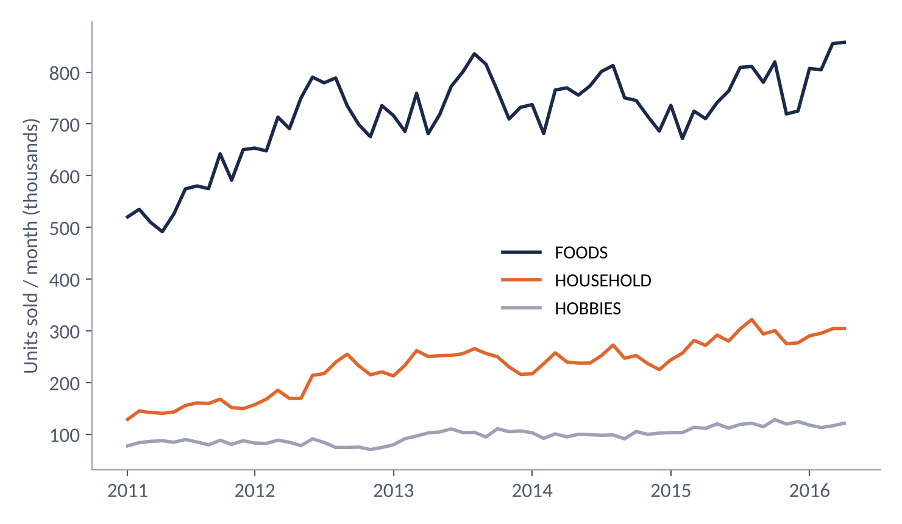
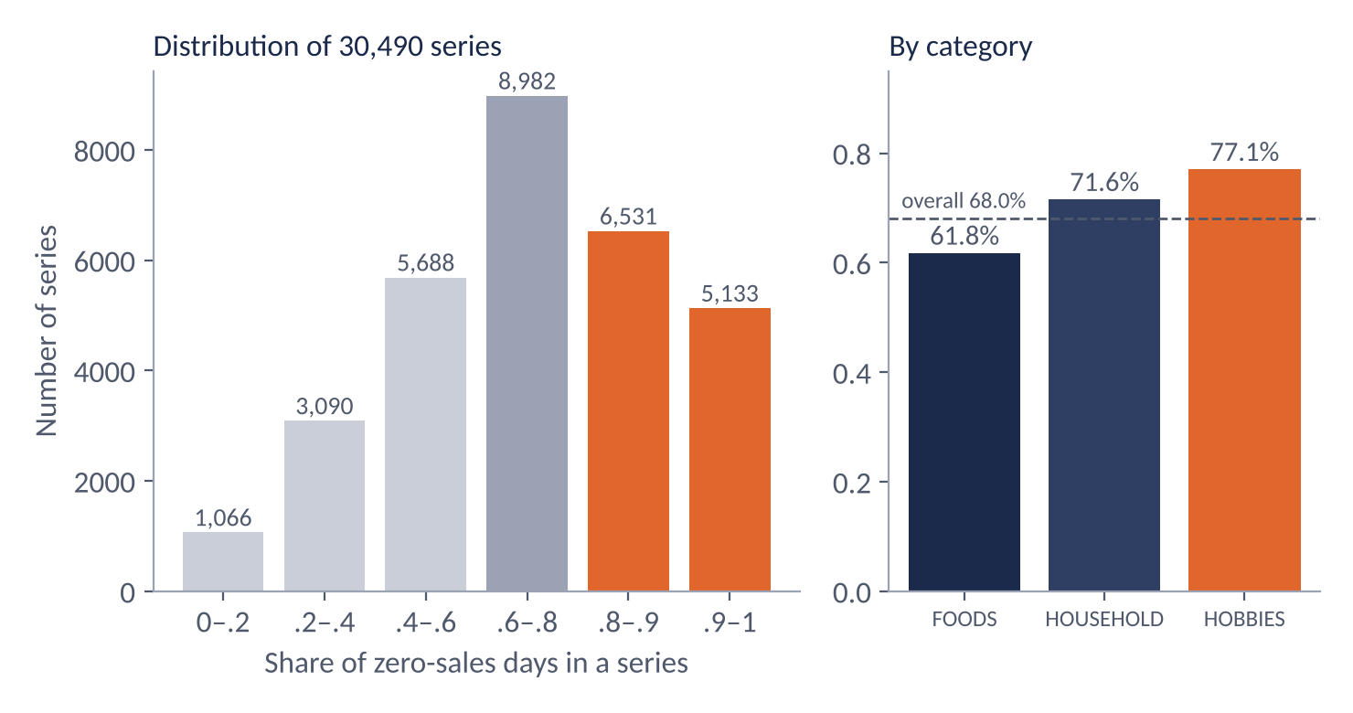
STAGE 1 · M5
The data trends upward, has a weekly rhythm, and is full of zero days
Units per year (millions)
Weekly rhythm
Zero days
2011: 8.86 · 2012: 12.06 · 2013: 13.14 · 2014: 13.09 · 2015: 13.80
Sat and Sun sell about 31% more than Mon–Fri (41.7k and 41.3k vs. a mean of 31.7k units/day)
68.0% overall; FOODS 61.8%, HOUSEHOLD 71.6%, HOBBIES 77.1%
DFIOS · SE_18 · FPT University Da Nang · SET490
11
Notes:
Left: monthly units by category, partial months removed. FOODS dominates and everything grows until 2015. Right: zero sales. Across all 30,490 series, 68 percent of series-days are zero; HOBBIES is the sparsest. That intermittency is exactly what stresses a quantile policy.
Source: computed by the team from sales_train_evaluation.csv and calendar.csv (Jan 2011 and May 2016 are partial months, excluded from the chart).

Slide 12
STAGE 1 · M5
Why M5 fits an inventory problem
DFIOS needs
M5 provides
Caveat
Many items, many demand patterns
30,490 series; split into 9 ABC×XYZ groups
C³-OUT tests use 8,831 series from 3 stores
Long daily history
1,941 days (over 5 years)
One retailer (Walmart), 3 states
Sparse, intermittent demand
68% of series-days are zero
Sales = demand censored by stockouts
Explanatory drivers
Price, calendar, 162 event days, SNAP
Target-day price is treated as known in advance
Public, standard yardstick
The M5 competition, WRMSSE metric
Foundation models may have seen M5 in pretraining
DFIOS · SE_18 · FPT University Da Nang · SET490
12
Notes:
We picked M5 for five concrete reasons, and each comes with a caveat. The most important caveat: M5 records sales, not demand, so real lost sales are invisible; we simulate inventory on top of it.
Source: C³-OUT detailed report (SE_18), Sections 4.4 and 6.5; M5 counts computed by the team.

Slide 13
2
STAGE 2 · PREPROCESSING
Data preprocessing
How do we turn three raw tables into model-ready inputs without leaking the future?
7 steps · framing and split · 53 features · preparing for C³-OUT
DFIOS · SE_18 · FPT University Da Nang · SET490
13
Notes:
Stage two. The rule that governs everything here: no information from the future may reach a feature.

Slide 14
STAGE 2 · PREPROCESSING
Seven steps from raw data to a training table
1
2
3
4
Wide to long
Encode the calendar
SNAP matrix
Price matrix
Each d_x column becomes a row: series × day
Events become codes; “none” must be code 0; 162 event days
One SNAP flag per state (CA, TX, WI), joined by the store’s state
Price per week; NaN means not sold that week
5
6
7
The governing rule
No time leakage: every feature at origin T uses data up to day T only.
First-sale date
Build features
Time-based split
Mask rows before launch; drop SKU-days not yet on sale when training
Lags, rolling stats, price, calendar, horizon; only data up to origin T
Train, validation, test by origin; never shuffled
DFIOS · SE_18 · FPT University Da Nang · SET490
14
Notes:
Seven steps. Three details people often get wrong: the calendar code for no event must be zero, SNAP is a matrix per state, and rows before a product’s first sale are masked, because a zero before launch is not a real zero demand.
Source: DFIOS_Tier1_Forecasting_M5_Kaggle.ipynb, C3OUT_bi_kip_1 and Tier1_Backend_Handover (SE_18).

Slide 15
STAGE 2 · PREPROCESSING
Each training sample is (series, origin, horizon); the split follows time
40 training origins, stride 21 days
d_1
d_1941
validation: origin d_1885, forecasts d_1886 to d_1913
test: origin d_1913, forecasts d_1914 to d_1941
Item
Value
Formulation
Direct multi-horizon: sample = (series s, origin T, horizon h ∈ [1, 28])
Training rows
32,614,120 rows × 53 features
Check
40 origins × 30,490 series × 28 horizons = 34.1M; 32.6M remain after dropping not-yet-on-sale days
Training run
2 × T4 GPU, 3 h 48 min 59 s in total
DFIOS · SE_18 · FPT University Da Nang · SET490
15
Notes:
Direct multi-horizon: one sample is a series, a forecast origin T, and a horizon h from 1 to 28; the target is the sales at day T plus h. Forty training origins spaced 21 days apart. Validation origin is day 1885 and test origin day 1913, so the test covers the final 28 days, d_1914 to d_1941. Note: an earlier design document said 24 origins and stride 14; the run that produced the results used 40 and 21.
Source: Result OK run of 13 Sep 2026 (Tier 1) and Tier1_Forecasting_Design_Decisions (SE_18). Row count re-checked by the team by multiplication.

Slide 16
STAGE 2 · PREPROCESSING
53 features in three groups
31
17
5
Static features at the origin
Horizon features
Identifiers
Lags 1–7, 14, 21, 28
Rolling mean 7/14/28/56/180; std 7/28/56; max 28
Zero ratio (28, 90); days since last sale; non-zero mean (28)
Same-period last-year mean; trend 28/180
5 price features; days since release
h; same-weekday mean over 8 weeks
Target-day price (absolute, relative)
Weekday, month, day, week of year
SNAP flag and consecutive SNAP days
Events (names, types, 2 events), days to/from event
item_id
dept_id
cat_id
store_id
state_id
DFIOS · SE_18 · FPT University Da Nang · SET490
16
Notes:
Thirty-one features describe the history of the series at the origin, seventeen depend on the horizon and the target day, five are identifiers. Later, SHAP shows that history features carry 70 percent of the attribution.
Source: DFIOS_Tier1_Forecasting_M5_Kaggle.ipynb (feature lists), Result OK.

Slide 17
STAGE 2 · PREPROCESSING
C³-OUT’s own preparation: ABC×XYZ groups and window forecasts
Series in the 9 groups (M5, 3 stores)
How groups are defined
X
Y
Z
ABC by revenue, XYZ by the coefficient of variation (CV) of weekly demand over the last 364 history days. Thresholds stated for the synthetic data: 80%/95% and 0.5/1.0.
A
AX
AY
AZ
1,337
1,739
360
Window forecasts
Forecasts at 546 daily origins for windows L + R ∈ {2, 4, 8, 10, 14}; 19 quantile levels up to 0.999 are stored.
B
BX
BY
BZ
214
1,576
837
Time split
History d 0–1394; validation d 1395–1576 (26 weeks); test d 1577–1940 (52 weeks).
C
CX
CY
CZ
15
561
2,192
Inventory simulation
Holding 0.2% of price/day, lost sale 35% of price, order fee 2 per order line; opening stock = 28-day mean demand × (L + R).
DFIOS · SE_18 · FPT University Da Nang · SET490
17
Notes:
C3-OUT uses its own subset: 8,831 series from three stores, one per state. Each series is classified by revenue (ABC) and by variability of weekly demand (XYZ), giving nine groups. Group size is what makes the feedback signal smooth. Groups under 15 SKUs are merged; CX has exactly 15 on M5.
Source: C³-OUT detailed report (SE_18), Sections 3.1, 4.1, 4.3, 4.4.

Slide 18
3
STAGE 3 · TRAINING
Training: forecast, then control
How do we forecast demand, then turn the forecast into orders that keep the service promise?
3A forecasting Ensemble · 3B C³-OUT: idea, loop, equations, theorem, learned θ
DFIOS · SE_18 · FPT University Da Nang · SET490
18
Notes:
Stage three has two parts. 3A trains the forecasters. 3B is C3-OUT, which is not trained like a neural network: it is a feedback rule that learns one number per group while it runs.

Slide 19
STAGE 3A · ENSEMBLE
3A: four trained models, blended with weights fitted on validation
Model
Type and loss
Training notes
Ensemble weights
LightGBM
Gradient boosting, Tweedie p = 1.1
Random search, 6 trials
NNLS on the validation set
XGBoost
Gradient boosting, Tweedie
GPU, QuantileDMatrix
LightGBM
0.441
LSTM
Seq2seq, Tweedie
Encoder 112 days, decoder 28 days
TFT
Temporal Fusion Transformer, pinball loss
Pure PyTorch: GRN, VSN, interpretable attention; quantiles via cumsum(softplus)
XGBoost
0.078
LSTM
0.000
Seasonal Naive
Baseline, period m = 7
No training
ARIMA
Baseline, 200-SKU stratified sample
Pick between 2 orders by AIC
TFT
0.481
The two largest (TFT, LightGBM) hold 92% of the weight; LSTM gets zero.
DFIOS · SE_18 · FPT University Da Nang · SET490
19
Notes:
Four learned models plus two reference baselines. LightGBM and XGBoost use a Tweedie loss, which suits sales that are non-negative and full of zeros. The LSTM is a seq2seq model, and the TFT is written in pure PyTorch with pinball loss. Ensemble weights come from non-negative least squares on validation: LightGBM 0.441, XGBoost 0.078, LSTM zero, TFT 0.481. The LSTM gets no weight, which tells us it adds nothing the others do not already have.
Source: Result OK run of 13 Sep 2026 (ensemble_weights.json, Tier 1 notebook). Seasonal Naive and ARIMA are baselines, not part of the Ensemble.

Slide 20
STAGE 3B · C³-OUT
3B: C³-OUT closes the gap between the quantile and delivered service
C
C
C
Calibrated
Class-pooled
Closed-loop
Multiply the model’s quantile by a factor e^{θ}. The factor is 1 when θ = 0; above 1 means more stock.
One θ per ABC×XYZ group (hundreds of SKUs). The group’s stockout signal is far less noisy than a single SKU’s.
Update θ from the group’s observed stockout rate, known d reviews later. Independent of the forecasting model.
Why pool by ABC×XYZ
Group gap
Cost
Boundary hits
C³-OUT, ABC×XYZ (default)
0.0012
baseline
0
Pool all SKUs
0.0161
+0.47%
0
Per-SKU calibration
0.0015
+21.59%
3,751.6
DFIOS · SE_18 · FPT University Da Nang · SET490
20
Notes:
The name says the three ideas. Calibrated: one multiplier on the model’s own quantile. Class-pooled: one multiplier per ABC by XYZ group, so each feedback signal averages hundreds of SKUs instead of a noisy yes-or-no for one. Closed-loop: the multiplier is updated from what actually happened. It never touches the forecaster, which is why the same layer worked with eight different models.
Source: C³-OUT detailed report (SE_18), Sections 1, 3 and Table 5 (ablation).

Slide 21
STAGE 3B · C³-OUT
The C³-OUT loop: forecast, order, observe, calibrate
Forecast model
Window distribution
Group multiplier
Order-up-to level
unchanged, any type
quantile Q̂(τ_{g}) of L + R days
times e^{θ} (one θ per group g)
S = ⌈Q̂ · e^{θ}⌉; order q = max(0, S − IP)
changes e^{θ}
orders arrive, sell
Top row is the ordering path (forecaster unchanged). The bottom is the new part: the feedback loop, delayed by d reviews.
Update θ
Sales and lost sales
θ_{k} = θ_{k−1} + η(ẽ_{k−d} − α*)
what really happened in the cycle
group stockout rate e_{g}, known after d reviews
Only the navy blocks are new. Extra compute is O(G) per review for G groups, negligible next to forecasting. d = ⌈(L + R)/R⌉; α* = 1 − τ.
DFIOS · SE_18 · FPT University Da Nang · SET490
21
Notes:
Read the top row left to right: the unchanged forecaster gives a window distribution, we take the group quantile, multiply by e to the theta, round up, and order up to that level. The bottom row is the new part: after a cycle ends we measure what fraction of the group ran out, compare it with the allowed rate one minus tau, and nudge theta. Because a cycle takes L plus R days to finish, the outcome arrives d reviews late, which is why the update uses e from d periods ago.
Source: C³-OUT detailed report (SE_18), Figure 1 and Algorithm 1.

Slide 22
STAGE 3B · C³-OUT
Two equations make C³-OUT: Eq. 1 orders, Eq. 3 updates
Eq. 1
S_{i,k} = ⌈ Q̂_{i,k}(τ_{g}) · exp( clip(θ_{g,k}, θ_{min}, θ_{max}) ) ⌉
Take the τ-quantile of window demand, multiply by e^{θ} (θ = 0 leaves it unchanged), clip θ to a safe range, round up. Order q = max(0, S − IP).
Order-up-to level
Eq. 3
θ_{g,k} = θ_{g,k−1} + η ( ẽ_{g,k−d} − α*_{g} )
If the group ran out more often than allowed, α* = 1 − τ, θ rises (more stock); less often, θ falls. η is the step; the result from d reviews ago is used because a cycle takes time to finish.
Update of θ
Eq. 2
ẽ = 0 if θ ≥ θ_{max}; ẽ = 1 if θ ≤ θ_{min}; else ẽ = e
When θ sits at its limit, the recorded error is forced to the extreme so θ cannot drift out forever. It affects only the update variable, never the actual stock level.
Boundary convention
DFIOS · SE_18 · FPT University Da Nang · SET490
22
Notes:
Equation one: take the quantile, multiply by e to the theta, clip theta to a safe range, round up. Equation three: theta moves up if the group ran out more often than allowed, and down if less often. Equation two is a safety rule: when theta is pinned at its limit, the recorded error is forced to the extreme, so the update cannot wind up forever.
Source: C³-OUT detailed report (SE_18), Sections 3.3 and 3.4, Eq. (1), (2), (3).

Slide 23
STAGE 3B · C³-OUT
Theorem 1: the recorded error converges to the target at rate 1/K
Lemma 1 (range of θ)
Setting
d
K
Bound
θ_{min} − ηd < θ_{g,k} < θ_{max} + ηd
Weekly, 1 year
2
52
0.160
θ cannot run away: it always stays within ηd of its two limits.
Weekly, 3 years
2
156
0.052
Daily, 1 year
4
365
0.033
Theorem 1
Daily, 2 years
4
730
0.017
| (1/(K−d)) · Σ_{j=1}^{K−d} ẽ_{g,j} − α*_{g} | ≤ (θ_{max} − θ_{min} + 2ηd) / (η(K−d))
Scope of the guarantee
For any demand series, any forecasting model, any inventory dynamics and any K > d. The recorded average stockout rate approaches α* = 1 − τ.
It bounds the recorded error ẽ, not real CSL directly; boundary hits void Corollary 1.
The bound is loose; the observed accuracy (about 0.001) is empirical.
The proof has not been independently reviewed.
Bound of Theorem 1 (θ ∈ [−2, 2], η = 1, L = 3)
DFIOS · SE_18 · FPT University Da Nang · SET490
23
Notes:
Lemma one says theta can never run away: it stays within eta times d of its limits. Adding up equation three over K minus d reviews, the left side is bounded by that range, and dividing by eta times K minus d gives the theorem. It holds for any demand series and any forecaster. The crucial caveat is on the right: it bounds the recorded error, not directly the real service level, and the proof is ours, checked numerically but not independently reviewed.
Source: C³-OUT detailed report (SE_18), Section 3.7, Lemma 1, Theorem 1, Corollary 1, Table 1 (proof built by the team, not independently reviewed).

Slide 24
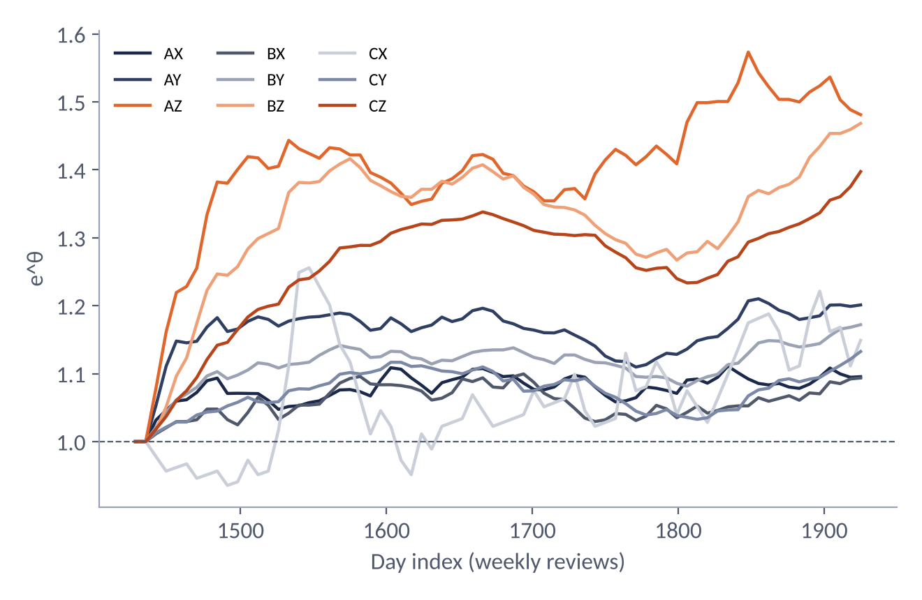
STAGE 3B · C³-OUT
The learned θ is a diagnostic: above 1 the forecast is too narrow, below 1 too wide
Context
Final e^{θ}
Reading
CA_1 case (ETS, PDF)
0.81 – 0.97
Forecast has surplus; C³-OUT trims the order-up-to level 3–19%
M5, 8 models (PDF)
0.71 – 2.36
Depends on model and group
Retrained Ensemble (team)
1.09 – 1.48
Forecast too narrow; sparse (Z) groups need the largest factor: AZ 1.48, BZ 1.47
One formula, three settings, three directions of error: the learned factor tells you whether the forecaster is too narrow or too wide, per group.
DFIOS · SE_18 · FPT University Da Nang · SET490
24
Notes:
The chart is our own run on the retrained Ensemble: all nine groups drift above one, most for the sparse Z groups, because the Ensemble under-covers. In the single-store CA_1 case of the report the opposite happens: all factors are below one, between 0.81 and 0.97, because the exponential-smoothing forecast carries a safety surplus. Across the M5 experiments the final factor ranges from 0.71 to 2.36 depending on model and group. In other words theta is a direct readout of how miscalibrated the forecaster is, per group.
Source: chart from a team run (c3ok_theta.csv, 30 Sep 2026); CA_1 figures and the 0.71–2.36 range from the C³-OUT detailed report, Tables 17 and 18.

Slide 25
4
STAGE 4 · EVALUATION
Evaluation and benchmark
Does the new method beat the baselines, and on which yardstick?
design · Tier 1 accuracy · service · cost · ablation · CA_1 · extra check
DFIOS · SE_18 · FPT University Da Nang · SET490
25
Notes:
Stage four uses three sources and is careful to say which is which: the Tier 1 forecasting run, the supervisor-reviewed C3-OUT report as the main source for service and cost, and our own extra run on the retrained Ensemble.

Slide 26
STAGE 4 · EVALUATION
Evaluation design: against which baselines, measured how
Policy
Description
Data and models
B1: RAW 0.95
S = the 0.95 quantile, no calibration
Synthetic: 10 seeds × 900 SKUs × 730 days, 4 forecast types
M5: 8,831 series, 3 stores, 52 test weeks
8 models: Seasonal Naive, Croston-SBA, TSB, ETS, LightGBM-Q, Chronos-Bolt, Chronos-2, TimesFM-2.5
B2: RAW, global τ
τ cost-optimal on validation, grid up to 0.999. The strongest baseline.
Static calibration
Run C³-OUT on validation, then freeze the factors
P1: C³-OUT
Proposed method, τ = 0.95
C³-OUT-CR
τ = critical ratio b/(b + hR), rounded to the grid
Metrics
Cost: holding + lost sales + ordering (h = 0.2%/day, b = 35%, c = 2)
Service: CSL, group gap |CSL − τ|, boundary hits
95% CI by moving block bootstrap (block 4, 2,000 reps)
DFIOS · SE_18 · FPT University Da Nang · SET490
26
Notes:
The key baseline is B2: one global tau tuned on validation over a wide grid up to 0.999. It is deliberately strong. If C3-OUT cannot beat B2 on cost, we want to say so.
Source: C³-OUT detailed report (SE_18), Sections 4.1–4.5, Table 2.

Slide 27
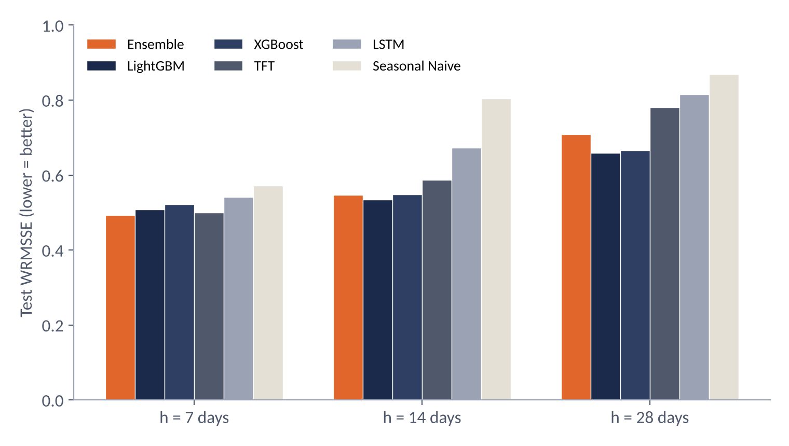
STAGE 4 · TIER 1 ACCURACY
Forecast: the Ensemble is best at 7 days, but LightGBM alone edges it at 14 and 28
0.4935
Ensemble WRMSSE at h = 7 (LightGBM 0.5083; Seasonal Naive 0.5711)
MASE is better than Seasonal Naive by 13.5% / 13.0% / 12.6% (h = 7 / 14 / 28).
At h = 14 and 28, LightGBM alone beats the Ensemble (0.5347 and 0.6587).
Negative bias: forecasts run below actuals by 4.1% (7 days) to 7.6% (28 days).
DFIOS · SE_18 · FPT University Da Nang · SET490
27
Notes:
WRMSSE on the final 28 days, lower is better. The Ensemble wins at seven days, 0.4935 against 0.5083 for LightGBM. At 14 and 28 days a single LightGBM is better, 0.5347 and 0.6587 against 0.5475 and 0.7094 for the Ensemble. So the ensemble is not a free win at long horizons, which we say plainly. Against Seasonal Naive, the MASE gain is 13.5, 13.0 and 12.6 percent. All models under-forecast, by 4.1 percent at 7 days growing to 7.6 percent at 28.
Source: Result OK run of 13 Sep 2026 (metrics_comparison.csv, mase_improvement_vs_naive.csv), test set d_1914–d_1941.

Slide 28
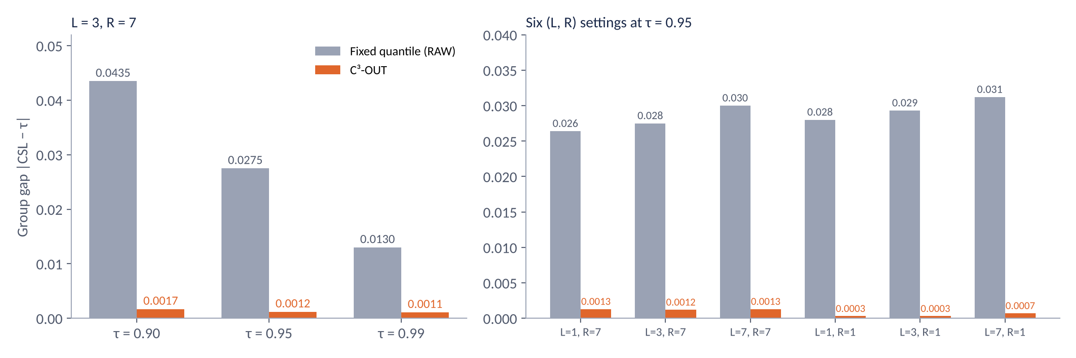
STAGE 4 · SERVICE
Service: C³-OUT keeps the group gap 10 to 100 times smaller than a fixed quantile
Every run without a boundary hit has a group gap ≤ 0.0027; boundary hits in 9/288 runs (8 on M5 original route, 1 on the alternate route).
Static calibration: about 8× larger gap (0.0074 vs. 0.0009 on M5).
DFIOS · SE_18 · FPT University Da Nang · SET490
28
Notes:
This is the headline result for service. Left: at L=3, R=7 the fixed quantile misses the target by 0.044, 0.028 and 0.013 at the three targets; C3-OUT by about 0.001. Right: the same holds across six lead-time and review settings. In every run without a boundary hit, the group gap is at most 0.0027. There were 9 runs out of 288 where theta hit its limit, mostly slow movers under daily review at a low target, and one foundation model whose forecast tail is too short.
Source: C³-OUT detailed report (SE_18), Section 5.4, Tables 8, 9 (mean of 8 models, original route).

Slide 29
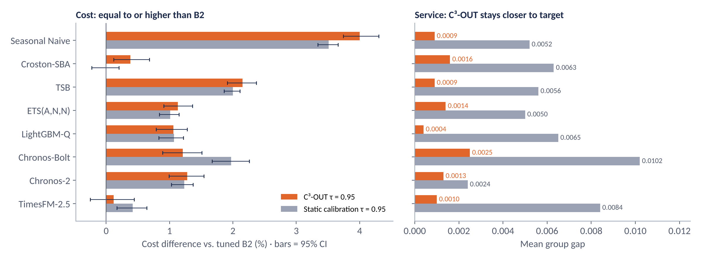
STAGE 4 · COST
Cost: C³-OUT is not cheaper than the tuned B2 baseline, for any of the 8 models
C³-OUT 0.95 costs more than B2 for 8/8 models (+0.12% to +4.00%), CI excludes 0 for 7/8. B2 picks a low τ* (0.90) for statistical models that already have surplus service; C³-OUT forces CSL to exactly 0.95.
DFIOS · SE_18 · FPT University Da Nang · SET490
29
Notes:
This is the honest cost result. Against the tuned B2, C3-OUT at 0.95 costs 0.12 to 4.00 percent more, for all eight models; the interval excludes zero for seven. The reason is in the cost split: B2 chooses a low tau of 0.90 for the statistical models, which have surplus service, and saves holding cost; C3-OUT forces service to exactly 0.95 and pays for lost sales. Static calibration costs about the same as C3-OUT, but its group gap is five to ten times larger.
Source: C³-OUT detailed report (SE_18), Section 5.5, Table 10 (L = 3, R = 7, original route; 95% block-bootstrap CI).

Slide 30
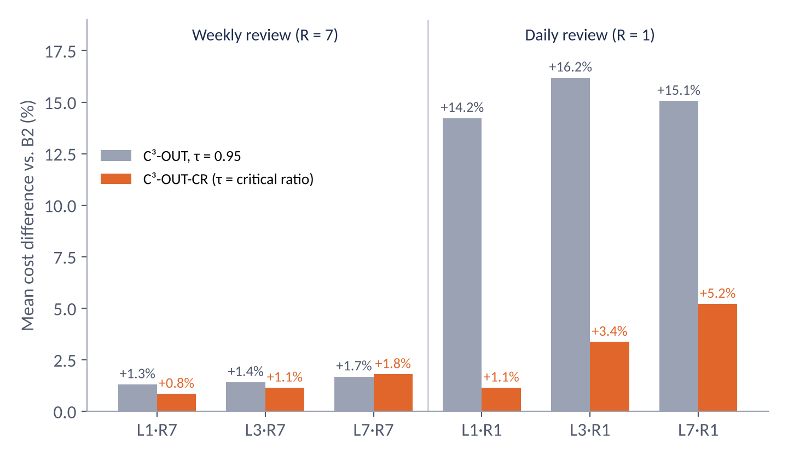
STAGE 4 · COST
Daily review and the τ target: a wrong target adds 14–16% to cost
Weekly review (R = 7)
C³-OUT is only +1.31% to +1.69% dearer than B2; critical ratio 0.962.
Daily review (R = 1)
Critical ratio 0.994: a 0.95 target is far too low, 14–16% dearer. Using the critical ratio as target: +1.15% to +5.21%.
Across all comparisons
Significantly cheaper than B2 in 1/96 (τ = 0.95) and 4/96 (critical ratio) cases, all foundation models on route (b).
216 cost-parameter sets: cheaper than B2 in 17.6%; from −13.7% to +41.7%, mean +2.4%.
DFIOS · SE_18 · FPT University Da Nang · SET490
30
Notes:
Weekly review: C3-OUT is 1.3 to 1.7 percent dearer than B2. Daily review is different: the economic critical ratio is 0.994, so a 0.95 target is far too low and costs 14 to 16 percent extra. Using the critical ratio as the target brings the penalty down to 1.1 to 5.2 percent. Across all 96 comparisons, C3-OUT is significantly cheaper in only 1 at tau 0.95 and 4 with the critical ratio, all with foundation models on route b where B2 was stuck at the 0.999 cap.
Source: C³-OUT detailed report (SE_18), Section 5.5, Tables 11 and 12 (mean of 8 models vs. B2).

Slide 31
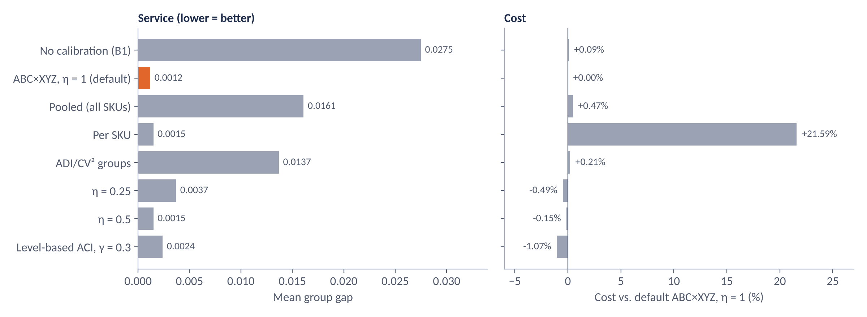
STAGE 4 · ABLATION
Ablation: pooling by ABC×XYZ with η = 1 is the best balance
Level-based ACI is 1.07% cheaper but weak when forecasts are too narrow (UNDER: gap 0.0818 and 280 boundary hits vs. 0.0102 for C³-OUT). Per SKU: cost +21.59%.
DFIOS · SE_18 · FPT University Da Nang · SET490
31
Notes:
Each bar is one design change, everything else held fixed. Pooling all SKUs or by four ADI/CV2 groups leaves the group gap at 0.016 and 0.014. Per-SKU calibration gets a small gap but costs 21.6 percent more and hits the boundary 3,752 times per model. Level-based ACI is 1.07 percent cheaper with a small gap, but its weakness shows when the forecast is too narrow: in the synthetic UNDER case its gap is 0.082 against 0.010 for C3-OUT, with 280 boundary hits.
Source: C³-OUT detailed report (SE_18), Section 5.7, Table 15 (M5, L = 3, R = 7, τ = 0.95, mean of 8 models) and Table 4.

Slide 32
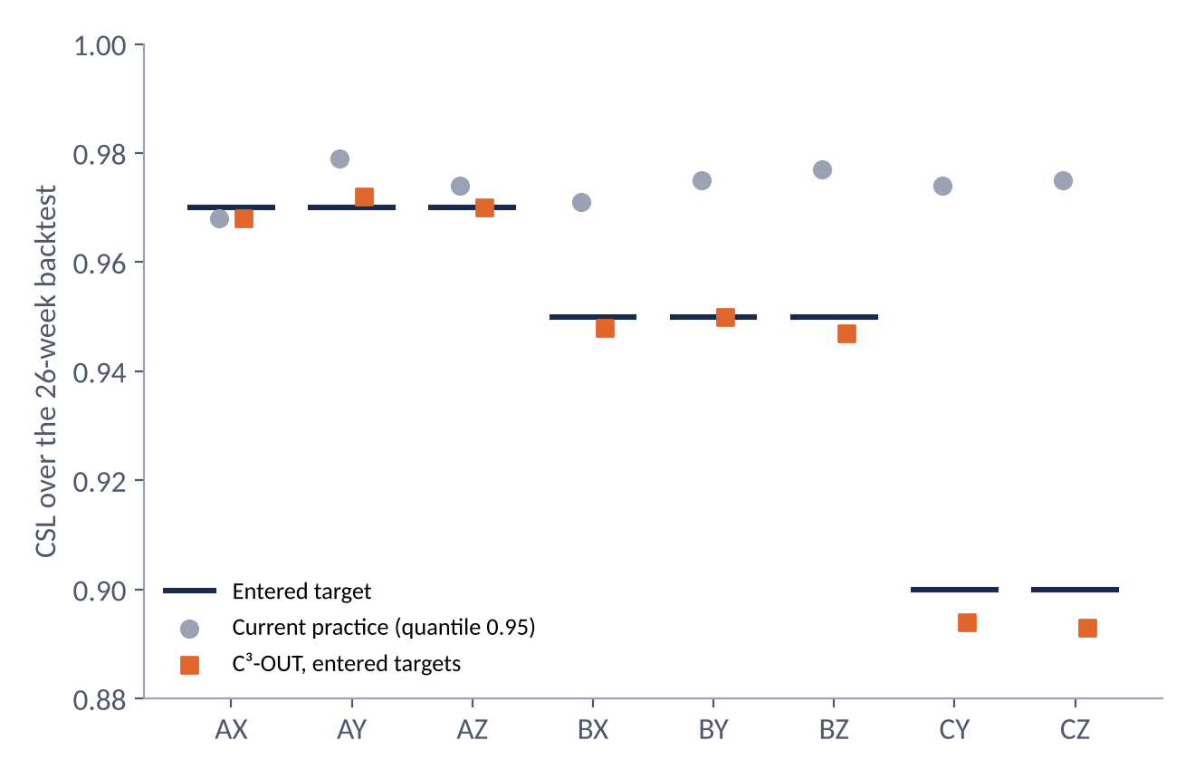
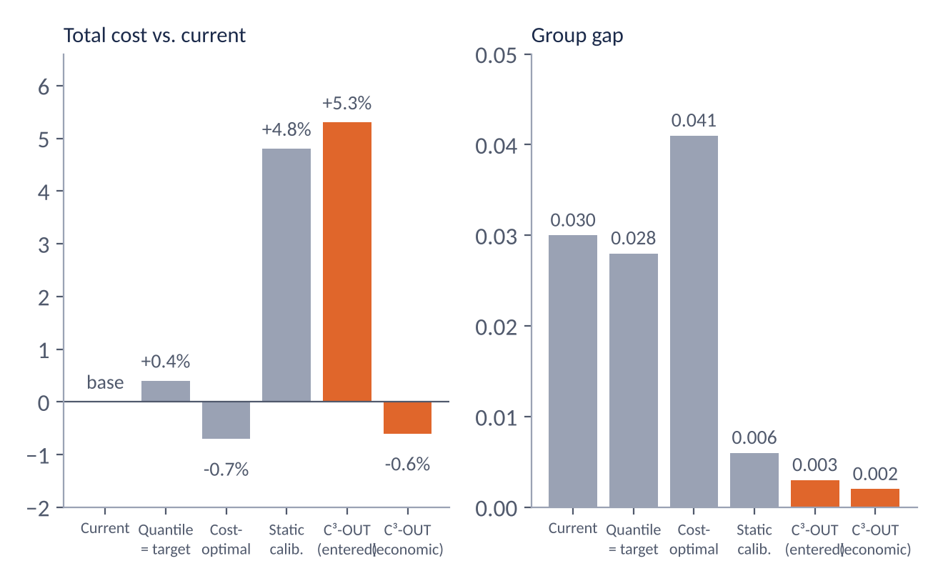
STAGE 4 · SINGLE-STORE CASE
A real store (CA_1): only C³-OUT differentiates A/B/C service as asked
A fixed quantile gives every class nearly the same service (0.97–0.98), even class C that needs only 0.90; C³-OUT gives about 0.97 / 0.95 / 0.89.
Economic target (≈ 0.985): C³-OUT is 0.6% cheaper than current, gap 0.002. Entered targets below the economic level: +5.3%. Order fees are about 77% of total cost.
DFIOS · SE_18 · FPT University Da Nang · SET490
32
Notes:
A realistic single-store backtest on CA_1. Left: the current practice, one fixed quantile, gives every class about 0.97 to 0.98, even class C that only needs 0.90. C3-OUT delivers about 0.97, 0.95 and 0.89, as requested. Right: setting lower targets saves holding cost but costs lost sales, so total cost rises 5.3 percent because the targets are below the economic optimum of about 0.986. With the economic target, C3-OUT is 0.6 percent cheaper than current practice at a gap of 0.002.
Source: C³-OUT detailed report (SE_18), Section 5.8, Tables 16 and 17 (2,942 items, 26-week backtest, ETS(A,N,N), A/B/C targets = 0.97/0.95/0.90).

Slide 33
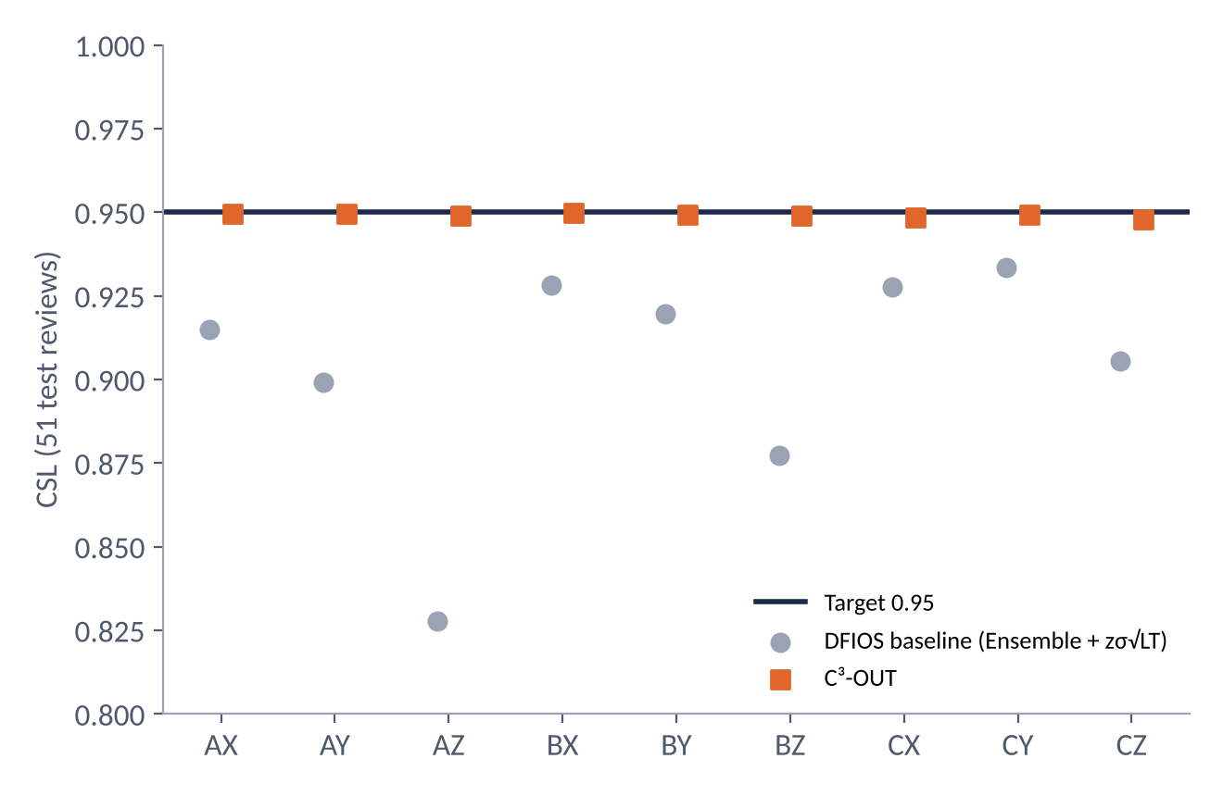
STAGE 4 · EXTRA CHECK
Extra check on our own Ensemble: a stronger result, because the baseline is weaker
Aspect
PDF (main)
Team run (extra)
Baseline
B2: global-τ quantile tuned on a grid up to 0.999
DFIOS formula: Ensemble + zσ√LT
Q0.95 coverage
0.926–0.951 (4 point models; route c ≈ 0.95)
0.831 on test (bias −4.4%)
Cost
C³-OUT +0.12% to +4.00% vs. B2
−6.19% / −17.95% vs. τ = 0.95
Service
Group gap ≤ 0.0027
Group gap 0.0010
51 test reviews, 25,950 SKUs, 9 classes. τ = 0.95: baseline CSL 0.907, gap 0.0463; C³-OUT CSL 0.949, gap 0.0010. Cost −6.19% (95% CI −6.59% to −5.79%) under the BIKIP cost-parameter set, −17.95% under PAPER (the two sets the team used).
Conclusion: both agree on service. On cost, a gain appears only when the baseline is weak; against a well-tuned baseline as in the PDF, the advantage vanishes.
DFIOS · SE_18 · FPT University Da Nang · SET490
33
Notes:
This slide is supplementary and we label it that way. We also ran C3-OUT on our retrained Ensemble: 51 test reviews, 25,950 SKUs, 9 classes. Against the DFIOS formula baseline at tau 0.95, the class gap falls from 0.0463 to 0.0010 and cost falls 6.2 percent under one cost setting and 18 percent under another. Why does it look better than the PDF? The baseline is different. The PDF’s B2 is a tuned quantile of a calibrated distribution. Ours is the DFIOS formula, Ensemble plus z sigma root lead time, whose 0.95 quantile only covers 83 percent on test. Any calibration helps a baseline that weak. Also, this retrained Ensemble is itself worse than the Result OK run: WRMSSE 0.593, 0.636, 0.786 against 0.494, 0.548, 0.709.
Source: team’s own run of 30 Sep 2026 (c3ok_results.csv, c3ok_csl_by_class.csv, c3ok_forecast_calibration.csv); supplementary to the PDF, not the main result.

Slide 34
STAGE 4 · VERDICT
Verdict: C³-OUT is a service controller, not a cost-cutting tool
Aspect
Verdict
Evidence
Keep group CSL on target
High
Gap ≤ 0.0027 without boundary hits; RAW 0.006 to 0.069; static about 0.007
Differentiate service by group
Only C³-OUT does it
CA_1 case: 0.97 / 0.95 / 0.89 vs. a flat 0.97–0.98
Model-independent
By construction
Uses only output quantiles; ran on 8 models, 3 of them foundation models
Theoretical guarantee
Conditional
Recorded error only; loose bound; proof not independently reviewed
Cost vs. a tuned baseline
No
+0.1% to +4.0% (weekly review); cheaper in 1/96 and 4/96 cases
Beats static calibration
Yes, on service
Gap about 8× smaller; equal cost
DFIOS · SE_18 · FPT University Da Nang · SET490
34
Notes:
This is the one-slide verdict, straight from the report’s summary table. Strong where it claims to be strong: holding each group at its service target, differentiating service by group, working with any model. It does not reduce cost against a well-tuned baseline. Its theory is conditional. The right sentence for the committee is: it is a service controller, worth using when service by group is a management or contractual constraint.
Source: C³-OUT detailed report (SE_18), Section 6.2, Table 18.

Slide 35
CLOSING
Limitations and next steps, including stage 5
Limitations
Future work (PDF)
M5: one 52-week test period, 3 of 10 stores; foundation models may have seen M5.
Sales stand in for demand (censored by stockouts); lost sales are unobservable in practice.
Pooling moves stock between SKUs: SKU-level gap is still about 0.03.
The proof is not independently reviewed; the CA_1 case has no confidence intervals.
The team’s own run uses a weaker baseline than the PDF.
Repeat over more time windows, all 10 stores, and data after the pretraining cutoff.
An additive term for items with a zero quantile; tune target and factor jointly.
Compare with conformal prediction and in-model calibrations.
Stage 5 · Deploy + Test (planned)
Run it operationally and test on real data from a business with real stock and stockout records. A prototype web app (c3out_webapp) exists for the single-store case; it is not deployed.
DFIOS · SE_18 · FPT University Da Nang · SET490
35
Notes:
We close with what we do not know. M5 is one dataset and three of ten stores; sales stand in for demand; the proof is ours and not independently reviewed. Next steps follow the report’s future work, and stage 5, deploy and test with a partner’s real stock and stockout data, is still a plan.
Source: C³-OUT detailed report (SE_18), Sections 6.5 and 6.6; stage 5 is the team’s plan.

Slide 36
Thank you for listening
Questions and feedback
Team SE_18 · FPT University Da Nang · Supervisor: Dr. Nguyễn Gia Trí
DFIOS · SE_18 · FPT University Da Nang · SET490
36
Notes:
Thank you. We are happy to take questions; the appendix has the full tables behind every chart.

Slide 37
Appendix
Full tables behind the charts: calibration, service, per-model cost, Tier 1 detail, CA_1, extra check.
DFIOS · SE_18 · FPT University Da Nang · SET490

Slide 38
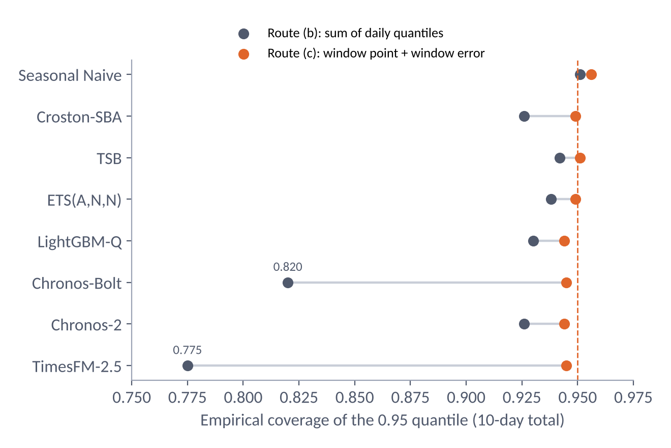
APPENDIX · CALIBRATION
How the distribution is aggregated matters more for coverage than the model
Route (b): interpolate daily quantiles, sum 1,000 independent Monte Carlo draws.
Route (c): point forecast of the window plus a quantile of window error at the 364 prior origins.
Chronos-Bolt: 0.820 → 0.945; TimesFM-2.5: 0.775 → 0.945. SPL falls from 0.523 and 0.497 to 0.397 and 0.376.
On route (c), TimesFM-2.5 and Chronos-2 do not differ significantly from the most accurate model, LightGBM-Q (p = 0.21 and 0.13).
DFIOS · SE_18 · FPT University Da Nang · SET490
Notes:
Route b sums daily quantiles under an independence assumption, which makes the total too narrow. Chronos-Bolt and TimesFM-2.5 cover 0.82 and 0.775 on route b, but 0.945 on route c, where the window error is used instead. So the foundation-model under-coverage is mostly an artefact of how daily deciles are summed, not of the models.
Source: C³-OUT detailed report (SE_18), Section 5.3, Table 7.

Slide 39
APPENDIX · SERVICE
Full group gap by (L, R) setting and target level
L
R
d
τ = 0.90 RAW
C³-OUT
τ = 0.95 RAW
C³-OUT
τ = 0.99 RAW
C³-OUT
1
7
2
0.0401
0.0018
0.0264
0.0013
0.0124
0.0011
3
7
2
0.0435
0.0017
0.0275
0.0012
0.0130
0.0011
7
7
2
0.0445
0.0018
0.0300
0.0013
0.0165
0.0012
1
1
2
0.0616
0.0003
0.0280
0.0003
0.0063
0.0002
3
1
4
0.0652
0.0012
0.0293
0.0003
0.0065
0.0002
7
1
8
0.0695
0.0068
0.0312
0.0007
0.0065
0.0003
M5 runs with boundary hits (mean gap / CSL)
τ = 0.90, R = 1: Chronos-2 (L = 3, 7), LightGBM-Q, Croston-SBA, Seasonal Naive (L = 7); cause: slow movers, S cannot go below 1 unit. τ = 0.99, R = 7: Chronos-Bolt (L = 1, 3, 7); cause: the extrapolated tail is too short.
DFIOS · SE_18 · FPT University Da Nang · SET490
Notes:
Full Table 8: mean group gap over eight models. The right-hand list is the eight runs on M5 where theta hit its boundary.
Source: C³-OUT detailed report (SE_18), Tables 8 and 9.

Slide 40
APPENDIX · COST
Cost and group gap of each model against B2
Model
B2 τ*
C³-OUT 0.95 vs. B2 [CI]
Static 0.95 vs. B2
Gap C³-OUT
Gap static
Seasonal Naive
0.900
+4.00% [3.74; 4.30]
+3.51%
0.0009
0.0052
Croston-SBA
0.900
+0.38% [0.12; 0.68]
−0.00%
0.0016
0.0063
TSB
0.900
+2.15% [1.91; 2.37]
+2.00%
0.0009
0.0056
ETS(A,N,N)
0.900
+1.13% [0.91; 1.36]
+1.01%
0.0014
0.0050
LightGBM-Q
0.975
+1.06% [0.79; 1.28]
+1.07%
0.0004
0.0065
Chronos-Bolt
0.995
+1.21% [0.89; 1.51]
+1.97%
0.0025
0.0102
Chronos-2
0.950
+1.28% [0.99; 1.54]
+1.23%
0.0013
0.0024
TimesFM-2.5
0.999
+0.12% [−0.25; 0.44]
+0.42%
0.0010
0.0084
DFIOS · SE_18 · FPT University Da Nang · SET490
Notes:
Full Table 10. Note B2’s chosen tau per model in the second column, from 0.90 for the statistical models up to 0.999 for TimesFM-2.5.
Source: C³-OUT detailed report (SE_18), Table 10 (L = 3, R = 7, original route; 95% CI in brackets).

Slide 41
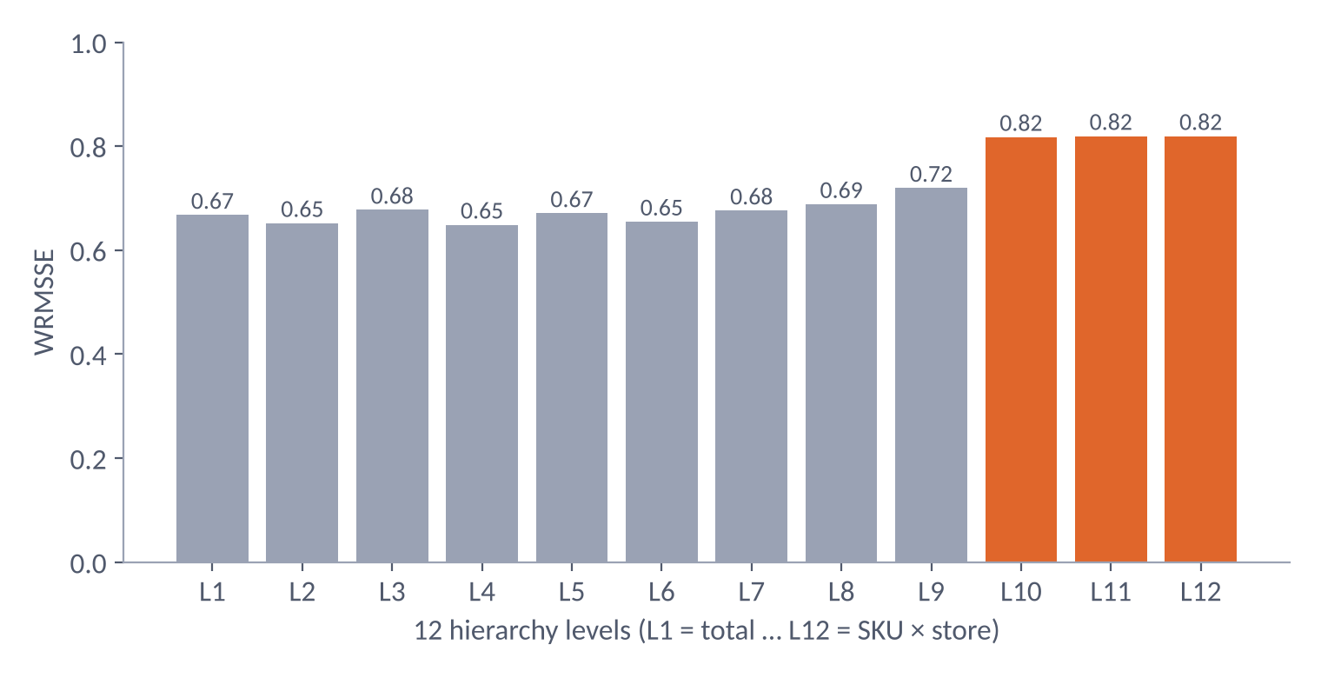
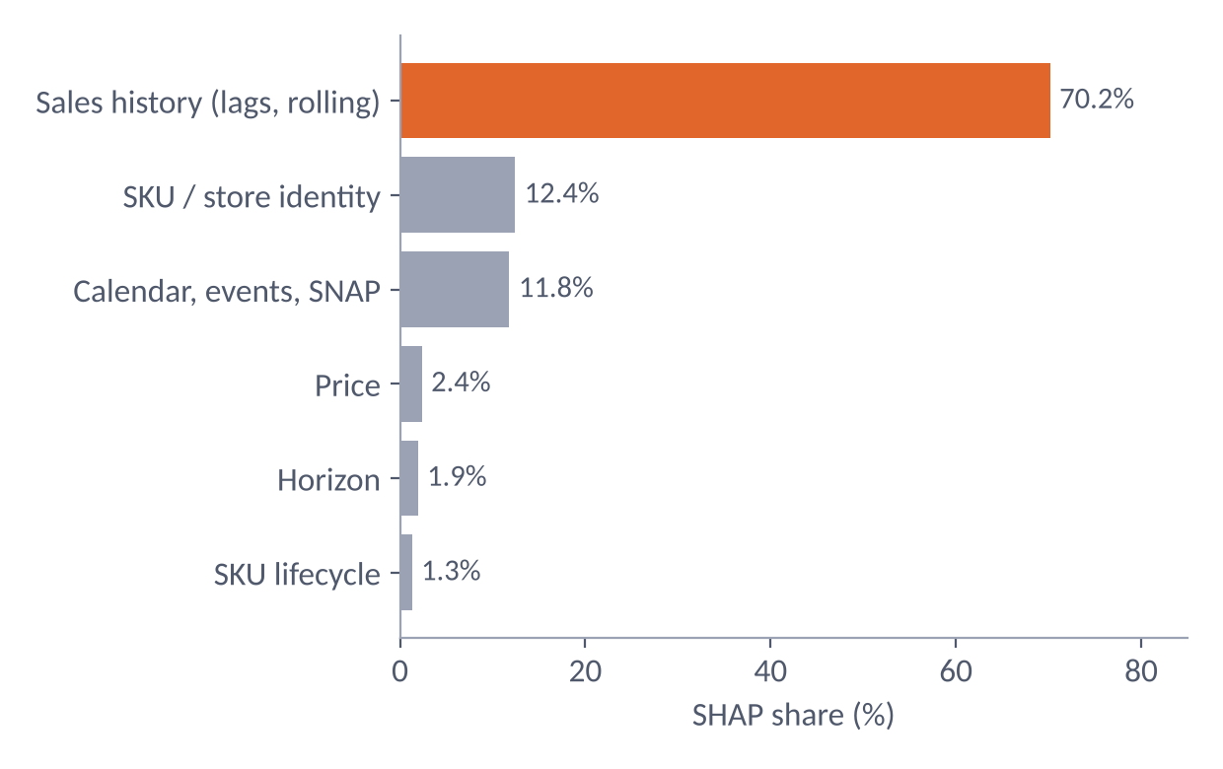
APPENDIX · TIER 1 DETAIL
WRMSSE by the 12 hierarchy levels and SHAP share by feature family
SHAP by single feature: rmean_28 18.2%; rmean_180 8.4%; item_id 7.8%; days_since_last_sale 7.5%; rmean_56 7.2%; rmean_14 6.9%; wday 5.7%.
DFIOS · SE_18 · FPT University Da Nang · SET490
Notes:
WRMSSE rises from about 0.65 at aggregate levels to 0.82 at the item level, where the data is sparsest. SHAP shows 70 percent of the attribution on sales history; the top single features are the 28-day rolling mean at 18.2 percent, the 180-day rolling mean at 8.4 percent, and the item id at 7.8 percent.
Source: Result OK run of 13 Sep 2026 (wrmsse_by_level.csv, shap_by_family.csv, shap_feature_importance.csv).

Slide 42
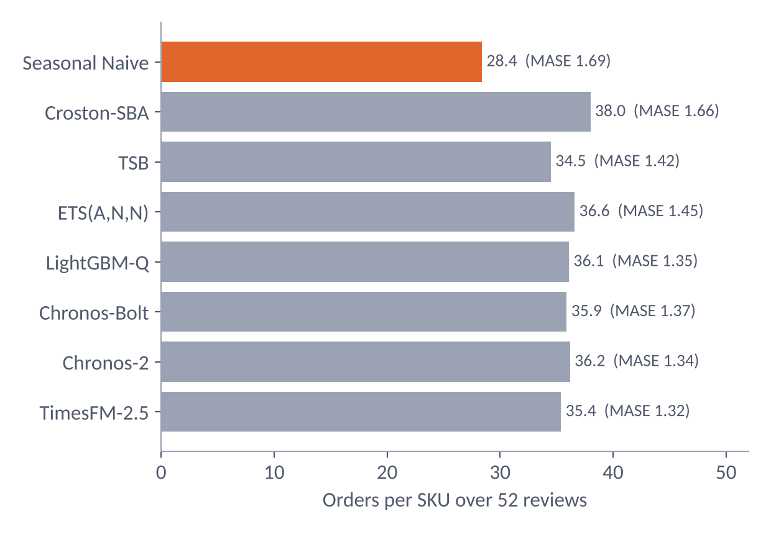
APPENDIX · COST RANKING
Seasonal Naive has the worst MASE but the best cost rank because it orders less
Order fees are 54% to 63% of total cost.
Seasonal Naive places about 28.4 orders/SKU, below the 34.5 to 38.0 of the others, so it ranks 1st on cost when c = 2.
When c = 0 it drops to last and Chronos-2 is cheapest.
Consequence: comparing models by inventory cost requires fixing and publishing the aggregation route and cost parameters.
DFIOS · SE_18 · FPT University Da Nang · SET490
Notes:
Order fees are 54 to 63 percent of total cost. Seasonal Naive places about 28.4 orders per SKU against 34.5 to 38.0 for the others, so it wins under B2 despite the worst MASE. When the order fee c is zero it falls to last place and Chronos-2 becomes cheapest. Cost rank is therefore not a direct measure of forecast value unless the route and cost parameters are fixed and published.
Source: C³-OUT detailed report (SE_18), Section 5.6, Tables 13 and 14.

Slide 43
APPENDIX · CA_1
CA_1 case: six policies over a 26-week backtest
Policy
Total (USD)
vs. current
Holding
Lost sales
Ordering
CSL
Gap
Current (quantile 0.95)
145,672
–
21,920
11,477
112,276
0.974
0.030
Quantile = group target
146,218
+0.4%
23,341
10,747
112,130
0.972
0.028
Cost-optimal (0.975)
144,654
−0.7%
25,586
6,718
112,350
0.986
0.041
Static calibration
152,640
+4.8%
19,968
19,267
113,406
0.946
0.006
C³-OUT, entered targets
153,453
+5.3%
19,819
20,068
113,566
0.942
0.003
C³-OUT, economic target
144,811
−0.6%
25,920
6,485
112,406
0.986
0.002
DFIOS · SE_18 · FPT University Da Nang · SET490
Notes:
Full Table 16. Rows are policies; the total cost is in USD and the percentage is against current practice. The last row, C3-OUT with the economic target, matches the cheapest policy within 0.1 percent while keeping every group within 0.002 of its target.
Source: C³-OUT detailed report (SE_18), Table 16 (USD).

Slide 44
APPENDIX · TIER 1 DETAIL
MASE on the 200-SKU sample: ARIMA is below every ML model
Model
MASE h = 7
MASE h = 14
MASE h = 28
ARIMA
0.9697
0.9655
0.9827
Ensemble
1.0069
0.9998
1.0119
LightGBM
1.0035
0.9979
1.0106
TFT
1.0112
1.0028
1.0142
XGBoost
1.0098
1.0039
1.0171
LSTM
1.0212
1.0081
1.0188
Seasonal Naive
1.0993
1.0960
1.1185
DFIOS · SE_18 · FPT University Da Nang · SET490
Notes:
An honest finding we keep in the appendix: on the 200-SKU sample ARIMA has the lowest MASE, 0.970, 0.966 and 0.983, below the ML models, which sit around 1.00 to 1.02. The sample is small and stratified, so this should not be read as ARIMA beating the ML models overall; it is a reminder that classical models stay competitive on a subset.
Source: Result OK run of 13 Sep 2026 (metrics_arima_subset.csv). A 200-SKU stratified sample; not directly comparable with the MASE over all 30,490 series.

Slide 45
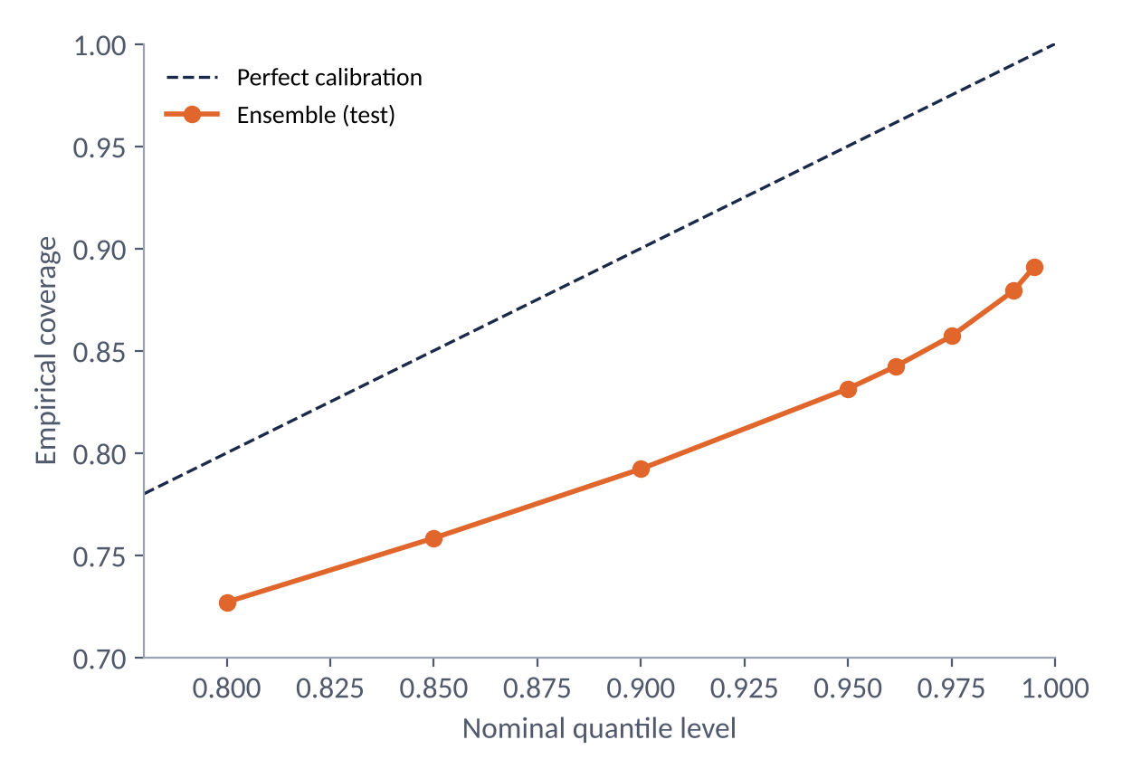
APPENDIX · EXTRA CHECK
Team’s own run: calibration of the retrained Ensemble
Coverage on test: Q0.95 = 0.831; Q0.975 = 0.857; Q0.99 = 0.879; Q0.995 = 0.891.
10-day bias: −2.6% (validation), −4.4% (test).
The retrained Ensemble has WRMSSE 0.593 / 0.636 / 0.786 (h = 7 / 14 / 28), worse than the Result OK run (0.494 / 0.548 / 0.709).
The baseline here is the DFIOS formula (Ensemble + zσ√LT), different from the PDF’s tuned B2.
DFIOS · SE_18 · FPT University Da Nang · SET490
Notes:
The retrained Ensemble under-covers at every level: its 0.95 quantile covers 83 percent on test and its 0.995 quantile only 89 percent, with a bias of minus 4.4 percent. That is why a calibration loop helps so much against the DFIOS formula baseline.
Source: team’s own run of 30 Sep 2026 (c3ok_forecast_calibration.csv, c3ok_results.csv). Supplementary, not the main result.

Slide 46
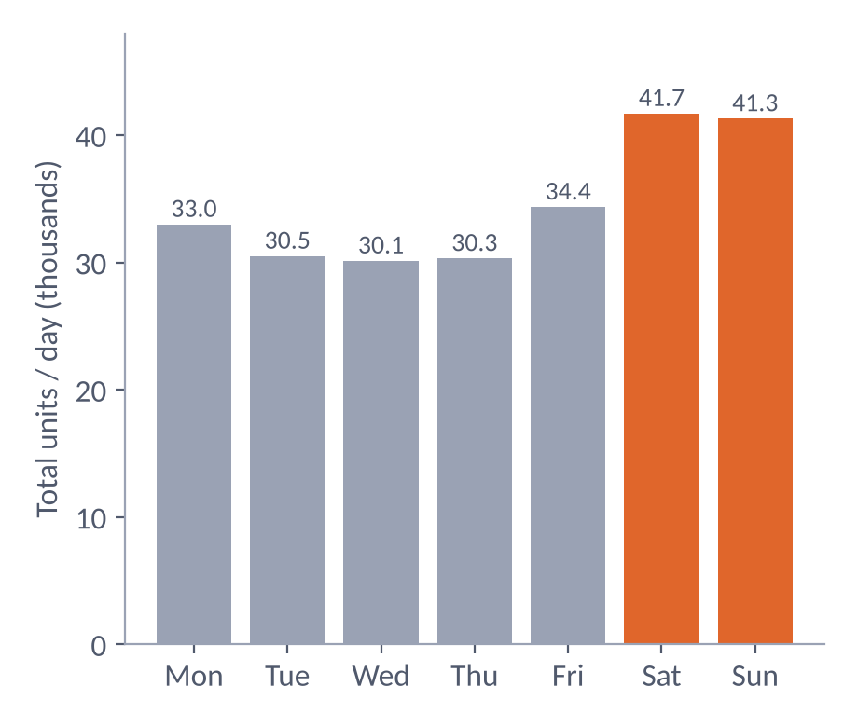
APPENDIX · M5 DATA
Weekly rhythm, event calendar and SNAP
Mean total per day: Mon 33.0k; Tue 30.5k; Wed 30.1k; Thu 30.3k; Fri 34.4k; Sat 41.7k; Sun 41.3k.
162 event days, 30 type-1 event names, four types: Cultural, National, Religious, Sporting.
SNAP: 650 days for each of CA, TX, WI.
Calendar encoding: “none” must be code 0 so event features stay clean.
DFIOS · SE_18 · FPT University Da Nang · SET490
Notes:
Saturday and Sunday are the busiest days. The calendar holds 162 event days across 30 event names and four event types, and 650 SNAP days per state.
Source: computed by the team from sales_train_evaluation.csv and calendar.csv.

