Slide 1
BOTANY
PLASTIDS
The colour and energy factories of plant cells
SEMINAR
Presented and introduced by Vivek VM and Prijith P

Slide 2



A puzzle to begin
Why is a leaf green, a tomato red and a potato white?
One small organelle decides it: the plastid
2

Slide 3
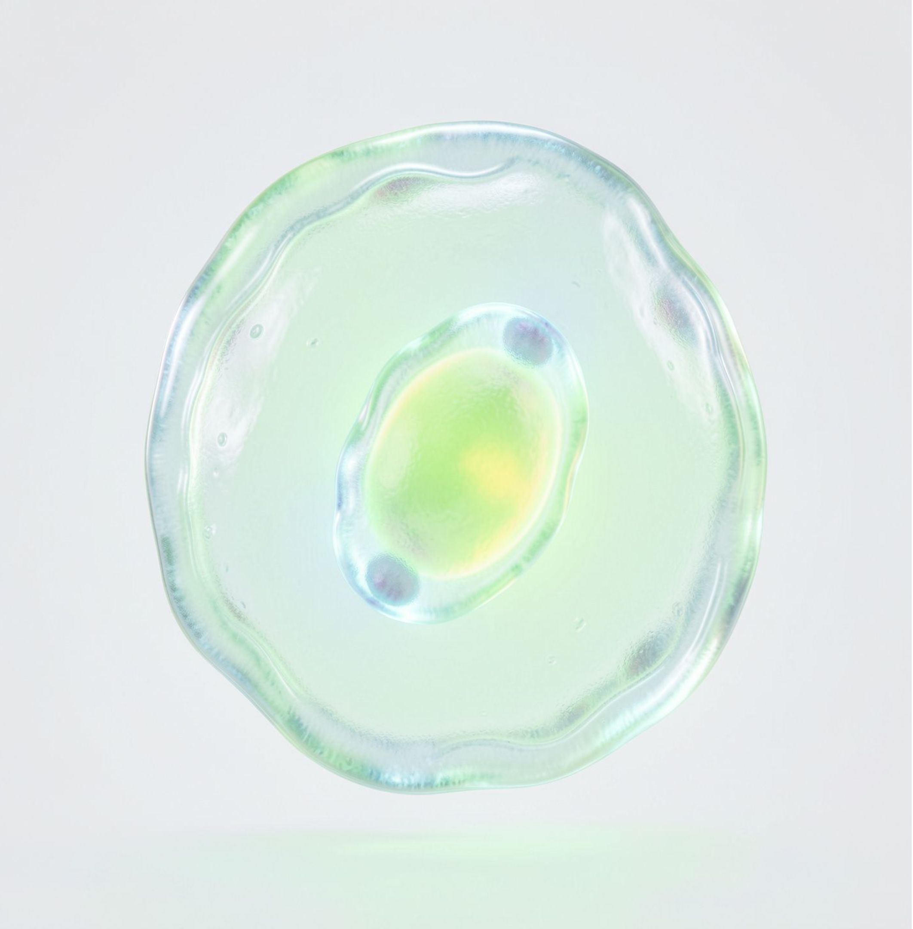
What are plastids?
Large organelles, easily seen under the microscope
Carry specific pigments that give plants their colours
Found in all plant cells and in euglenoids
Absent in animal cells
3

Slide 4



Three types of plastids
The pigment decides the plastid
Chloroplasts
Chromoplasts
Leucoplasts
green, trap light
yellow, orange, red
colourless, store food
4

Slide 5
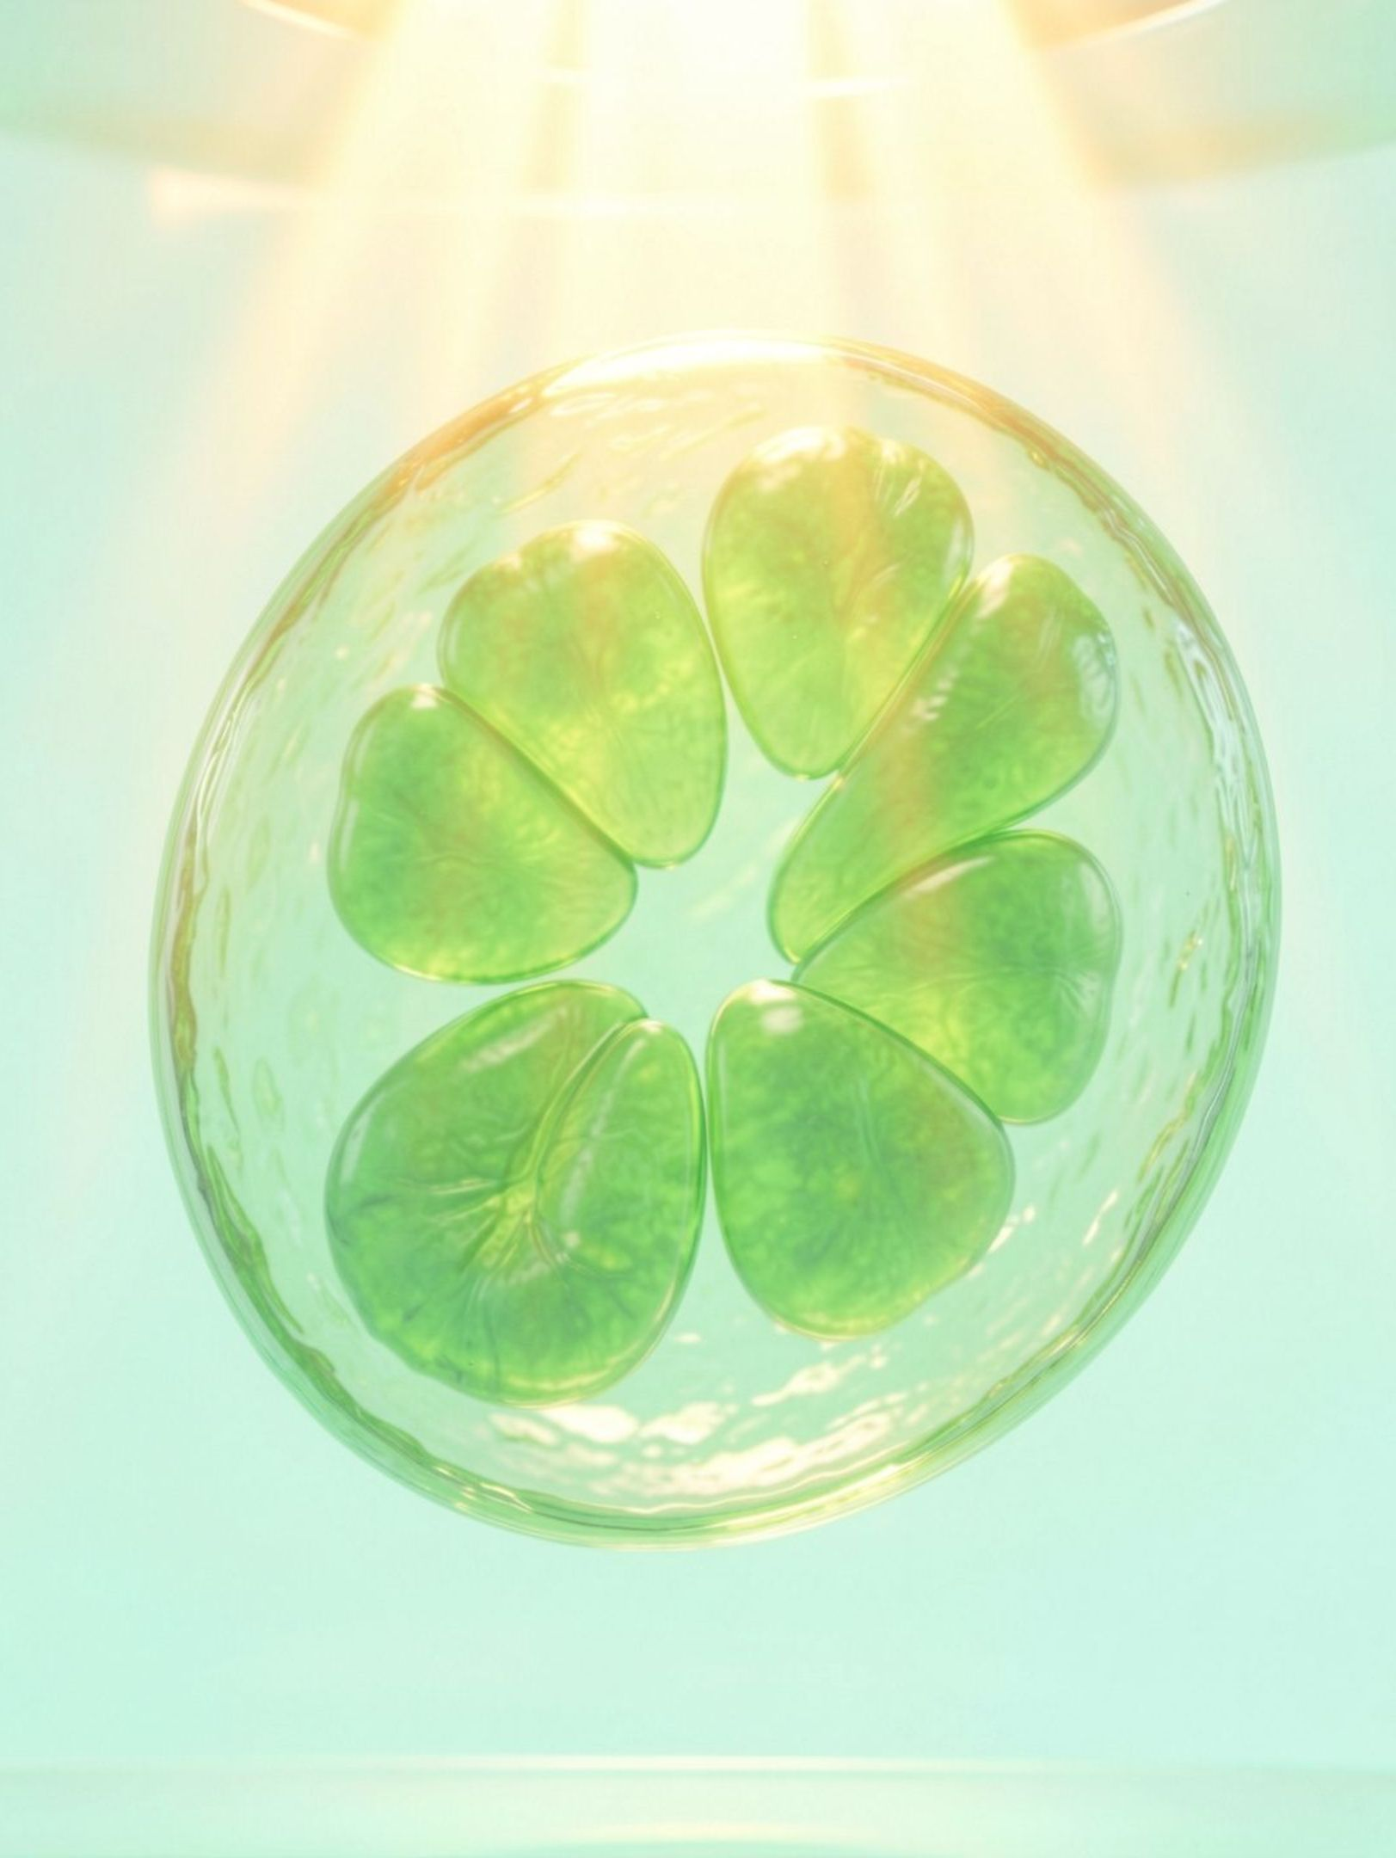
Chloroplast: the green solar factory
Contains chlorophyll and carotenoid pigments
Traps light energy needed for photosynthesis
Found mostly in the mesophyll cells of leaves
5

Slide 6
Chromoplasts: the colour makers
Contain fat-soluble carotenoids: carotene, xanthophylls
Give yellow, orange or red colour to plant parts

Slide 7
Leucoplasts: the storage rooms
Colourless plastids of varied shapes and sizes
Amyloplasts: starch, e.g. potato
Elaioplasts: oils and fats
Aleuroplasts: proteins

Slide 8
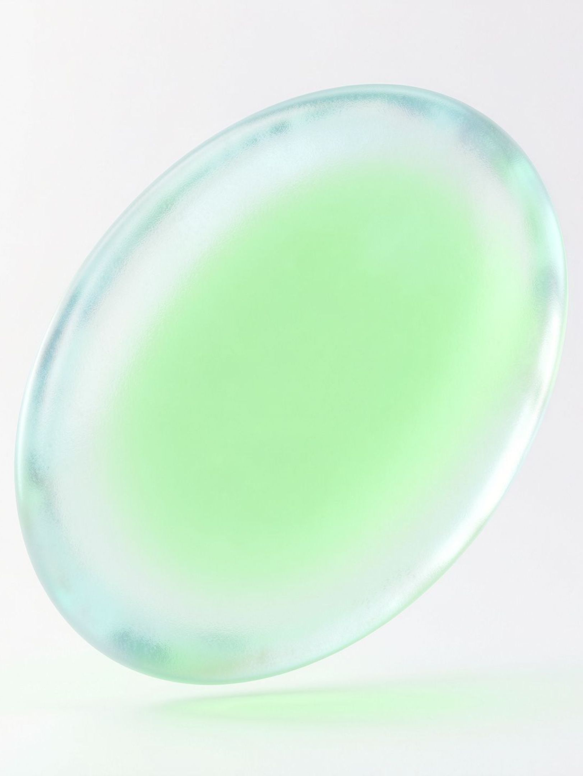
Chloroplast at a glance
5 to 10
2 to 4
Width
Length
micrometres
micrometres
20 to 40
1
per cell
in Chlamydomonas (a green alga)
per cell
in mesophyll cells
8
Shape: lens-shaped, oval, spherical, discoid or ribbon-like

Slide 9
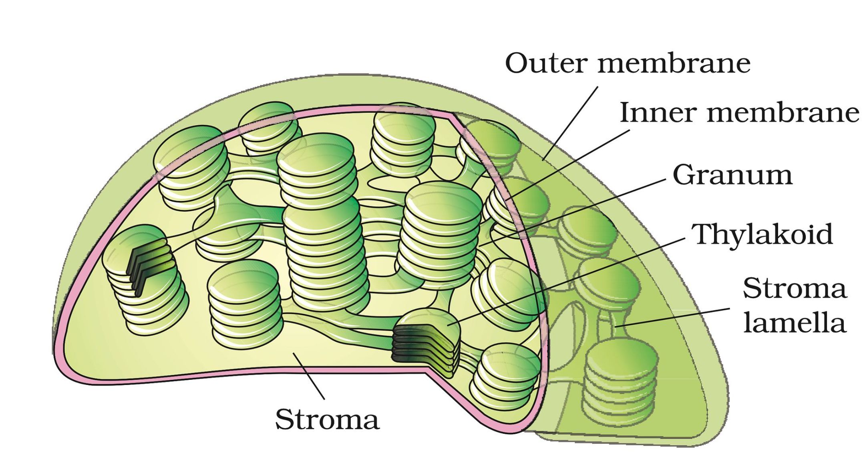
Let us build a chloroplast
Figure 8.8: Sectional view of a chloroplast
Six parts, one at a time
9

Slide 10
Part 1: Outer membrane
The outer boundary of the chloroplast
One of its two membranes

Slide 11
Part 2: Inner membrane
Lies just inside the outer membrane
Relatively less permeable
Encloses the stroma

Slide 12
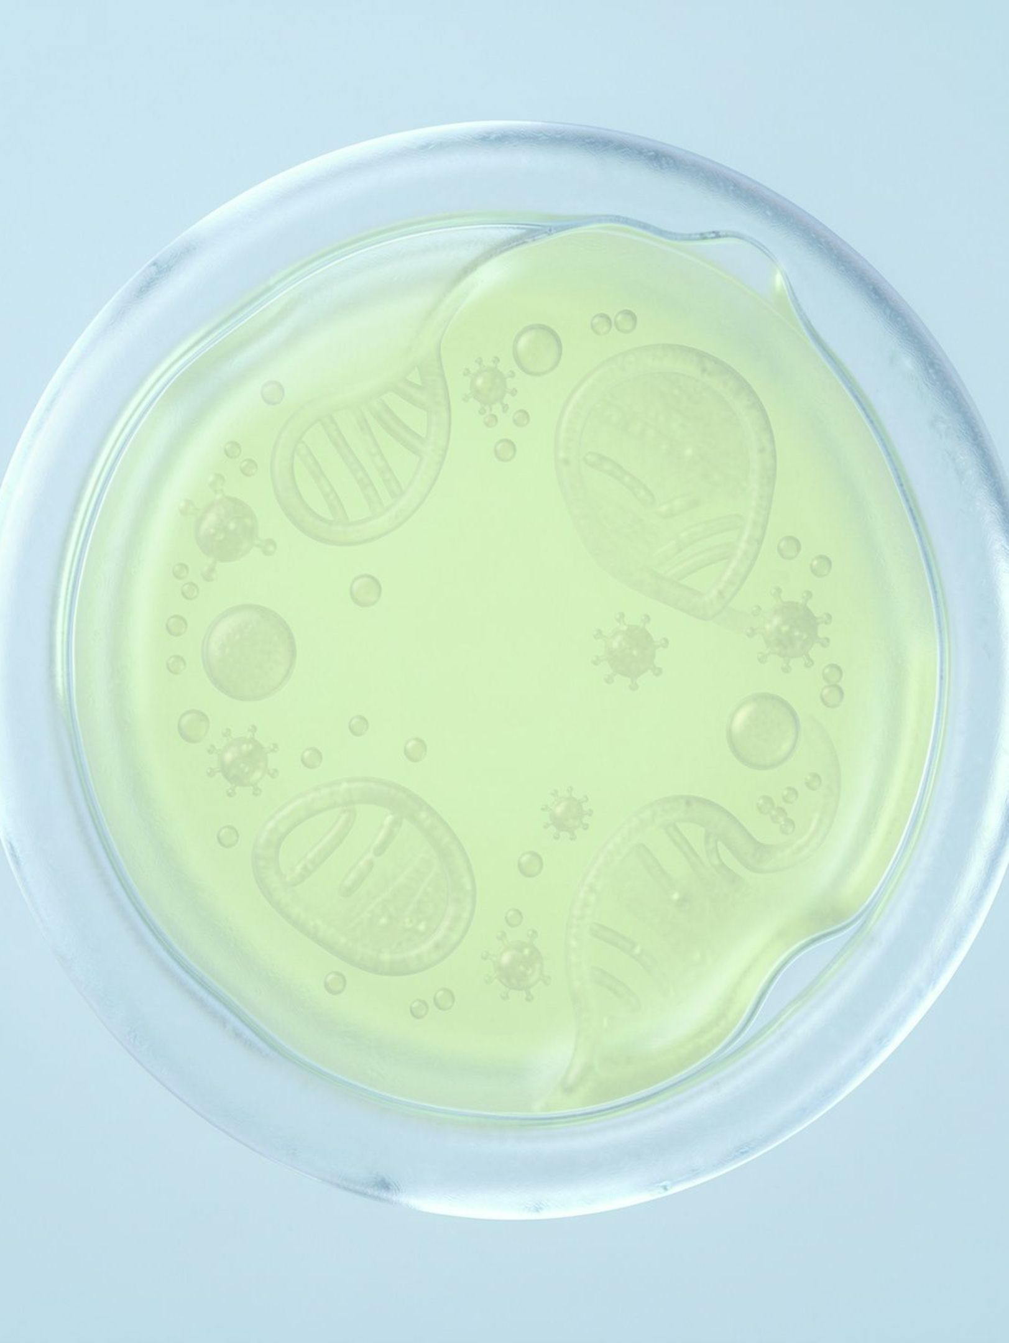
Part 3: Stroma
The space inside the inner membrane
Enzymes to make carbohydrates and proteins
Small circular double-stranded DNA
70S ribosomes
12

Slide 13
Part 4: Thylakoids
Flattened membranous sacs inside the stroma
Chlorophyll pigments sit here
Their membrane encloses a space called the lumen

Slide 14
Part 5: Granum
Thylakoids stacked like a pile of coins
Many stacks = grana

Slide 15
Part 6: Stroma lamellae
Flat membranous tubules
They connect the thylakoids of different grana

Slide 16
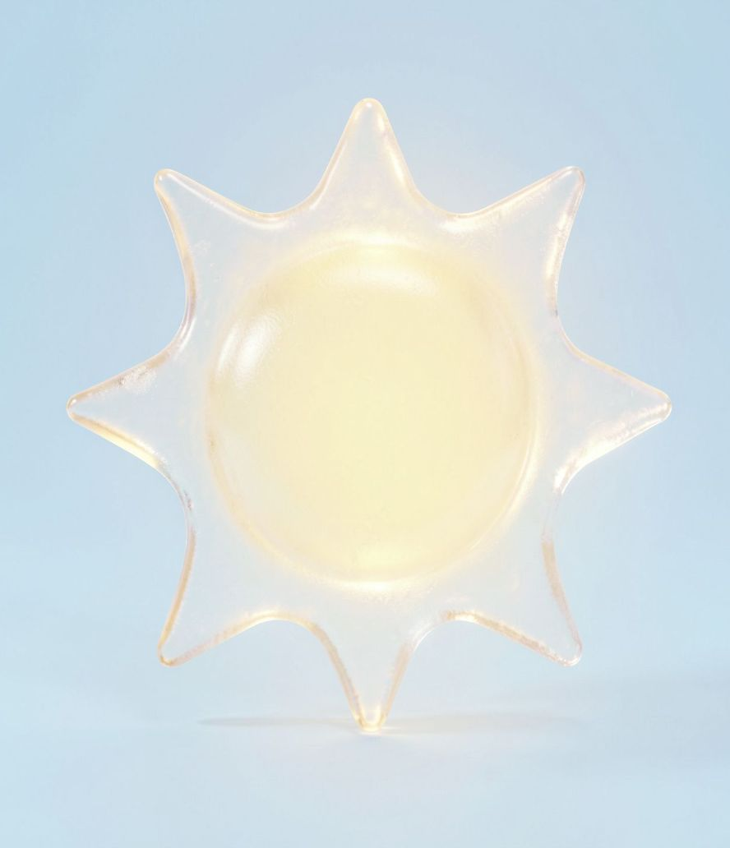
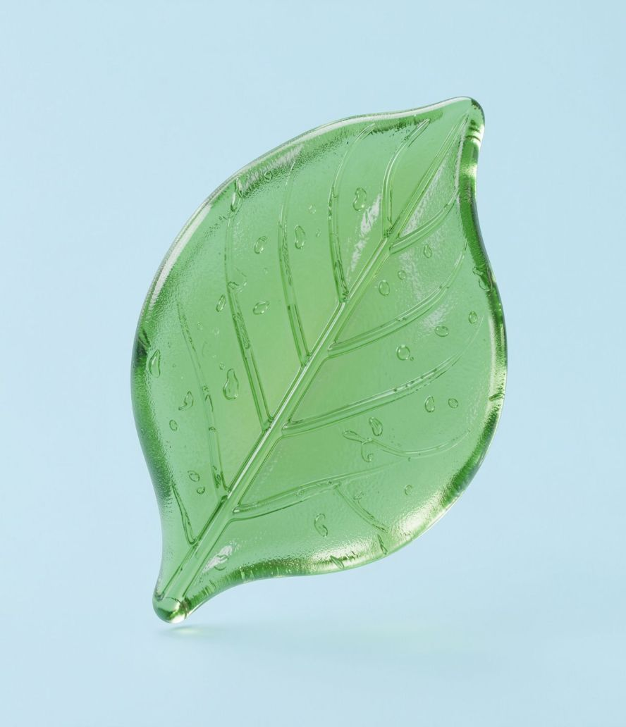
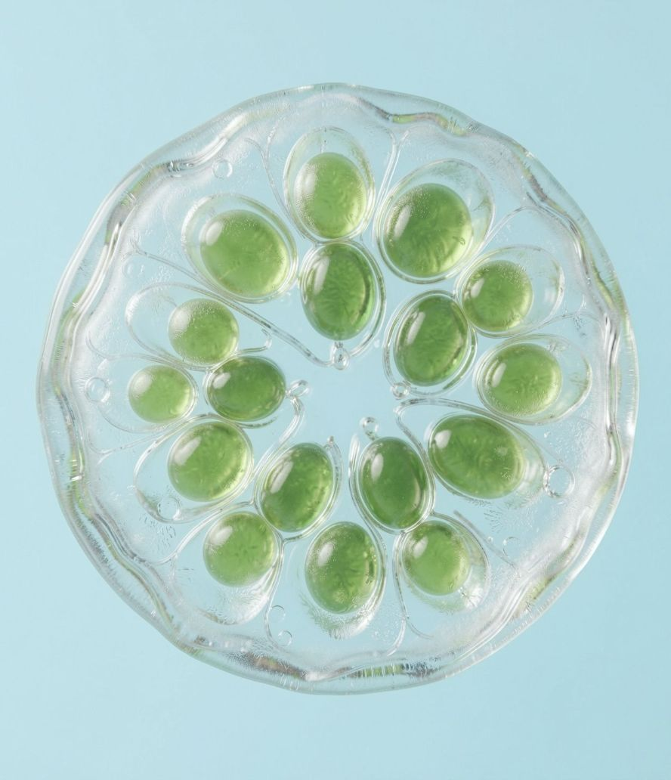
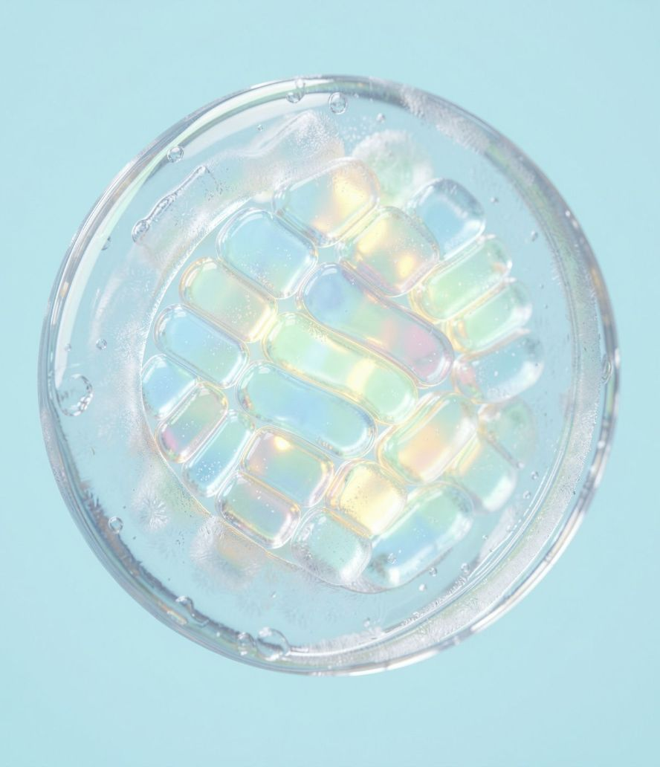
The journey of sunlight
Sun, then leaf, then mesophyll cell, then chloroplast. Zoom in: sunlight reaches the grana.

Slide 17
Photosynthesis begins
Grana: light reactions
Stroma: dark reactions
Light energy is trapped and food is made

Slide 18
Chloroplast and mitochondria: alike
Both have a double membrane
Both have their own circular DNA
Both have 70S ribosomes

Slide 19
Summary
Plastids are pigment-bearing organelles of plants
Chloroplast, chromoplast, leucoplast
Chloroplast: outer and inner membrane, stroma, thylakoids, grana, stroma lamellae
Light reactions in grana, dark reactions in stroma

Slide 20
Quiz time
Spin the wheel. Who is next?

Slide 21
Thank you
Questions?
Vivek VM and Prijith P

