Slide 1
Chapter TWO
Measures of Central Tendency
Or
Measures of Location
Definition
In a representative sample, the values of a series of data have a tendency to cluster around a certain point usually at the center of the series. This tendency of clustering the values around the center of the series is usually called tendency. And its numerical measures are called the measures of central tendency.
Or
A measure of central tendency is a typical value around which others figure congregate.

Slide 2
Objectives of Measures of central tendency:
1. To get one single value that describes the characteristics of the entire data.
2. To easily compare the data.
Types:
Different measures of central tendency are as follows:
1. Arithmetic Mean (A.M.)
2. Geometric Mean (G.M.)
3. Harmonic Mean (H.M.)
4. Median (Me)
5. Mode (Mo)

Slide 3
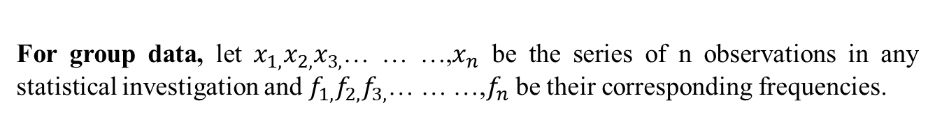
Arithmetic mean/ Average/Mean:
Arithmetic mean of a set of observations is the sum of all observations divided by the total number of observations. It is usually denoted by A.M
Or the sum of a set of data divided by the number of data.
,
For ungroup data, let x₁,x₂,x₃,… … …,x_{n} be the series of n observations in any statistical investigation. Then their arithmetic mean
For group data, let $x_{1,}x_{2,}x_{3,}$… … …,$x_{n}$ be the series of n observations in any statistical investigation and $f_{1,}f_{2,}f_{3,}$… … …,$f_{n}$ be their corresponding frequencies.

Slide 4
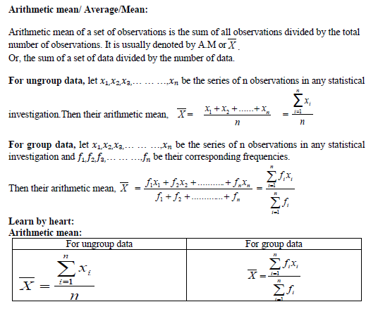

Slide 5
Practice-1: Find the mean from the data: 20, 37, 32, 39, 33, 34, 32
Practice-2: Find the mean from the data: 20.5, 37.5, 32.6, 39.9, 33.7, 34, 32
Practice-3: Find the mean from the data: 2, 7, -5, -7, 3.5, 4.7, 11
For ungroup data | For group data
Example-1: Calculate arithmetic mean from the following grouped frequency table:
Number of games | Frequency
1 - 5 | 2
6 - 10 | 7
11 - 15 | 8
16 - 20 | 3

Slide 6
Solution: Estimating the mean from Grouped Data
Number of games | Frequency f | Midpoint x | f_{i}x_{i}
1 - 5 | 2 | 3 | 6
6 - 10 | 7 | 8 | 56
11 - 15 | 8 | 13 | 104
16 - 20 | 3 | 18 | 54
 |  | Totals:
We know, Mean =

Slide 7
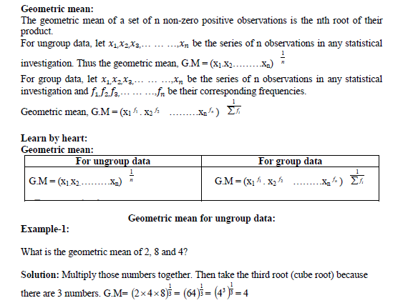
Geometric mean

Slide 8
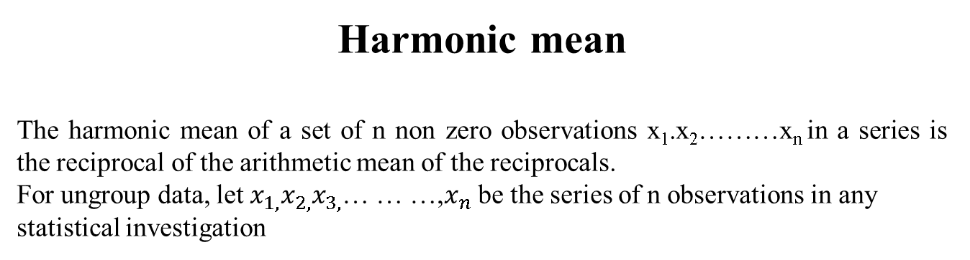
Harmonic mean
The harmonic mean of a set of n non zero observations x₁.x₂………x_{n} in a series is the reciprocal of the arithmetic mean of the reciprocals.
For ungroup data, let $x_{1,}x_{2,}x_{3,}$… … …,$x_{n}$ be the series of n observations in any statistical investigation
Thus, Harmonic Mean =
=
Find the harmonic mean of the following data 8, 9, 6, 11, 10, 5
Solution: Given data: 8, 9, 6, 11, 10, 5.
So Harmonic mean =
=
= 7.560

Slide 9
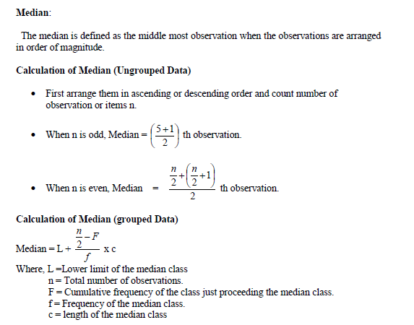

Slide 10
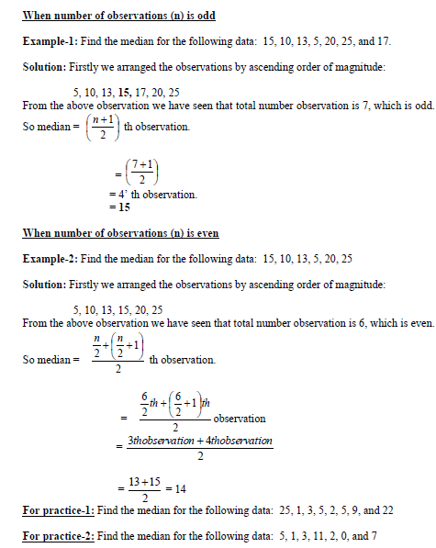

Slide 11
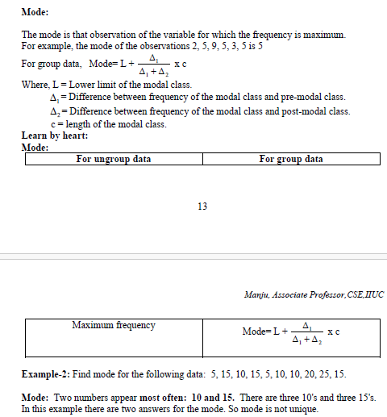

Slide 12
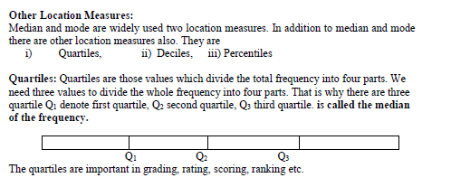
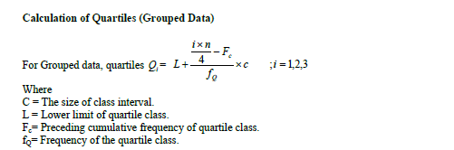

Slide 14
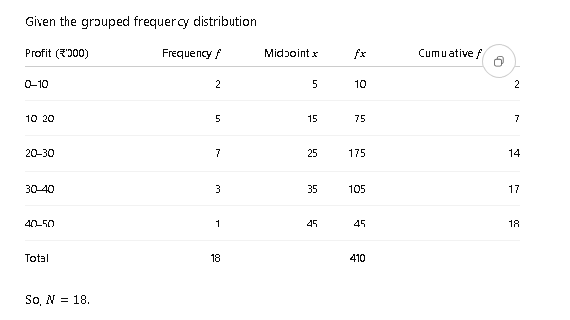
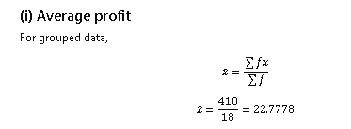

Slide 15
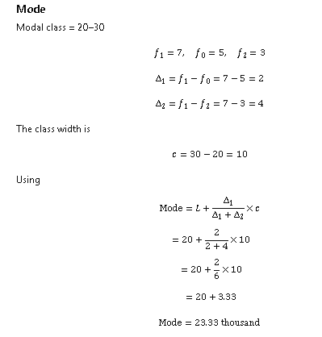

Slide 16
