Slide 1
课程介绍
培训说明和MuleSoft总体介绍
What is Mule?
Why Mule?
How Mule?
How to setup Mule?
Learn Mule by self
Chinasofti MuleSoft Training 2017
Notes:
培训说明和Mulesoft总体介绍(15-25分钟)

Slide 2
What is Mule?
MuleSoft公司和产品介绍
MuleSoft is a software company headquartered in San Francisco, California that provides integration software for connecting applications, data and devices. the runtime engine
——Wikipedia
Mule, the runtime engine of Anypoint Platform, is a lightweight Java-based enterprise service bus (ESB) and integration platform that allows developers to connect applications together quickly and easily, enabling them to exchange data. It enables easy integration of existing systems, regardless of the different technologies that the applications use, including JMS, Web Services, JDBC, HTTP, and more. The ESB can be deployed anywhere, can integrate and orchestrate events in real time or in batch, and has universal connectivity.
——MuleSoft.com
Chinasofti MuleSoft Training 2017
Notes:
培训说明和Mulesoft总体介绍(15-25分钟)

Slide 3
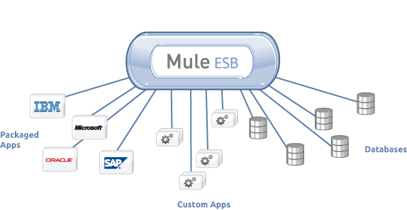
What is Mule?
ESB介绍
Chinasofti MuleSoft Training 2017
Notes:
MuleSoft是一家提供基于云的应用集成服务商，成立于2006年，总部位于旧金山。公司的主打产品是 Anypoint 平台，可实现SaaS、SOA及API等的集成，也能实现本地系统与云，以及云与云服务的集成。该平台可以对企业的集成策略进行集中的设计和管理，并作为hub中心与各类端结点系统对接，将二维的点对点连接降低到一个维度，从而简化了集成的复杂性。
——36氪

Slide 4

Why Mule?
为什么要用MuleSoft？TA为我们解决了什么问题？
Chinasofti MuleSoft Training 2017
Notes:
培训说明和Mulesoft总体介绍(15-25分钟)

Slide 5
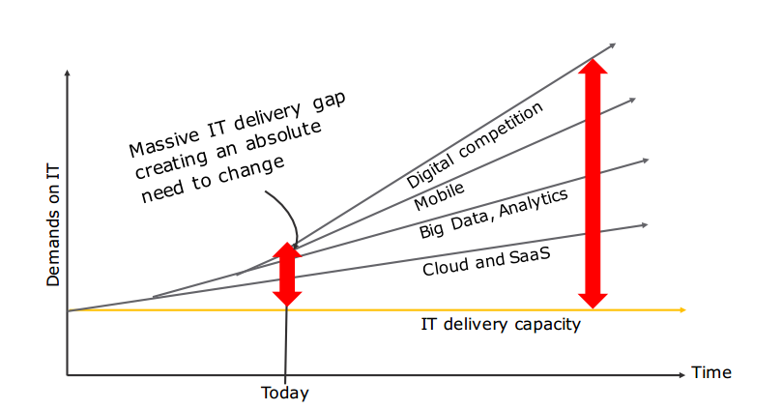
Why Mule?
为什么要用MuleSoft？TA为我们解决了什么问题？
Chinasofti MuleSoft Training 2017
Notes:
培训说明和Mulesoft总体介绍(15-25分钟)

Slide 6
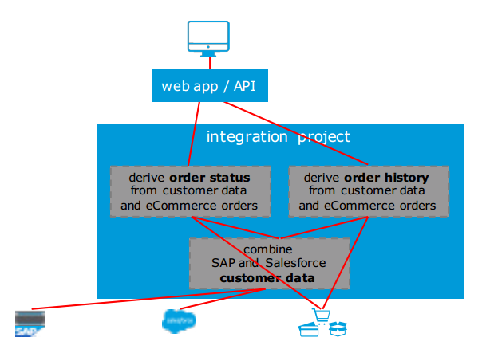
Why Mule?
为什么要用MuleSoft？TA为我们解决了什么问题？
Chinasofti MuleSoft Training 2017
Notes:
培训说明和Mulesoft总体介绍(15-25分钟)

Slide 7
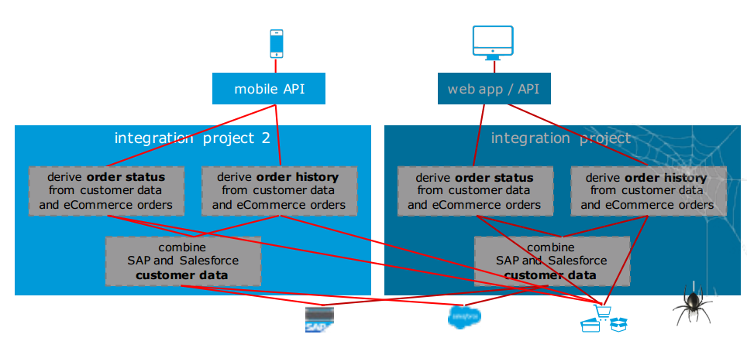
Why Mule?
为什么要用MuleSoft？TA为我们解决了什么问题？
Chinasofti MuleSoft Training 2017
Notes:
培训说明和Mulesoft总体介绍(15-25分钟)

Slide 8
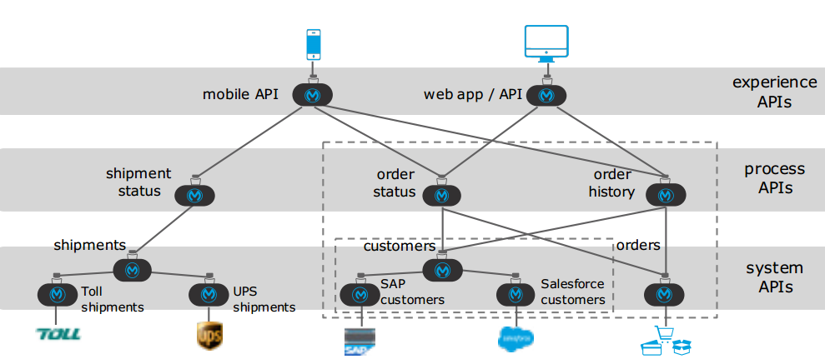
How Mule?
MuleSoft是怎么解决问题的？
Chinasofti MuleSoft Training 2017
Notes:
培训说明和Mulesoft总体介绍(15-25分钟)

Slide 9
How to setup Mule?
使用MuleSoft的硬软件要求
JDK 1.8
http://www.oracle.com/technetwork/java/javase/downloads/jdk8-downloads-2133151.html
Anypoint studio
https://www.mulesoft.com/lp/dl/studio
Postman
https://www.getpostman.com/
Accounts
Anypoint platform: https://www.anypoint.mulesoft.com/
Traing account: https://training.mulesoft.com/
Chinasofti MuleSoft Training 2017
Notes:
培训说明和Mulesoft总体介绍(15-25分钟)

Slide 10
How to setup Mule?
使用MuleSoft的硬软件要求
Knowledge
Microservice Architecture / Web Service / HTTP以及URL schema
VPN
Motivation – 动机
好读书，欣然忘食
Chinasofti MuleSoft Training 2017
Notes:
培训说明和Mulesoft总体介绍(15-25分钟)

Slide 11
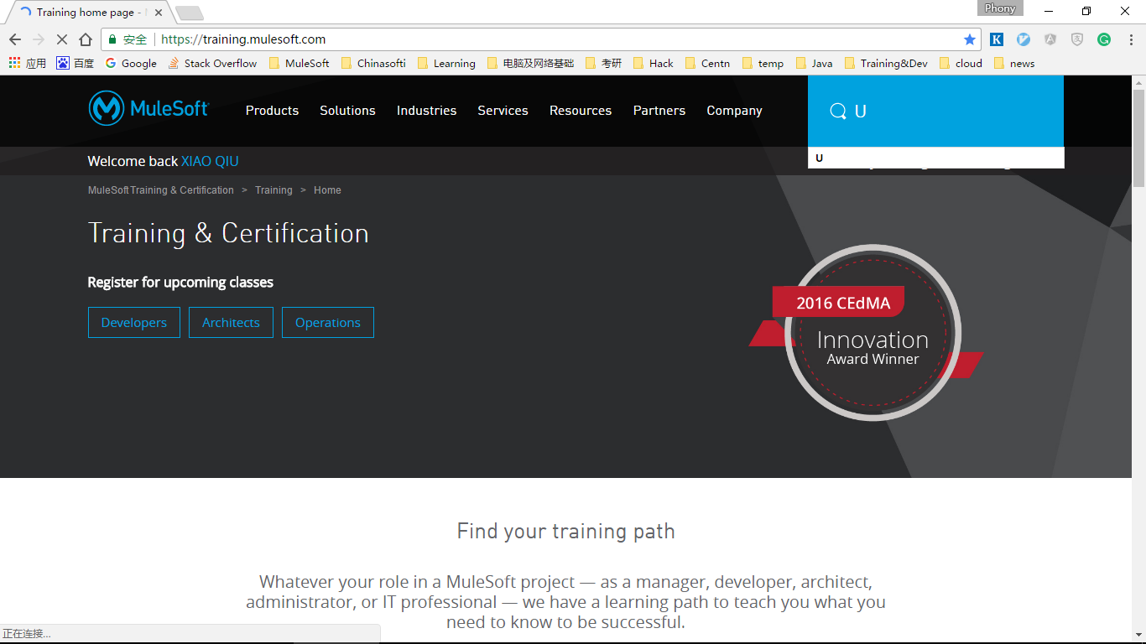
Learn Mule by self
自学mulesoft
Chinasofti MuleSoft Training 2017
Notes:
培训说明和Mulesoft总体介绍(15-25分钟)

Slide 12
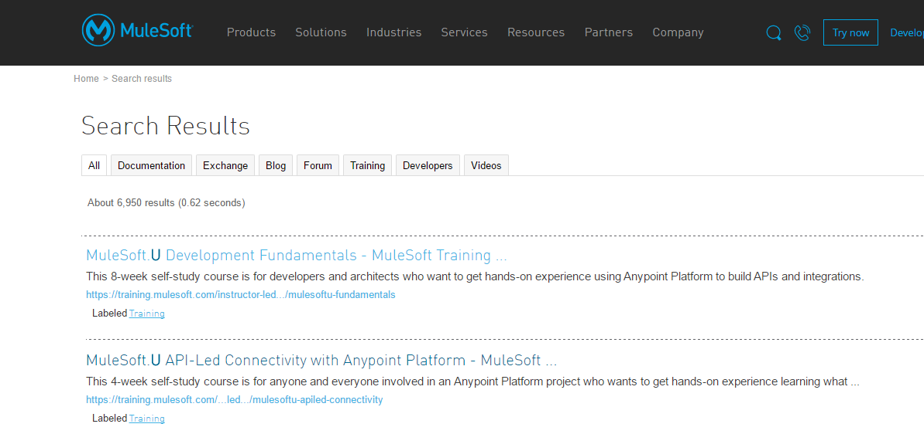
Learn Mule by self
自学mulesoft
Chinasofti MuleSoft Training 2017
Notes:
培训说明和Mulesoft总体介绍(15-25分钟)

Slide 13
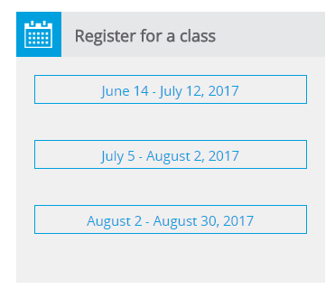
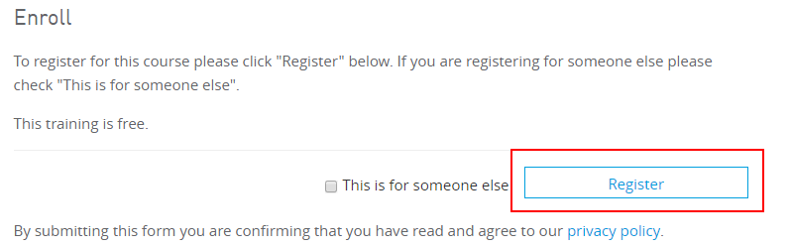
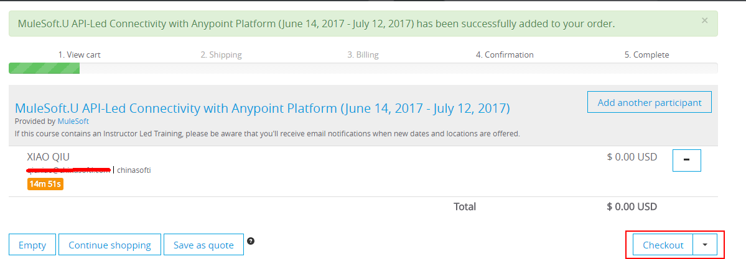
Learn Mule by self
自学mulesoft
Chinasofti MuleSoft Training 2017
Notes:
培训说明和Mulesoft总体介绍(15-25分钟)

Slide 14
Thanks
课程介绍结束
Chinasofti MuleSoft Training 2017
Notes:
培训说明和Mulesoft总体介绍(15-25分钟)

