Slide 1
What to do if you are sick?😢
🦟 Study in dengue patients and age of group in Thailand between 2016 to 2020

Slide 2
Overview
Key facts
⚠ The infection causes flu-like illness, and occasionally develops into a potentially lethal.
⚠ There is no specific treatment for dengue, but early detection and access to proper medical care lowers fatality rates below 1%.
Objectives
🔮 To predict the number of patients by temperature, rainfall, humidity.
📊 To visualize information that is relevant to the data.

Slide 3
Dataset
🤒 Dengue dataset
🌧 Rain dataset
🌡 Temp. dataset
🦟
💦 Humidity dataset
Source:
Dengue patient dataset - Department of disease control - Ministry of Public Health. (476,935 observations)
Rain, Humidity, Temperature dataset - National Statistical Office of Thailand

Slide 4
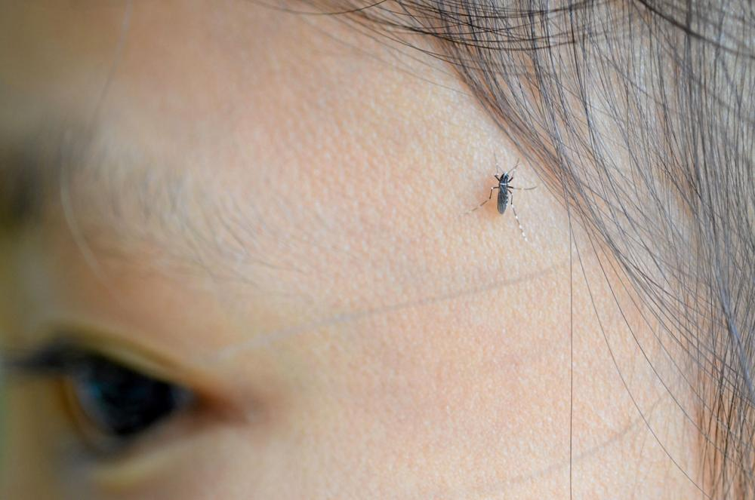
Temperature
28-35 Celsius. Aedes mosquitoes take about 9-14 days to grow from egg to adult.
If the temperature is higher than 35 Celsius, Aedes mosquitoes only take 5-7 days to grow.
Thairath Online

Slide 5
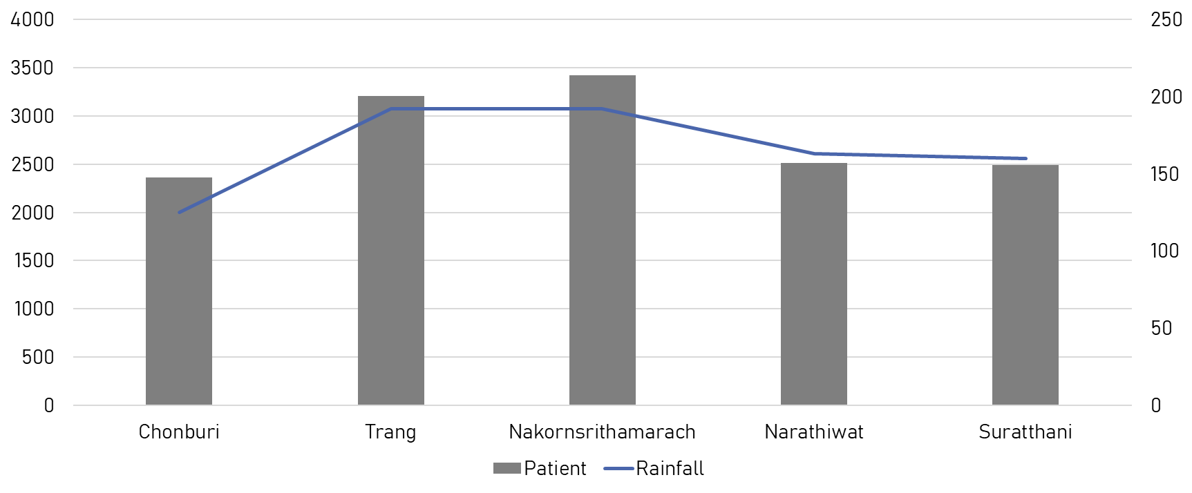
Rainfall 🌧

Slide 6
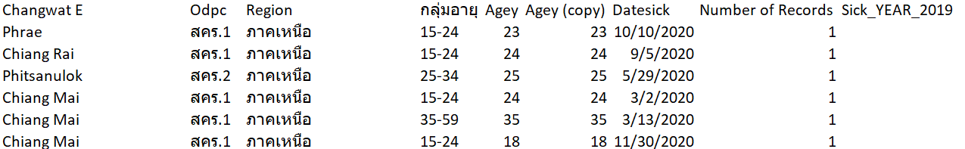
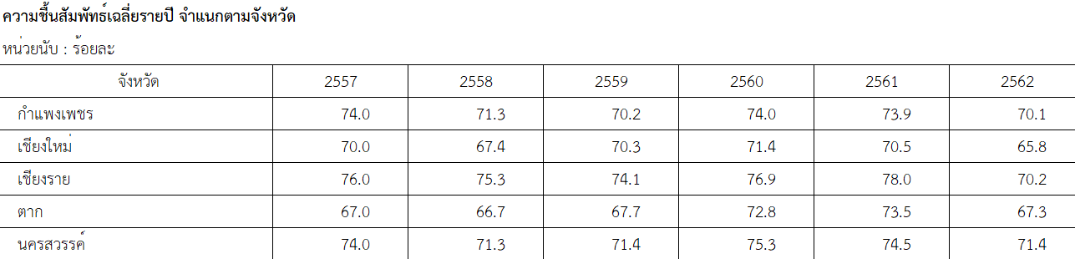
Sample
Dengue patient
Humidity

Slide 7
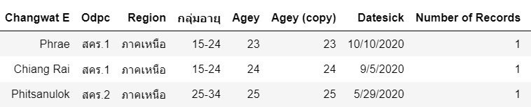

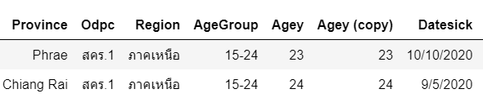
Data preprocessing
🥵 Challenge of THAI datasets

Slide 8
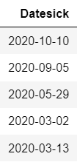

Data preprocessing
Challenge of THAI datasets 🥵
Extract year
B.E. to A.D

Slide 9

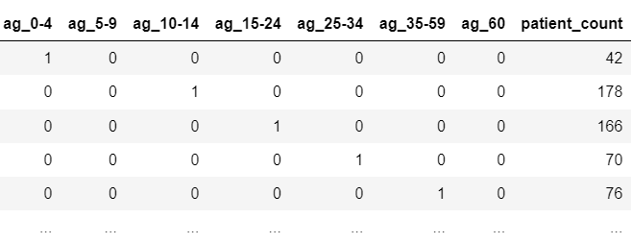
Data preprocessing
One hot encoding
Extract year

Slide 10
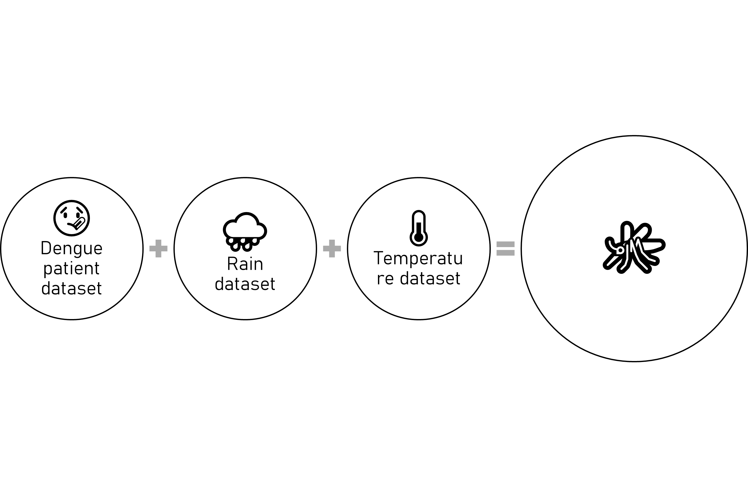
Data preprocessing
What are you doing?
☠ The infection causes flu-like illness, and occasionally develops into a potentially lethal. [1]
⏲ There is no specific treatment for dengue, but early detection and access to proper medical care lowers fatality rates below 1%.

Slide 11
Data preprocessing
📈 Linear regression model
⚙ Processed

Slide 12
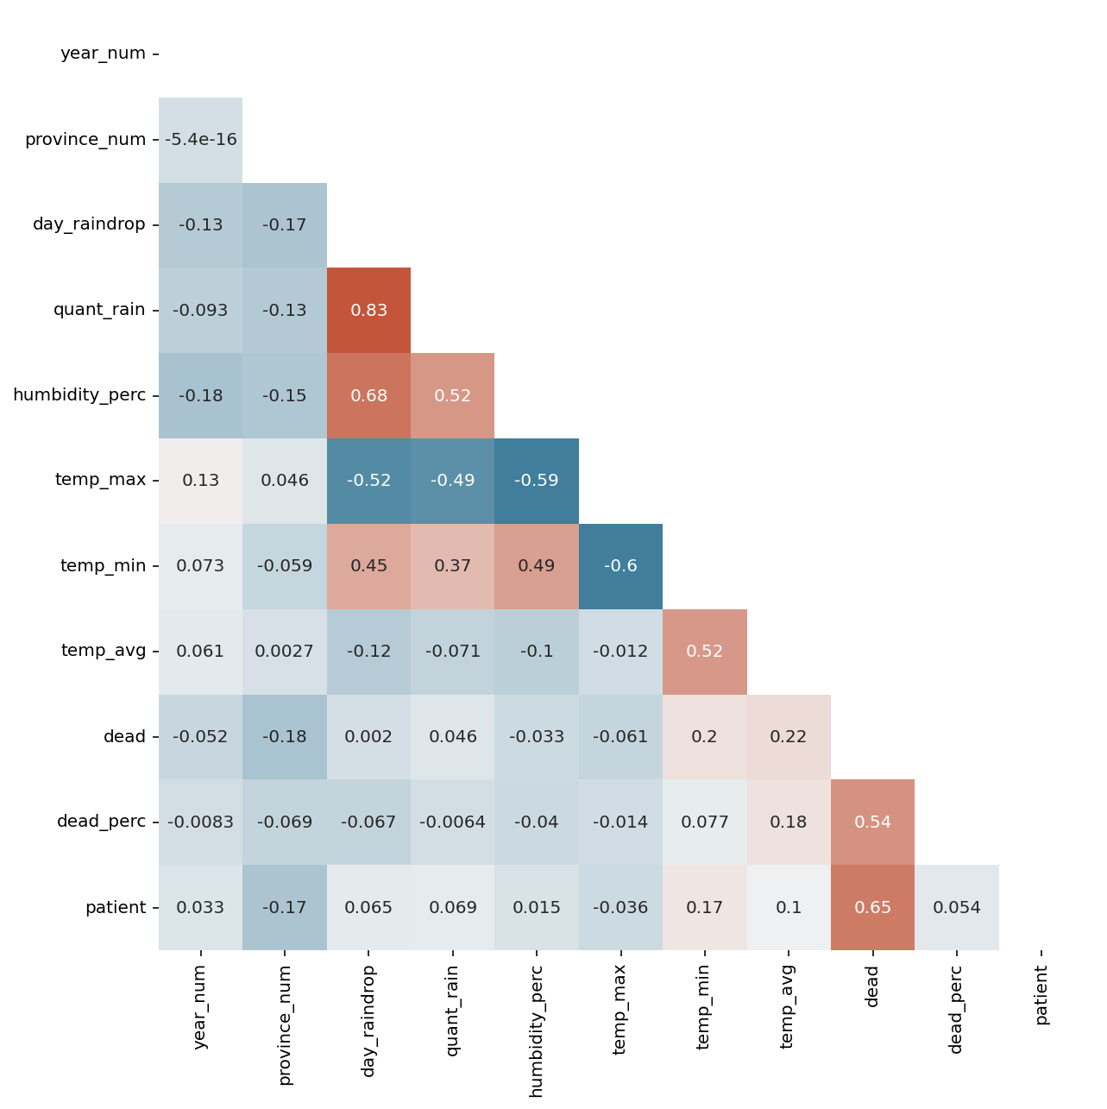
Regression model

Slide 13
Try to test in 5 methods
Multiple Linear Regression (Original)
K-folds Cross Validation (+ Repeats)
Features Selection: Recursive Feature Elimination (RFE)
Grid Search CV
Polynomial Regression ⭐

Slide 14
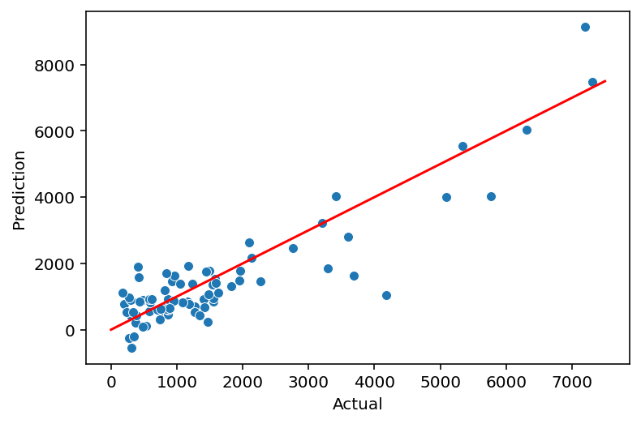
Polynomial regression
Degree = 2

Slide 15
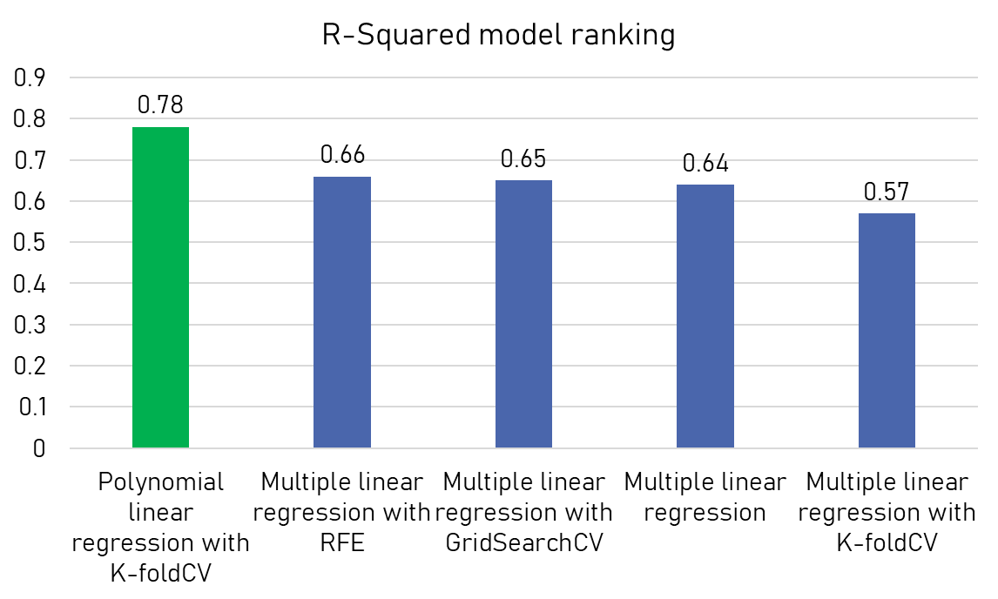
Polynomial regression
👑

Slide 16
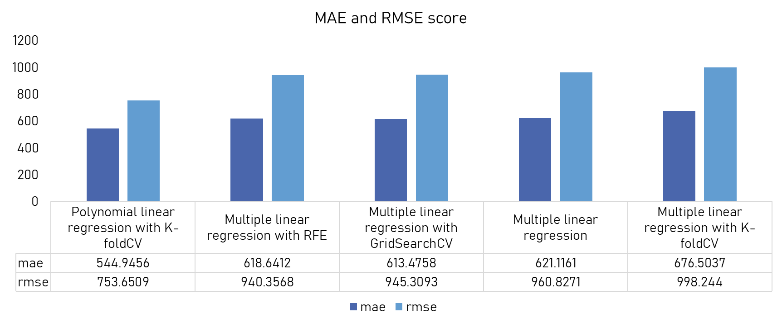
Polynomial regression

Slide 17
Sample results
Province | Year | Actual Patient | Predicted Patient | Accuracy
Trang | 2020 | 3211 | 3225.647 | 0.995
Songkhla | 2017 | 7314 | 7472.123 | 0.979
Nakhon Sri Thammarat | 2020 | 3419 | 4024.796 | 0.849
Kanjanaburi | 2020 | 1491 | 1769.510 | 0.843
Ubon Ratchathani | 2020 | 2092 | 2635.774 | 0.794
Nakhon Ratchasima | 2016 | 7194 | 9131.089 | 0.788

Slide 18
Conclusion
👍🏽 Machine learning
👍🏽 Visualization
👍🏽
🤔 More observations more dataset.
🤔 For decision making or second opinion.

Slide 19
Rain fall

Slide 20
Code
👩🏼‍💻 https://github.com/Phophism/python_project
Reference
Dengue fever: Thai researchers who co-developed the world's first dengue vaccine offer the government to accelerate vaccine procurement
Dengue fever situation in Thailand 2020. Chulabhorn Hospital.
Fact sheet: Dengue and severe dengue Updated April 2017, World Health Organization.
Ecological biology and mosquito control in Thailand. Department of Medical Sciences.

Slide 21
Stay safe❤
Thank you

