Slide 1
What to do if you are sick?😢
🦟 Dengue patient estimation and visualization from weather data using simple linear regression between 2016 to 2020

Slide 2
Overview
Key facts
- The infection causes flu-like illness, and occasionally develops into a potentially lethal.
- There is no specific treatment for dengue, but early detection and access to proper medical care lowers fatality rates below 1%.
Objectives
🔮 To predict the number of patients by temperature, rainfall, humidity.
✨ To cluster the patient into multiple groups of regions.
📊 To visualize information that is relevant to the data.

Slide 3
Dataset
🤒 Dengue dataset
🌧 Rain dataset
🌡 Temp. dataset
💦 Humidity dataset
Source:
Dengue patient dataset - Department of disease control - Ministry of Public Health. (476,935 observations)
Rain, Humidity, Temperature dataset - National Statistical Office of Thailand

Slide 4
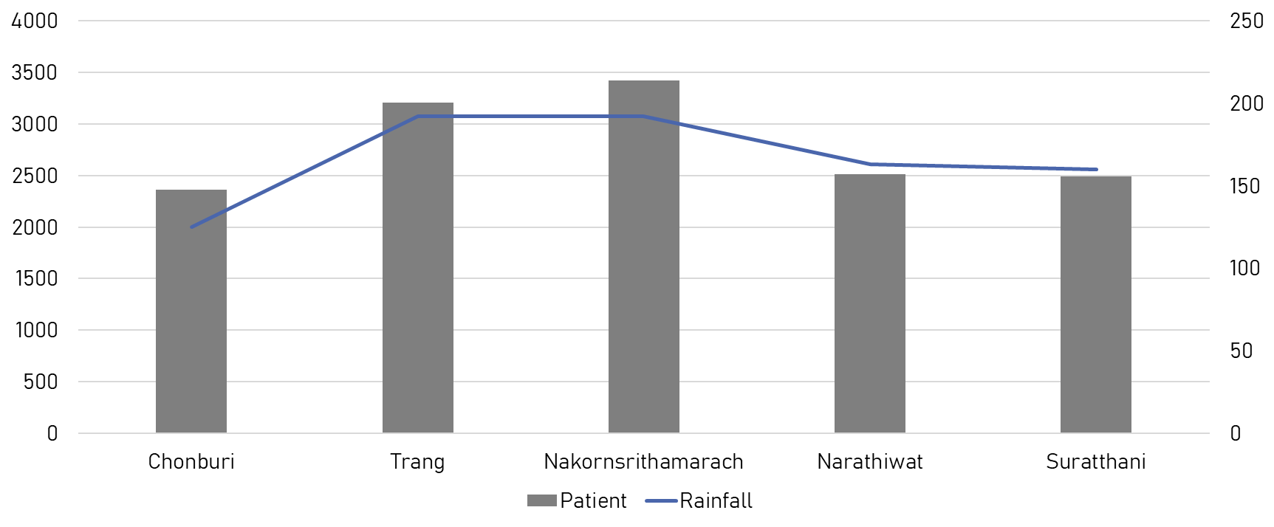
Why ? Rainfall
Environmental and climatic affecting the rapid spread of the disease. Rainfall, humidity and temperature are relative to the Aedes larvae index (Papanit Suangto, Watcharee Kaewnokkhao and Saman Sayumpuruchinan, 2013).

Slide 5
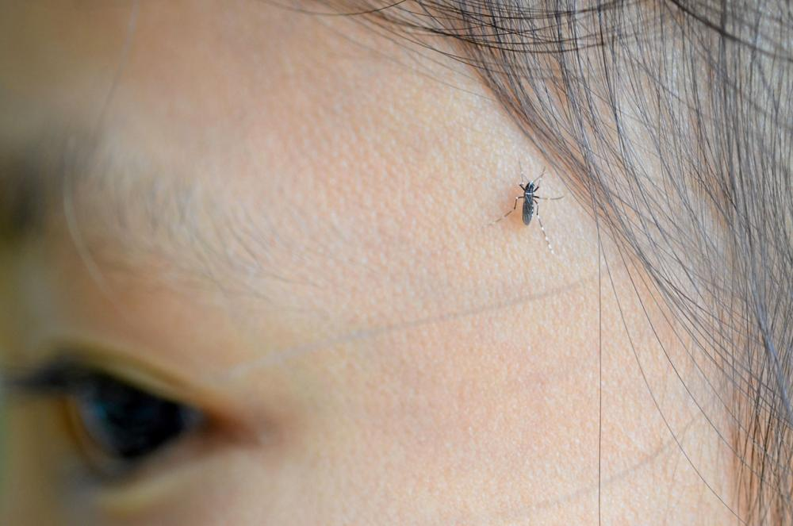
Temperature
28-35 Celsius. Aedes mosquitoes take about 9-14 days to grow from egg to adult.
If the temperature is higher than 35 Celsius, Aedes mosquitoes only take 5-7 days to grow.
Thairath Online

Slide 6
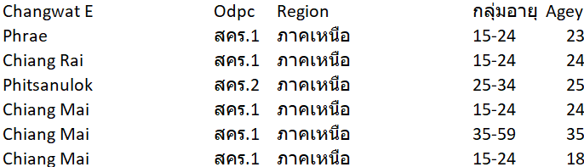
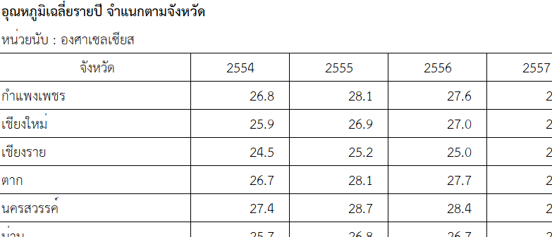
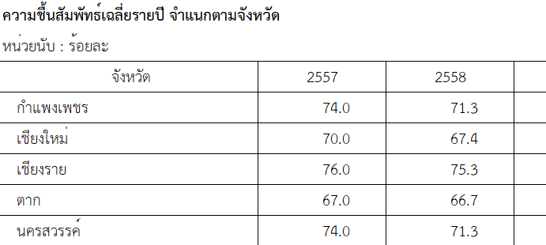
Sample data
Dengue patient
Average temp.
Humidity

Slide 7
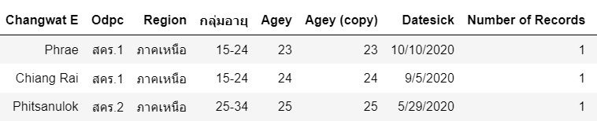
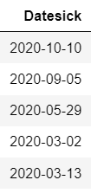


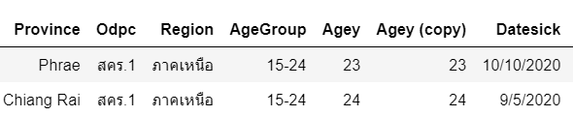
Data preprocessing🧹
Challenge of THAI datasets
Extract year
Rename column

Slide 8
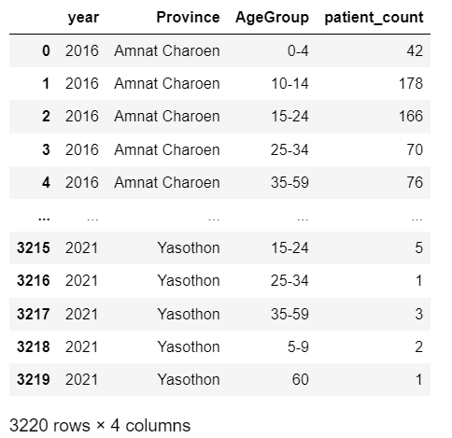
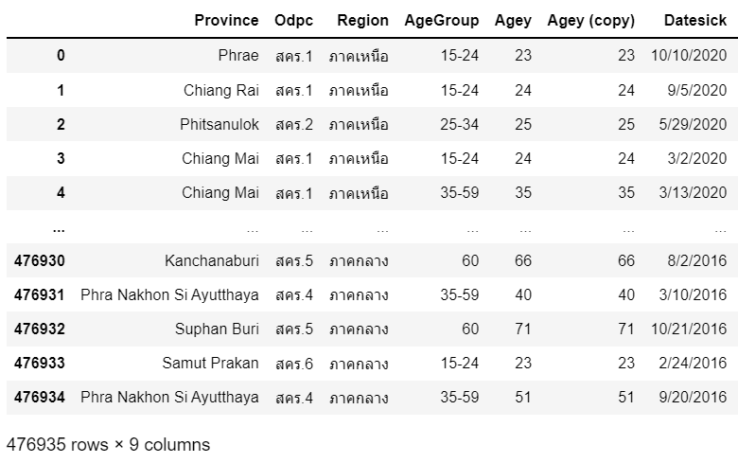
Data preprocessing
Count number of patient by “Year”

Slide 9
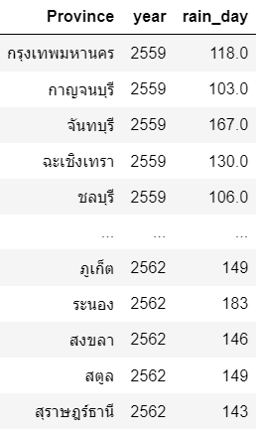
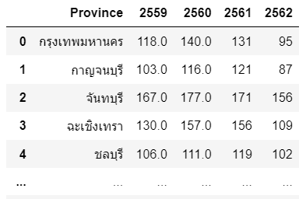

Data preprocessing
Convert wide data type to long data type
🌧Rain (days)

Slide 10
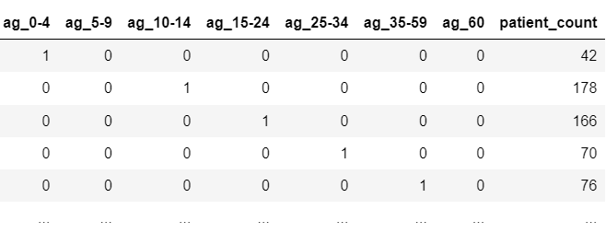

Data preprocessing
One hot encoding

Slide 11
Try to test in 5 methods 🛠
Multiple Linear Regression (Original)
K-folds Cross Validation (+ Repeats)
Features Selection: Recursive Feature Elimination (RFE)
Grid Search CV
Polynomial Regression

Slide 12
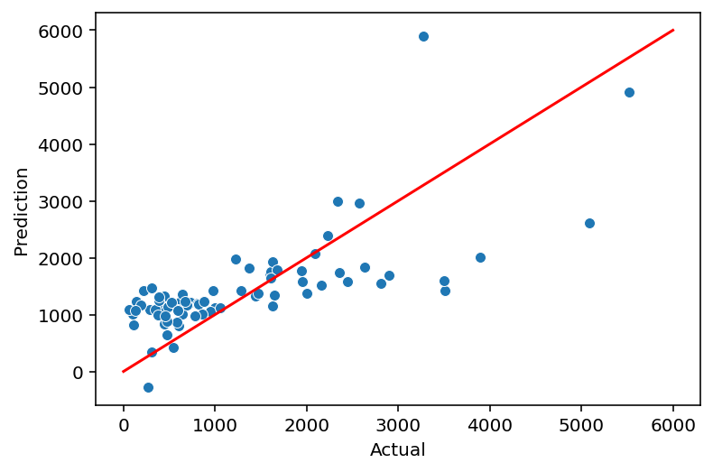
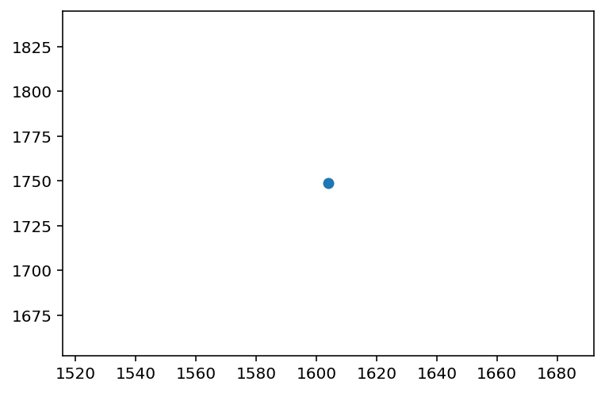
Multiple Linear Regression
Sample
Kalasin
Actual Patient 1604.0
Predicted Patient 1748

Slide 13
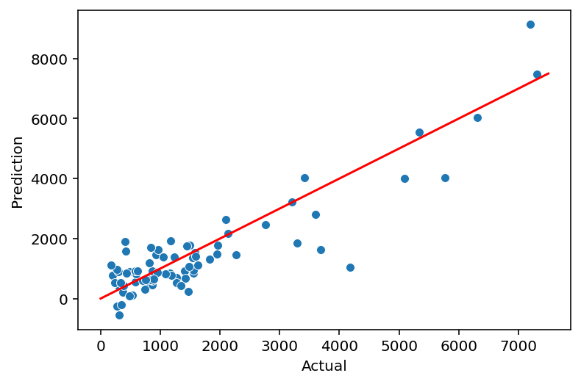
Polynomial regression
Degree = 2
Polynomial Regression is a form of linear regression in which the relationship between the independent variable x and dependent variable y is modelled as an nth degree polynomial.

Slide 14
Polynomial regression
⭐

Slide 15
Polynomial regression

Slide 16
Prediction results
Province | Actual Patient | Predicted Patient | Accuracy
Trang | 3211 | 3225.647 | 0.995
Songkhla | 7314 | 7472.123 | 0.979
Nakhon Sri Thammarat | 3419 | 4024.796 | 0.849
Kanjanaburi | 1491 | 1769.510 | 0.843
Ubon Ratchathani | 2092 | 2635.774 | 0.794
Nakhon Ratchasima | 7194 | 9131.089 | 0.788
… | … | … | …

Slide 17
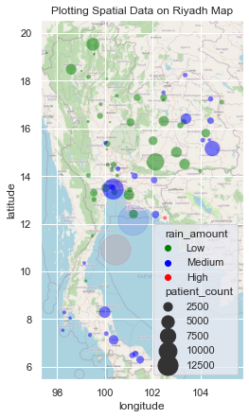
Clusters
Green color is low rain (1181)
Blue color is medium rain (2155)
Red color is high rain (3647)
Size of the circle is demonstrated by the percentage of deaths by Dengue
Centroid

Slide 18
Clusters
Province | patient_count | rain_ml | rain_day | rain_amount
Mukdahan | 1576 | 1587.0 | 110 | Medium
Ubon Ratchathani | 7583 | 1697.7 | 130 | Medium
Sa kaeo | 1503 | 1638.0 | 130 | Medium
Nakhon Phanom | 1038 | 2178.1 | 127 | Medium
* Northeastern 66.62 per 100,000 population sick with dengue. BBC Thai.

Slide 19
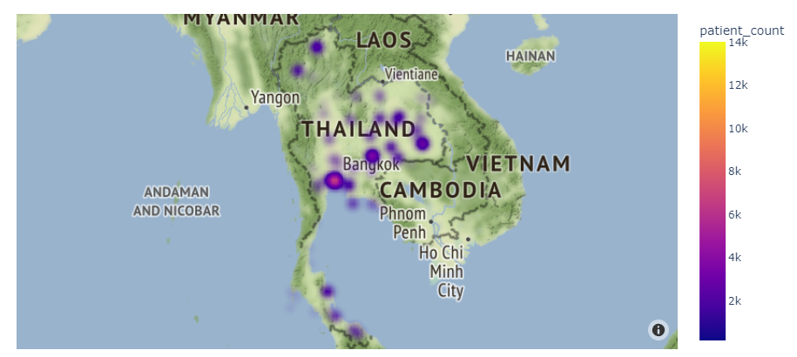
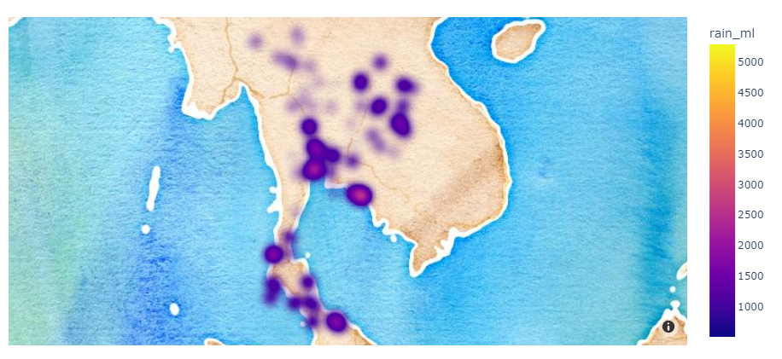
Heatmap
2019
2019
Rainfall in Thailand
Cases and the concentration of patients

Slide 20
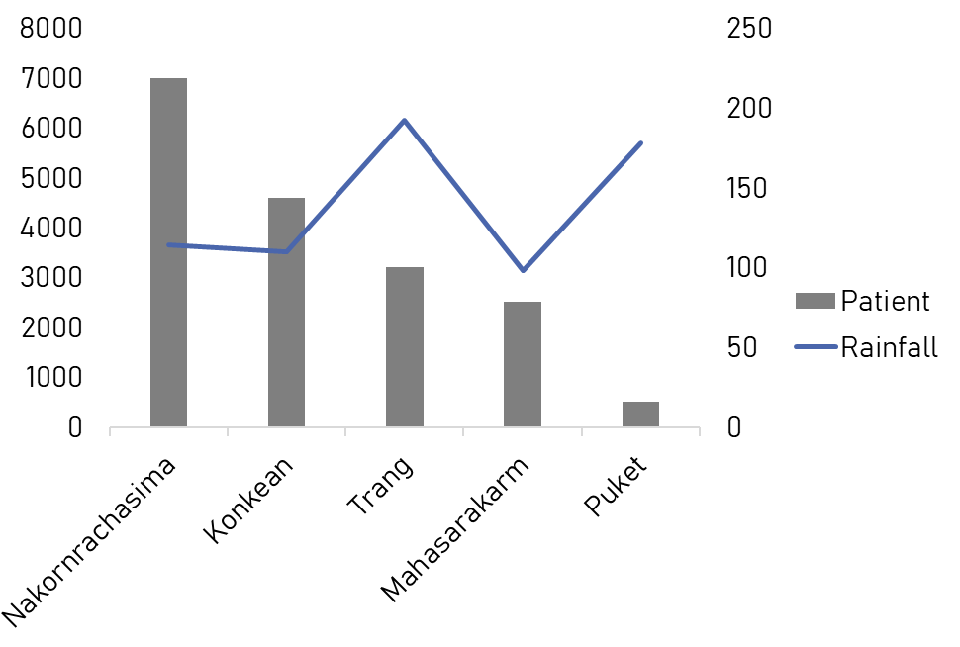
However
The outbreak of dengue cannot be described as caused by the proliferation of Aedes mosquitoes only in the rainy season (Tonn et al., 1969).

Slide 21
Conclusion
👍🏽
The predicted results of the model are satisfied in some provinces, on the other hand, some provinces need more variables or more data to improve results.
Clustering are related with visualization.
Visualization are related with clustering.
🤔
Limitation data the same kind of data is distributed. such as climate data are under the organization that does not own the data and is difficult to access information.
For more accuracy of prediction and clustering dengue patients with adding more features like “swamp” that are a source of Aedes for growth and cause to illness.

Slide 22
Code
👩🏼‍💻 https://github.com/Phophism/python_project
Reference
Dengue fever: Thai researchers who co-developed the world's first dengue vaccine offer the government to accelerate vaccine procurement
Dengue fever situation in Thailand 2020. Chulabhorn Hospital.
Dengue Fever: The Department of Disease Control reveals that the number of cases has almost doubled from 2018.
Fact sheet: Dengue and severe dengue Updated April 2017, World Health Organization.
Ecological biology and mosquito control in Thailand. Department of Medical Sciences.

Slide 23
Stay safe❤
Thank you

