Slide 1
What to do if you are sick?😢
🦟 Study in dengue patients and age of group in Thailand between 2016 to 2020

Slide 2
Overview
Key facts
⚠ The infection causes flu-like illness, and occasionally develops into a potentially lethal. [1]
⚠ There is no specific treatment for dengue, but early detection and access to proper medical care lowers fatality rates below 1%. [1]
Objectives
🔮 To predict the number of patients by rainfall, temperature, humidity.
📊 To visualize information that is relevant to the data.

Slide 3
Rain

Slide 4
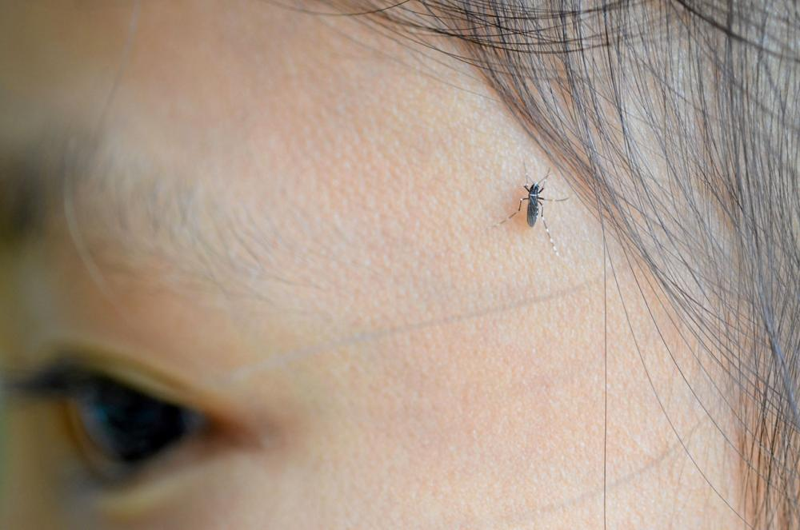
Temperature
1
2
3
Thairath online

Slide 5
Data preprocessing
Source: National Statistical Office of Thailand
🌧 Rain dataset
🌡 Temperature dataset
🤒 Dengue patient dataset
Source: Department of disease control - Ministry of Public Health
476,935 rows/observations.

Slide 6
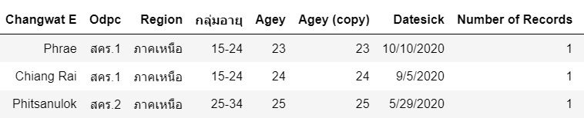

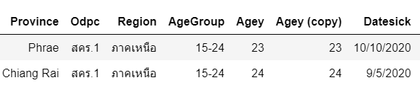
Data preprocessing
Challenge of THAI datasets 🥵

Slide 7
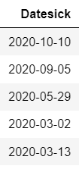

Data preprocessing
Challenge of THAI datasets 🥵
Extract year
B.E. to A.D

Slide 8

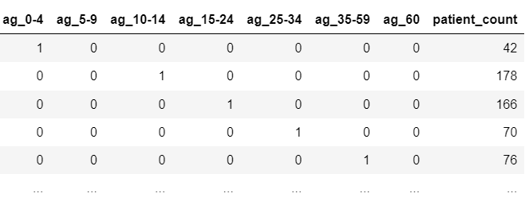
Data preprocessing
One hot encoding
Extract year

Slide 9
Data preprocessing
🤒 Dengue patient dataset
🌧 Rain dataset
🌡 Temperature dataset
🦟

Slide 10
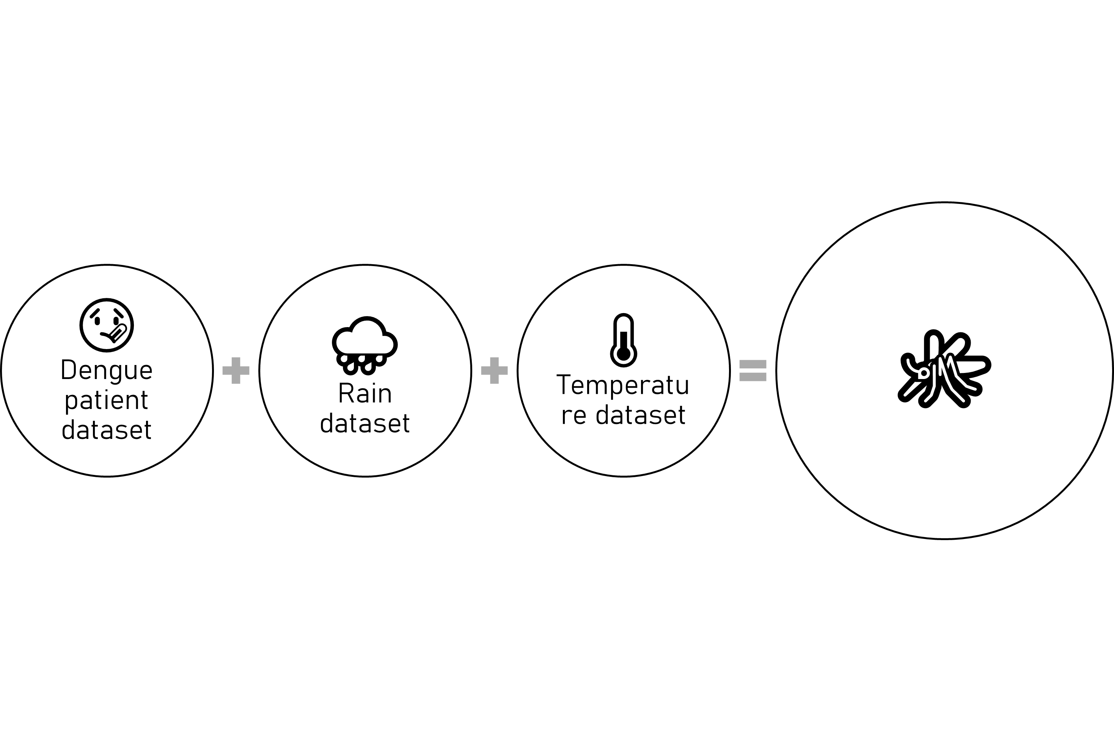
Data preprocessing
What are you doing?
☠ The infection causes flu-like illness, and occasionally develops into a potentially lethal. [1]
⏲ There is no specific treatment for dengue, but early detection and access to proper medical care lowers fatality rates below 1%.

Slide 11
Data preprocessing
📈 Linear regression model
⚙ Processed
🧮 Clustering model

Slide 12
Linear regression model
📈 Linear regression model
⚙ Processed
🧮 Clustering model

Slide 13
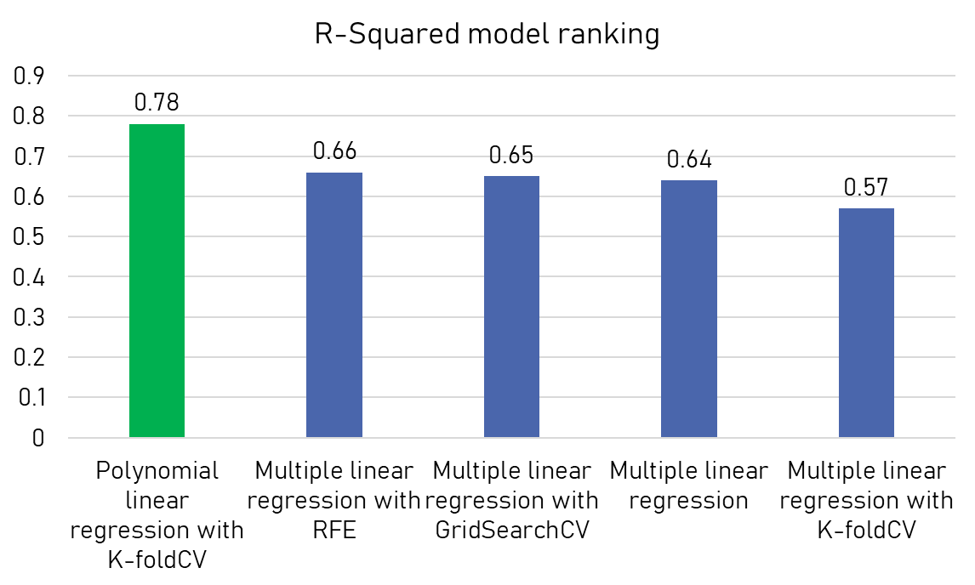
Test results
👑

Slide 14
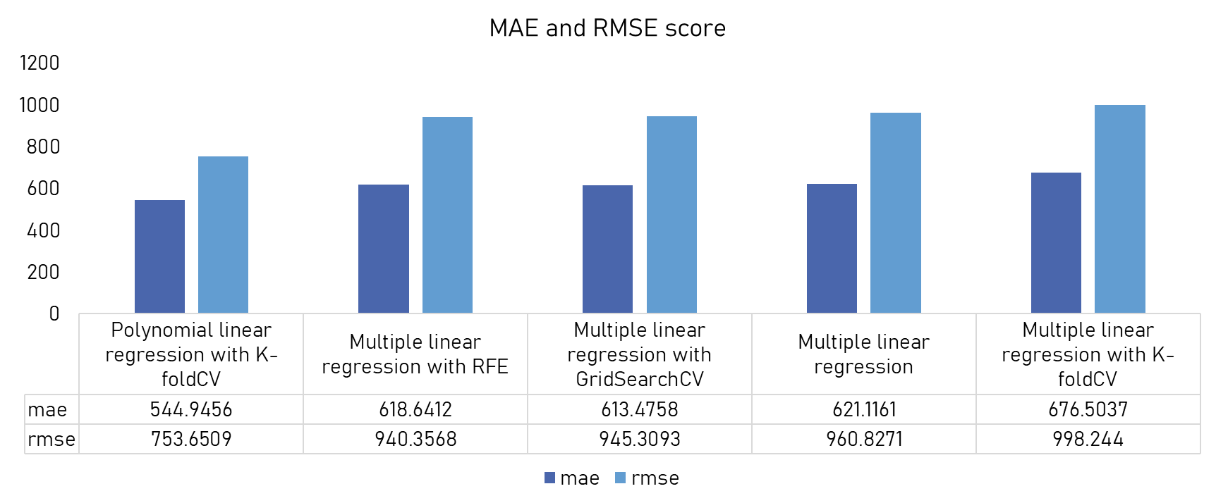
Test results

Slide 15
Clustering

Slide 16
Evaluation

Slide 17
Conclusion
👍🏽 Machine learning
👍🏽 Visualization
👍🏽
🤔 Suggestion

Slide 18
Code
👩🏼‍💻 https://github.com/Phophism/python_project
Reference
[1] Fact sheet: Dengue and severe dengue Updated April 2017, World Health Organization.
[2] https://www.bbc.com/thai/thailand-57479000
[3] https://www.chulabhornhospital.com/page.php?name=1142

Slide 19
Stay safe✌🏽
Thank you

