Slide 1
What to do if you are sick?😢
🦟 Study in dengue patients and age of group in Thailand between 2016 to 2020

Slide 2
Overview
Key facts
⚠ The infection causes flu-like illness, and occasionally develops into a potentially lethal.
⚠ There is no specific treatment for dengue, but early detection and access to proper medical care lowers fatality rates below 1%.
Objectives
🔮 To predict the number of patients by temperature, rainfall, humidity.
📊 To visualize information that is relevant to the data.

Slide 3
Dataset
🤒 Dengue dataset
🌧 Rain dataset
🌡 Temp. dataset
🦟
💦 Humidity dataset
Source:
Dengue patient dataset - Department of disease control - Ministry of Public Health. (476,935 observations)
Rain, Humidity, Temperature dataset - National Statistical Office of Thailand

Slide 4
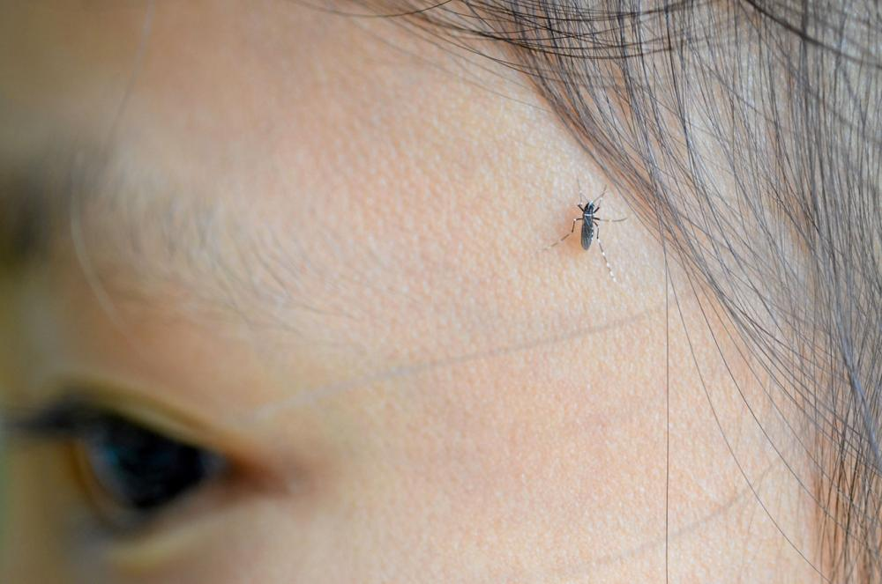
Temperature 🌡
28-35 Celsius. Aedes mosquitoes take about 9-14 days to grow from egg to adult.
If the temperature is higher than 35 Celsius, Aedes mosquitoes only take 5-7 days to grow.
Thairath Online

Slide 5
Rainfall

Slide 6
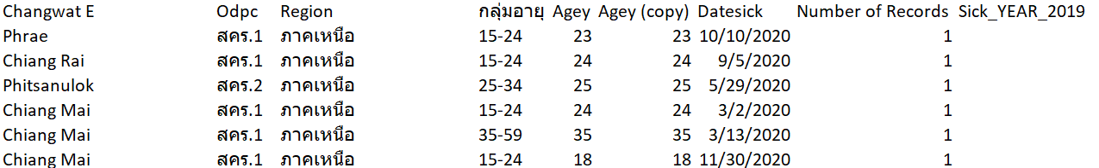
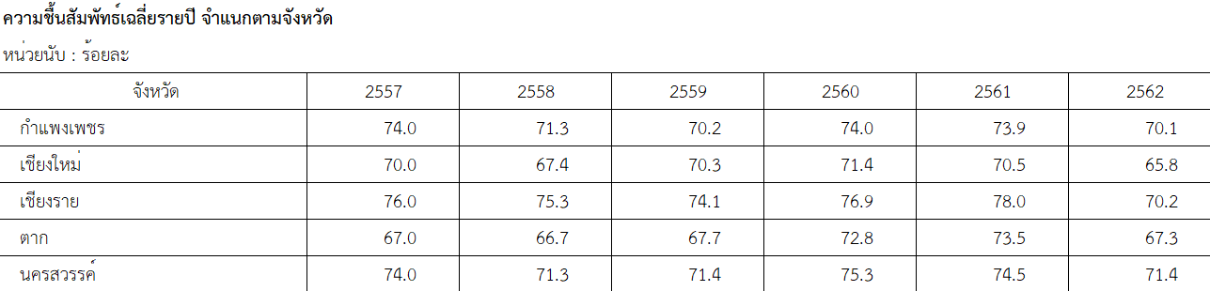
Sample
Dengue patient
Humidity

Slide 7
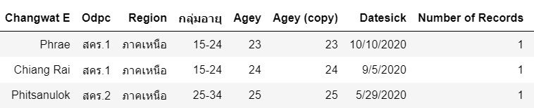

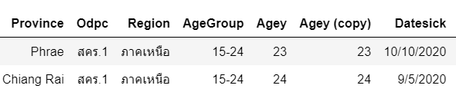
Data preprocessing
🥵 Challenge of THAI datasets

Slide 8
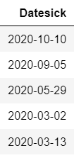

Data preprocessing
Challenge of THAI datasets 🥵
Extract year
B.E. to A.D

Slide 9

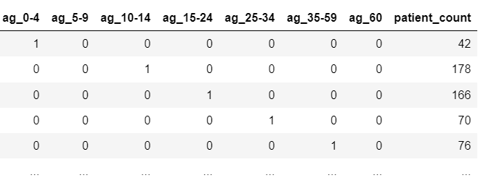
Data preprocessing
One hot encoding
Extract year

Slide 10
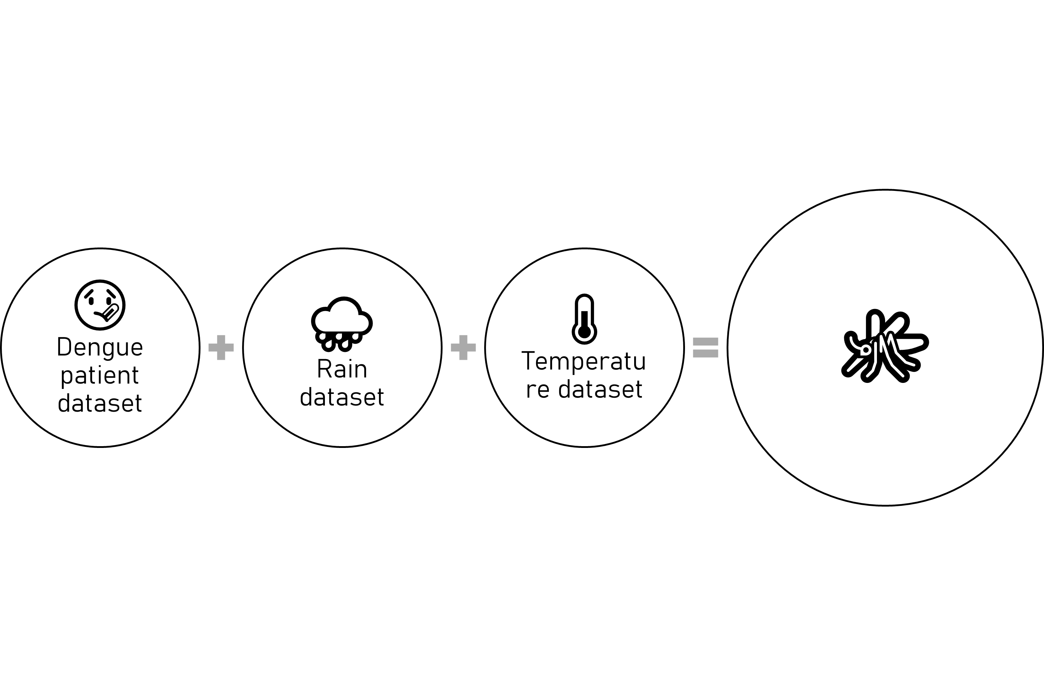
Data preprocessing
What are you doing?
☠ The infection causes flu-like illness, and occasionally develops into a potentially lethal. [1]
⏲ There is no specific treatment for dengue, but early detection and access to proper medical care lowers fatality rates below 1%.

Slide 11
Data preprocessing
📈 Linear regression model
⚙ Processed

Slide 12
Regression model
📈 Linear regression model

Slide 13
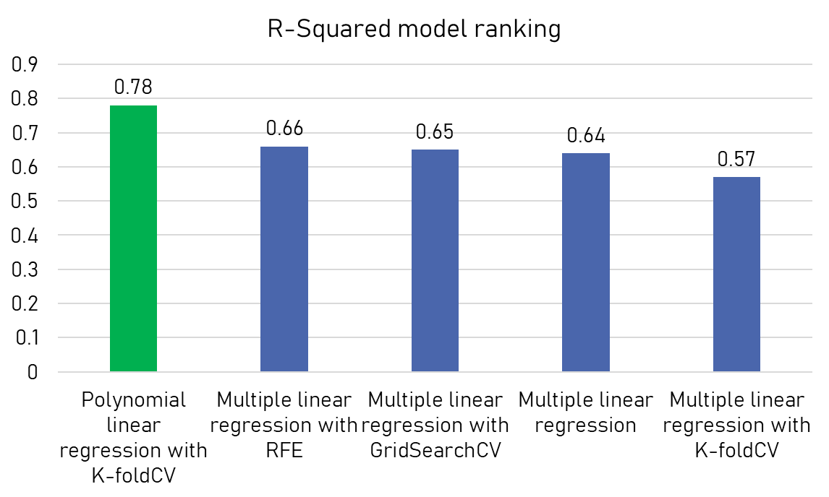
Test results
👑

Slide 14
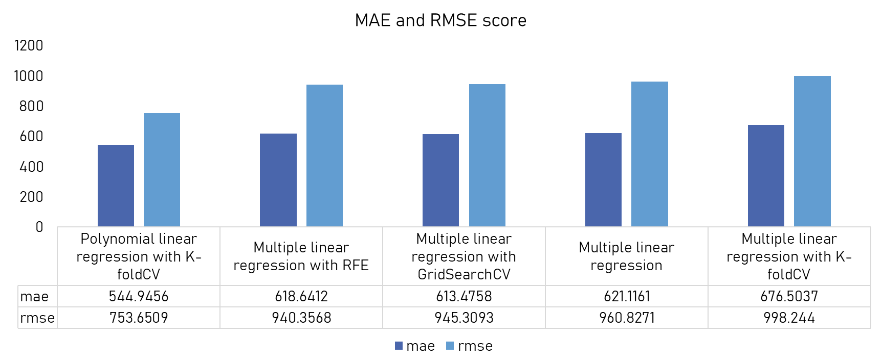
Test results

Slide 15
Test results
แสดง ตารางจังหวัดกับผลลัพธ์ที่พยากรออกมาได้

Slide 16
Conclusion
👍🏽 Machine learning
👍🏽 Visualization
👍🏽
🤔 More observations more dataset.
🤔 For decision making or second opinion.

Slide 17
Rain fall

Slide 18
Code
👩🏼‍💻 https://github.com/Phophism/python_project
Reference
Dengue fever: Thai researchers who co-developed the world's first dengue vaccine offer the government to accelerate vaccine procurement
Dengue fever situation in Thailand 2020. Chulabhorn Hospital.
Fact sheet: Dengue and severe dengue Updated April 2017, World Health Organization.
Ecological biology and mosquito control in Thailand. Department of Medical Sciences.

Slide 19

Stay safe❤
Thank you

