Slide 1
Blockchain Solution for Real Estate Transactions
Evaluating Hyperledger Fabric for Optimizing Real Estate Transactions
Tiago Sousa
Notes:
[Instructions]
In this project, you will briefly present your blockchain solution to your scenario of choice. You will complete this deck and make a video recording of your presentation. You will find some instructions for each slide in the speaker notes section. You can optionally use the speaker notes section to add scripts to your presentation.
If you are using Google Slides and want to use other types of layouts for your slides, you can click on Slide > Apply Layout and choose a layout.

Slide 2
Real Estate transactions
Overview
Currently, the real state transaction are in many cases slow, paper heavy,
prone to fraud and expensive.
Cost in traditional systems span from agent commissions, legal fees, title
insurance, taxes and several administrative charges.
Challenges
This costs all added make up for a significant percentage of the property's value,
making the process costly for buyers and sellers.
High load of burocracy.
High processing costs.
Notes:
[Instructions]
On this slide, you should introduce your use case and show comparable traditional approaches you found to compare it against. Make sure to:
Update the slide title to reflect your use case
Give a high-level overview of your scenario and list the challenges associated with it

Slide 3
Existing Solutions
Multiple Listing Service (MLS): is a centralized database where real estates agents and brokers list properties for sale. It allows agents to share information about properties and helps buyers find available homes.
Escrow: is a financial arrangement where a neutral third party (the escrow agent) holds funds and documents on behalf of the buyer and seller until all conditions of the transaction are met.
Title companies: are organizations that verify the legal ownership of a property and ensure there are no claims, liens, or disputes before a sale. They also provide title insurance to protect buyers and lenders from future ownership issues.
Notaries: are authorized officials who verify the identity of parties, witness signatures, and certify documents. Legal professionals (lawyers, solicitors provide legal advice, draft contracts, and ensure compliance with laws).
Notes:
[Instructions]
On this slide, you should show some non-blockchain alternatives and call out how these centralized systems fail.
Be sure to answer the following questions:
What are the problems in the current systems?
Will decentralized features, such as transparency, access, censorship resistance, and resilience, provide value in the use case you’ve chosen?

Slide 4
Existing Solutions (cont.)
Banks and mortgage lenders: are financial institutions that provide loans to buyers for purchasing real estate. They assess creditworthiness, offer financing options, and manage payments over the life of the loan.
Government registries: are official databases maintained by local or national authorities to record property ownership, transfers, and related legal documents. They ensure legal recognition and public record of property rights.
Notes:
[Instructions]
On this slide, you should show some non-blockchain alternatives and call out how these centralized systems fail.
Be sure to answer the following questions:
What are the problems in the current systems?
Will decentralized features, such as transparency, access, censorship resistance, and resilience, provide value in the use case you’ve chosen?

Slide 5
Why Build on blockchain-based implementation?
Transparency: All transaction records are stored on a public or permissioned ledger, making ownership
history and transfers easily auditable and reducing fraud.
Efficiency: Smart contracts automate processes like payments, escrow, and title transfers, reducing
paperwork and speeding up transactions.
Cost Reduction: By minimizing intermediaries (agents, escrow, title companies), blockchain can lower fees
and administrative costs.
Security: Cryptographic verification and decentralized storage protect against tampering and unauthorized changes.
Accessibility: Parties can access records and verify ownership instantly, even across jurisdictions.
Immutability: Once recorded, transaction data cannot be altered, ensuring a reliable and permanent
record.
Notes:
[Instructions]
Analyze at least 2-3 potential blockchain platforms. Research technical attributes and the consensus approach of the blockchain
On this slide, you should present and explain the benefits of your chosen blockchain platform. Make sure to:
Research the technical aspects of your chosen blockchain and match it to the use case.
Update the slide title to reflect your choice of blockchain
List your reasons for this question: Why are you opting to build on your blockchain of choice?
Prioritizes criteria like decentralization needs and performance
Evaluate how many transactions the system would need to handle
Analyze how fast the system needs to process transactions to meet demands and still work well as usage grows

Slide 6
Alternative Blockchains
Ethereum:
  Consensus Approach: Proof of Stake (PoS)
  Technical Attributes: Smart contracts, public ledger, tokenization standards (ERC-721, ERC-1155), large developer ecosystem
  Suitability: Good for transparent ownership records and automation, but has scalability and cost concerns.
Hyperledger Fabric:
  Consensus Approach: Pluggable consensus (e.g., Raft, Kafka)
  Technical Attributes: Permissioned blockchain, modular architecture, private channels, chaincode in Go/Java/Node.js, high throughput
  Suitability: Ideal for enterprise and government use cases requiring privacy and compliance.
Notes:
[Instructions]
On this slide, you should
Name and explain some alternative chains you considered, and
Explain why you chose the blockchain mentioned on the previous slide above the alternatives.

Slide 7
Alternative Blockchains (cont.)
Polygon:
  Consensus Approach: Proof of Stake (PoS)
  Technical Attributes: Layer 2 scaling solution for Ethereum, fast and low-cost transactions, Ethereum-compatible smart contracts, interoperability bridges
  Suitability: Good for scalable, cost-effective applications such as high-volume property listings.
Notes:
[Instructions]
On this slide, you should
Name and explain some alternative chains you considered, and
Explain why you chose the blockchain mentioned on the previous slide above the alternatives.

Slide 8
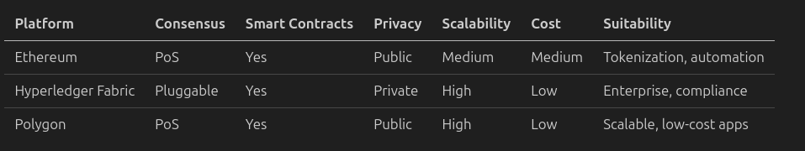
Chosen Blockchain
Notes:
[Instructions]
On this slide, you should
Name and explain some alternative chains you considered, and
Explain why you chose the blockchain mentioned on the previous slide above the alternatives.

Slide 9
Chosen Blockchain (cont.)
Hyperledger Fabric:
  Privacy & Compliance: Permissioned network ensures only authorized parties access sensitive property and financial data, meeting regulatory requirements
  Confidential Transactions: Private channels allow secure negotiations between specific parties (buyer-seller-bank) without exposing details to the entire network
  Enterprise Integration: Designed for business use, enabling seamless integration with existing MLS, title companies, and government registry systems
  High Performance: Supports high transaction throughput with low latency, essential for processing multiple property deals efficiently
  Flexible Consensus: Pluggable consensus mechanisms can be tailored to specific regional or organizational trust requirements
  Smart Contract Automation: Chaincode automates escrow, title transfers, and payments while maintaining enterprise-grade security and compliance.
Notes:
[Instructions]
On this slide, you should
Name and explain some alternative chains you considered, and
Explain why you chose the blockchain mentioned on the previous slide above the alternatives.

Slide 10
Technical Implementation
Client Applications
Fabric SDK
Peers (Endorsers)
Entry points for all participants (buyers, sellers, agents, banks, government registries).
Real Estate Role: Web or mobile apps where users initiate property transactions, submit documents, make payments, and track transaction status.
Acts as a bridge between client applications and the Hyperledger Fabric network, providing APIs to submit transactions, query the ledger, and manage identities.
Enables developers to build user-friendly web or mobile apps for buyers, sellers, agents, and banks to interact with the blockchain seamlessly.
Network nodes that store the ledger, execute chaincode (smart contracts), and validate transactions.
Maintain copies of property records, execute business logic for transfers, and endorse transaction proposals
Notes:
[Instructions]
On this slide, you should dive into the technical implementation of your use case.
You don’t need to get into code details here, but given all the knowledge you’ve acquired on blockchain, how would you approach the high-level architecture and what components of your use case need to live on blockchain?

Slide 11
Technical Implementation (cont.)
Ordering Service
Certificate Authority (CA)
Channels
Collects endorsed transactions, orders them chronologically, and packages them into blocks.
Ensures all property transactions are processed in the correct sequence to prevent double-spending or conflicting ownership claims.
Issues digital identities and manages authentication for network participants.
Verifies the identity of buyers, sellers, agents, banks, and government entities.
Private communication subnets that isolate transactions between specific parties.
Enable confidential negotiations and transactions between relevant parties only.
Notes:
[Instructions]
On this slide, you should dive into the technical implementation of your use case.
You don’t need to get into code details here, but given all the knowledge you’ve acquired on blockchain, how would you approach the high-level architecture and what components of your use case need to live on blockchain?

Slide 12
Technical Implementation (cont.)
Smart Contracts (Chaincode)
Ledger
Programmable business logic that automates transaction processes.
Automate escrow, title transfers, payment releases, and compliance checks.
Immutable distributed database storing all transaction history.
Maintains complete property ownership history, transaction records, and legal documents.
Notes:
[Instructions]
On this slide, you should dive into the technical implementation of your use case.
You don’t need to get into code details here, but given all the knowledge you’ve acquired on blockchain, how would you approach the high-level architecture and what components of your use case need to live on blockchain?

Slide 13
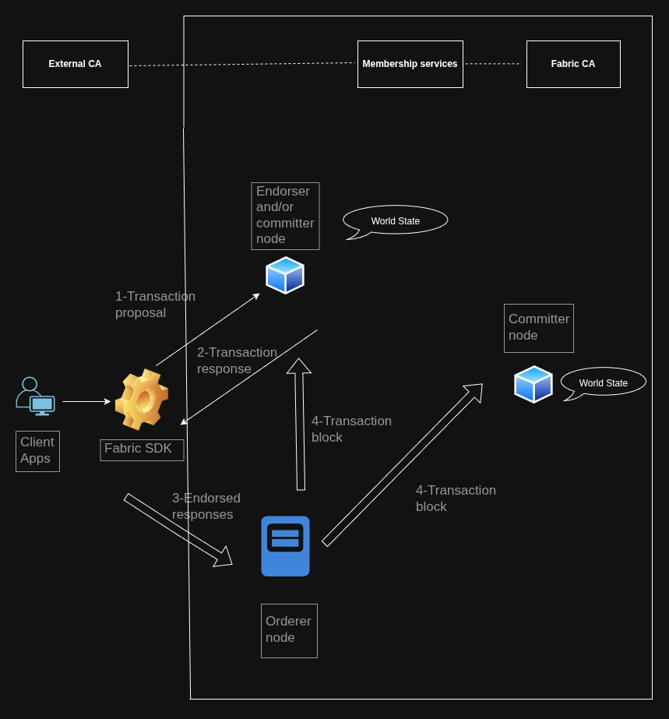
Architecture Diagram
Notes:
[Instructions]
On this slide, you should map out at a high level the flow of information of your use case. Visualize major user steps connecting on-chain and off-chain.
Here are some tips:
Your diagram should depict key components and flows at a high level and show how blockchain integrates with overall system.
This should be high-level enough that within 20 seconds your reader should understand what is happening.
You don’t need to go too much into details, but it is recommended to use brief annotations to guide your explanations of the user and data flow.
To draw the diagram, you can use tools like draw.io, https://excalidraw.com/, Google slides’ built-in shapes and arrows (click on “Insert” in the top toolbar, then “Shape” or “Line” if you are using Google Slides), or other options.

Slide 14
Architecture Challenges
Scalability challenges: may face performance bottlenecks when handling thousands of simultaneous real estate transactions across multiple regions.
  Possible solutions: multiple channels per geographic region, horizontal scalling, off chain storage of large documents, optimization of chain code.
User Experience (UX) Challenges: Poorly designed interfaces may hinder adoption to non technical users.
  Possible solutions: development of intuitive web and mobile applications, training for users, gradual migration strategy.
Regulatory requirements: Real estate regulations vary significantly across jurisdictions and transactions may not be legally recognized in some regions.
  Possible solutions: Collaborate with regulatory bodies to establish blockchain-friendly policies and framework
Notes:
[Instructions]
On this slide, you should answer the following questions:
What technical and practical challenges do you anticipate? Discuss potential implementation challenges such as scalability, user experience, regulatory requirements, adoption incentives, and other relevant factors.
[Nice-to-have] How could these be addressed?
[Nice-to-have] What alternatives could complement the blockchain aspects?

Slide 15
Architecture Challenges (cont.)
Adoption incentives: Convincing established real estate industry players to adopt blockchain technology can be difficult, when the existing systems are working.
  Possible solutions: Demonstrate clear ROI by showcasing reduced transaction costs, faster processing times, and enhanced security. Launch pilot programs with progressive real estate agencies to prove the system’s value.
Notes:
[Instructions]
On this slide, you should answer the following questions:
What technical and practical challenges do you anticipate? Discuss potential implementation challenges such as scalability, user experience, regulatory requirements, adoption incentives, and other relevant factors.
[Nice-to-have] How could these be addressed?
[Nice-to-have] What alternatives could complement the blockchain aspects?

Slide 16
Notes:
[Instructions]
Lastly, make a video recording of yourself presenting your entire presentation and introducing your use case and solution.
Here are some requirements for the video:
3-5 minutes should be enough to explain your project but feel free to go into more detail if you need. Do not exceed 7 minutes in your video.
Speak clearly and do not rush explanations.
You can use tools like Loom or Veed to record your screen while presenting the slides
https://www.loom.com/
https://www.veed.io/
Export the video file from your software in a common video format like .mp4 or .mov.

