Slide 1
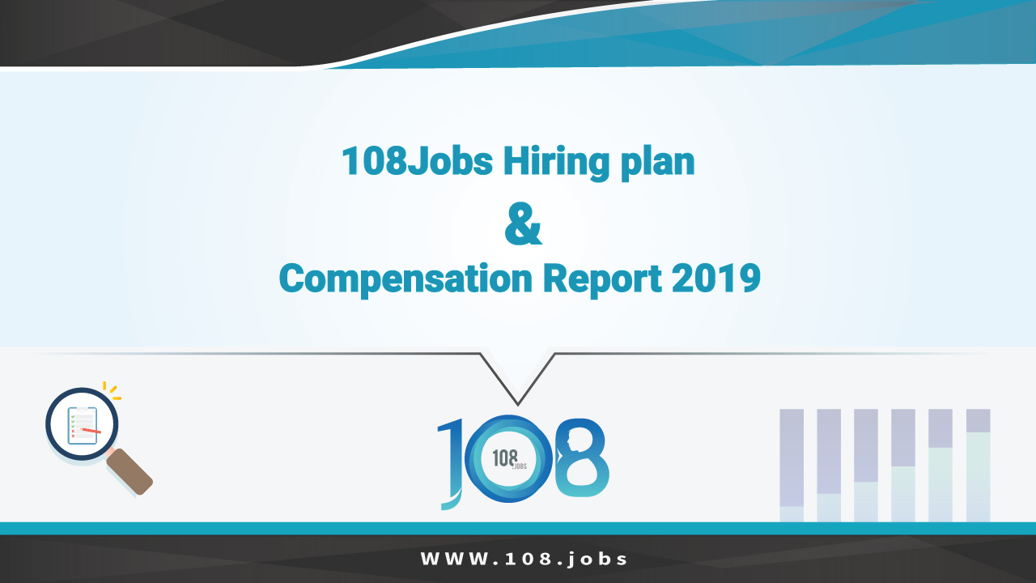

Slide 2
INTRODUCTION
To provide various Companies, Organizations and individual with annual salary and benefit information for each job and position in Laos, 108-1009 Group., Ltd had conducted a hiring plan, compensation and benefit survey in 2019. There are 100 Companies in different business sectors joining the survey. The result of this survey will show the insights of monthly salaries, compensation and benefit based on many factors for instance positions, work experiences and industry sectors.

Slide 3
SCOPE AND METHODOLOGY
Objective
Survey Coverage
The objective of this survey is to collect the information about Hiring plan, Compensation and Benefit for various positions in various industry sectors in Laos. These findings will help not only Companies and Organizations in hiring decision making but also individual or job seekers who do not know the amount of salary and compensation they should propose in job application and interview.
The survey covered 66 Companies from different industry sectors in Laos. Only the private sectors and the full-time employed were surveyed.

Slide 4
SCOPE AND METHODOLOGY
Data Collection Method
Data Analysis
The survey was conducted through an online platform. The respondents were asked to fill the questionnaire through Google Form from 15 to 30 May 2019.
The respondents were asked to fill out the forms with basic monthly salary of each job position, hiring plan and skillset they want from employee.
The collected data has been analyzed in form of “average” starting from new graduate, 1 to 3 years experience, 4 to 6 and 7 more years experience.
The data has also been analyzed by both business sectors and overview.

Slide 5
Survey Coverage
Size of Participating Companies and Organizations
(No. of Participating Companies and Organizations = 66)
No. of employee:

Slide 6


Slide 7
Banking / Micro Finance / Leasing
Currency: USD
Number of Participating Companies: 6
Job Positions | New Graduate | Exp. 1-3 years | Exp. 4-6 years | Exp. 7 years and up
Teller | 292 | 362 | 465 | 662
Credit Officer | 315 | 389 | 515 | 662
Relationship Manager | 1125 | 1550 | 1862 | 2125
HR Officer | 318 | 375 | 487 | 662
Finance Officer | 315 | 388 | 487 | 662
IT Officer | 328 | 398 | 730 | 725
Admin Officer | 315 | 398 | 680 | 612
Compliance Officer | 318 | 378 | 475 | 612
Legal Officer | 347 | 427 | 512 | 650

Slide 8


Slide 9
Construction / Architecture
Currency: USD
Number of Participating Companies: 4
Job Positions | New Graduate | Exp. 1-3 years | Exp. 4-6 years | Exp. 7 years and up
Architect | 241 | 317 | 426 | 745
Civil Engineer | 263 | 342 | 439 | 678
Site Engineer | 280 | 364 | 481 | 797
Drafter | 302 | 439 | 606 | 860
HR Officer | 297 | 435 | 574 | 746
Finance Officer | 270 | 400 | 566 | 770
Foreman | 283 | 375 | 579 | 783
Admin Officer | 300 | 345 | 453 | 899

Slide 10


Slide 11
Hotel and Hospitality
Currency: USD
Number of Participating Companies: 6
Job Positions | New Graduate | Exp. 1-3 years | Exp. 4-6 years | Exp. 7 years and up
Housekeeper | 211 | 280 | 409 | 651
Sale Officer | 255 | 331 | 455 | 786
Marketing Officer | 206 | 251 | 370 | 501
HR Officer | 220 | 290 | 397 | 587
Finance Officer | 234 | 342 | 466 | 816
Chef | 227 | 305 | 425 | 718
Admin Officer | 244 | 339 | 416 | 613
Receptionist | 276 | 338 | 475 | 583
Tour guide | 467 | 600 | 667 | 717

Slide 12


Slide 13
Hydro-power and Mining
Currency: USD
Number of Participating Companies: 4
Job Positions | New Graduate | Exp. 1-3 years | Exp. 4-6 years | Exp. 7 years and up
Project manager | 572 | 757 | 728 | 994
Safety Officer | 247 | 332 | 442 | 541
Mining Engineer | 386 | 500 | 797 | 1143
HR Officer | 267 | 375 | 519 | 581
Finance Officer | 276 | 348 | 435 | 599
IT Officer | 298 | 357 | 488 | 587
Admin Officer | 298 | 396 | 676 | 593
Planning and Budget Analyst | 227 | 442 | 512 | 610
Logistics Officer | 320 | 389 | 456 | 587

Slide 14


Slide 15
Insurance
Currency: USD
Number of Participating Companies: 2
Job Positions | New Graduate | Exp. 1-3 years | Exp. 4-6 years | Exp. 7 years and up
Agent | 240 | 300 | 370 | 1500
Sale Officer | 240 | 315 | 395 | 1500
Marketing Officer | 250 | 350 | 500 | 1650
HR Officer | 250 | 315 | 500 | 1650
Finance Officer | 250 | 315 | 500 | 1800
Legal Officer | - | - | - | -
Admin Officer | 240 | 345 | 420 | 1500
Claims Officer | - | - | - | -

Slide 16


Slide 17
International Organization
Currency: USD
Number of Participating Organizations: 7
Job Positions | New Graduate | Exp. 1-3 years | Exp. 4-6 years | Exp. 7 years and up
Project Manager | 900 | 1271 | 1671 | 1987
Assistant Project Manager | 400 | 600 | 800 | 1037
Project Coordinator | 550 | 787 | 930 | 1130
Consultant Officer | 575 | 983 | 1217 | 1517
HR Officer | 550 | 458 | 970 | 1175
Project Finance | 427 | 600 | 792 | 1147
Communication Officer | 250 | 500 | 700 | 900
Admin Officer | 450 | 543 | 694 | 1020

Slide 18


Slide 19
IT And Telecommunication
Currency: USD
Number of Participating Companies: 8
Job Positions | New Graduate | Exp. 1-3 years | Exp. 4-6 years | Exp. 7 years and up
Project Manager | 275 | 412 | 670 | 1314
Sale Officer | 236 | 396 | 697 | 1058
Marketing Officer | 200 | 383 | 675 | 1250
IT Support | 250 | 383 | 612 | 1200
Graphic Designer | 225 | 425 | 750 | 1400
Web Designer | 240 | 367 | 690 | 1137
Network Engineer | 275 | 417 | 670 | 1112
HR Officer | 250 | 407 | 717 | 1183
Finance Officer | 250 | 424 | 687 | 1137
Software Developer | 275 | 405 | 700 | 1187
Admin Officer | 250 | 367 | 640 | 1025

Slide 20


Slide 21
Motor Vehicles
Currency: USD
Number of Participating Companies: 2
Job Positions | New Graduate | Exp. 1-3 years | Exp. 4-6 years | Exp. 7 years and up
Technical Engineer | 287 | 425 | 825 | 1650
Sale Officer | 275 | 375 | 475 | 575
Marketing Officer | 337 | 475 | 650 | 850
HR Officer | 337 | 500 | 650 | 900
Finance Officer | 375 | 500 | 650 | 1025
IT Officer | 350 | 525 | 700 | 1000
Admin Officer | 337 | 475 | 650 | 850
After Sale Service Officer | 325 | 475 | 600 | 775

Slide 22


Slide 23
Trade and Distribution
Number of Participating Companies: 6
Currency: USD
Job Positions | New Graduate | Exp. 1-3 years | Exp. 4-6 years | Exp. 7 years and up
Product Manager | 226 | 420 | 637 | 620
Sale Officer | 220 | 273 | 458 | 660
Marketing Officer | 198 | 299 | 413 | 878
HR Officer | 244 | 320 | 441 | 619
Finance Officer | 193 | 264 | 375 | 638
Procurement Officer | 186 | 252 | 385 | 654
Admin Officer | 228 | 324 | 439 | 677
Stock Manager | 241 | 316 | 470 | 776

Slide 24


Slide 25
Other Sectors
Number of Participating Companies: 21
Currency: USD
Job Positions | New Graduate | Exp. 1-3 years | Exp. 4-6 years | Exp. 7 years and up
Project Manager | 259 | 413 | 537 | 1186
Sale Officer | 203 | 293 | 456 | 693
Marketing Officer | 219 | 341 | 484 | 641
HR | 241 | 341 | 480 | 649
Finance Officer | 267 | 339 | 493 | 611
IT Officer | 236 | 342 | 477 | 623
Admin Officer | 237 | 338 | 479 | 638

Slide 26


Slide 27
Overview
Currency: USD
Job Positions | New Graduate | Exp. 1-3 years | Exp. 4-6 years | Exp. 7 years and up
Project Manager | 474 | 655 | 886 | 1336
Assistant Project Manager | 400 | 600 | 800 | 1037
Consultant | 575 | 983 | 1217 | 1517
Admin Officer | 278 | 382 | 541 | 799
Project Finance Officer | 427 | 600 | 792 | 1147
Communication Officer | 250 | 500 | 700 | 900
HR Officer | 291 | 367 | 555 | 816
Procurement Officer | 186 | 252 | 385 | 654
Safety Officer | 247 | 331 | 441 | 541

Slide 28
Overview
Job Positions | New Graduate | Exp. 1-3 years | Exp. 4-6 years | Exp. 7 years and up
Mining Engineer | 386 | 500 | 797 | 1143
Finance Officer | 264 | 358 | 503 | 791
Planning and Budget Analyst Officer | 227 | 442 | 512 | 610
Sale Officer | 232 | 330 | 506 | 856
Marketing Officer | 220 | 327 | 475 | 838
Product Manager | 226 | 420 | 637 | 620
Stock Manager | 241 | 316 | 470 | 776
Teller | 292 | 362 | 465 | 662
Credit Officer | 315 | 389 | 515 | 662
Relationship Manager | 1125 | 1550 | 1862 | 2125
IT Supporter | 275 | 376 | 580 | 780

Slide 29
Overview
Job Positions | New Graduate | Exp. 1-3 years | Exp. 4-6 years | Exp. 7 years and up
Compliance Officer | 318 | 378 | 475 | 612
Legal Officer | 347 | 427 | 512 | 650
House Keeper | 211 | 279 | 409 | 651
Receptionist | 276 | 338 | 475 | 583
Chef | 227 | 305 | 425 | 718
Tour guide | 467 | 600 | 667 | 717
Technical Engineer | 287 | 425 | 825 | 1650
After Sale Service Officer | 325 | 475 | 600 | 775
Graphic Designer | 225 | 425 | 750 | 1400
Network Engineer | 275 | 417 | 670 | 1112
Software Developer | 275 | 405 | 700 | 1187

Slide 30
Overview
Job Positions | New Graduate | Exp. 1-3 years | Exp. 4-6 years | Exp. 7 years and up
Web Designer | 240 | 367 | 690 | 1137
Agent Officer | 240 | 300 | 370 | 1500
Architect | 241 | 317 | 426 | 745
Civil Engineer | 263 | 342 | 439 | 679
Site Engineer | 280 | 364 | 481 | 797
Drafter | 302 | 439 | 606 | 860
Foreman | 283 | 375 | 579 | 783
Logistics Officer | 320 | 389 | 456 | 587

Slide 31


Slide 32
Hiring Plan
Does your Company or Organization plan to increase or decrease headcount in next 6 to 12 months?

Slide 33
Reasons of Increasing headcount
Why does your Company or Organization increase headcount?

Slide 34
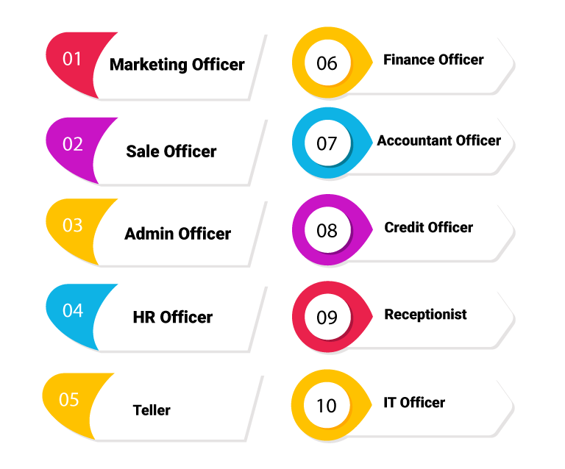
In-demand Positions
Job functions that Companies or Organizations plan to hire or increase in next 6 to 12 months

Slide 35


Slide 36
In-demand Skills

Slide 37

(856) 21 254349, (856) 21 254709 and (856) 2028811009 Mon - Fri, 8:30 am - 5:30 pm Sat 8:30am - 12:00am E-mail: info@108.jobs

