Slide 1
Bellabeat: Marketing Case Study with R
A Google data analytics certification project
Presented by: Humphrey
Updated: 23 Sep 2021

Slide 2
Table of content
INTRODUCTION TO SCENARIO
PURPOSE AND LIMITATION OF SCOPE FOR DATA ANALYSIS PROJECT
ABOUT THE DATASET
Limitations of data analysis project
Statistical summary
CONCLUSIONS
Appendix - DATA PROCESSING DETAILS

Slide 3
Introduction TO SCENARIO
BUSINESS TASK
Junior analyst looking for marketing insights
COMPANY
Bellabeat
High-tech company that manufactures health-focused smart products for women.
Tracks data on activity, sleep, stress, water consumption, reproductive health
PRODUCTS (smart devices)
Leaf (accessory)
Time (watch)
Spring (Waterbottle)
Bellabeat app
DATASET
FitBit dataset
More details in later slide
Notes:
Scenario:
You are a junior data analyst working on the marketing analyst team at Bellabeat, a high-tech manufacturer of health-focused products for women.
Bellabeat is a successful small company, but they have the potential to become a larger player in the global smart device market. Urška Sršen, cofounder and Chief Creative Officer of Bellabeat, believes that analyzing smart device fitness data could help unlock new growth opportunities for the company.
You have been asked to focus on one of Bellabeat’s products and analyze smart device data to gain insight into how consumers are using their smart devices.
The insights you discover will then help guide marketing strategy for the company.
You will present your analysis to the Bellabeat executive team along with your high-level recommendations for Bellabeat’s marketing strategy.
Products:
Bellabeat app:
The Bellabeat app provides users with health data related to their activity, sleep, stress, menstrual cycle, and mindfulness habits.
This data can help users better understand their current habits and make healthy decisions.
The Bellabeat app connects to their line of smart wellness products.
Leaf: (Accessories) – smart device
Bellabeat’s classic wellness tracker can be worn as a bracelet, necklace, or clip.
The Leaf tracker connects to the Bellabeat app to track activity, sleep, and stress.
Time: (Watch) – smart device
This wellness watch combines the timeless look of a classic timepiece with smart technology to track user activity, sleep, and stress.
The Time watch connects to the Bellabeat app to provide you with insights into your daily wellness.
Spring: (Waterbottle) – smart device
This is a water bottle that tracks daily water intake using smart technology to ensure that you are appropriately hydrated throughout the day.
The Spring bottle connects to the Bellabeat app to track your hydration levels.
Bellabeat membership:
Bellabeat also offers a subscription-based membership program for users.
Membership gives users 24/7 access to fully personalized guidance on nutrition, activity, sleep, health and beauty, and mindfulness based on their lifestyle and goals.

Slide 4
PURPOSE AND LIMITATION OF scope FOR data analysis project
Scope of project
Only aimed to suggest potential directions of marketing team to build a strategy
Customise their marketing message
Customise any product feature developments
Based on limited dataset and limited time for data exploration.

Slide 5
About the dataset
These FitBit datasets were generated by respondents to a distributed survey via Amazon Mechanical Turk between 03.12.2016-05.12.2016.
Thirty eligible Fitbit users consented to the submission of personal tracker data, including minute-level output for physical activity, heart rate, and sleep monitoring.
Variation between output represents use of different types of Fitbit trackers and individual tracking behaviors / preferences.
Source: Crowd-sourced Fitbit datasets 03.12.2016-05.12.2016
Dataset source: FitBit Fitness Tracker Data

Slide 6
Limitations of data analysis project
Comprehensiveness of dataset
No gender differentiation in explored FitBit dataset.
Application of this data analysis project is for the purposes to market products of Bellabeat, which is focused on women.
Hence, the dataset may not be sufficiently comprehensive for a more effective study.
The study contains observations of only a few days, and of limited number of samples.
Statistical confidence and insights may be limited or skewed due to sample size limits.

Slide 7
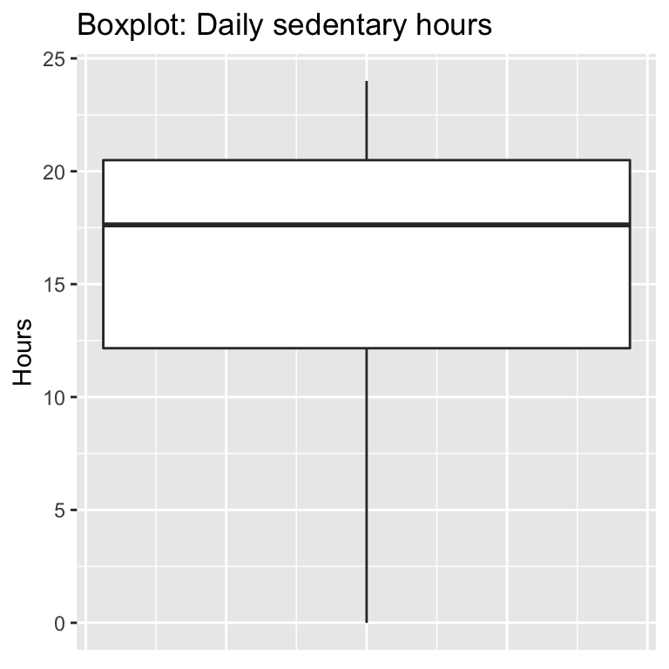
Statistical summary
Daily sedentary hours (Boxplot)
About 50% (Q1 to Q3) between 12.5 to 20.0 hours
About 25% (Q1) between 20.0 hours to 24 hours, significant proportion?
Potential value to unlock: Can a smart device feature decrease daily sedentary hours via recommended usage?

Slide 8
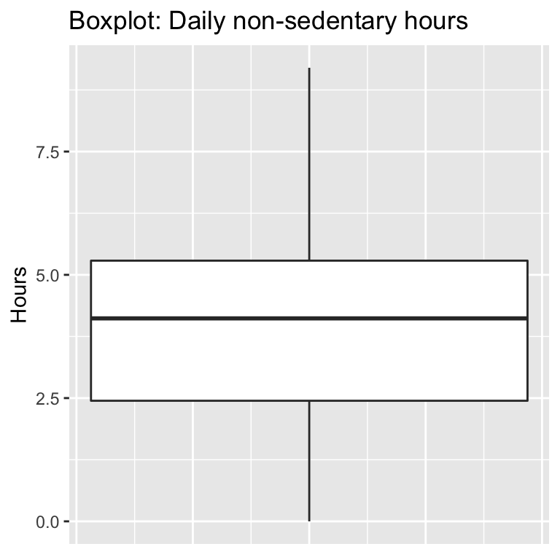
Statistical summary
Daily non-sedentary hours (Boxplot)
About 50% (Q1 to Q3) between 2.5 to 5.0 hours
About 25% (Q4) lower than 2.5 hours

Slide 9
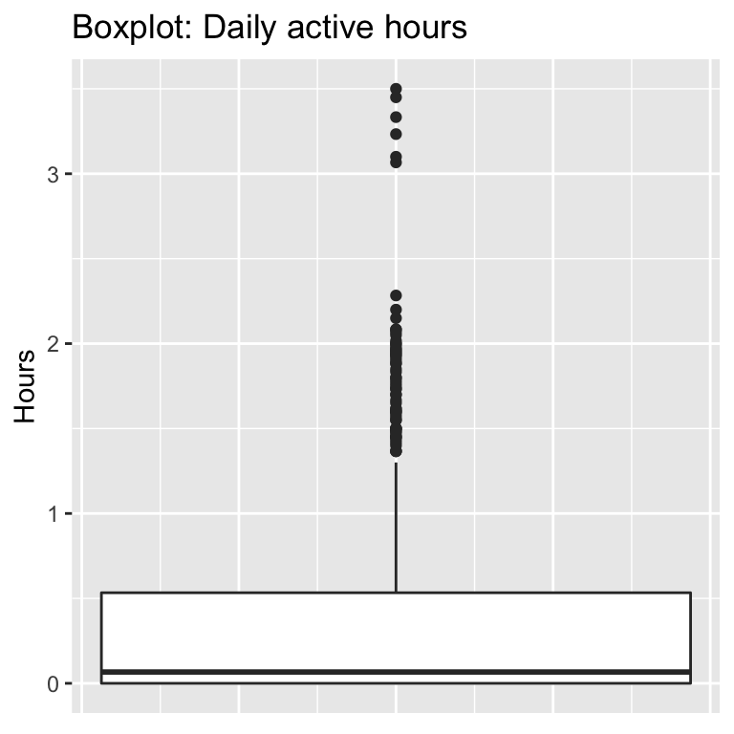
Statistical summary
Daily active hours (Boxplot)
About 75% (up to Q3) between 0 to 0.5 hours
About 25% have more than 0.5 active hours

Slide 10
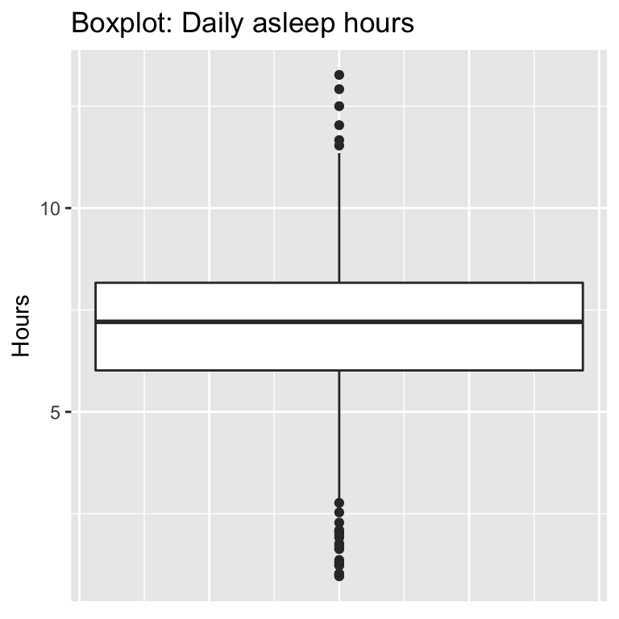
Statistical summary
Daily asleep hours (Boxplot)
About 50% (Q1 to Q3) between 6 to 8 hours
About 25% sleep less than 6 hours, significant proportion?
Potential value to unlock: Can a smart device feature increase daily sleep hours and quality via recommended usage?

Slide 11
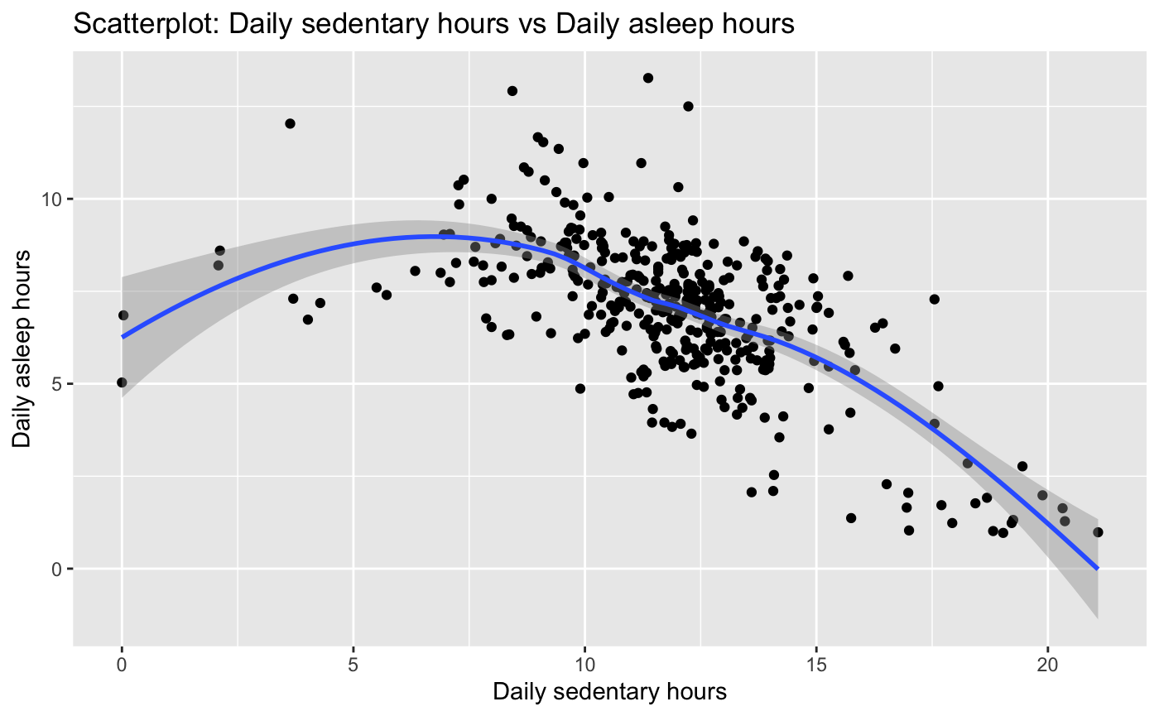
Statistical summary
It would appear that there are severe cases of insomnia for sedentary sampled FitBit users, as it can be seen that sleeping hours are decreasing beyond the mark for 10 daily sedentary hours.
A possible theory would be that they are not tired enough to sleep at night as their lifestyles are not very physically active.
BellaBeat can potentially focus on improving the sleeping quality and hours by implementing product features and marketing activities to encourage a higher activity level for women.

Slide 12
conclusionS
Key observations
Insights and Recommendations
Significant proportion (about 25%) of observations with daily sedentary hours above 20 hours.
Significant proportion (about 25%) of observations with daily asleep hours below 6 hours.
High levels of daily sedentary hours are correlated with high levels of insufficient sleeping hours, indicating insomnia.
Inversely, it is suggested that higher levels of physical activities (lower levels of sedentary hours) would hence improve the quality of life by improving sleeping hours and quality.
Customise product features, marketing message and recommended usage of Bellabeat products to target women to be less sedentary.

Slide 13
Appendix - DATA PROCESSING DETAILS
For further details on the data analytic processes including data cleaning, refer to link to R markdown file hosted on Kaggle.

Slide 14
Thank you

