Slide 1
Churn Prediction: Ranking‑First Retention Strategy
IBM Telco Customer Churn

Slide 2
Business & Dataset Context
Business
Churn prediction helps retention teams focus limited budget on customers most likely to leave.
Retention is often cheaper than acquisition, so better targeting can protect recurring revenue.
Dataset
Use the IBM Telco Customer Churn dataset as a representative example of customer account, service, billing, and churn outcome data.
Key Results & Insights
Systems & Decisions

Slide 3
Problem Framing & Hypothesis
Problem Framing
Decide which customers should be contacted first when retention budget or campaign capacity is limited.
Expected Outcome
Hypothesis: top X% customers targeting captures majority of churners
Example: if the retention team can contact 20% of customers, a well-performing model should capture a majority of churners within this segment.
Decision Framing
Ranking problem using churn probability - “Who should we contact first when retention capacity is limited?”
Predict which customers are at the highest risk of churn.
Improve retention decisions by helping teams prioritize outreach and match interventions to likely risk drivers.
Key Results & Insights
Systems & Decisions

Slide 4
Metric & Validation
Evaluate the model
Use ROC-AUC
Use Top-K% evaluation
Use a train-test split
mainly as a ranking tool, not just a yes/no classifier.
to assess overall ranking quality.
to measure how many churners are captured within target segments such as the top 10% or 20% of customers.
so evaluation reflects out-of-sample performance
no validation split for this compact illustrative case example
Key Results & Insights
Systems & Decisions

Slide 5
Modeling Approach
Logistic Regression — Baseline Model
XGBoost — Comparison Model
Start with a simple, interpretable baseline first; only prefer a more complex model if it clearly improves ranking quality or business usefulness.
Key Results & Insights
Systems & Decisions

Slide 6
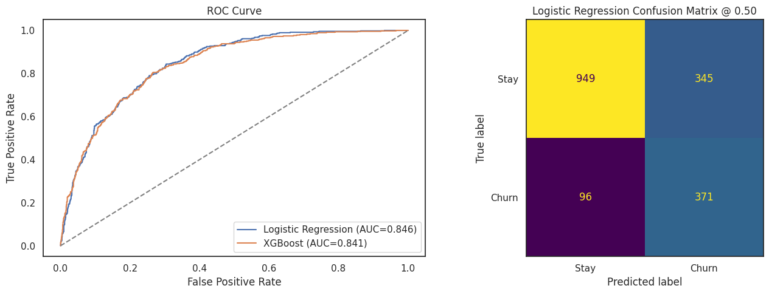
Key Results & Insights
Takeaway: Select Logistic Regression — slightly better ranking performance and relationships between inputs and outputs are more interpretable
Model Evaluation
Default 0.50 threshold cutoff on test split (predict churn if probability >= 0.5)
Logistic Regression slightly outperforms XGBoost on ROC-AUC (0.846 vs 0.841)
Better at ranking churners near the top of the list → preferred for targeting
Logistic Regression Model
Identifies 371 churners, 949 non-churners correctly
Misses 96 churners (lost opportunities)
Flags 345 non-churners incorrectly (unnecessary outreach)
Key Results & Insights
Systems & Decisions

Slide 7
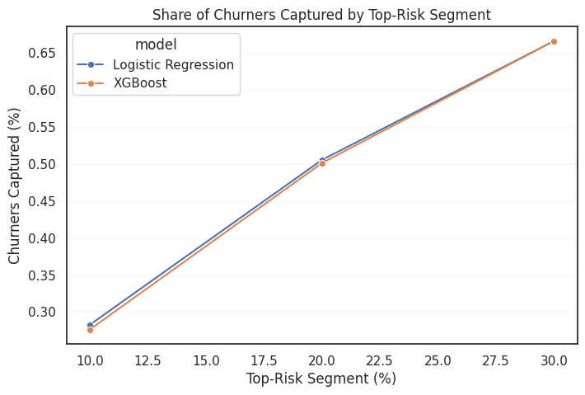
Key Results & Insights
Top-K% Campaign Policy Evaluation
Budget-Constrained Scenario: Top 20% highest-risk customers contain about 50% of actual churners and roughly `$229k` (`56%` of annualized churn revenue).
Takeaway: Targeting Top-K% customers capture top segment of churners which enables prioritized retention intervention when budget or outreach capacity is limited.
Key Results & Insights
Systems & Decisions

Slide 8
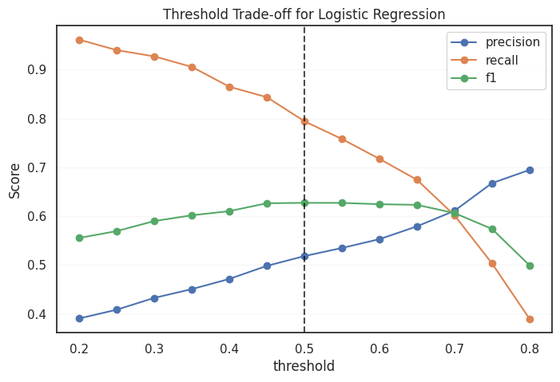
Key Results & Insights
Threshold Policy Sensitivity Analysis
This view is still useful for a threshold to inform churn/no-churn prediction for marketing campaign action.
Takeaway:
Threshold-based decisions involve trade-offs between reach (recall) and cost (precision). While 0.5 threshold provides a reasonable baseline, the optimal cutoff depends on campaign capacity.
Top-K% customers targeting policy may be preferred when marketing campaign size is fixed.
Lower cutoff reach more potential churners but higher marketing budgets.
Higher cutoff concentrate lower marketing budgets on fewer potential churners.
Key Results & Insights
Systems & Decisions

Slide 9
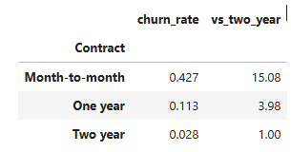
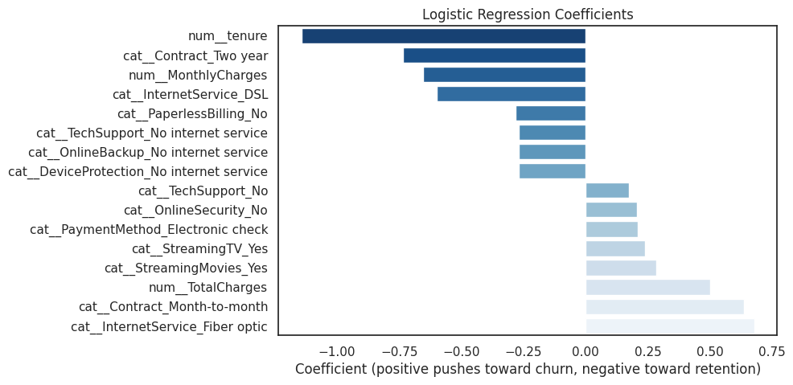
Key Results & Insights
Feature Importance
Relevant Feature Groups — Churn Predictors Examples
Contract Types, Tenure
Higher Period (Higher Retention), Lower Period (Higher Churn Risk)
Example — Month-to-month Contract 15x churn vs Two-Year Contract
Internet Service Types (Product Mix) — DSL (Higher Retention), Fiber Optics (Higher Churn Risk)
Potential revenue loss from churn — help size value-at-risk.
Takeaway:
These churn-risk patterns are useful for targeting and message design, but they should not be treated as causal proof.
In practice, customer value should also inform final targeting priorities.
Key Results & Insights
Systems & Decisions

Slide 10
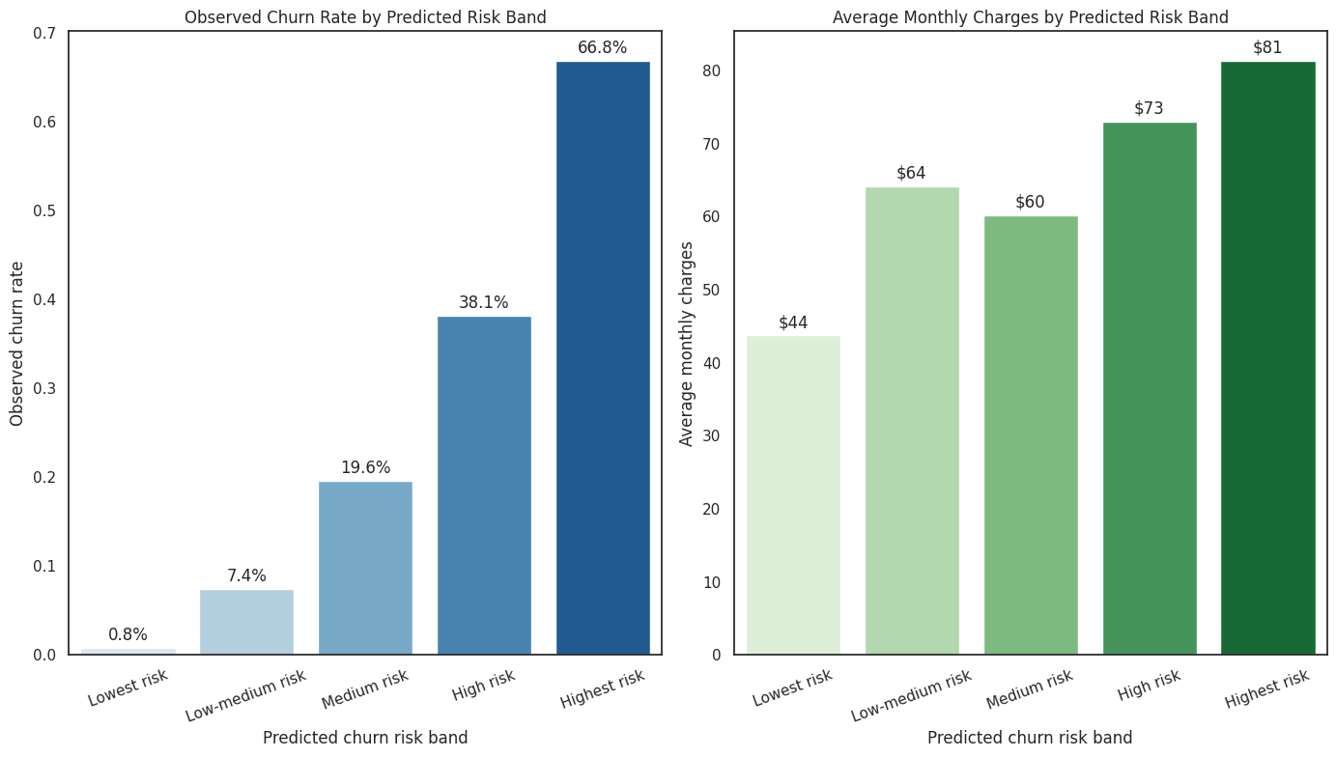
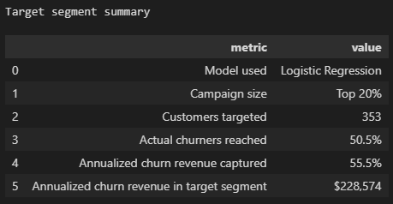
Key Results & Insights
Retention Target Segment Review
Takeaway:
This section turns the model results into a retention campaign analytics view.
The emphasis here is on reporting and actionability rather than model mechanics.
Risk Band Summary (Test Slice)
Target Segment (Top 20% of Test Slice)
Key Results & Insights
Systems & Decisions

Slide 11
How the system works
Offline training
Risk Scoring
Ranking
Campaign selection
Business rules (not implemented here)
learns a churn risk model from historical customer data.
assigns each customer a churn probability.
orders customers from highest risk to lowest risk.
chooses the top segment based on capacity and budget.
can further prioritize high-risk, high-value customers.
Periodically retrain (not implemented here)
the model to reflect changes in customer behaviour.
Key Results & Insights
Systems & Decisions

Slide 12
Key Trade-Offs
Ranking vs classification
Interpretability vs complexity
Risk vs value
Offline vs business impact
Limitation
The main business use is prioritization, so ranking quality matters more than a binary label alone.
Simpler models are easier to explain and operationalize, while more complex models may improve performance but add maintenance cost.
Churn risk alone is useful, but production decisions should also consider customer value and intervention cost.
Good offline metrics are helpful, but the real test is whether targeted outreach improves retention outcomes.
Without intervention-response data, the model can rank risk but cannot directly recommend the best retention action.
Key Results & Insights
Systems & Decisions

Slide 13
Key Recommendations
Adopt a ranking-first retention strategy
rank customers by predicted churn risk
target the top X% segment based on campaign capacity
prioritize high-risk and high-value customers
Model Evaluation
aligns directly with business action and helps maximize retention impact under budget constraints.
Key Results & Insights
Systems & Decisions

Slide 14
Appendix - Glossary
Top-K% targeting: contacting only the highest-risk segment, such as the top 10% or 20% of customers.
Ranking metric: a metric that checks whether the riskiest customers appear near the top of the list.
Threshold: a cutoff used to convert a predicted probability into a yes/no classification.
Churn probability: the model’s estimated likelihood that a customer will leave.

