Slide 1
Churn Prediction: IBM Telco Customer Churn
Ranking‑First Retention Strategy

Slide 2
Business & Dataset Context
Business
Churn prediction helps retention teams focus limited budget on customers most likely to leave.
Retention is often cheaper than acquisition, so better targeting can protect recurring revenue.
Dataset
Use the IBM Telco Customer Churn dataset as a representative example of customer account, service, billing, and churn outcome data.

Slide 3
Problem Framing, Decision & Hypothesis
Problem Framing
Decide which customers should be contacted first when retention budget or campaign capacity is limited.
Hypothesis
Hypothesis: top X% captures majority of churners
Example: if the retention team can contact 20% of customers, a well-performing model should capture a majority of churners within this segment.
Decision
Ranking problem using churn probability - “Who should we contact first when retention capacity is limited?”
Predict which customers are at the highest risk of churn.
Improve retention decisions by helping teams prioritize outreach and match interventions to likely risk drivers.

Slide 4
Metric & Validation
Evaluate the model
Use ROC-AUC
Use Top-K% evaluation
Use a train-test split
mainly as a ranking tool, not just a yes/no classifier.
to assess overall ranking quality.
to measure how many churners are captured within target segments such as the top 10% or 20% of customers.
so evaluation reflects out-of-sample performance
no validation split for this compact illustrative case example

Slide 5
Modeling Approach
Logistic Regression baseline
XGBoost comparison model
Start with a simple, interpretable baseline first; only prefer a more complex model if it clearly improves ranking quality or business usefulness.

Slide 6
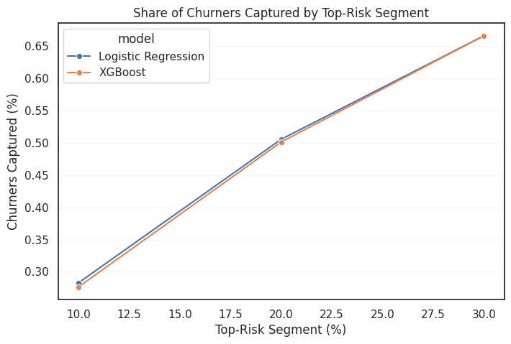
Key Results & Insights
Key Result (Test Split) - Default `0.50` predicted probability threshold cutoff
Logistic Regression slightly outperformed XGBoost on ROC-AUC (`0.846` vs `0.841`)
Top 20% highest-risk customers contain about 50% of actual churners and roughly `$229k` (`56%` of annualized churn revenue).

Slide 7
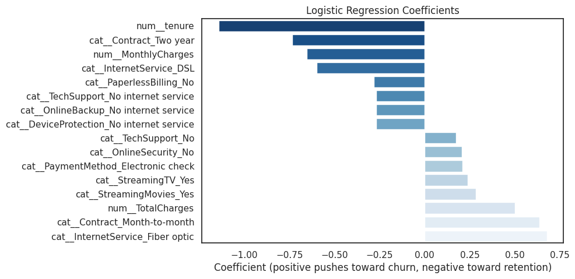
Key Results & Insights
Key Insights (Coefficients Review)
Contract types strongly predicts churn risks
Month-to-month → high churn
Two-year → high retention
Churn-risk ranking can guide who should be contacted first
In practice, customer value should also inform final outreach priorities.

Slide 8
How the system works
Offline training
Risk Scoring
Ranking
Campaign selection
Business rules
learns a churn risk model from historical customer data.
assigns each customer a churn probability.
orders customers from highest risk to lowest risk.
chooses the top segment based on capacity and budget.
can further prioritize high-risk, high-value customers.
Periodically retrain
the model to reflect changes in customer behaviour.

Slide 9
Key Trade-Offs
Ranking vs classification
Interpretability vs complexity
Risk vs value
Offline vs business impact
Limitation
The main business use is prioritization, so ranking quality matters more than a binary label alone.
Simpler models are easier to explain and operationalize, while more complex models may improve performance but add maintenance cost.
Churn risk alone is useful, but production decisions should also consider customer value and intervention cost.
Good offline metrics are helpful, but the real test is whether targeted outreach improves retention outcomes.
Without intervention-response data, the model can rank risk but cannot directly recommend the best retention action.

Slide 10
Recommendation
Adopt a ranking-first retention strategy
rank customers by predicted churn risk
target the top X-Y% segment based on campaign capacity
prioritize high-risk and high-value customers
Model Evaluation
aligns directly with business action and helps maximize retention impact under budget constraints.

Slide 11
Appendix - Glossary
Top-K% targeting: contacting only the highest-risk segment, such as the top 10% or 20% of customers.
Ranking metric: a metric that checks whether the riskiest customers appear near the top of the list.
Threshold: a cutoff used to convert a predicted probability into a yes/no action rule.
Churn probability: the model’s estimated likelihood that a customer will leave.

