Slide 1
Marketing Incrementality via A/B Testing
Hillstrom Email Marketing Dataset – Experimentation for Marketing ROI and Budget Decisions

Slide 2
Business & Dataset Context
Business
Problem
Why it matters
Dataset
Source: Hillstrom Email Marketing Dataset (MineThatData)
Does the campaign drive incremental conversions and revenue? Or does it take credit for existing behavior?
Weak incrementality → wasted spend and inflated ROI Inflated ROI → misleading decisions
Background & Users
Key Labels (Outcomes)¹: `conversion`, `spend`
Key Features (Customer attributes)¹: `history`
Randomized experiment – 3 equal groups (Men / Women / No Email)
64k customers (last purchased within 12 months)
suitable for causal (incremental) lift measurement
Note 1: Key labels and features to be further described in experiment design slide
Key Results & Insights
Systems & Decisions

Slide 3
Problem Framing
Problem Framing
Attribution vs Incrementality
Decision Framing
Business objective: Prioritize highest-value users for marketing investment
“Attribution can overstate impact because some users would convert anyway.
Roll out – Lift must be positive and meaningful
Budget decision framing
Scale budget – Only if incremental revenue per user > cost per treated user
Budget ceiling – Cap to break-even cost per treated user
Targeting – Prioritize highest incremental value segments
We therefore measure incrementality (causal lift): the true effect caused by the campaign.”
Key Results & Insights
Systems & Decisions

Slide 4
Experiment Design (A/B Testing)
Original randomized design reused and adapted for incremental impact and budget decisions
Element | Choice | Why
Treatment (Customers) | Received any marketing email | Enables measurement of the treatment effect of sending email
Control (Customers) | Received no email | Provides the causal baseline
Assignment | Randomized assignment | Makes comparisons credible
Primary outcome¹ | `conversion` – purchase (binary) | Direct link to business value
Supporting outcomes¹ | `spend` – spend dollars | Adds business value context
Customer features | `history` – actual dollars spent in the prior year | Enables targeting and segment-level analysis
Key Takeaway: Randomization enables causal lift measurement, by linking conversion (primary outcome), revenue impact, and segment-level analysis.
Evaluation Criteria
Conversion lift (treatment vs control)
Statistical significance (confidence)
ROI / unit economics (break-even threshold)
Note 1: Outcomes measured within 2 weeks post-treatment
Key Results & Insights
Systems & Decisions

Slide 5
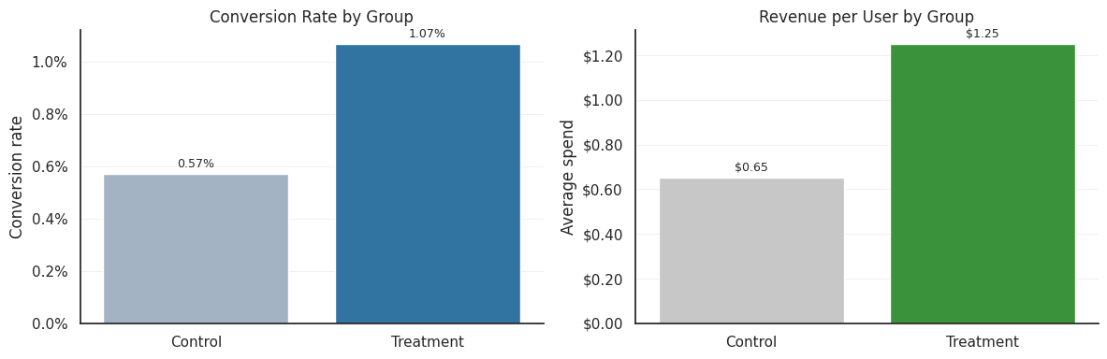
Key Results & Insights
Overall Lift (A/B Testing Analysis)
Key Takeaway
Conversion rate (CVR): 1.07% vs 0.57% (control)
CVR absolute lift: +0.50pp (~+86.5% relative)
Revenue per user: $1.25 vs $0.65 (+$0.60)
Lift is commercially meaningful and clears the first decision gate for further evaluation
Next: Validate statistical significance (confirm effect is not due to random variation)
Key Results & Insights
Systems & Decisions

Slide 6
Key Results & Insights
Statistical Significance
Metrics | Values
Treatment CVR | 1.07%
Control CVR | 0.57%
p-value | < 0.001
Lift 95% CI (pp) | +0.35 to +0.64
Note
CVR (%): Conversion rate = conversions / users * 100%
Key Takeaway
Lift in conversion rates is real, clearing the statistical gate for unit economics evaluation (ROI) and scaling decisions.
The 95% confidence interval (CI) for lift is roughly 0.35 to 0.64 percentage points (pp), which stays above zero throughout.
The p-value < 0.001, indicating strong statistical evidence of a real effect, and unlikely to be due to random chance.
Key Results & Insights
Systems & Decisions

Slide 7
Key Results & Insights
Attribution vs Incrementality (Causal Impact)
Measurement Approach | Users¹ | Conversions | Revenue ($)
Treated Total (Naive attribution) | 42,694 | 456 (100%) | 53,350 (100%)
Estimated Baseline (Apply control CVR; no treatment assumption) | 42,694 | 244¹ (54%) | 27,870 (52%)
Incremental | - | 212 (46%) | 25,480 (48%)
Note 1
Estimated impact differs by measurement method on the same treated users.
Estimated baseline conversions = treated users × control CVR
= 42,694 x 0.57% = 244
Key Takeaway
Attribution overstates impact by including conversions that would have happened anyway.
Only ~50% of conversions and revenue are truly incremental; the naive view overstates impact by ~2x.
This gap materially affects ROI estimation and budget allocation decisions.
Key Results & Insights
Systems & Decisions

Slide 8
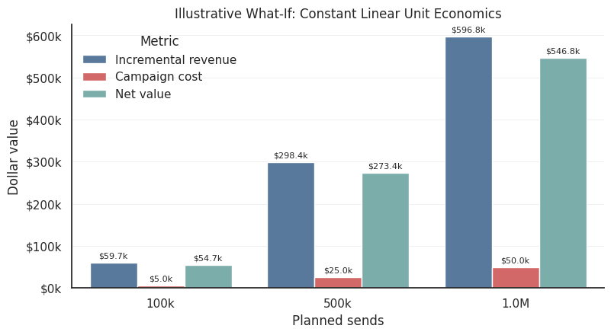
Key Results & Insights
Unit Economics (ROI) and Budget Decision
Unit Economics Snapshot
Scaling implication (assuming stable unit economics)
 | $ per User
Treatment – Revenue | 1.25
Control – Revenue | 0.65
Incremental Revenue | 0.60
Assumption: Email Cost | (0.05)
Net Incremental Value | 0.55
Break-Even Cost (Assumption: Budget Ceiling = Break-Even) | 0.60
Key Takeaway
Positive Unit Economics → Scale with cost discipline.
Unit economics are strongly positive (~$0.55 net per user), supporting scale.
Scaling remains attractive if cost per user < ~$0.60 (break-even). Decision rule: Scale while cost per user < $0.60 and monitor marginal performance.
At scale, performance may weaken as targeting expands to less responsive users.
Key Results & Insights
Systems & Decisions

Slide 9
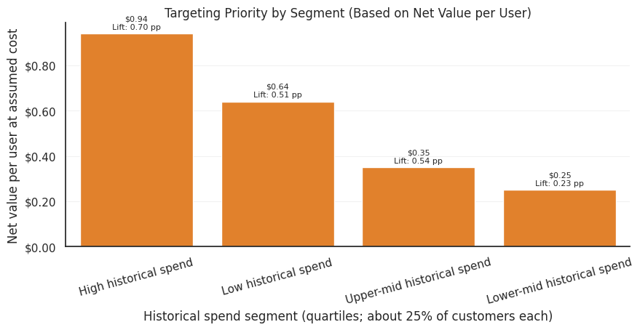
Key Results & Insights
Segment Insights: Who Should We Target First?
Key Takeaway
Scale from highest incremental value segments first; monitoring marginal returns.
All segments are profitable at assumed cost per user ($0.05).
Prioritize the highest-spend segment first (~$0.94 net value per user).
Allocate budget primarily by net value per user, while lift remains a supporting metric.
Key Results & Insights
Systems & Decisions

Slide 10
Decision Framework
From Experiments to Business Decisions
Translate experimental results into ROI-driven targeting and scaling decisions
Experiment Design (A/B Testing)
A/B Testing Analysis
Attribution vs Incrementality
Unit Economics (ROI) and Budget Decision
Segment Insights: Who Should We Target First?
Key Recommendations
Randomized design
Measures Lift
True campaign impact
Value vs Cost
Who to prioritize
What to do
Key Results & Insights
Decision Framework

Slide 11
Key Recommendations
Key Takeaway: Scale the campaign with disciplined targeting and incrementality-based measurement.
Rollout: Scale with holdout monitoring
Incremental revenue per user (~$0.60) exceeds assumed cost per send ($0.05), implying strong margin. Break-even cost cap at ~$0.60.
Measurement Rule: Use incrementality as the decision metric
Naive attribution overstates impact (~2×); only ~46% of conversions and ~48% of revenue are incremental.
Targeting Priority: Prioritize highest-value segments first
Start with high historical-spend segments (~$0.94 net value per user), then expand based on marginal returns.
Operating Risk: Monitor and re-test at scale
Budget Rule: Scale while incremental revenue > cost
Statistically significant lift supports rollout (CVR: 1.07% vs 0.57%).
Unit economics depend on cost assumptions and experiment representativeness, which may degrade as targeting expands to less responsive users.
Key Results & Insights
Decision Framework

Slide 12
Limitations & Production Considerations
Limitations (Current Approach)
Channel scope: Email experiment, not full marketing mix like mobile ads.
Outcome definition as evaluation: Only revenue is reliable (not profit/margin).
Linear scaling economics assumption: Current assumptions are simplified and would likely differ in production.
Segment-level estimates are directional: Less reliable than overall a/b testing.
Production Considerations
Periodic re-measurement: Maintain holdout / periodic re-test.
Economics validation: Due diligence on cost and margin assumptions before scaling.
Monitoring: Track lift, value, and performance by segment
Operationalization: Translate into send policy (who, how much, when to pause)
Key Results & Insights
Decision Framework

Slide 13
Potential Extensions
Experiment Design
User-Level Uplift Model: Augment segment-level targeting strategy with user-level targeting strategy
Profit lens: Move from revenue to contribution margins if more accurate data becomes available.
Multi-Arm Experiments: Move beyond binary treatment e.g., Men vs Women vs Control (No Email)
Targeting & modeling
Economics
Richer segmentation: Leverage additional customer features (beyond historical spend) to refine targeting
Key Results & Insights
Decision Framework

