Slide 1
Architecture
Market growth levers with ML

Slide 2
Marketplace Growth Optimization with ML
Key Problems
Marketing budgets (e.g., vouchers or promotions) are limited.
Poor targeting wastes spend and reduces campaign ROI.
Common baseline approaches:
Random targeting
Simple heuristics (e.g., RFM rules)
Proposed ML Solution
Two ML levers support growth decisions.
1. Purchase Propensity
Predict purchase probability and expected revenue at user-level
Rank users by expected value to allocate marketing budget more efficiently
2. Recommender
Recommend relevant products to users
Improve discovery and engagement
Outcome – Purchase Propensity Improves Budget Allocation
ML targeting consistently beats random targeting
ML targeting remains competitive with heuristic RFM
ML provides a scalable framework as richer data becomes available

Slide 3
Overall Platform Architecture
Feature Store
Shared Feature Engineering Layer (bronze/silver)
Online Retail transaction dataset of 2 years (Online Retail II (UCI transactional dataset)
See repo for documentations, including Target Data Model, Data Dictionary and respective quickstart.md
Growth Decisioning (who to treat, how likely to buy and expected value)
Purchase Propensity
Training Pipeline (Offline): Purchase Propensity Modelling
Serving (Policy) Pipeline: Incentive Allocation (Budget-Constrained)
Offline Policy Evaluation
Compare Incentive Allocation Policies
Compare Assumptions (Freeze After Validation)
ML Engines operate independently
Content/Product Selection (what to show to end users)
Recommender
Training Pipeline (Offline): Two-Tower Collaborative Filtering
Offline Model Evaluation
Proxy metrics for commercial engagement: Recall/NDCG/Hit Rate
Serving (Retrieval) Pipeline: Stage 1 Candidate Retrieval (Two-Tower Dot Product + ANN)

Slide 4
Purchase Propensity
Compare Model & Assumptions (Freeze After Validation)
Propensity: logistic/xgboost with different windows
Prediction window validation with inter-purchase distribution analysis (30d/60d/90d)
Feature lookback window validate with model evaluation metrics (long term 60d/90d/120d + always include short-term 30d)
Feature Store
Models Training
Models Validation
Training Pipeline (Offline): Purchase Propensity Modelling
Purchase Propensity Model (logistic/xgboost + calibration) Primary metric: PR-AUC (purchase positive-class targeting)
Guardrails:
ROC-AUC | Top-decile lift | Brier | ECE
Revenue Prediction Model (xgboost regression) RMSE / MAE/ MAPE
Preprocessing in Feature Store Feature engineering includes derived RFM-style behavioural aggregation at user level
Window Sensitivity Experiments (Train + Validation)
Periodic Retraining (If Production Environment)
Out Of Scope: No causality incrementality inferred
Offline back testing compares allocation policies on a future holdout window using the same budgets for each policy to ensure fair comparison
True incremental impact would require randomized online experimentation (A/B Testing), which is out of scope for this repository.
Time-based split (Train/Val/Test): Historical rolling behavioural features (say 90 days windows) -> Future purchase probability (say 30 days windows) for each monthly snapshot slice
Frozen models and windows after model validation
Final models before test: refit on train + val data
User Features
Load Trained Models
Rank with predicted expected value
(User-Level)
Budget-Constrained Optimization (Top K users by EV)
Targeting Decisions (User-level)
Serving (Policy) Pipeline: Incentive Allocation (Budget-Constrained)
(Used for Both Offline Backtesting and Serving)
Compare Policies (Budget-Constrained)
Policy A (Default ML-driven targeting): Target top ranked by expected value
Policy B (Random baseline)
Policy C (Business heuristic baseline): Target top ranked RFM users
Offline Policy Evaluation (Validation)
ML targeting ranks users by expected value (purchase probability × revenue) per snapshot
Non-ML policies (Random, RFM) use their own non-EV ranking rules.
Offline Policy Evaluation (Test)
Policy is evaluated on actual holdout outcomes (historical realized revenue) across out-of-time snapshot slices

Slide 5
Recommender
Terms for reference
Collaborative Filtering: Behaviour-driven learning from User-Item Interactions
Two-Tower Model Training:
Generate embeddings for both users and items in shared embedding space for recommendations
Feature Store
Two-Tower Model Training (Collaborative Filtering)
Experimental Models
Popularity: recommends globally most-bought items.
MF: Matrix factorization (TruncatedSVD) on user-item interactions.
Two-Tower (ML-default): Current architecture model.
Training Pipeline (Offline): Two-Tower Collaborative Filtering
Preprocessing in Feature Store:
Interaction Matrix Construction (Time-aware user–item interaction features)
Interaction Signal:
Experimental Models use binary user–item interactions — each (user, item) pair counted once (duplicates collapsed; quantity ignored)
This is the standard implicit-feedback baseline used in many recommender systems
Model-specific transformations are then applied to the interaction signals:
Popularity: log-scaled counts of unique users interacting with item
MF: TF-IDF weighted interaction matrix
Two-tower: uses binary pairs directly
Out-of-scope (Dataset-specific): Dataset retains purchase quantity for potential extensions
count-weighted interactions — repeated interactions increase signal strength (retain repeated user-item interaction; no deduplication, quantity used)
log-scaled interaction strength — reduces the impact of extreme purchase quantities
revenue-aware recommendation — prioritizes high-value transactions
Periodic Retraining (If Production Environment)
Time-based split ((Train/Val/Test): Chronological split (no future data leak into training)
User Embedding
Cosine Similarity (via L2-normalized embeddings)
Top-K items Retrieval
Serving (Retrieval) Pipeline: Stage 1 Candidate Retrieval (Two-Tower Dot Product + ANN)
What content/product to show to end users
Offline Model Evaluation
Proxy metrics for commercial engagement
Recall
NDCG Evaluation
Hit Rate
Candidate Pool (Offline & Serving):
Exclude train-seen items (offline & serving) to enforce discovery. Note: Repeat purchase (“buy again”) not handled by this recommender.
Out-of-scope:
Stage 2 Re-ranking to improve recall
Feature store keeps latest canonical build (no experiment tracking); reruns overwrite prior outputs.
With precomputed item embeddings
Offline Eval: exact ranking over all items
Serving: ANN (FAISS HNSW); Efficient Approximate Nearest Neighbour search for large catalogs (e.g. millions of items)

Slide 6
Purchase Propensity (Appendix – Model & Evaluation Design)
Choosing Training Features Example (Example Profile: 30d prediction window, 90d feature lookback window)
Example features/profile (30d prediction/90d lookback):
recency_days
frequency_30d (Note 1)
monetary_30d (Note 1)
frequency_90d (Note 2)
monetary_90d capped (Note 2,3)
avg_basket_value_90d (Note 2)
country
label_net_revenue_30d (Note 5)
label_purchase_30d (Note 5)
Note 1: 30d short-term lookback windows (frequency_30d, monetary_30d) – Always include
Note 2: Longer-term feature lookback window days (frequency, monetary) - Include depending on lookback window config (e.g. 90d)
Note 3: Cap longer-term monetary lookback by excluding outliers during training/serving to reduce skew to fit model towards majority of users.
Note 4: Skip 30‑day average basket size because most users have too few purchases in 30 days for a stable average. Still keep 30‑day counts and spend totals because even small activity in the last 30d is a useful signal.
Note 5: label_* features – Include depending on prediction window config
Choosing Window Sensitivity Features Example Window sensitivity analysis reruns training/model validation with alternate feature profiles while keeping the same split logic.
Example feature-lookback features extract (with 30d prediction window):
60d lookback profile: frequency_60d, monetary_60d capped, avg_basket_value_60d, label_net_revenue_30d, label_purchase_30d
90d lookback profile: frequency_90d, monetary_90d capped, avg_basket_value_90d, label_net_revenue_30d, label_purchase_30d
120d lookback profile: frequency_120d, monetary_120d capped, avg_basket_value_120d, label_net_revenue_30d, label_purchase_30d
Then it compares model validation metrics (PR-AUC, ROC-AUC, lift, Brier, ECE) across these profiles.
Choosing Model Evaluation Metrics Purchase Propensity Model (logistic / xgboost)
ROC-AUC: Ranking discrimination across thresholds (Ability to rank likely buyers above non-buyers)
PR-AUC: Precision/recall performance for the positive class
Top-decile lift: Buyer-rate concentration in top X% vs base rate (top decile positive rate / base positive rate)
Brier score: Probability error (lower is better)
ECE: Calibration Gap - Predicted probabilities aligned with actual outcomes?
Revenue Prediction Model (Regression)
RMSE (Root Mean Squared Error) : “How far off are our revenue predictions, with large mistakes penalized more heavily?”
MAE (Mean Absolute Error): “On average, how many dollars are we off per user?”
MAPE (Mean Absolute Percentage Error): “On average, how wrong are we in percentage terms?”
Choosing Retraining
For each train-val-test split cycle, we prespecify 12 snapshots per cycle: 10M training, 1M validation, 1M testing
We then included overlapping quarterly retraining on a rolling basis with lightweight infra in this project demo since we have ~2 years dataset. For demo purposes, we only perform retraining for 1 quarterly cycle after the initial training cycle..
Note: See repository docs for specs and implementation details.

Slide 7
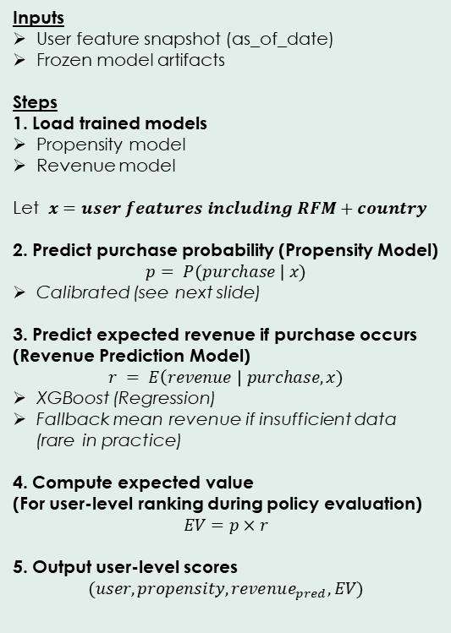
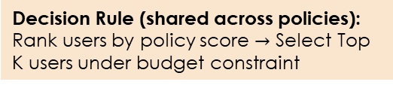
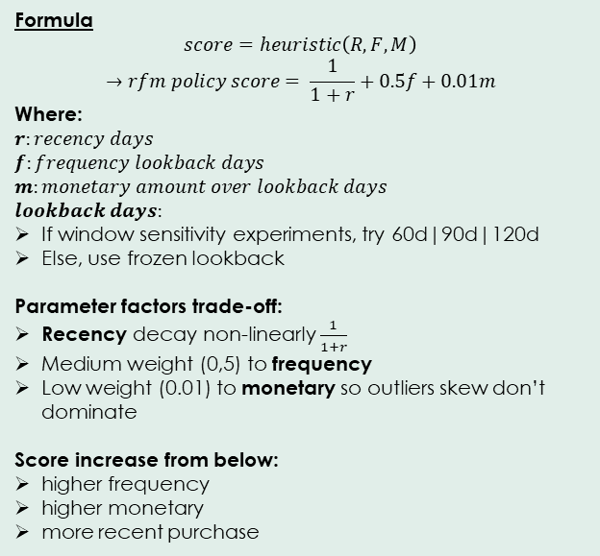
Purchase Propensity (Appendix – Policy Scoring Mechanics)
Policy A (Default ML-driven targeting): Target top ranked by Expected Value
Policy C (Business heuristic baseline): Target top ranked RFM users
Policy B (Random baseline)
Inputs
User feature snapshot (as_of_date)
Frozen model artifacts
Steps
1. Load trained models
Propensity model
Revenue model
Let $x=user features including RFM+country$
2. Predict purchase probability (Propensity Model)
$$p= P(purchase | x)$$
Calibrated (see next slide)
3. Predict expected revenue if purchase occurs (Revenue Prediction Model)
$$r = E\left(revenue \right| purchase, x)$$
XGBoost (Regression)
Fallback mean revenue if insufficient data (rare in practice)
4. Compute expected value (For user-level ranking during policy evaluation)
$$EV=p×r$$
5. Output user-level scores
$$(user, propensity, revenue_{pred}, EV)$$
Formula
Deterministic pseudo-random:
score = Hash to [0,1] by (user id, as_of_date. "policy_random")
Purpose: Sanity baseline
Formula
$$score=heuristic\left(R, F, M\right)$$
$$→rfm policy score= \frac{1}{1+r}+0.5f+0.01m$$
Where:
$$r:recency days$$
$$f:frequency lookback days$$
$$m:monetary amount over lookback days$$
$$lookback days:$$
If window sensitivity experiments, try 60d|90d|120d
Else, use frozen lookback
Parameter factors trade-off:
Recency decay non-linearly $\frac{1}{1+r}$
Medium weight (0,5) to frequency
Low weight (0.01) to monetary so outliers skew don’t dominate
Score increase from below:
higher frequency
higher monetary
more recent purchase
Decision Rule (shared across policies): Rank users by policy score $→$ Select Top K users under budget constraint

Slide 8
Purchase Propensity (Appendix – Policy Scoring Mechanics)
Note: Calibration is important because the predicted probability is used
directly in expected-value ranking downstream.
Calibration:
Classification models often output probabilities that are poorly calibrated
(e.g., a predicted 0.8 probability may only correspond to ~0.6 actual event
frequency). Calibration adjusts these predicted probabilities so they better
reflect true outcome frequencies.
This implementation uses Platt scaling via
`CalibratedClassifierCV(method="sigmoid", cv=3)`.
Internally:
1) Split (X_fit, y_fit) into 3 folds
2) Train the base model on 2 folds
3) Predict probabilities on the held-out fold
4) Collect out-of-fold predictions
5) Fit a sigmoid mapping that adjusts the model's pre-calibrated predicted
probabilities to calibrated probabilities
Temporal caveat:
The 3-fold CV used inside `CalibratedClassifierCV` ignores temporal ordering
and may mix rows from different snapshot timestamps within (X_fit, y_fit).
The leakage impact is limited because it occurs only within the training partition
and does not affect downstream validation or test evaluation:
a) Calibration only adjusts the model's pre-calibrated predicted probabilities.
b) The temporal mixing arises from the CV folds used to generate
out-of-fold predictions.
c) True model evaluation (validation/test) still respects the
temporal split and therefore remains leakage-free.

Slide 9
Purchase Propensity (Appendix – Key Results)
Executive Takeaway
ML targeting (xgboost expected-value user ranking) is recommended for budget allocation as it consistently beats naive targeting (Random).
ML targeting is competitive with heuristic RFM and provides a more extensible framework as richer data features become available (Why ML may be preferred over heuristic approaches).
Continue benchmarking against RFM each retraining cycle to maintain performance guardrails.
Initial cycle freeze decision (Best PR-AUC):
ML propensity model: xgboost (vs logistic regression)
prediction window: 90d
feature lookback: 120d (chosen long-term signal) + 30d (always include short-term signal)
Key Steps & Reporting
Window Sensitivity + Freeze Decision (Train + Validation)
Frozen Model Quality (Validation Slice; Drift Signal Monitor)
Policy Comparison Under Budget Constraint (Test Slice)
Key Setup
Each cycle has 12 snapshots 10M-1M-1M train-validate-test split. Subsequent retraining cycles are quarterly overlapping.
Initial cycle ending 2010-11-01
Retrain cycle ending 2011-02-01
Window Sensitivity is only performed on initial cycle and decision freeze once, unless there is significant need to retrain with different configurations.

Slide 10
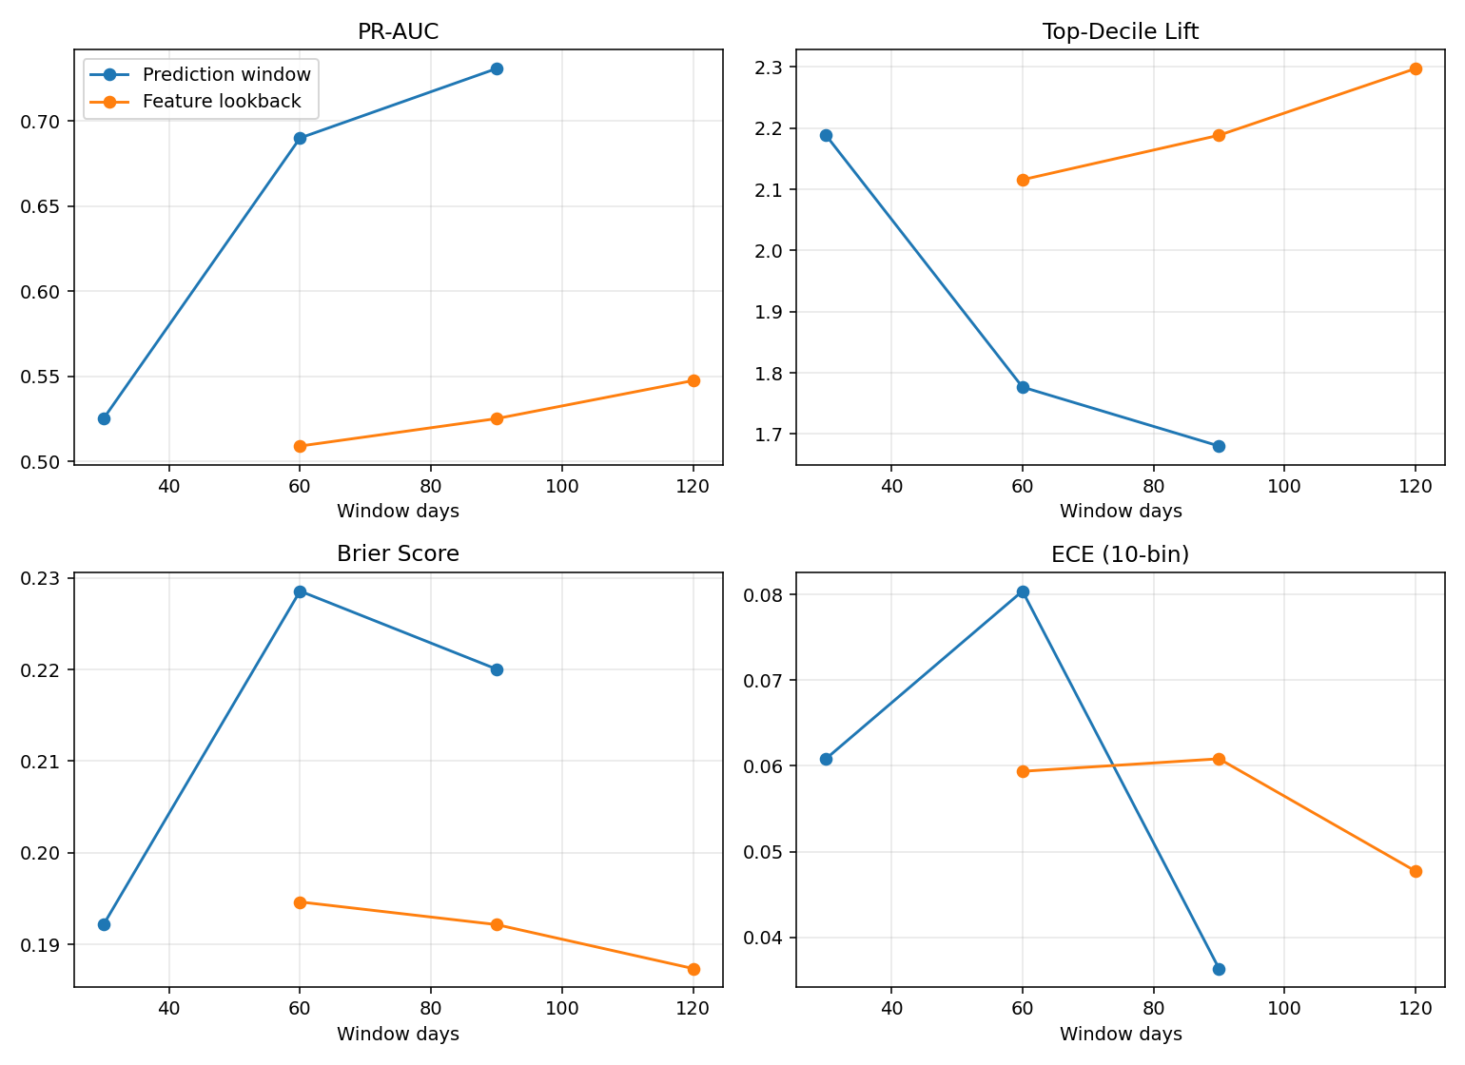
Purchase Propensity (Appendix – Key Results)
Window Sensitivity + Freeze Decision (Train + Validation)
Initial cycle freeze decision (Best PR-AUC):
ML propensity model: xgboost (vs logistic regression)
prediction window: 90d
feature lookback: 120d (chosen long-term signal) + 30d (always include short-term signal)
Primary metric: PR-AUC (positive-class targeting)
Guardrail metrics: Others listed

Slide 11
Purchase Propensity (Appendix – Key Results)
Frozen Model Quality (Validation Slice; Drift Signal Monitor)
Drift monitoring (data/model):
Validation errors increase in retrain cycle — possible data/model drift signal; monitor alongside policy outcomes.
Retrained model seems to concentrate buyers more effectively in top segments (Top-Decile Lift improves), although ranking (PR-AUC) and calibration (ECE) declined.
Primary metric: PR-AUC (positive-class targeting)
Other guardrail metrics
Ranking (AUC, Top-Decile Lift): Whether buyers rank above non-buyers
Calibration (Brier, ECE): Whether predicted probabilities are accurate
Revenue error metrics
Propensity Model Propensity Ranking Quality | PR-AUC | ROC-AUC | Top-Decile Lift | Brier | ECE
Initial | 0.75 | 0.71 | 1.75 | 0.22 | 0.03
Retrain | 0.66 | 0.77 | 2.52 | 0.20 | 0.15
Interpretation | Initial better | Retrain improves | Retrain improves | Retrain improves | Initial better
Revenue Prediction Model Revenue Regression Error | RMSE | MAE | MAPE
Initial | 2019 | 692 | 1.2
Retrain | 2873 | 801 | 2.7
Interpretation | Initial better | Initial better | Initial better
Policy Comparison Under Budget Constraint (Test Slice)
ML targeting (xgboost expected-value user ranking) is recommended for budget allocation as it consistently beats naive targeting (Random).
ML targeting is competitive with heuristic RFM and provides a more extensible framework as richer data features become available (Why may choose ML over heuristic approach).
Continue benchmarking against RFM each retraining cycle to maintain performance guardrails.
Selection Rule: Maximize Revenue per Targeted User (Historical Realized)
Secondary Metric: Purchase Rate (Historical Realized)
Cycle | Revenue per Targeted User (Historical Realized) |  |  |  |  |  | Purchase Rate (Historical Realized)
 | ML | Random | RFM | ML vs Random | ML vs RFM |  | ML | Random | RFM | ML vs Random | ML vs RFM
Initial | 1432.0 | 471.5 | 1444.4 | +960.5 | -12.3 |  | 0.68 | 0.41 | 0.70 | +0.27 | -0.02
Retrain | 956.0 | 323.1 | 949.3 | +632.9 | +6.7 |  | 0.66 | 0.35 | 0.65 | +0.31 | +0.01
Notes:
Large MAPE (Mean Absolute Percentage Error): MAPE appears relatively large because transaction revenue data often contains many small purchases, which can inflate percentage errors.
In this system the revenue model is primarily used to estimate expected value for ranking, so the policy backtest results are more informative for evaluating the targeting strategy than the regression error metrics alone.

Slide 12
Recommender (Appendix – Model & Evaluation Design)
Experiments Setup
Hierarchy of Baselines for Recommenders
Experiments Setup | Description
Time-based split (chronological, no leakage) | For each user, use earliest interactions for `train`, second-latest for `validation`, latest for `test`. Why: Prevent temporal leakage.
Train/Val/Test proportions | User-level chronological holdout: `train:` all items from user’s older purchase invoices `validation:` all items from user’s second-latest purchase invoice `test:` all items from user’s latest purchase invoice users with fewer than 3 purchase invoices are excluded from ranking evaluation Why: Next-item prediction protocol Evaluation: recommend Top-K items and measure how many appear in the user’s held-out next basket (basket = all items in the held-out invoice)
Implicit feedback setting | We model observed transactions as positive interaction signals (purchase events), with no explicit rating scale (e.g., 1-5). Why: No explicit ratings available.
Interaction matrix construction | Build a sparse user-item binary matrix from `train` interactions only; this becomes the core input for MF/two-tower retrieval.
Evaluation protocol | Compare `popularity`, `MF`, `Two-Tower`; select by validation `Recall@20`, report final test metrics at `K=20` candidates
Model Baseline | Type | Why included
Level 0 — Random Baseline | Statistical (Null Model) | Theoretical Floor
Level 1 — Popularity Baseline | Heuristic | Heuristic Baseline
Level 2 — Matrix Factorization (TruncatedSVD) | Classical ML: Collaborative Filtering (CF) | Strong benchmark
Level 3 — Two-Tower | Neural Retrieval | Scalable, extensible
Model Baseline | Model Design & Convergence Policy
Two-Tower | Architecture: Embedding-only dual encoder (no hidden layers). Why: No justification to increase complexity with hidden layers.
 | Scoring Function: Dot-product retrieval with L2-normalized embeddings (cosine-style), temperature-scaled logits. Why: Stable default with cosine similarity ranking, better optimization control. `temperature` (during training) rescales logits by `1/T` before softmax. Low (high) temperature sharpen (flatten) the softmax probability distribution to amplify (dampen) probability score differences to get stronger (weaker) separation between positives and negatives. There is no temperature control at serving or evaluation.
 | Negative Strategy: In-batch negatives + globally sampled random negative. Why: Stronger contrastive signal without heavy complexity.
 | Loss Function Objectives: Cross-entropy over positive item vs in-batch/sampled negatives (maximize separation for retrieval ranking). Why: Standard retrieval objective, directly optimizes ranking separation.
 | Convergence Control: early stopping on validation 1)`Recall@20` if stop improving on few iterations or 2) maximum iterations. Why: Aligns stopping rule to business-facing retrieval metric (recall).
Popularity | Rank by global item interaction frequency (log1p transform). Why: Fast heuristic floor; sanity check above random. `log1p(c)` transforms item count `c` to `log(1 + c)`, reducing skew to limit impact of popular items dominating rankings.
MF | TruncatedSVD on train-only implicit user-item matrix (TF-IDF weighting) then normalized cosine-similarity style. Why: Strong classical collaborative-filtering benchmark. TF-IDF lets rarer items get higher weights to reduce popularity bias.

Slide 13
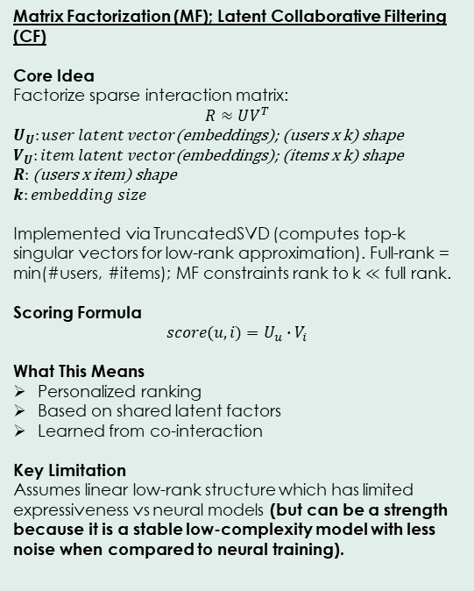
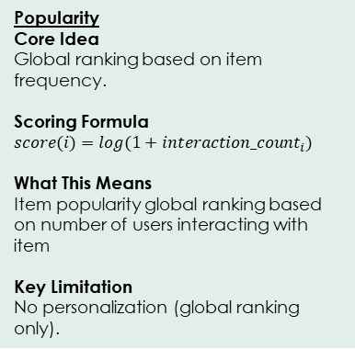
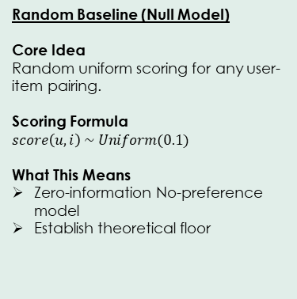
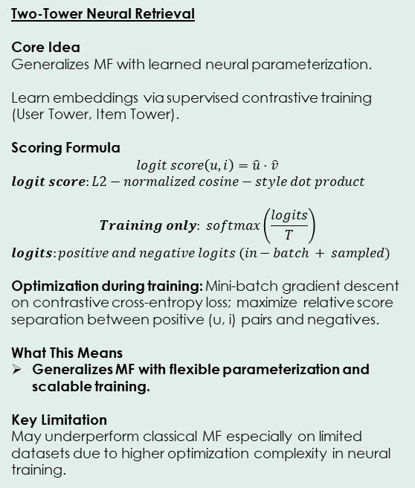
Recommender (Appendix – Model Scoring Mechanics)
Random Baseline (Null Model)
Core Idea
Random uniform scoring for any user-item pairing.
Scoring Formula
$$score\left(u,i\right) \sim Uniform(0.1)$$
What This Means
Zero-information No-preference model
Establish theoretical floor
Popularity
Core Idea
Global ranking based on item frequency.
Scoring Formula
$$score(i)=log(1+{interaction_count}_{i}​)$$
What This Means
Item popularity global ranking based on number of users interacting with item
Key Limitation
No personalization (global ranking only).
Matrix Factorization (MF); Latent Collaborative Filtering (CF)
Core Idea
Factorize sparse interaction matrix:
$$R≈UV^{T}$$
$U_{U}:user latent vector\text{(}\text{embeddings}\text{)}$; (users x k) shape
$$V_{U}:item latent vector\text{(}\text{embeddings}\text{); (}\text{items} \text{x} \text{k}\text{) }\text{shape}$$
$R:$ (users x item) shape
$$k:embedding size$$
Implemented via TruncatedSVD (computes top-k singular vectors for low-rank approximation). Full-rank = min(#users, #items); MF constraints rank to k $≪$ full rank.
Scoring Formula
$$score(u, i)=U_{u}∙V_{i}$$
What This Means
Personalized ranking
Based on shared latent factors
Learned from co-interaction
Key Limitation
Assumes linear low-rank structure which has limited expressiveness vs neural models (but can be a strength because it is a stable low-complexity model with less noise when compared to neural training).
Two-Tower Neural Retrieval
Core Idea
Generalizes MF with learned neural parameterization.
Learn embeddings via supervised contrastive training (User Tower, Item Tower).
Scoring Formula
$$logit score\left(u,i\right)=\hat{u}⋅\hat{v}$$
$$logit score:L2−normalized cosine−style dot product$$
$$Training only: softmax\left(\frac{logits}{T}\right)$$
$$logits:positive and negative logits (in−batch + sampled)$$
Optimization during training: Mini-batch gradient descent on contrastive cross-entropy loss; maximize relative score separation between positive (u, i) pairs and negatives.
What This Means
Generalizes MF with flexible parameterization and scalable training.
Key Limitation
May underperform classical MF especially on limited datasets due to higher optimization complexity in neural training.
Experiment models are trained on weights from binary interaction signals with model-specific transformations applied (see Interaction Signal in Architecture / Model & Evaluation Design slides)
Models | Representation | Personalization; User-Level Parameter Learning
Level 0 — Random Baseline | Zero-information No-preference | X
Level 1 — Popularity Baseline | Global interaction count ranking | X
Level 2 — Matrix Factorization (TruncatedSVD) | Low-rank embeddings | Matrix factorization
Level 3 — Two-Tower | Neural embeddings | Supervised contrastive neural training

Slide 14
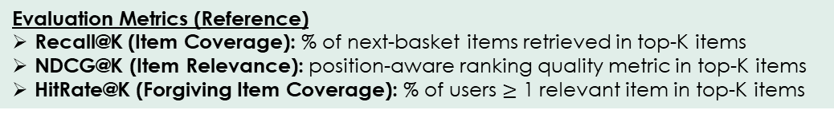
Recommender (Appendix – Key Results)
Executive Takeaway
Matrix Factorization is the current production default for Stage 1 Candidate Retrieval
Two-Tower remains a challenger pending richer features
Popularity as sanity baseline.
Secondary metrics (NDCG, HitRate) monitored; no conflicting signals with Recall@20.
Model Comparison (Recall@20)
Selection Rule: Maximize validation Recall@20
Model | Recall@20 (Validation) | Recall@20 (Test)
Popularity | 0.028 | 0.023
MF | 0.053 | 0.043
Two-Tower | 0.036 | 0.028
Evaluation: recommend Top-K items and measure how many appear in the user’s held-out next basket.
(basket = all items in the held-out invoice)
Evaluation Metrics (Reference)
Recall@K (Item Coverage): % of next-basket items retrieved in top-K items
NDCG@K (Item Relevance): position-aware ranking quality metric in top-K items
HitRate@K (Forgiving Item Coverage): % of users $≥$ 1 relevant item in top-K items

