Slide 1
Final Presentation for Mobile Bible App
A report by MobaDevvs
Jairus Emmanuel Gomez
Humphrey Manango
Gabriel Jret Ouano
John Michael Sta Ana

Slide 2
Contents
Requirements Documentations
Design and Implementation
Insights
Recommendations
Conclusion

Slide 3

Requirements Documentations
Mobile Bible App
A Personal Android Bible Reading Application
What is it?
A native Android Bible app built with Kotlin + Jetpack Compose
Personal use — no login, no account, no internet needed
6 screens: Home, Books, Reader, Search, Saved/Bookmarks, Settings
"Read, search, highlight, and save Bible verses — all offline."

Slide 4
Core Features (Functional Requirements)
Read all 66 Bible books
Chapter navigation
Daily verse
Reading streak counter
Continue reading
Recent history
Full-text search
Filter by OT / NT / Topic
Bookmark verses
Highlight in 4 colors
Add personal notes
Copy verse to clipboard

Slide 5
App Screens
Home — Daily verse, streak, quick book access
Books — All 66 books, OT/NT tabs, search filter
Reader — Read verses, highlight, bookmark, add notes
Search — Full-text search with filters and history
Saved/Bookmarks — All bookmarks and notes in one place
Settings — Theme, font size, translation, notifications

Slide 6
Reader Features (Key Screen)
- Tap any verse to select it
- Highlight in Yellow / Green / Blue / Pink
- Bookmark with one tap
- Add personal notes
- Copy verse text
- Previous / Next chapter navigation
- Switch translations: KJV, NIV, ESV, NLT

Slide 7
Settings & Personalization
Theme → Light | Dark | Sepia
Font Size → Small | Medium | Large | Extra Large
Translation → KJV | NIV | ESV | NLT
Notifications → ON / OFF
No login required — fully personal

Slide 8
Technical Stack
Language
UI Framework
Architecture
Navigation
Design
Min Android
Test Device
Kotlin
Jetpack Compose
MVVM
Navigation Compose
Material Design 3
API 21 (Android 5.0+)
Google Pixel 6 Pro

Slide 9
Privacy & Data
No data collected
No internet required
No login or account
Everything stored locally on device
Personal use only

Slide 10
Design and Implementation
Design and Implementation
Mobile Bible App
How it was designed and how it was built

Slide 11
Design Process
How the app was designed:
1. Wireframes created first (Figma)
2. Screen Specifications written for each screen
3. Component IDs assigned to every UI element
4. Requirements documented and validated
5. Code built based on the specs

Slide 12
Wireframes
6 screens wireframed before any code was written:
SCR-001 Home Screen
SCR-002 Search Screen
SCR-003 Books Screen
SCR-004 Reader Screen
SCR-005 Bookmarks Screen
SCR-006 Settings Screen

Slide 13
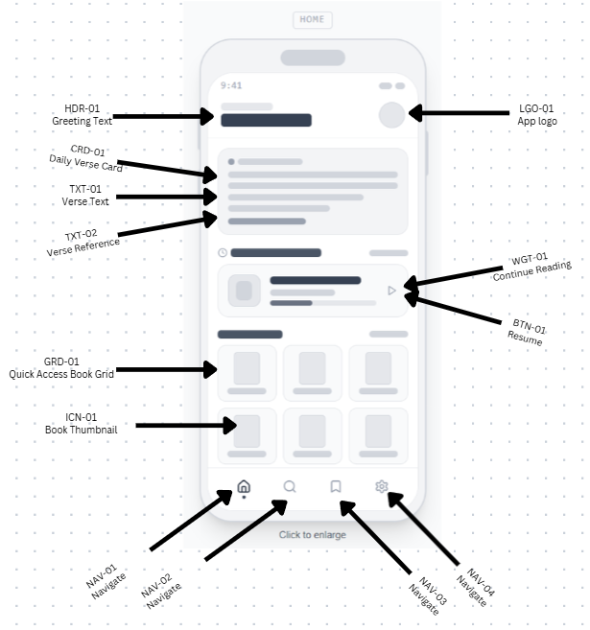
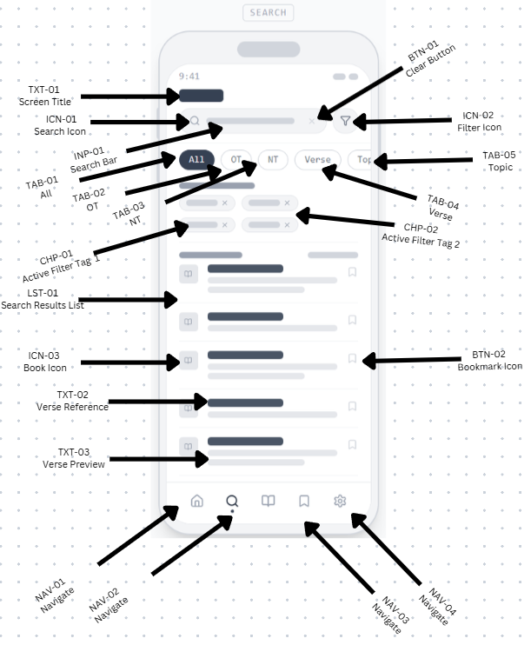
Wireframes (with element ID)
Home
Search

Slide 14
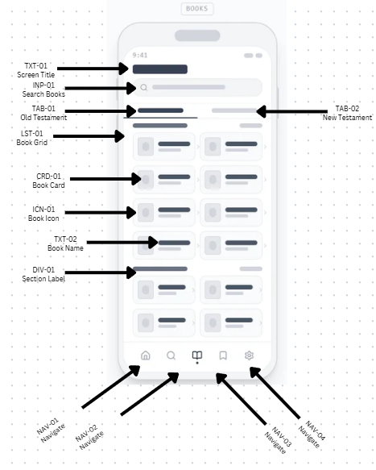
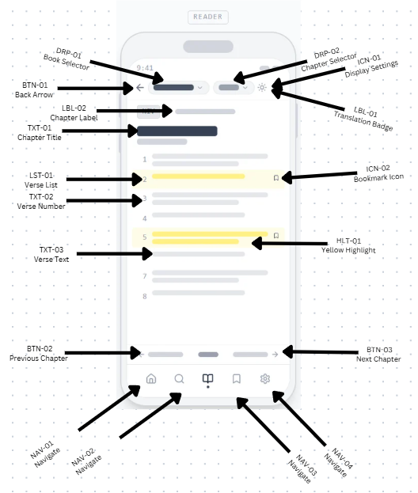
Wireframes (with element ID)
Books
Reader

Slide 15
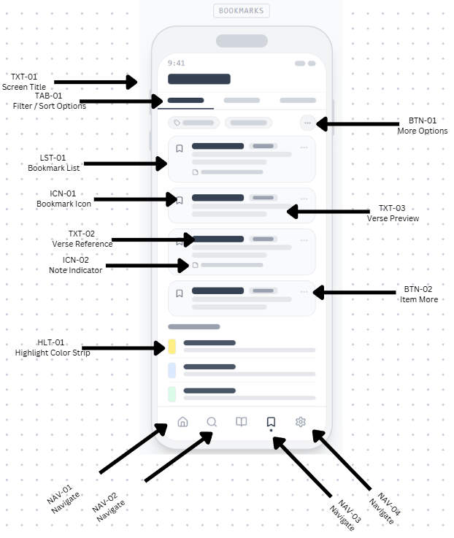
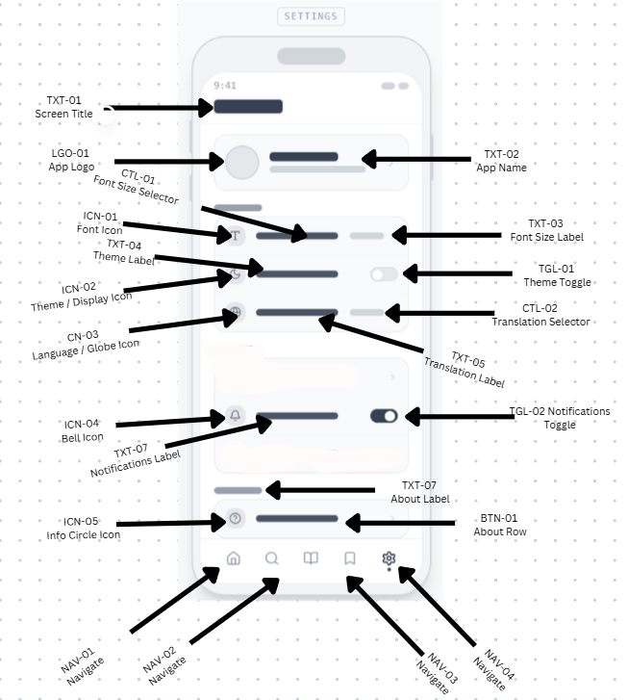
Wireframes (with element ID)
Bookmarks
Settings

Slide 16
UI Design Decisions
Design choices made:
Color Scheme → Amber / Gold primary (#D97706)
→ Stone / Warm neutral background
Typography → Material Design 3 type scale
Icons → Material Icons Extended
Theme Support → Light | Dark | Sepia
Font Control → S | M | L | XL adjustable by user
Bottom Nav → 5 tabs always visible (NAV-01 to NAV-05)

Slide 17
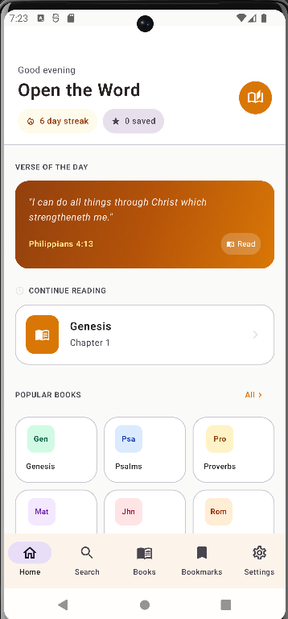
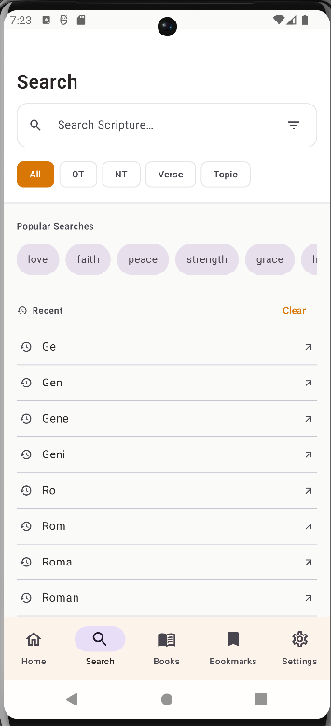
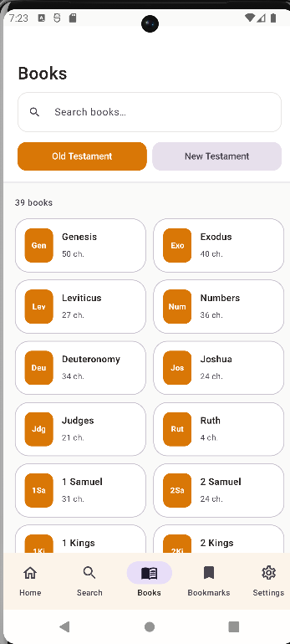
App UI Design
Home
Search
Books

Slide 18
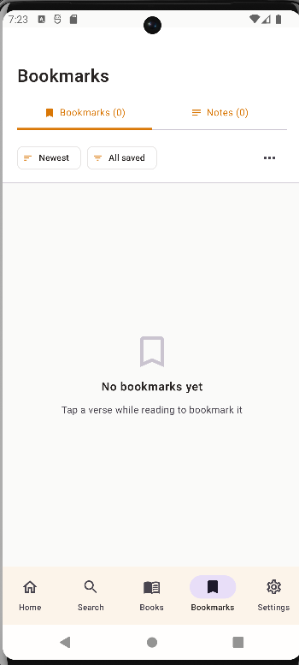
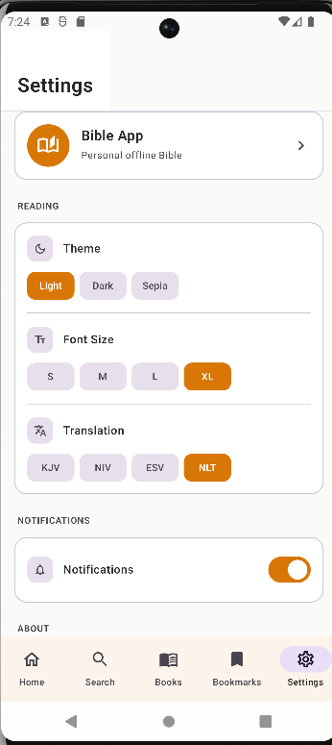
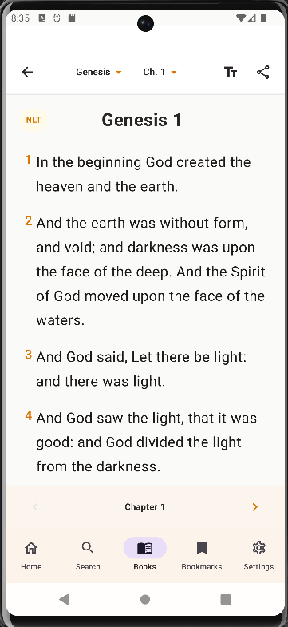
App UI Design
Bookmarks
Settings
Reader

Slide 19
UI Design Decisions
How data moves in the app:
User taps verse -> ReaderScreen.kt (UI) ->
BibleViewModel.kt (adds bookmark/highlight) ->
BibleRepository.kt (saves to DataStore) ->
Persisted locally on device ->
Next app launch -> DataStore loads saved data back

Slide 20
UI Design Decisions
Navigation uses typed routes:
Home → /home
Books → /books
Chapters → /chapters/{bookId}
Reader → /reader/{bookId}/{chapter}
Search → /search
Saved → /bookmarks
Settings → /settings

Slide 21
Insights
What is not yet fully implemented:
Full Bible text — only key chapters included
→ Full text to be added in BibleData.kt
Multi-translation data — UI only for now
→ KJV/NIV/ESV/NLT selector works
→ Actual verse data per translation not yet loaded
Android only — no iOS
→ Future: Flutter or React Native for cross-platform

Slide 22
Recommendations
Full Bible text — all 66 books
Real translation data (NIV, ESV, NLT)
Audio Bible playback
Daily reading plan
Cloud sync for bookmarks and notes
iOS support via Flutter or React Native
Offline Bible lands maps
Share verse as image

Slide 23
Conclusion
Mobile Bible App
Built with Kotlin + Jetpack Compose
Android | Personal Use | Offline
"Read. Highlight. Save. Reflect."

