Slide 1














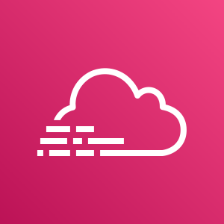

AWS Cloud
AWS CloudFormation template
Amazon GuardDuty
Integration
VPC Flow Logs
Amazon CloudWatch
Lambda function
AWS Security Hub
Amazon CloudWatch
Collector and sources
User
AWS WAF
Amazon Kinesis
Data Firehose
Apps
AWS Config
S3 buckets
AWS CloudTrail
Amazon SNS

