Slide 1

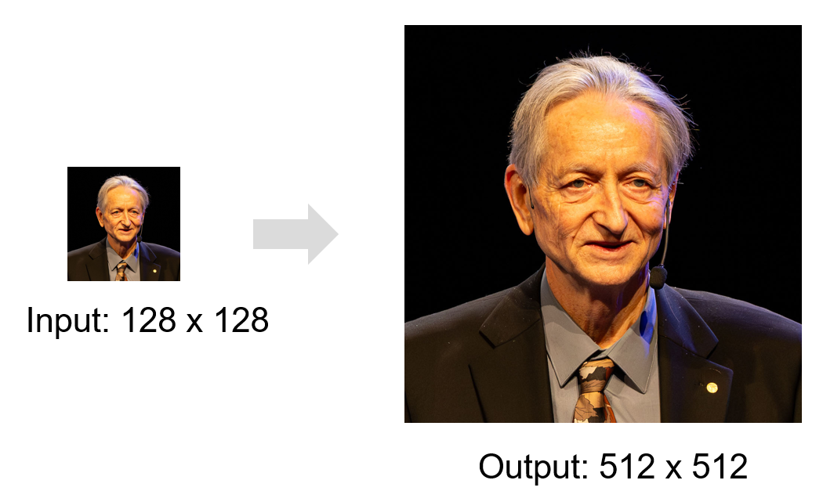
Super-Resolution in Deep Learning Era
A Model-Centric Perspective
Tran Dinh Phu
Ph.D. Student
phutx2000@kaist.ac.kr
AI2 Lab, KAIST
School of Computing, KAIST
2026.09.10
CS632_2026_Fall Embedded Operating Systems

Slide 2

Self-intro

Slide 3
Contents
Super-Resolution Fundamentals: Problem setup, Variants, and Evaluation
Application of Super-Resolution
Non-generative Image Super-Resolution
Generative Image Super-Resolution
Deep Learning for Video Super-Resolutoin
Open Issues & Pratical Takeaways

Slide 4
Super-Resolution Fundamentals

Slide 5
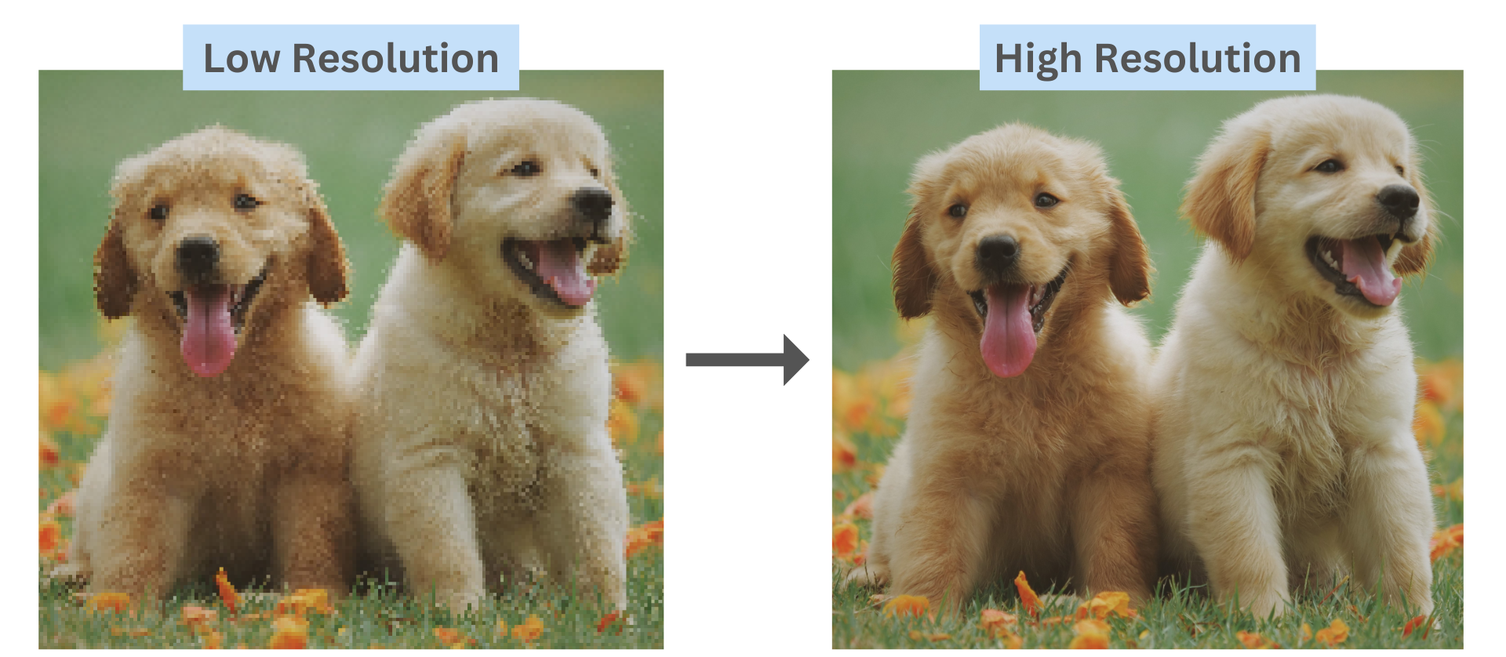
What is Super-Resolution (SR)?
Generate High-Resolution (HR) image/video from
Low-Resolution (LR) image/video

Slide 6
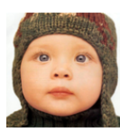
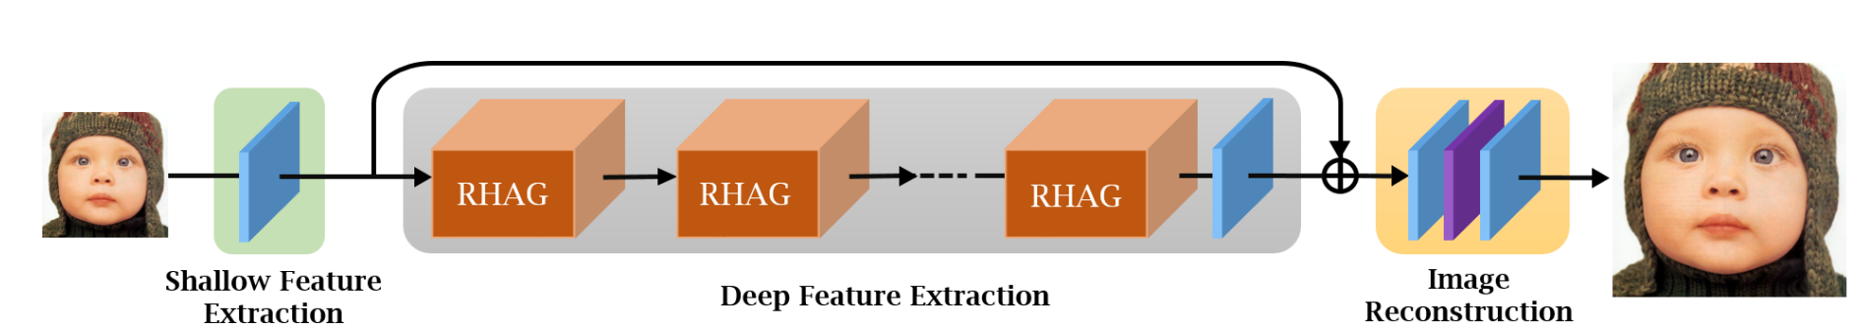
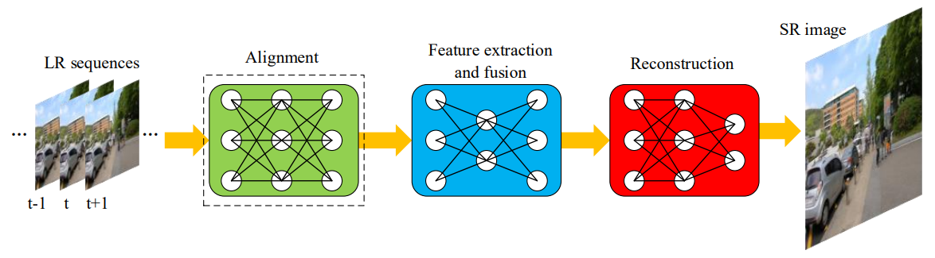
Super-Resolution Category
        Single Image Super-Resolution: High ambiguity, Fast inference
    Multiple Image Super-Resolution: Reduce ambiguity, Alignment
    Video Super-Resolution: Motion cues, More memory and latency
SISR
MISR
VSR

Slide 7
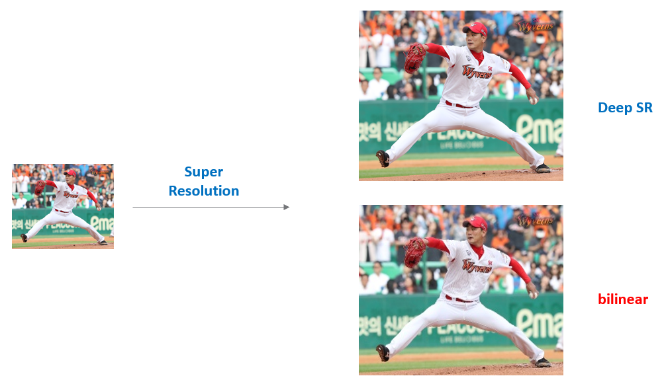
Traditional Technique
Traditional (Unlearning) approaches for Super-Resolution
        Interpolation methods: bicubic, bilinear or Lanczos interpols
        Easy, fast… but super poor quality

Slide 8


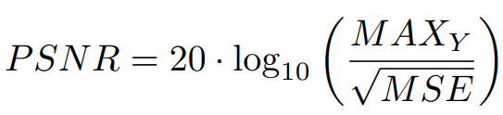
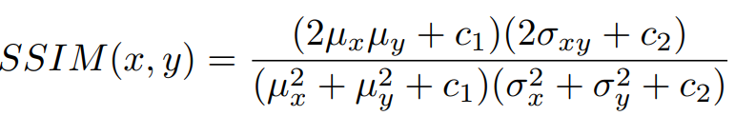
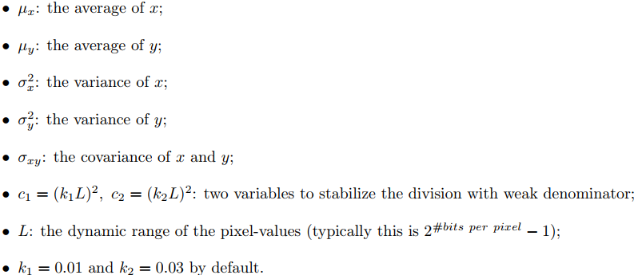
Evaluation Metric – Distortion Metric
Peak Signal-to-Noise Ratio (PSNR)
Structural Similarity Index Measure (SSIM)

Slide 9

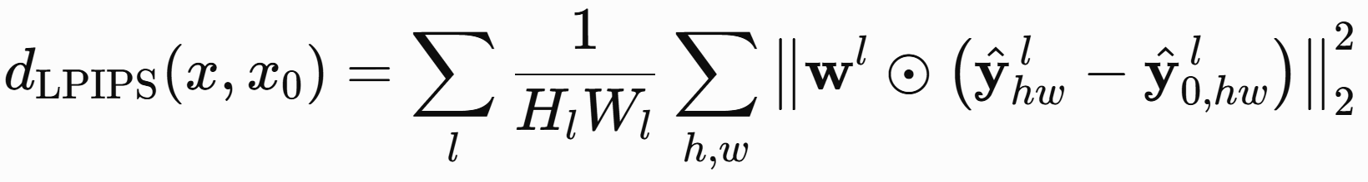
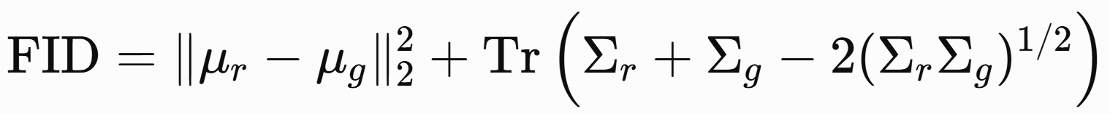
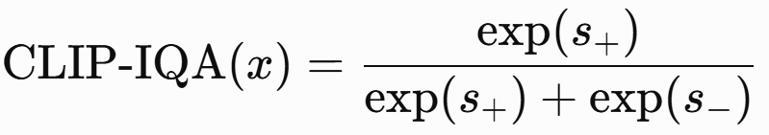
Evaluation Metric – Perceptual Metric
Learned Perceptual Image Patch Similarity (LPIPS)
Fre’chet Inception Distance (FID)
Clip-based Image Quality Assessment (ClipIQA)
…

Slide 10
Applications of Super-Resolution

Slide 11
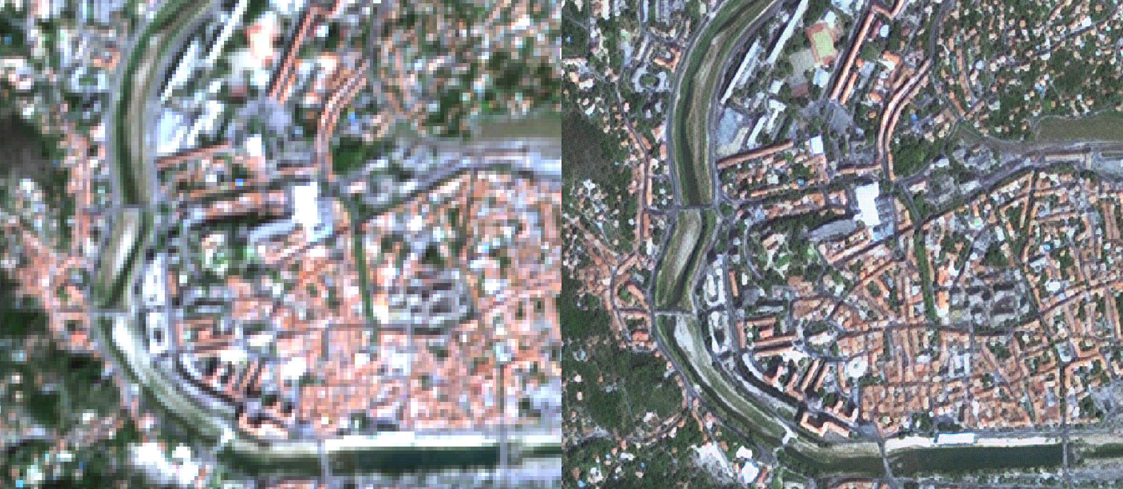
Applications: Why SR Matters
Remote sensing satellite imagery

Slide 12
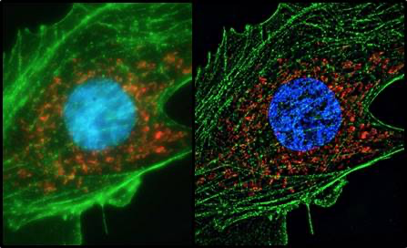
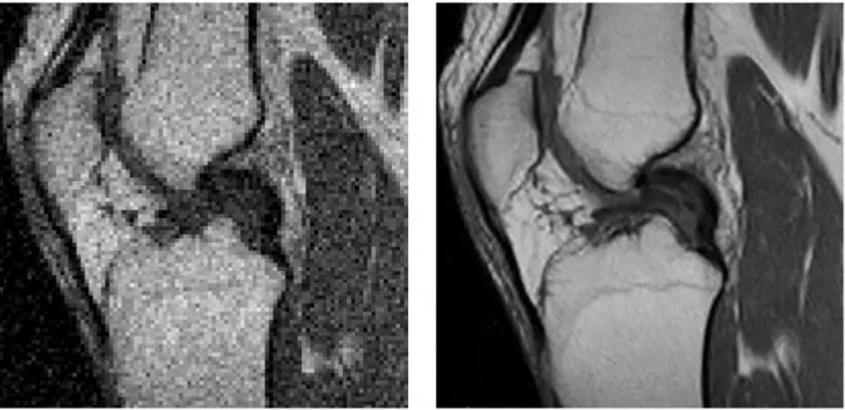
Applications: Why SR Matters
Medical imaging

Slide 13
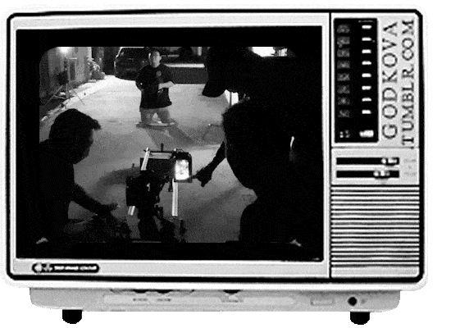
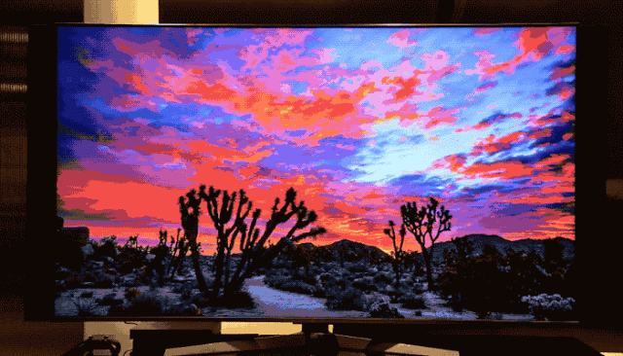
Applications: Why SR Matters
Multimedia industry, security camera, TV, Video Game,…

Slide 14
Non-generative Image Super-Resolution

Slide 15
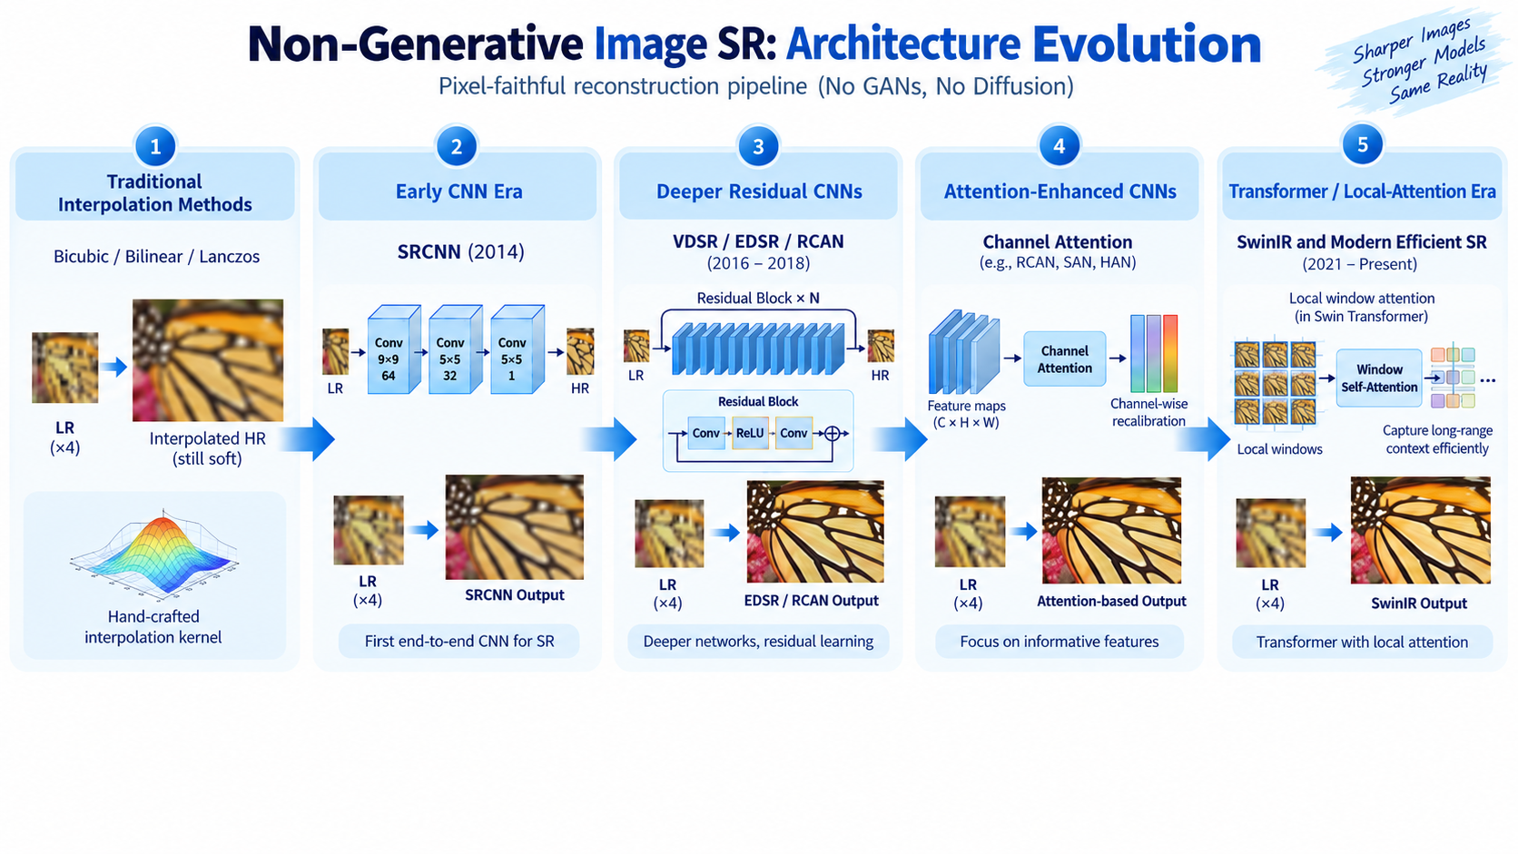
Non-Generative Image SR: Architecture Evolution
Credit: ChatGPT Image

Slide 16
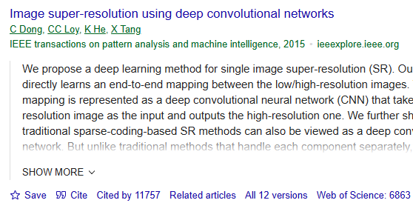
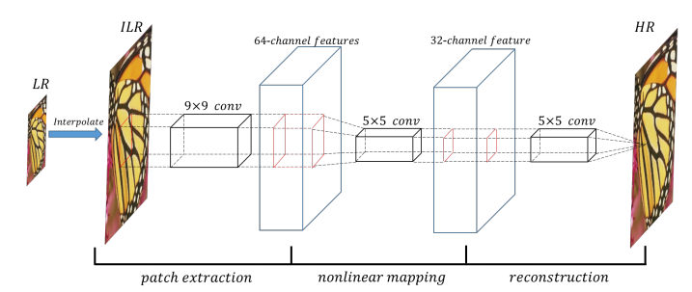
SRCNN: The Starting Point of Deep SR
First Deep Learning architecture for SISR
        SRCNN (2014): 3-layer CNN, MSE Loss, Early Upsampling
        Outperform traditional methods
Reference: Dong, C., Loy, C. C., He, K., & Tang, X. (2015). Image super-resolution using deep convolutional networks. IEEE transactions on pattern analysis and machine intelligence, 38(2), 295-307.

Slide 17
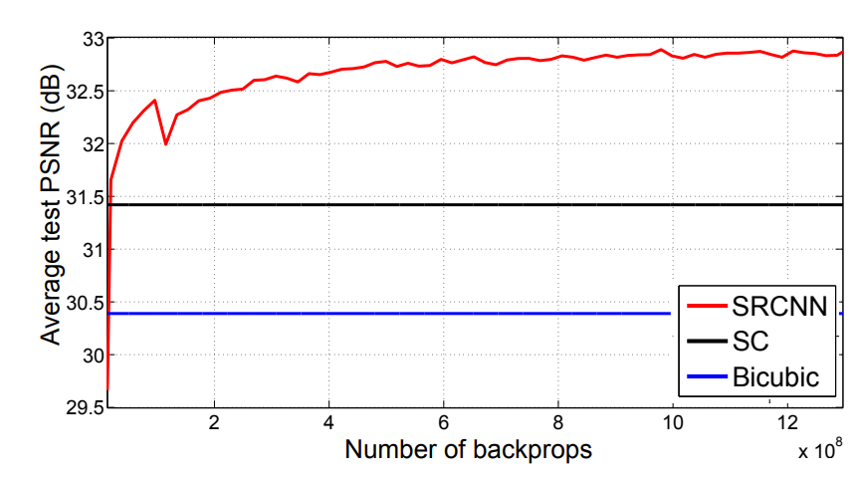
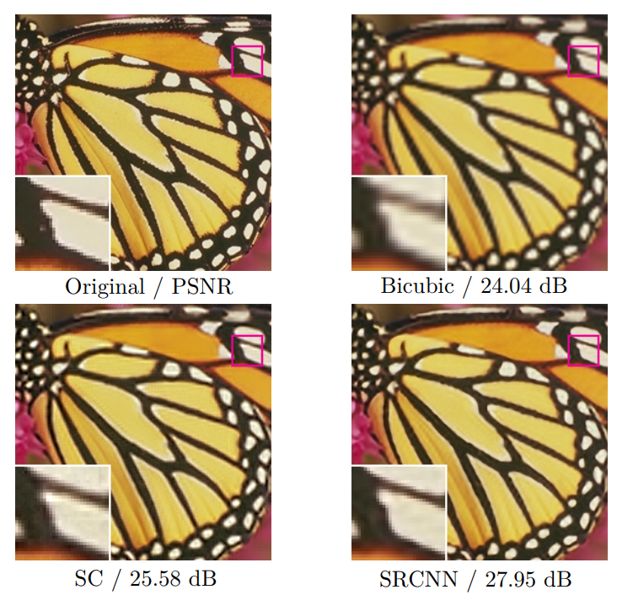
SRCNN: The Starting Point of Deep SR
SC: Sparse-coding-based method

Slide 18
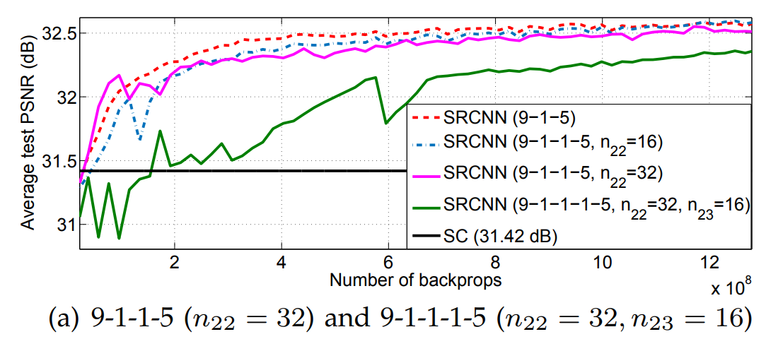
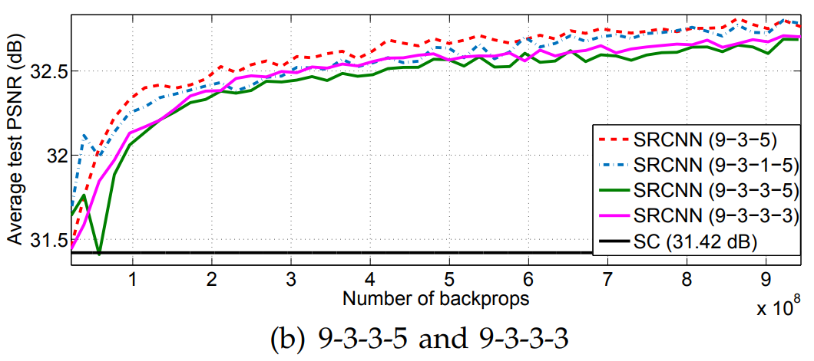
Current Architecture Issues
Do deeper networks work better?
        SRCNN (2014) are shallow network
        Failed to train deeper models => How to train deeper network?
Figure. Deeper structure does not always lead to better performance

Slide 19
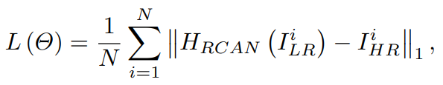
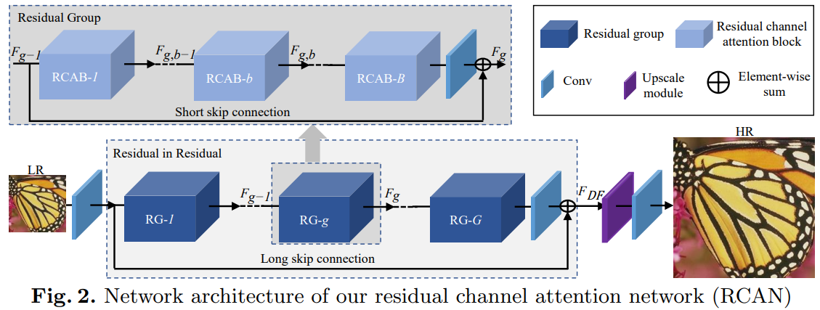
RCAN: Very Deep Network + Residual Learning
ResNet
RCAN (2018): Very deep Residual Channel Attention Network
        Deeper model (400-layer) => large receptive field
        Residual learning, Channel Attention
        L1 Loss
Reference: Zhang, Y., Li, K., Li, K., Wang, L., Zhong, B., & Fu, Y. (2018). Image super-resolution using very deep residual channel attention networks. In Proceedings of the European conference on computer vision (ECCV) (pp. 286-301).

Slide 20
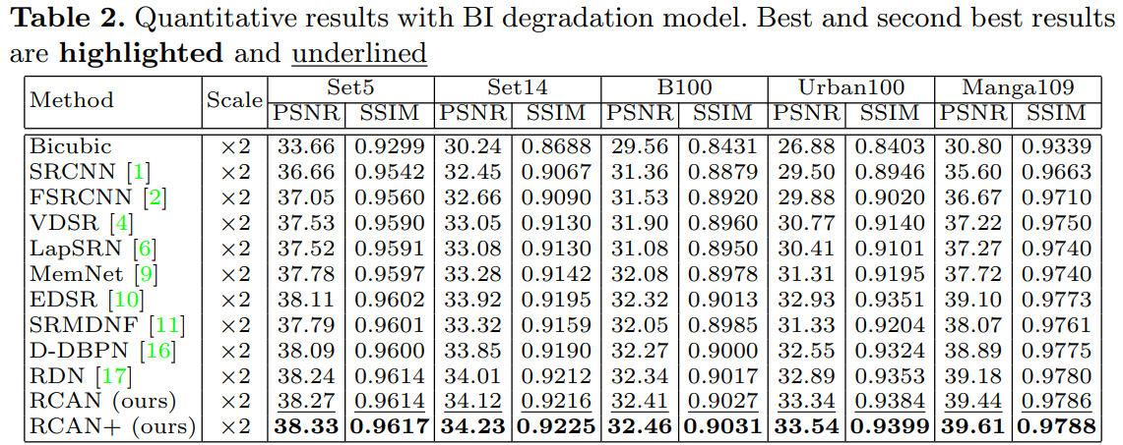
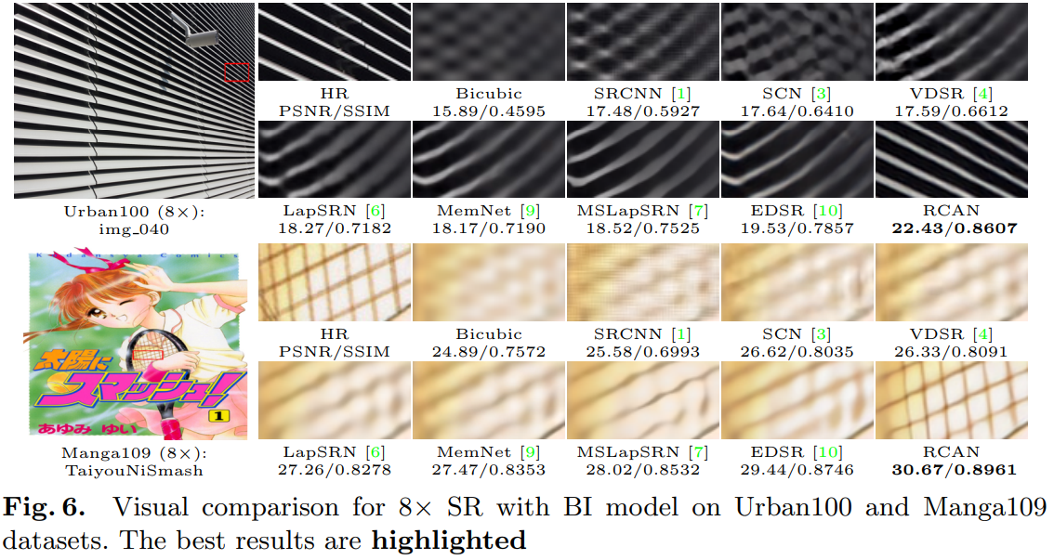
RCAN: Very Deep Network + Residual Learning

Slide 21
RCAN: Very Deep Network + Residual Learning
Key takeaways from RCAN structure
        Deeper model could lead to better performance
        Channel Attention could improve the performance overall
        L1 Loss is better than MSE Loss in SR tasks
Limitation
        Require a breakthrough in the model architecture design

Slide 22
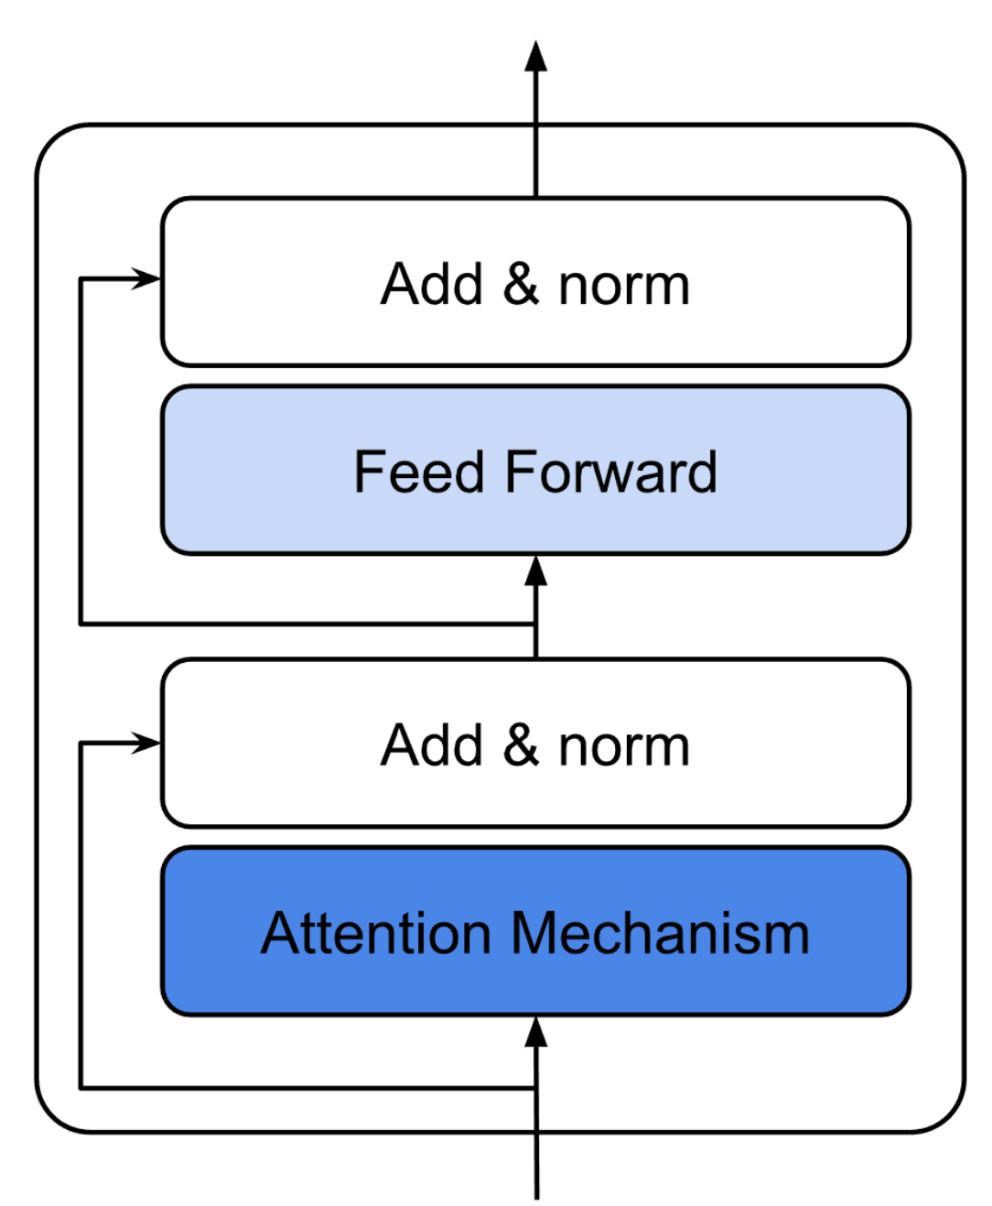
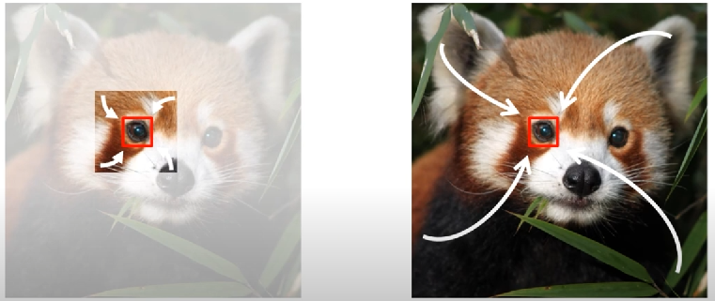
Transformer Architecture
Why Transformers?
        Global receptive field
        Long-range dependencies modeling
        SOTA performance in most of the tasks in CV
CNN-based method
(Local)
Transformer-based method
(Global)
General transformer
structure

Slide 23
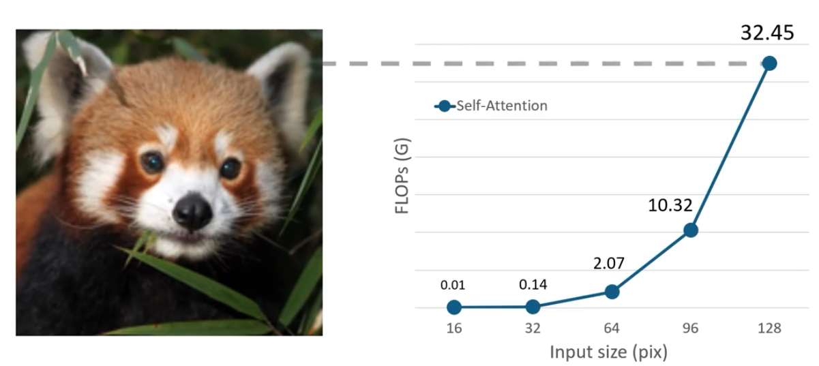
Transformer Architecture
But…
        What about Complexity?
        Quadratic Complexity
FLOPs v.s. Input size

Slide 24
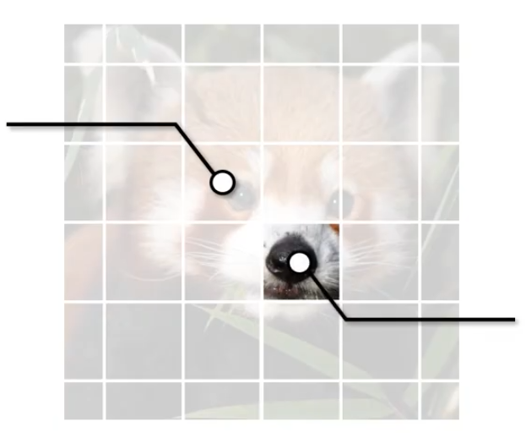
Transformer Architecture
What could be a good solution?
        Local Transformer
        E.g., Swin Transformer (2021)
Window Attention
Shifted Window Attention

Slide 25
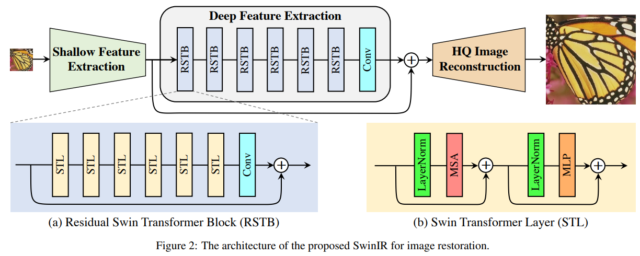
SwinIR: First Transformer-based Method for SR
Swin Transformer
SwinIR (2021): Image Restoration using Swin Transformer
        Outperforms CNN-based methods by up to 0.14∼0.45dB
        Total #parameters can be reduced by up to 67%
Reference: Liang, J., Cao, J., Sun, G., Zhang, K., Van Gool, L., & Timofte, R. (2021). Swinir: Image restoration using swin transformer. In Proceedings of the IEEE/CVF international conference on computer vision (pp. 1833-1844).

Slide 26
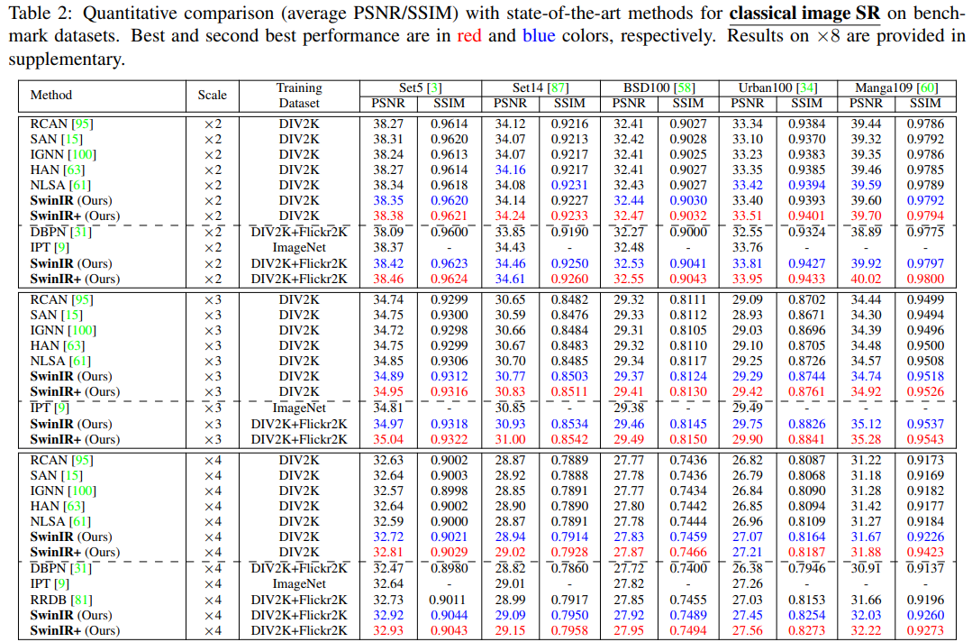
SwinIR: First Transformer-based Method for SR
Reference: Liang, J., Cao, J., Sun, G., Zhang, K., Van Gool, L., & Timofte, R. (2021). Swinir: Image restoration using swin transformer. In Proceedings of the IEEE/CVF international conference on computer vision (pp. 1833-1844).

Slide 27
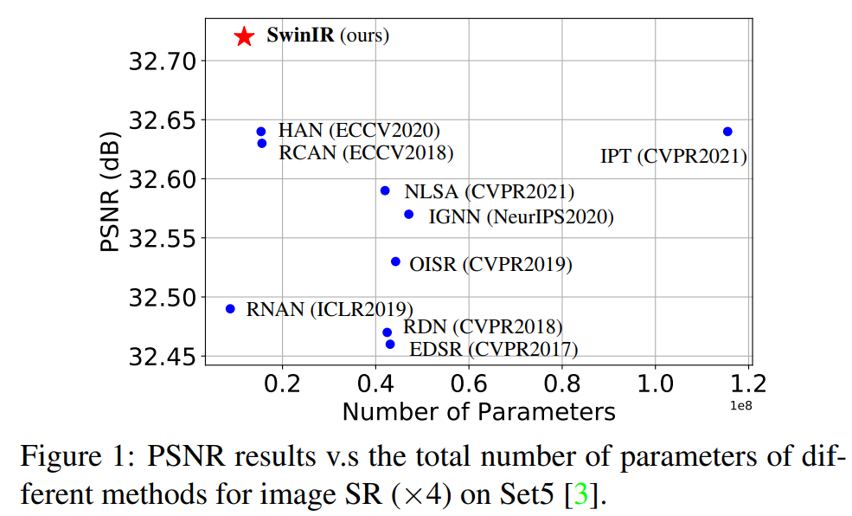
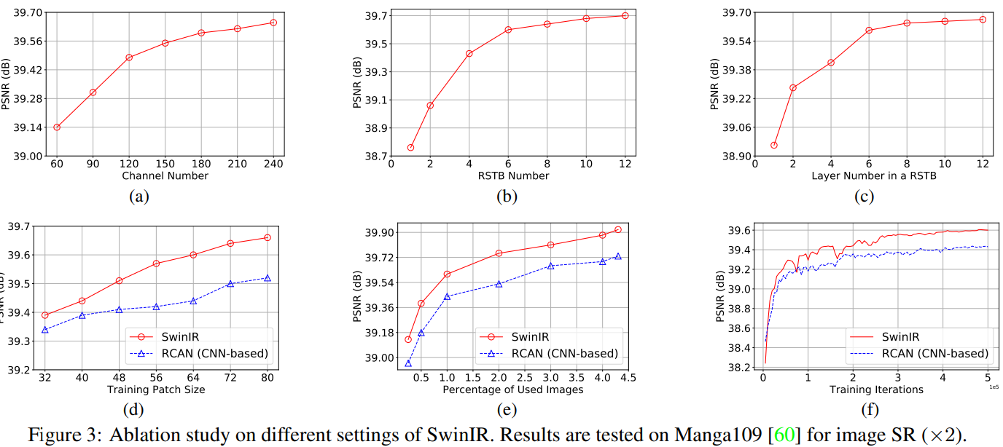
SwinIR: First Transformer-based Method for SR

Slide 28
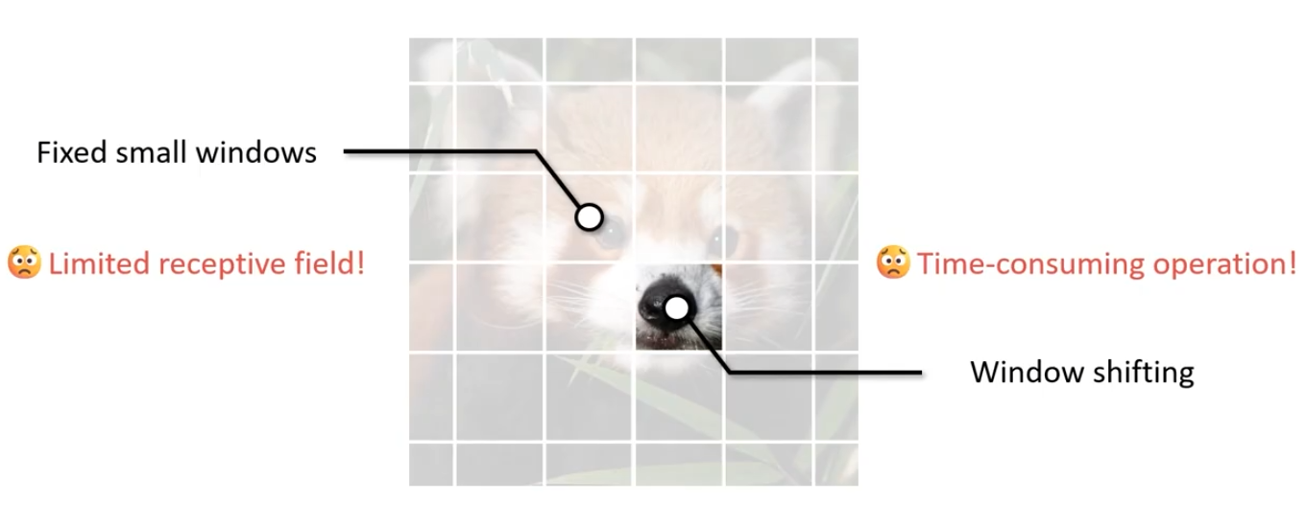
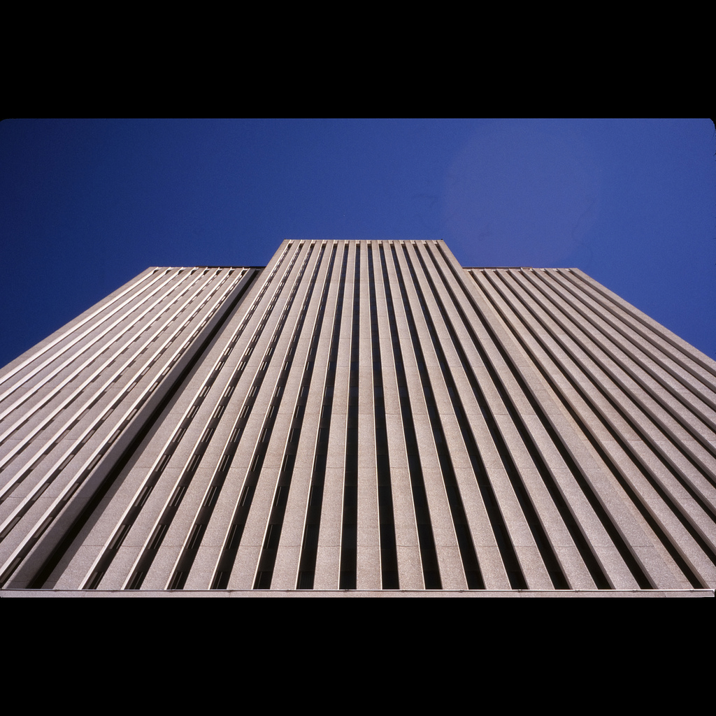
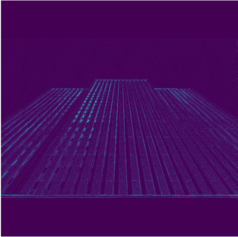

SwinIR: First Transformer-based Method for SR
Limitation
HR
RCAN
SwinIR

Slide 29
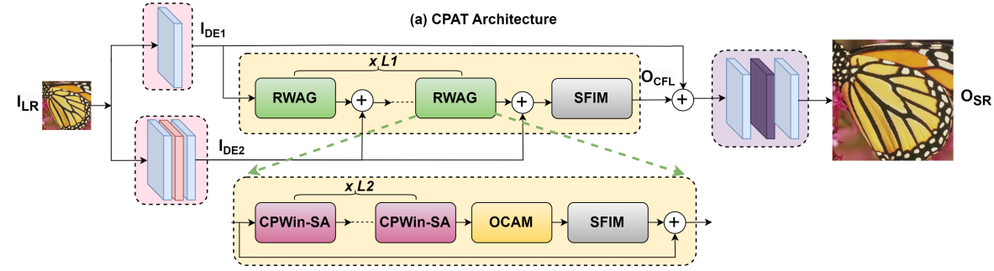
CPAT: Channel-Partitioned Attention Transformer
CPAT (2024): Channel-Partitioned Attention Transformer
        RWAG: Residual Window Attention Group
        SFIM: Spatial-Frequency Interaction Module
        CPWin-SA: Channel-Partitioned Window Self-Attention
        OCAM: Overlapping Cross-Attention Module
Reference: Tran, D. P., Hung, D. D., & Kim, D. (2024). Channel-Partitioned Windowed Attention And Frequency Learning for Single Image Super-Resolution. The 35th British Machine Vision Conference (BMVC 2024).

Slide 30
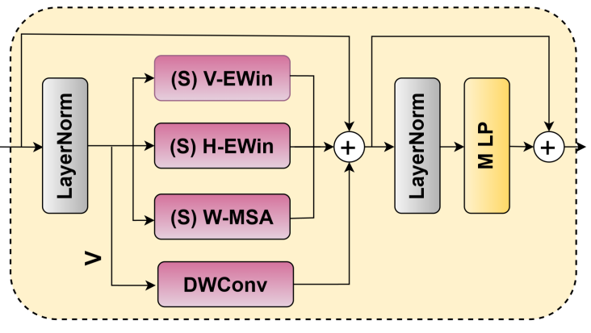
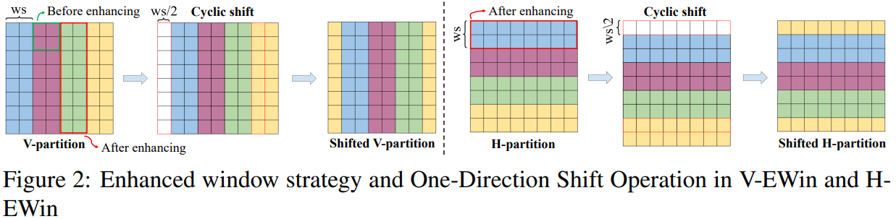
CPAT: Channel-Partitioned Attention Transformer
ChannelPartitioned Window Self-Attention structure
Figure 1: CPWin-SA Module

Slide 31
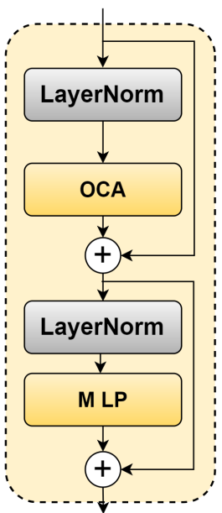
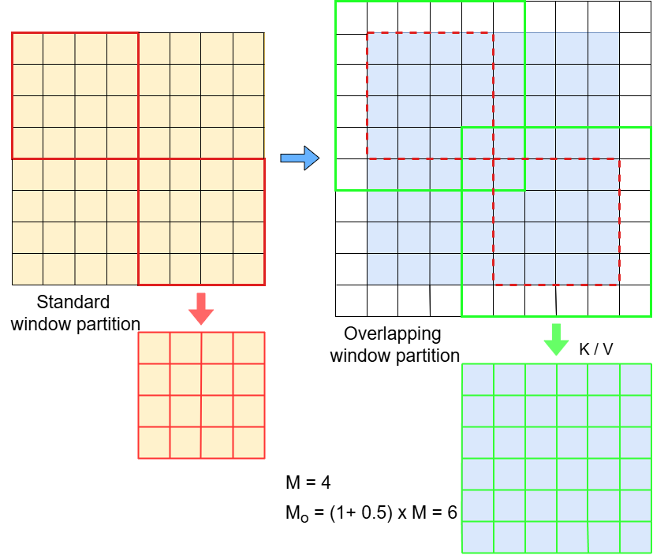
CPAT: Channel-Partitioned Attention Transformer
Overlapping Cross-Attention Module structure

Slide 32
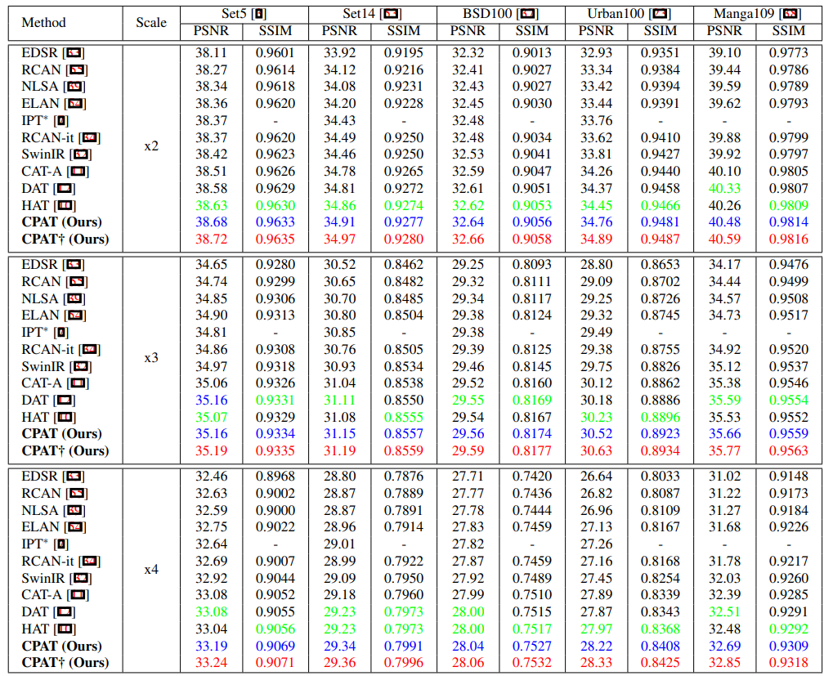
CPAT: Channel-Partitioned Attention Transformer

Slide 33
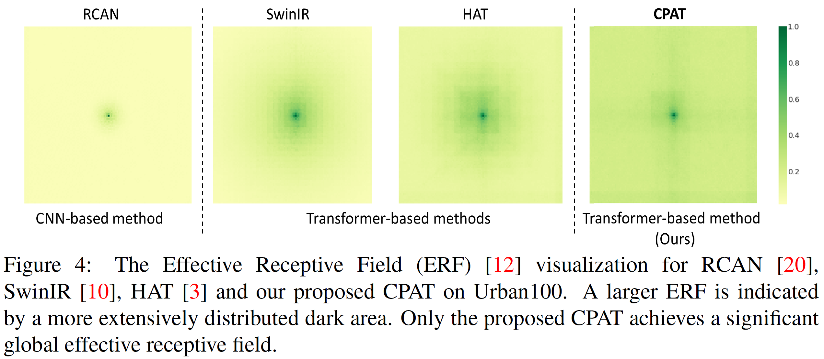
CPAT: Channel-Partitioned Attention Transformer

Slide 34
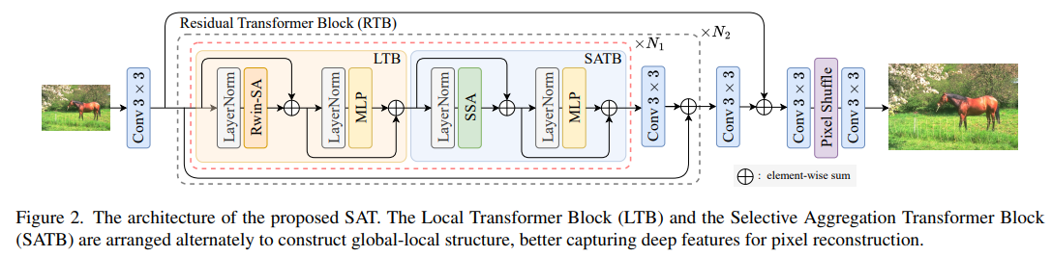
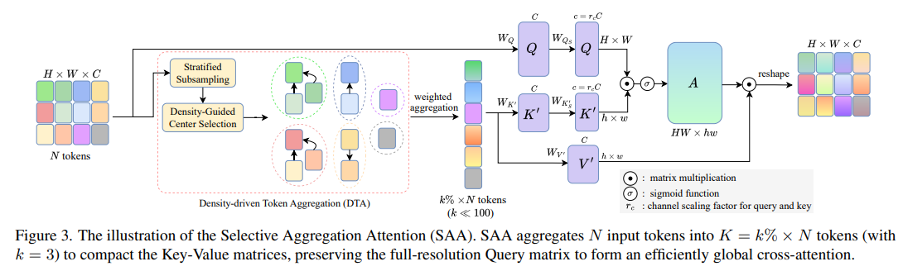
SAT: Selective Aggregation Transformer
Reference: Tran, D., Do, T., Wazir, S., Kim, S., Kim, S., & Kim, D. (2026). SAT: Selective Aggregation Transformer for Image Super-Resolution. In Proceedings of the IEEE/CVF Conference on Computer Vision and Pattern Recognition (CVPR 2026) Findings (pp. 4982-4992).

Slide 35
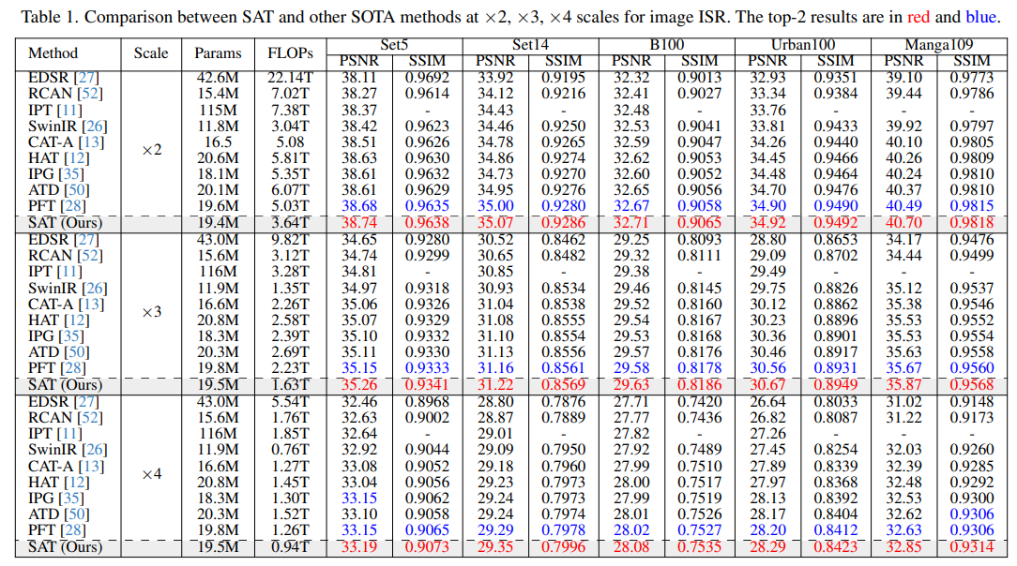
SAT: Selective Aggregation Transformer
Reference: Tran, D., Do, T., Wazir, S., Kim, S., Kim, S., & Kim, D. (2026). SAT: Selective Aggregation Transformer for Image Super-Resolution. In Proceedings of the IEEE/CVF Conference on Computer Vision and Pattern Recognition (CVPR 2026) Findings (pp. 4982-4992).

Slide 36
Key Takeaways from Non-generative Approach
Strengths
Weaknesses
• High fidelity to paired ground truth
• Stable and deterministic outputs
• Reliable PSNR/SSIM improvement
• Often efficient enough for deployment
• Tends to produce smooth textures
• Struggles with unknown real degradations
• Cannot recover truly missing detail
• Metrics may disagree with human preference
This gap motivates generative super-resolution.

Slide 37
Generative Model for Super-Resolution

Slide 38

Overview
From Discriminative models to Generative Priors
From “predict the average HR image” to “sample a plausible HR image”
GAN prior
sharp texture, adversarial realism
Diffusion prior
iterative refinement, diversity
Foundation prior
large pretrained text-to-image models
Core risk: Generated detail can be realistic but not necessarily true, hallucination risk.

Slide 39
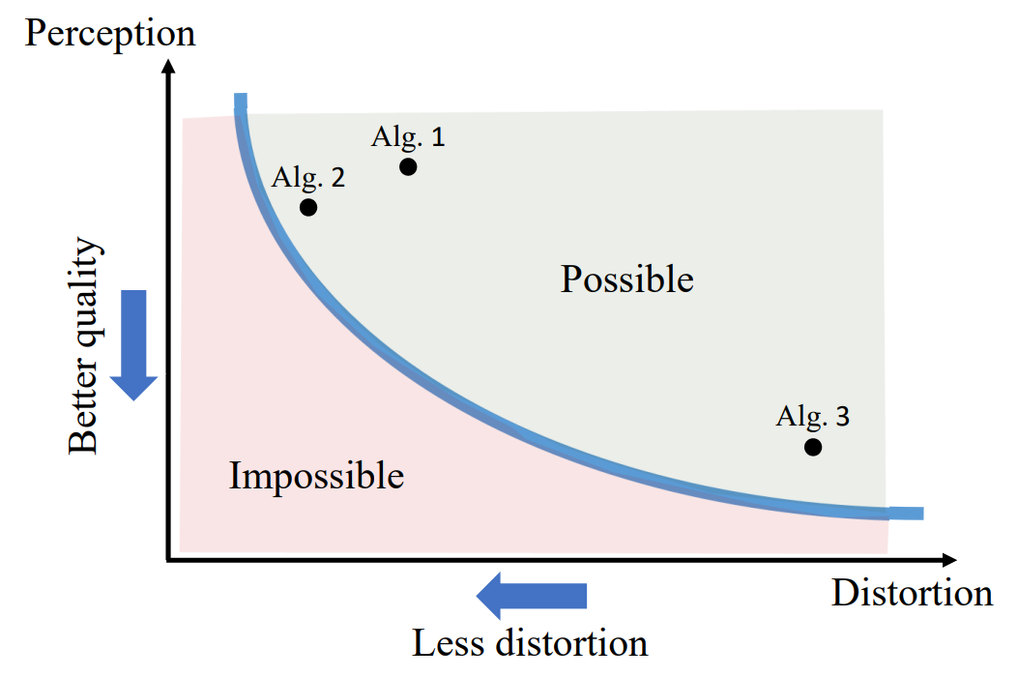
Why Do We Need Generative SR?
Many real-world applications require Perceptual quality instead of Distortion quality.
Reference: Blau, Y., & Michaeli, T. (2018). The perception-distortion tradeoff. In Proceedings of the IEEE conference on computer vision and pattern recognition (pp. 6228-6237).

Slide 40
GAN-based Super-Resolution: SRGAN → ESRGAN
SRGAN introduced perceptual + adversarial training for photo-realistic SR
ESRGAN improve visual quality using residual CNN learning, adversarial loss and improved perceptual loss
GAN-based method: fast inference but can make artifacts or over-sharpened hallucinations.
Generator
LR → SR
Discriminator
real or generated?
Sharper textures
more natural details
[1] Ledig, Christian, et al. "Photo-realistic single image super-resolution using a generative adversarial network." 2017 IEEE conference on computer vision and pattern recognition (CVPR). IEEE, 2017.
[2] Wang, Xintao, et al. "Esrgan: Enhanced super-resolution generative adversarial networks." European conference on computer vision. Cham: Springer International Publishing, 2018.

Slide 41
Diffusion-based Super-Resolution
Learns conditional denoising distribution p(xHR | xLR)
Produce highly realistic results
High cost: many sampling steps, higher latency than feed-forward CNN/GAN
LR condition
Gaussian noise
Denoising steps
T → 0
HR sample

Slide 42
Utilizing Large Diffusion Priors for Real-World SR
StableSR: exploits pretrained diffusion prior without fully retrain
Pretrained model: Stable Diffusion, FLUX,…
Pretrained text-to-image
diffusion model
SR-specific encoder / ControlNet
inject LR condition
Realistic HR output
+ controllable fidelity
Reference: Wang, Jianyi, et al. "Exploiting diffusion prior for real-world image super-resolution." International Journal of Computer Vision 132.12 (2024): 5929-5949.

Slide 43

FreqOrtho-SR: Frequency-Guided Expert Learning SR
Mitigate the perceptual-fidelity trade-off
Pretrained model: SD 1.5
Reference: Hoang, Tran, et al. "FreqOrtho-SR: Frequency-Guided Orthogonal Expert Learning for Real-World Image Super-Resolution." ECCV 2026.

Slide 44


FreqOrtho-SR: Frequency-Guided Expert Learning SR
Mixture of Frequency LoRA Expert
Frequency space can likely separate noise pattern better.

Slide 45

FreqOrtho-SR: Frequency-Guided Expert Learning SR

Slide 46

FreqOrtho-SR: Frequency-Guided Expert Learning SR

Slide 47
Deep Learning for Video Super-Resolution

Slide 48

Deep Learning for VSR
General pipeline for VSR
        Feature extraction & fusion and Reconstruction block is
        same in SISR
        Alignment module is added to work with frame sequence

Slide 49

Current Limitations in Architecture Designs
Feature extraction backbone
CNN backbone => Limited receptive field
Transformer backbone => Quadratic complexity & Scale poorly
What could be a good solution?
        Mamba architecture
        Linear Complexity
        Faster Inference
        Comparable Performance

Slide 50



Preliminary
Mamba architecture

Slide 51

VSRM: Video Super-Resolution with Mamba Architecture
VSRM (2025): Video Super-Resolution through Mamba
First work adapts Mamba structure for VSR
Enlarge receptive field, linear complexity
Reference: Tran, D. P., Hung, D. D., & Kim, D. (2025). Channel-Partitioned Windowed Attention And Frequency Learning for Single Image Super-Resolution. The International Conference on Computer Vision (ICCV 2025).

Slide 52

VSRM: Video Super-Resolution with Mamba Architecture
Mamba module
Spatial-to-Temporal Mamba (S2T-Mamba)
Temporal-to-Spatial Mamba (T2S-Mamba)

Slide 53

VSRM: Video Super-Resolution with Mamba Architecture
Deformable Cross-mamba Alignment (DCA)
Warping function
Reference frame
Target frame

Slide 54


VSRM: Video Super-Resolution with Mamba Architecture

Slide 55


VSRM: Video Super-Resolution with Mamba Architecture

Slide 56
Open Issues & Pratical Takeaways

Slide 57
Open Issues 1: Metrics and Human Preference
Metric: Almost paper use distortion metric (PSNR/SSIM)
But, high PSNR/SSIM donot guarantee that looks good to human
Perceptual quality (Human opinion score) needs to explore
The Perception-Distortion trade-off
Reference: Blau, Y., & Michaeli, T. (2018). The perception-distortion tradeoff. In Proceedings of the IEEE conference on computer vision and pattern recognition (pp. 6228-6237).

Slide 58
Open Issues 1: Real-World Degradations
Generalization to Real-World Degradations
        Most SR models assume bicubic downsampling
        But in real-world data, degradations are far more complex (noise, blur, compression, etc.)
        Require more datasets with diverse degradations types.

Slide 59
Open Issues 3: Efficiency & Scalability
Efficiency and Scalability
        Performance-Complexity trade-off
        Large SR models are computationally heavy => Limiting deployment on mobile/edge devices and real-time apps
Temporal Alignment among frames, making video more realistic
        Ensure smoothness across frames without flickering while still enhancing detail

Slide 60
Key Takeaways
1
1
Non-generative models optimize fidelity and remain strong for controlled settings.
2
Generative models improve perceptual realism but introduce hallucination risk.
3
Video SR adds temporal alignment, consistency, and scalability constraints.
4
The best SR method depends on the application objective and risk.

Slide 61
Choosing a Model Family: Fidelity – Realism - Efficiency
1
Family
Best for
Main risk
CNN / Transformer / Mamba
faithful benchmarks; safety-critical restoration
smooth texture; weak real-world robustness
GAN
fast perceptual enhancement; media restoration
artifacts and over-sharpened hallucination
Diffusion
high perceptual realism; blind real-world SR
slow inference; semantic hallucination
One-step diffusion
interactive generative restoration
distillation quality gap
No single family is universally best. The right choice depends on the application risk.

Slide 62
Thank you
Q&A
Comments

