Slide 1




Perpay Exercise presentation
Indego Analysis
Growth Solutions for Bike Sharing business

Slide 2


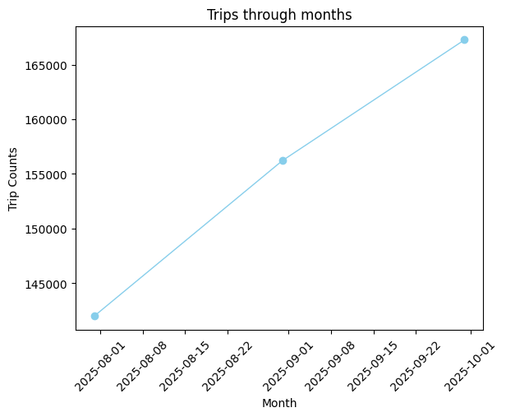
1. How would you recommend that decision makers quantify the current and recent growth rate of the program?
Change for better Performance Measurement
- The dataset includes some interesting columns like pass holder, duration and type of bike information which can be used further as explanatory variables. Besides, location records are also imperative to identify the volumes of customer in each area.
- What is missing to navigate all of these variable effects on Idego's sharing bike business is revenue or a profit conversion. This can help explain further potential of each factors that the board will not foresee thanks to more advanced data analysis.
- Following the picture placed at the rightmost, we have number of trips recorded but we don’t know exactly what how much did Indego make. Where was the revenue come from Pass Holder or Duration ? What was the budget? Did the business exceeded the break-even point?
Missing final quantitative outcome like revenue causing the hardship to evaluate overall development of the business through each variables performance
For more columns details please visit:
Steven_Nguyen_Indego.ipynb
Philly’s Bike Share

Slide 3
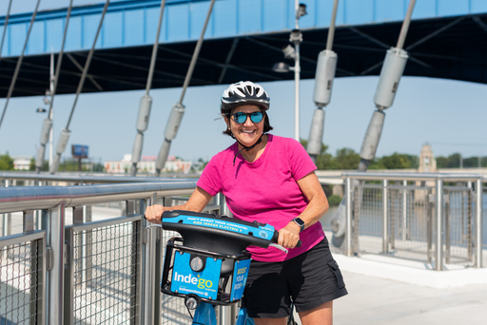
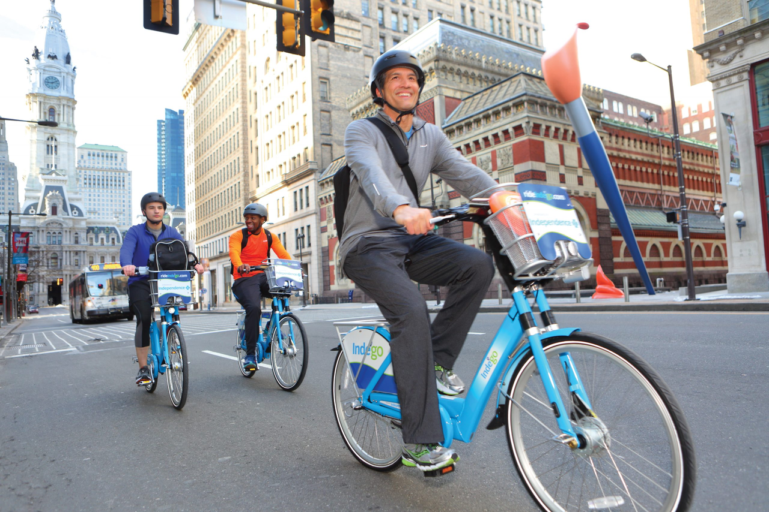
2. Is there any evidence to suggest the program is growing either too slowly or too quickly?
Observations from the program growth
From observation, the trips made through months have increased from below 140,000 to with nearly 170,000 rides. In the period from August to September, it great skyrocketed to more than 15,000 rides, but from September to October the growth has slowed down to around 10,000 rides
For more EDA details please visit:
Steven_Nguyen_Indego.ipynb
Philly’s Bike Share

Slide 4
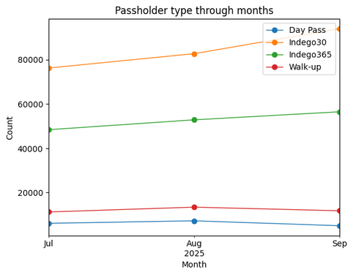
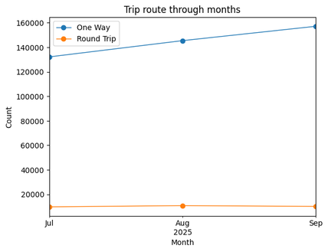
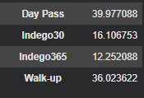
2. Is there any evidence to suggest the program is growing either too slowly or too quickly?
Observations from the program growth
- The summer was also ended so the walk-up and day pass are dropping noticeably due to the decline in tourists. We can find that drop of walk-up and day pass from August to September is significant even lower than July with under 10,000 rides. One-way also soar almost up to 10,000 more rides but round trip has slightly dropped.
According to the exploratory data analysis, the growth of Indego 30 and Indego 365 has soared more 10,000 uses from August to September during back-to-school period. This evidence signifies there are significant volumes of customer can come from campus where they choose to use the bike to go to school as the alternative transportation, which can be seen in the rise of one trip and day pass 30 figures and its duration.
Average Duration by pass holder
Philly’s Bike Share

Slide 5

Better vision, better decision
3. Recommeneded approach to growing the program
1 - Since we can collect locations, duration, bike types and pass holders. We should add other business performance such as revenue, all cost affiliation in running operations, marketing conversion.
2 - I would suggest to add more factors like age of customers, their career if it is possible to complete the picture of Idego's target customers. This can make a game changer for the business to deliver perks, benefits and marketing campaign more tailored with its main customer base.
3 - Thirdly, the business should also include their internal performance in each department. Optimizing the operation structure is the easiest way to increase the effectiveness for the firm's productivity. Once the company runs smoothly and efficiently, it can create more values for community and business result
4 - Furthermore, Lifetime Value calculation and other metrics relates to customer life span. Since keeping existing customers is more affordable than acquiring new customer. Loyal customers can create consistent revenue for the company, so it is important to understand what is keeping customers to stay with the business
5 – Finally, we can make a survey to understand more about our customers, what drives they to come to our services. In that way, we use these information to analyze their behavior and improve the service or product then increase the average customer's life span.
Philly’s Bike Share

Slide 6
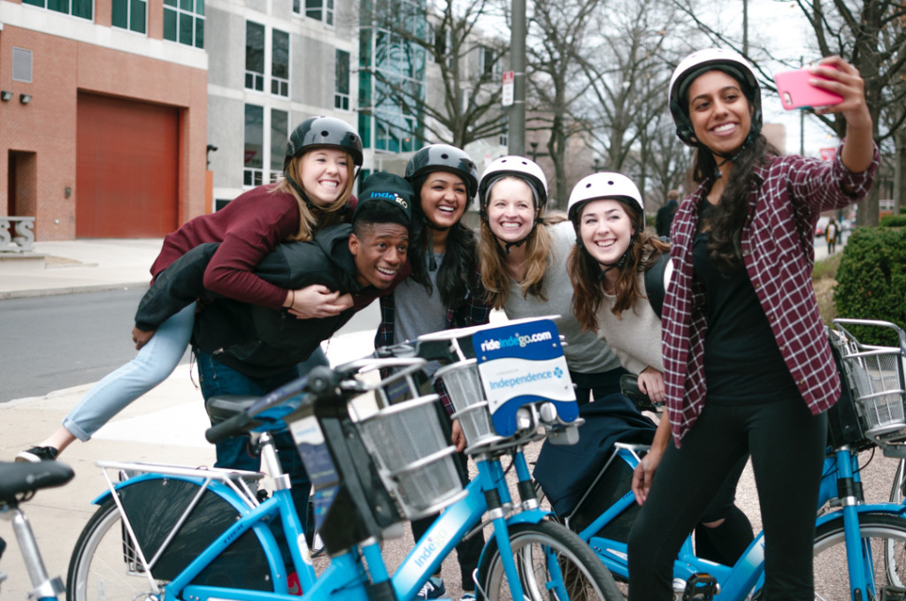
Thank You
Resources:
Colab Link: Steven_Nguyen_Indego.ipynb
Dataset: Trip Data
Author:
Steven Nguyen
Philly’s Bike Share

