Slide 1
Introduce DynamoDB
NoSQL of Amazon WebServices with high speed, stable, suitable for handling large data
Automatic data scattering with high access
No need to care about hardware provisioning, setup settings and data copying
Only need to care about the read / write throughput of the board

Slide 2
Structure of DynamoDB
Table
Secondary Indexes
Items
Attributes
Query

Slide 3
Table
Create table: name table, primary key, read / write throughput
Limit for each item is 400kb
Hash Primary Key and Hash and Range Primary Key

Slide 4
Secondary Indexes
Global secondary index: an index with a hash and a range key different from the hash and range key from the original table.
Local secondary index: an index whose hash key is the same as the hash key from the original table and range key is another attribute added when querying.

Slide 5
Items
An item is a collection of attributes.
Each attribute has a name and a value

Slide 6
Atributes
Scalar types: number, String, Binary, Boolean, Null Items
Document types: List and Map
Set types: String set, Number set, Binary Set
https://docs.aws.amazon.com/amazondynamodb/latest/developerguide/HowItWorks.NamingRulesDataTypes.html

Slide 7
Query
Query:
Access folder based on primary key value
Can query on tables or seconday indexes
Must provide hash key, range key is optional
Scan:
Browse all items in the table or secondary indexes
Slow speed, the more capacity then the slower the leveling
Limiting scanning

Slide 8
OrderBy
Does not support the order by function
Only support order by according to range key contained in primary or secondary key
Support maximum 5 for Local secondary index and 5 for Global secondary
Cannot order by many different fields like SQL, each query only delarce, each query only declare use 1 index and order by field of that index

Slide 9
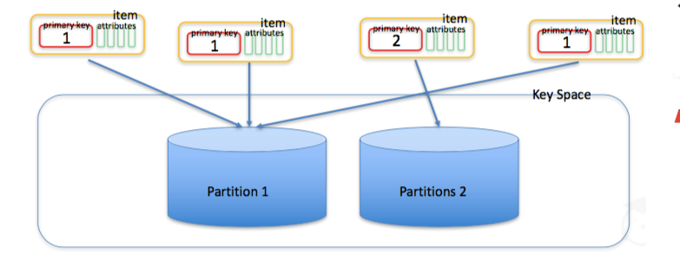
Pagination
Use LastEvaluatedKey and ExclusiveStartKey to Pagination
Can not choice from Pagination 1 to Pagination 2

Slide 10
Limit about response size
When using Query or Scan, both give respone max 1MB
How to fix: get each pack of 1MB and then handle

Slide 11
Limit about filter data
When using KeyConditions then with Sort Key we can’t use CONTAINS, IN that can only use operator EQ|LE|LT|GE|GT|BEGINS_WITH|BETWEEN
Distinguish between uppercase and lowercase letters. Example: `%Sample%` different with `%sample%`
How to fix: create function convert
https://docs.aws.amazon.com/amazondynamodb/latest/developerguide/Limits.html#limits-api

Slide 12
IN OPERATOR
Only receive maximum 100 value in array IN, will have error if over 100
How to fix: use And to join condition
Emple: id IN(1,2,3…100) AND id IN(101,102,…)
Not have NOT IN(). Fix: NOT(id IN(1,2,3))

Slide 13
Cost Of Use
?
Depend to index and capacity

Slide 14
Limit About Delete Data
Can’t delete all data of the table, delete by delete table or create look delete each Item
Maximum delete 25 items for one request (?)

Slide 15
IN OPERATOR
Only receive maximum 100 value in array IN, will have error if over 100
How to fix: use And to join condition
Emple: id IN(1,2,3…100) AND id IN(101,102,…)
Not have NOT IN(). Fix: NOT(id IN(1,2,3))

Slide 16
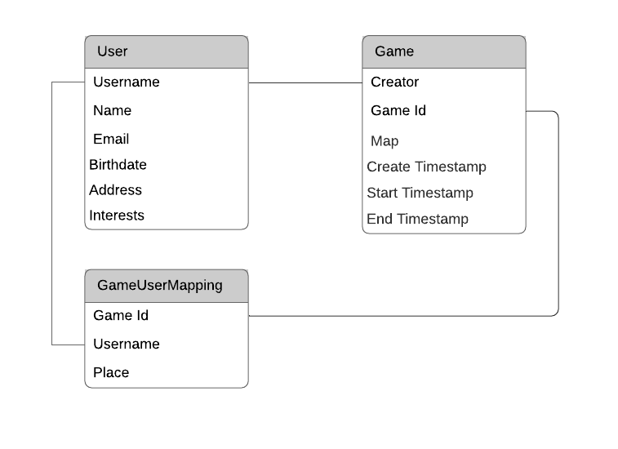
Entity-Relationship Diagram
A User can create multiple Game entities, so there is a one-to-many relationship between Users and Games
A Game contains multiple Users and a User can play in multiple different Games over time. Thus, there is a many-to-many relationship between Users and Games

Slide 17
Retrieve multiple entity types in a single request
Our game is an online multiplayer game similar to Fortnite or PUBG. Players can create a game at a particular map, and other players can join the game. When 50 players have joined the game, the game starts and no additional players can join.
In the gaming application, we may want to fetch details about a game. These details include information about the game itself such as the time it started, time it ended, who placed in it, and details about the users that played in the game
fetch_game_and_players.py

Slide 18
Secondary Index
Let’s see how this plays out for us. You might remember that we have two access patterns for finding open games:
Find open games (Read)
Find open games by map (Read)
We can create a secondary index using a composite primary key where the HASH key is the map attribute for the game and the RANGE key is the open_timestamp attribute for the game, indicating the time the game was opened.
add_secondary_index.py
find_open_games_by_map.py

Slide 19
Scan the sparse secondary index
Rather than using the query() method on the DynamoDB client, we use the scan() method. Because we’re using scan(), we don’t need to specify anything about the key conditions like we did with query(). We’re just having DynamoDB return a bunch of items in no specific order.
find_open_games.py

Slide 20
Add Users to a game
When adding a new user to a game, we need to:
Confirm that there are not already 50 players in the game (each game can have a maximum of 50 players).
Confirm that the user is not already in the game.
Create a new UserGameMapping entity to add the user to the game.
Increment the people attribute on the Game entity to track how many players are in the game
join_game.py

Slide 21
Start a game
When our application backend receives a request to start the game, we check three things:
- The game has 50 people signed up.
- The requesting user is the creator of the game.
- The game has not already started.
- Remove the open_timestamp attribute so that it does not appear as an open game in the sparse secondary index from the previous module.
Add a start_time attribute to indicate when the game started.
start_game.py

Slide 22
Add an inverted index
add_inverted_index.py
find_games_for_user.py

Slide 23
Document DB
An Amazon DocumentDB cluster consists of two components:
Cluster volume—Uses a cloud-native storage service to replicate data six ways across three Availability Zones, providing highly durable and available storage. An Amazon DocumentDB cluster has exactly one cluster volume, which can store up to 64 TB of data.
Instances—Provide the processing power for the database, writing data to, and reading data from, the cluster storage volume. An Amazon DocumentDB cluster can have 0–16 instances.
Instances serve one of two roles:
Primary instance—Supports read and write operations, and performs all the data modifications to the cluster volume. Each Amazon DocumentDB cluster has one primary instance.
Replica instance—Supports only read operations. An Amazon DocumentDB cluster can have up to 15 replicas in addition to the primary instance. Having multiple replicas enables you to distribute read workloads. In addition, by placing replicas in separate Availability Zones, you also increase your cluster availability.

Slide 24
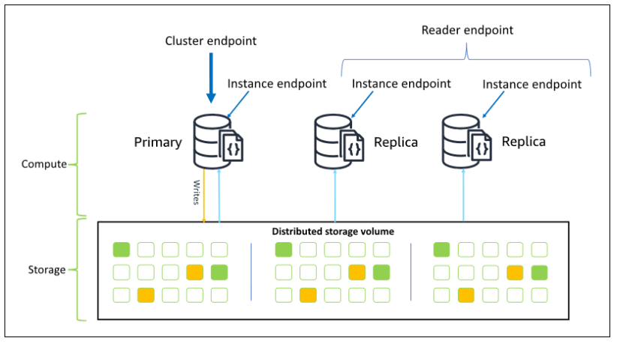
Add an inverted index

Slide 25
Add an inverted index
add_inverted_index.py
find_games_for_user.py

