Slide 1
FNMS-37729 HTTPS support for software download

Slide 2
Agenda
US 3 - Enhance harmonized device configuration intents to configure the file-server public-key in

Slide 3
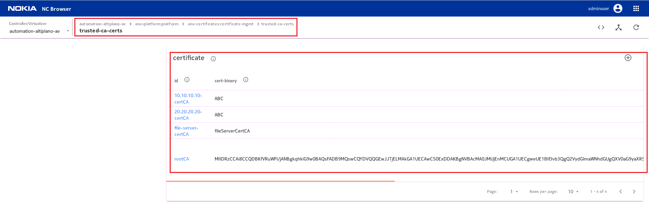
US 3 - Enhance harmonized device configuration intents to configure the file-server public-key in
Default CA cert is available for retrieval from AV through the YANG path /anv-platform:platform/anv-certificates:certificate-mgmt/trusted-ca-certs/certificate[id="name"]
User must be input manual by rpc request

Slide 4
US 3 - Enhance harmonized device configuration intents to configure the file-server public-key in
Support device:
device-dpu
device-fx
device-df
device-configuration

Slide 5
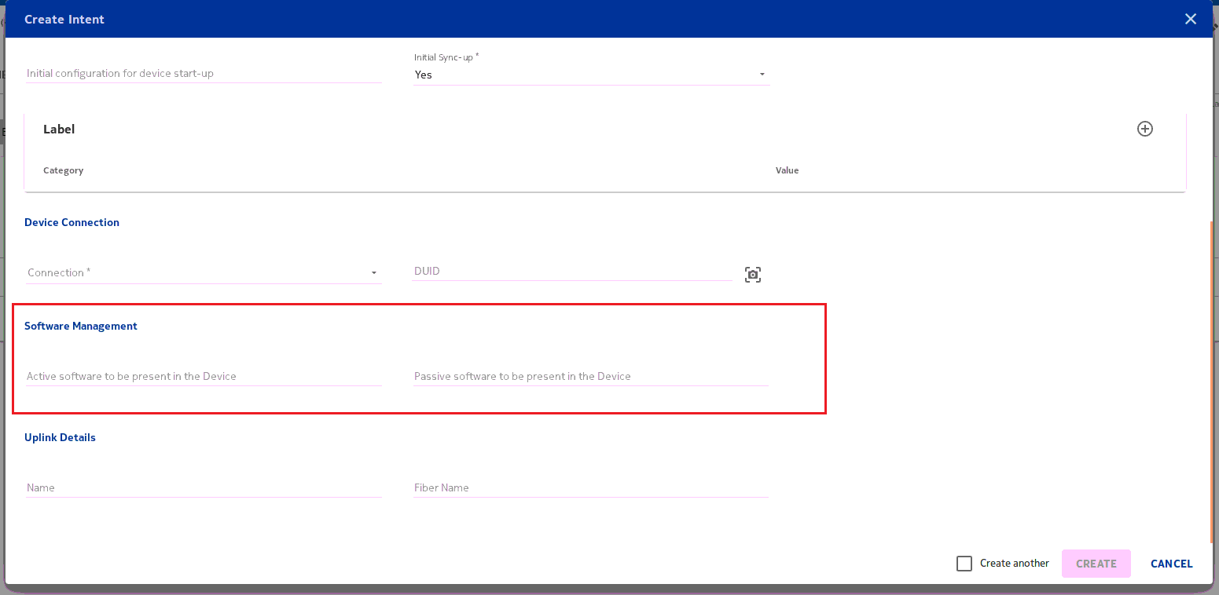
US 3 - Enhance harmonized device configuration intents to configure the file-server public-key in

Slide 6
US 3 - Enhance harmonized device configuration intents to configure the file-server public-key in
Case 1: https://<IP>/<image-name> → External secure File-Server; URL format = "https://<IP>/<image-name>"; <cert-name>=<IP>-certCA

Slide 7
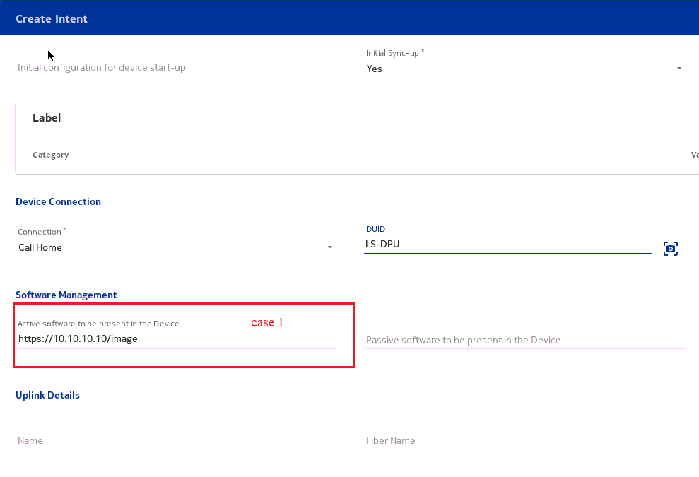
US 3 - Enhance harmonized device configuration intents to configure the file-server public-key in
Input url = https://10.10.10.10/image for Active software(or Passive software)

Slide 8
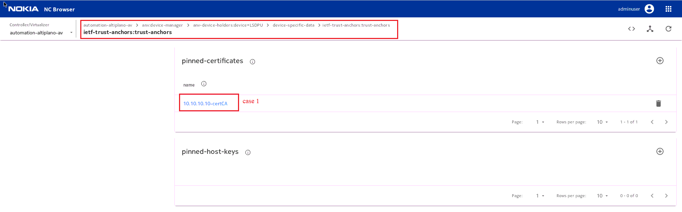
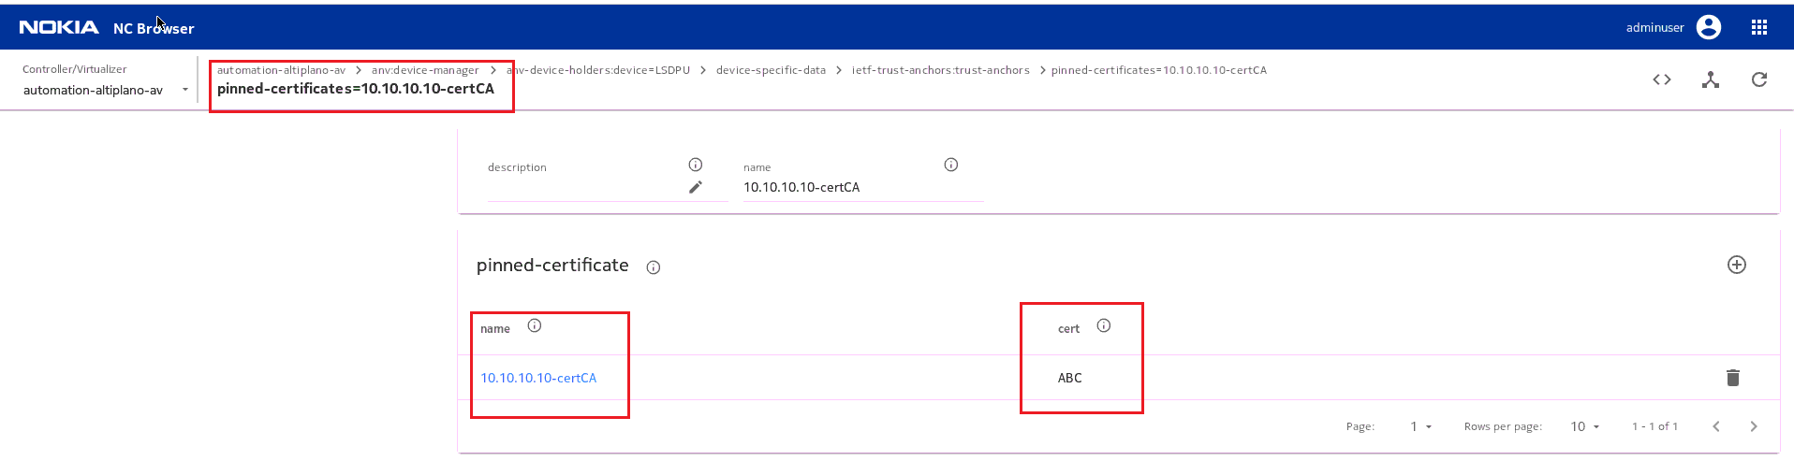
AC will query YANG container from /anv-platform:platform/anv-certificates:certificate-mgmt/trusted-ca-certs

Slide 9
US 3 - Enhance harmonized device configuration intents to configure the file-server public-key in
Case 2: http://<>, sftp://<>, ftp://<>, ftps://<> → SKIP edit-config on ietf-trust-anchors

Slide 10
US 3 - Enhance harmonized device configuration intents to configure the file-server public-key in
Case 3: Anything else → Altiplano WebDAV ; <cert-name> should be "sw_download_truststore" (same as existing 'rootCA')
Input in url: webdav:LS-DPU-CFAS-H/19B.09/L6GQAF61.374/L6GQAF61.374

Slide 11
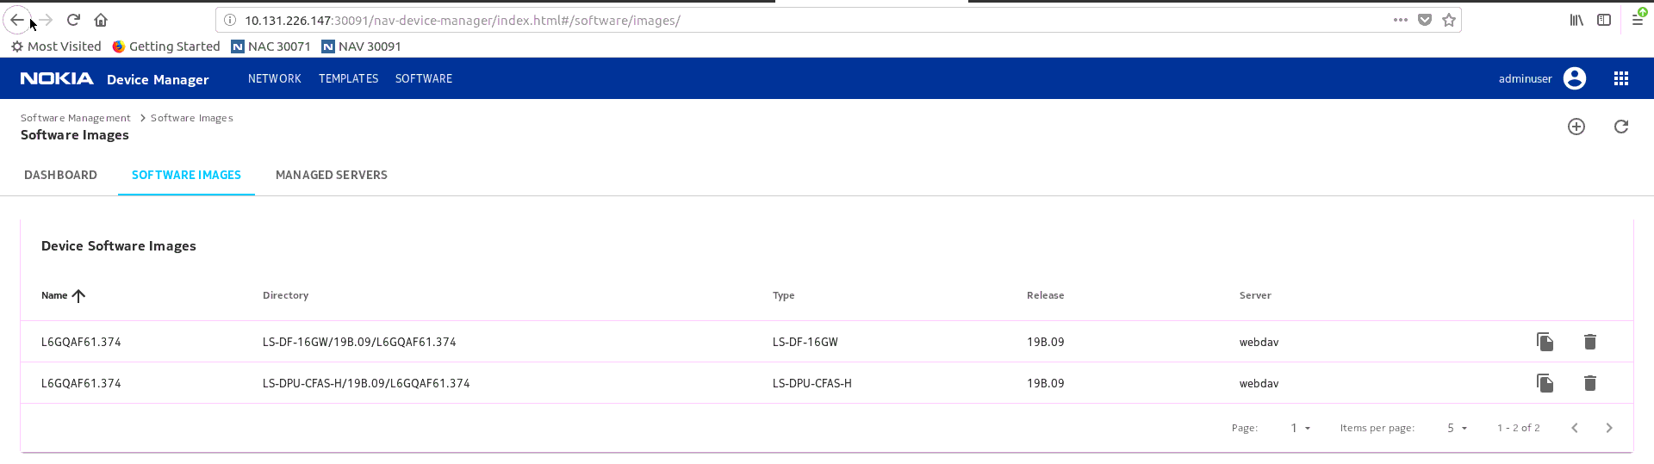
User also must be add New Software Image

Slide 12
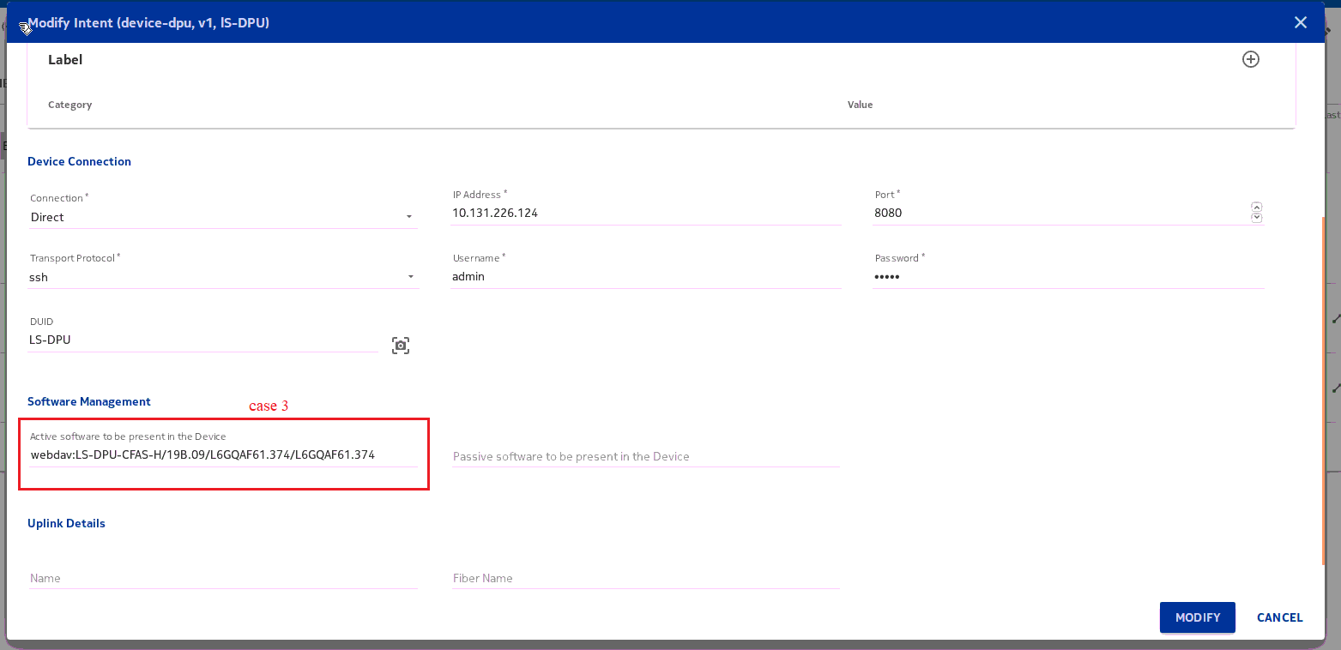
Case 3

Slide 13
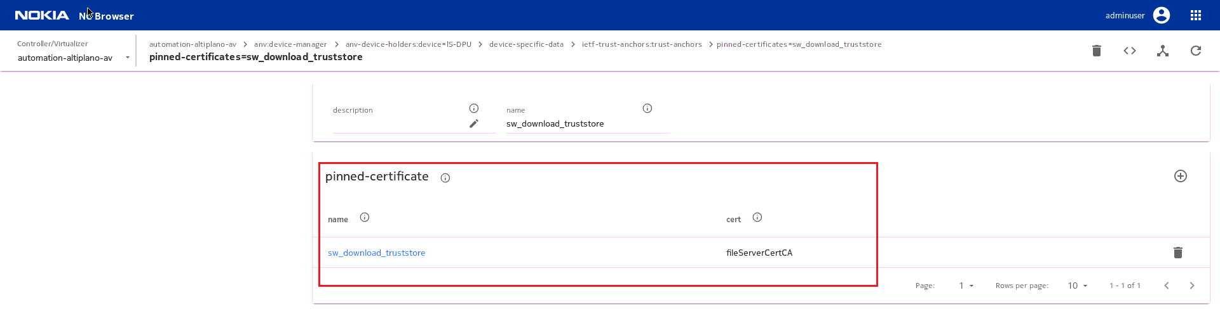
Case 3

Slide 14
DEMO

