Slide 1
Clean Architecture
Thien Tran

Slide 2
3 Layers Architecture (1/4)
Basic Principle
View / Presenter layer
Service layer
DAO / Repository layer
Entity Model
Problem
Redundant data sent to client
Change entity implementation
Support aggregated response
Presenter
Service
DAO

Slide 3

3 Layers Architecture (2/4)
Improvement
Build 2 separated model: Entity & DTO
Service is responsible to convert data model
DTO Model
Entity Model
Code is isolated between layers
Giant Service
Handle data model converting
Handle input validation
Handle many others business logic
Presenter
Service
DAO

Slide 4
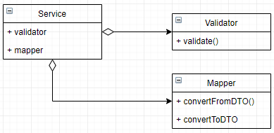
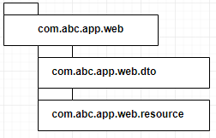
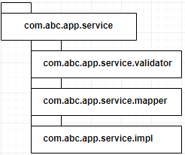
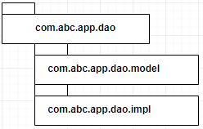
3 Layers Architecture (3/4)
Validator
DTO Model
Entity Model
Mapper
Presenter
Service
DAO
Seem we having clean architecture?

Slide 5
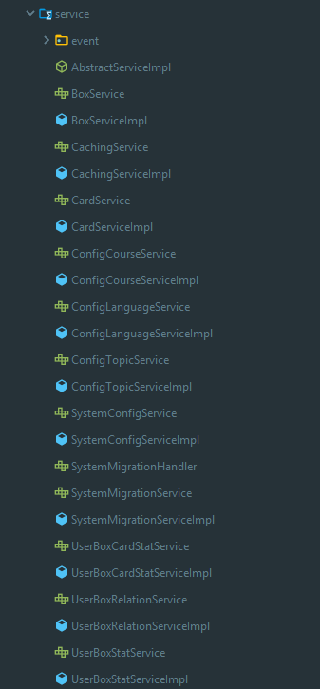

3 Layers Architecture (4/4)
Will notification be sent when user pay an invoice?
Did you handle Invoice backup use case?
How are you handling use case File Upload?

Slide 6
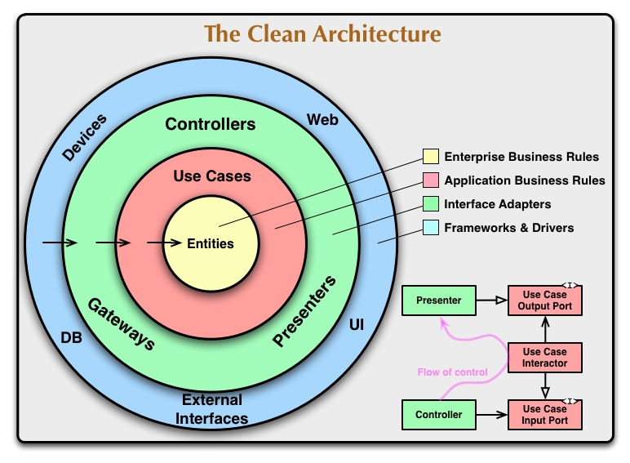
Clean Architecture
Use case: File upload file
Input:
Company ID
User ID
File attachments
Output:
File attachment entities
Behavior:
Validate valid company id & user id
Load & check current file upload setting
Execute file upload

Slide 7
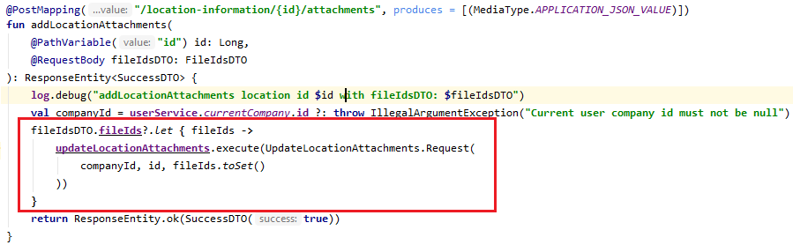
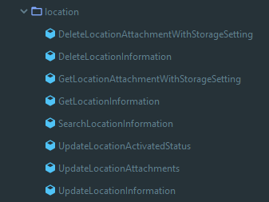
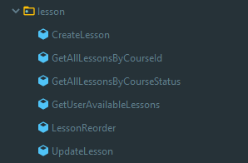
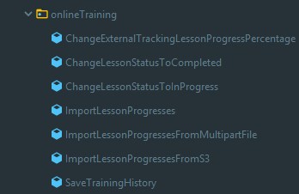
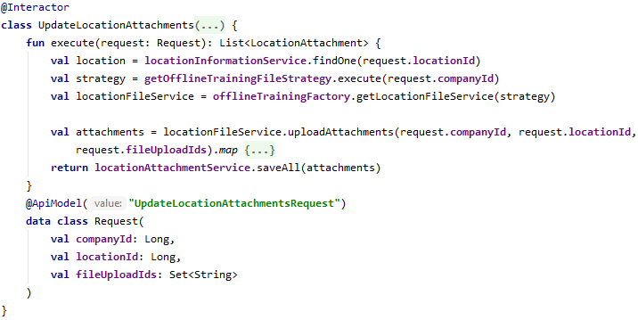
Implement Clean Architecture
Presenter
Validator
Interactor
(Use case)
Mapper
Service
DAO

Slide 8
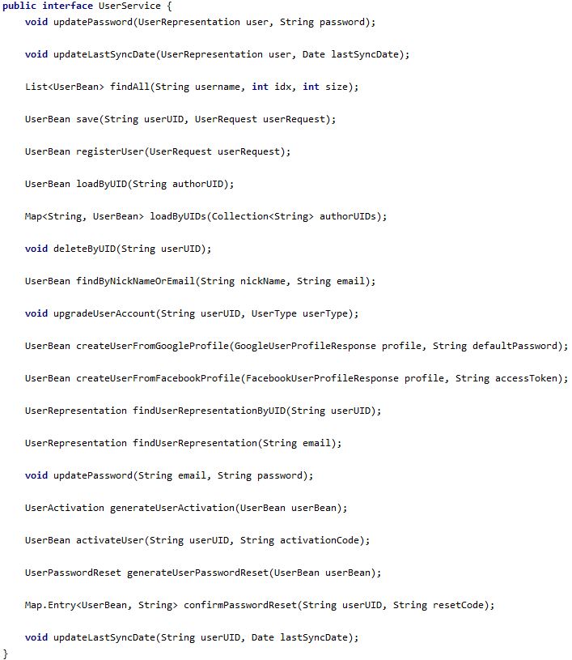
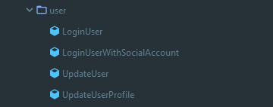
Sample of Refactoring to Interactor

Slide 9
Common Mistakes
Cross access between layer
Mix every thing in the service
Put processing in DTO class
Do some business process in Presenter
Data access in Entity Mapper
Keep access to layers correctly
Separate code to small & isolated component
Keep DTO simple
Let Interactor (use case) handle it
Data access should be invoked outside mapper
Let’s Use Case Drive Your Architecture

Slide 10
Q & A

