Slide 1
Multi-Label Code Comment Classification
SEMINAR 2 · NLBSE’23 CODE COMMENT CLASSIFICATION
Lecturer · Assoc. Prof. Nguyen Thanh Phuong
Group 21 · Mai Duc Phuc · Ngo Hoang Dang · Mai Hoang Long · Ninh Van Nghia
RoBERTa-large + LoRA with a training recipe for imbalanced labels, compared with an ML and a Transformer baseline under 5-fold cross-validation
6,738
19
0.8124
sentences · 3 languages
labels · multi-label
F1 (samples), 5-fold CV
Notes:
Opening (about 30 seconds). Good morning. Our project is multi-label code comment classification on the NLBSE’23 dataset: every sentence of a class comment, written in Java, Python or Pharo, gets one or more of 19 category labels. The assignment asked for four things: build ML and DL classifiers, choose suitable metrics, evaluate with k-fold cross-validation, and compare against a Transformer baseline based on RoBERTa. This talk follows exactly that structure. Preview the headline numbers on the bottom row: 6,738 sentences, 19 labels, and our best single model reaches 0.8124 F1 (samples) under 5-fold cross-validation. Everything I show today comes from runs in the repository’s runs/ folder; every number can be regenerated with the scripts compare_runs.py and analyze_oof.py. Transition: “First, what exactly are we classifying?”

Slide 2


Label every sentence of a class comment
THE TASK
Input
Output
One sentence of a class comment, plus its language (Java, Python or Pharo) and the name of its class.
Any subset of 19 labels. A sentence can be a summary and a pointer at once: multi-label, not multi-class.
EXAMPLE FROM THE DATASET · JAVA
@link #applicationstarted applicationstartdata is supposed to
expand_java
pointer
Assignment:
ML and DL classifiers
Suitable metrics
k-fold cross-validation
Comparison with a RoBERTa baseline
Multi-label code comment classification · NLBSE’23
2 / 18
Notes:
Goal of this slide: make the task concrete in under a minute. The unit of classification is one sentence, not a whole comment. The dataset authors split each class comment into sentences and annotated each sentence. Besides the sentence, we know its language and the class it belongs to. We will use both later as context. The output is a set of labels, not one label. Point at the example: this Java sentence is both expand_java (it adds detail) and pointer (it links to another element with @link). That is why this is multi-label classification and why plain accuracy is not a suitable metric. Note the text is already lowercased and normalized by the dataset: the demo reproduces exactly this normalization. Bottom row: the four assignment requirements. Each part of the talk maps to one of them: classifiers, metrics, k-fold CV, and the RoBERTa baseline comparison. Transition: “Let’s look at the data itself.”

Slide 3
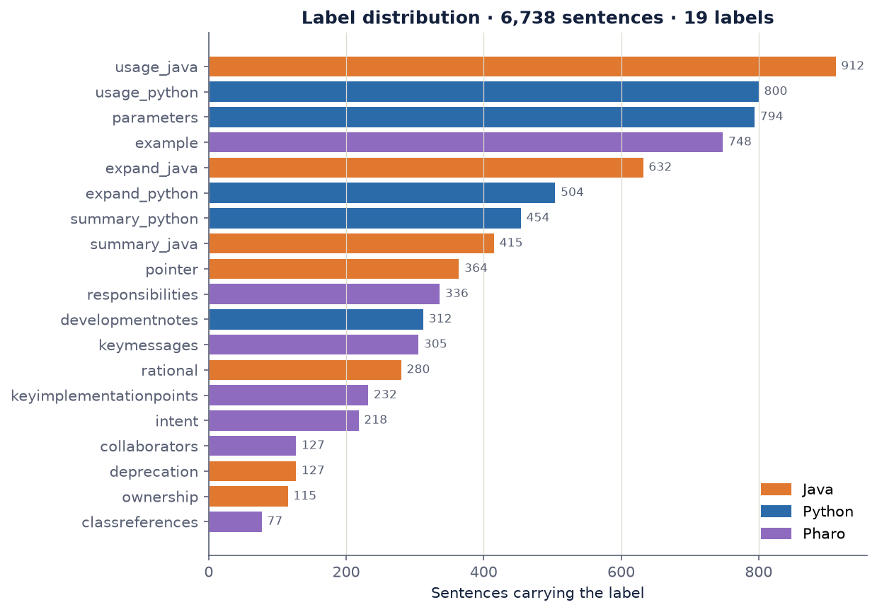
NLBSE’23: 6,738 sentences, 19 labels
THE DATA
Language | Sentences | Labels
Java | 2,418 | 7
Python | 2,555 | 5
Pharo | 1,765 | 7
Total | 6,738 | 19
16 label names; summary, usage and expand exist in Java and Python and are split by language, giving 19 labels.
1,006 classes, about 6.7 sentences per class. File: data/raw/sentences.csv
Multi-label code comment classification · NLBSE’23
3 / 18
Notes:
Key facts about the dataset (all computed from data/raw/sentences.csv). 6,738 sentences in total: 2,418 Java, 2,555 Python, 1,765 Pharo. They come from 1,006 classes, so on average about 6.7 sentences per class comment. The original dataset has 16 label names. Three of them, summary, usage and expand, are used in both Java and Python. Following the competition, we split them by language, which gives 19 labels; Java has 7, Python 5 and Pharo 7. Point at the chart on the right: the bars are very uneven. The largest label, usage_java, has 912 sentences; the smallest, classreferences in Pharo, has only 77. This imbalance is the first challenge, which the next slide summarizes. The dataset also has an original train/test partition (5,392 / 1,346). We do not use it for the main evaluation because we run 5-fold cross-validation on all sentences; I come back to this in the limitations. Transition: “Three properties make this harder than it looks.”

Slide 4

Three properties make the task hard
THE CHALLENGES
12×
13.5%
6 words
Imbalanced labels
Multi-label
Short sentences
912 sentences for usage_java, only 77 for classreferences.
912 sentences carry 2 to 4 labels: 816 with two, 90 with three, 6 with four.
Median length; 751 lines are a single word, e.g. the HTML tags li and p.
One helpful signal: 80% of adjacent sentences in the same class have identical labels, so the language and the class name are useful context.
Multi-label code comment classification · NLBSE’23
4 / 18
Notes:
Each challenge motivates one part of our recipe; say this explicitly so the method slides feel inevitable. 1. Imbalance, about 12 times between the largest and the smallest label. A model trained with plain cross-entropy learns to ignore the rare labels. Our answer: Asymmetric Loss and a weighted sampler. 2. Multi-label: 13.5% of sentences, 912 of them, have more than one label. So we need one sigmoid per label and a decision threshold per label, and we need multi-label metrics. 3. Very short inputs: the median sentence has 6 words, and 751 lines are a single word such as an HTML tag. A single sentence often does not carry enough information. The helpful signal at the bottom: when we look at two neighbouring sentences of the same class, 80% of the time they have exactly the same labels. That told us the context matters, so we give the model the language and the class name in a prompt. Transition: “Here is the model we built around these observations.”

Slide 5

One multi-label model on RoBERTa-large
OUR MODEL
MODEL INPUT (CONTEXT PROMPT)
[JAVA] Abfss.java | this impl delegates to the old filesystem
RoBERTa-large
Mean pooling
MLP head
Thresholds
Tokenizer
+ LoRA r = 32, α = 64 on query, key, value, dense
average of the non-padding token vectors
19 sigmoids, one tuned threshold per label
at most 128 tokens
1024 → 512 → 19, LayerNorm + GELU
3.99%
4.8 GB
2 h 41 min
of parameters trained: 14.76M of 370.1M
peak VRAM on an 8 GB RTX 5060 (bf16)
for all 5 folds, batch 16 × 4 accumulation
Multi-label code comment classification · NLBSE’23
5 / 18
Notes:
Walk the pipeline left to right. Input: we do not feed the bare sentence. We build a short prompt with the language tag and the class name, then the sentence. This is the context signal from the previous slide. Encoder: RoBERTa-large, the same backbone as the assignment’s baseline. We fine-tune it with LoRA: small low-rank adapters on the attention and dense layers (rank 32, alpha 64). Together with the head, only 14.76 million of 370.1 million parameters are trained, about 4%. This is what lets a large model fit on a consumer 8 GB GPU: peak memory was 4.8 GB. Pooling: we average the token vectors over the non-padding tokens to get one sentence vector. Later we test whether this matters by replacing it with the first token. Head: a small MLP from 1024 to 512 to 19 outputs. Each output goes through a sigmoid, so each label is an independent yes/no; then each label has its own tuned decision threshold. Why one model instead of 19 binary models: one forward pass, shared representation for frequent and rare labels, one checkpoint to deploy. Training cost: 2 hours 41 minutes for the full 5-fold cross-validation, effective batch 64 (16 × 4 gradient accumulation). Transition: “The architecture is quite standard. What is different is how we train it.”

Slide 6

Four changes from plain fine-tuning
TRAINING RECIPE
Part | RoBERTa baseline | Our recipe | Targets
Input | sentence only | prompt [LANG] class | sentence | short sentences
Loss | binary cross-entropy | Asymmetric Loss, γ⁺ = 0, γ⁻ = 4, clip 0.05 | many easy negatives
Sampling | random | weighted: Σ 1 / frequency of the sentence’s labels | rare labels
Decision | threshold 0.5 | one threshold per label: grid of 100 values, then coordinate descent on F1 | multi-label decisions
Identical in both: RoBERTa-large + LoRA r = 32, mean pooling + MLP head, lr 5e-5 with cosine schedule, up to 30 epochs, early stopping after 5, the same 5 folds and seed.
Multi-label code comment classification · NLBSE’23
6 / 18
Notes:
This slide defines the comparison the assignment asks for. The baseline is the same RoBERTa-large, fine-tuned the plain way; our model differs in exactly four places, shown in blue. 1. Input: the baseline sees only the sentence; ours sees the language and class name too. 2. Loss: binary cross-entropy treats every negative equally. With 19 labels and about 1.15 true labels per sentence, almost all targets are negatives and most are easy. Asymmetric Loss multiplies the loss of negatives by p to the power 4, so easy negatives almost disappear and the gradient focuses on positives and hard negatives. 3. Sampling: each sentence is drawn with a weight equal to the sum of 1 over the frequency of its labels, so rare labels appear more often in each epoch. 4. Decision: instead of 0.5 for everything, each label gets its own threshold, chosen on the validation fold with a 100-value grid and then coordinate descent to maximize F1 (samples). Everything else is identical, including the mean pooling and the MLP head, which is important: the gain we will see cannot come from the architecture. Honest note: these four parts were evaluated together, not one by one, except for the thresholds, which we can isolate post-hoc. I come back to this. Transition: “How did we measure all this?”

Slide 7

Same 5 folds and 8 metrics for every method
EVALUATION PROTOCOL
Metric | What it measures
F1 samples (main) | F1 of each sentence’s label set, averaged
F1 micro · F1 macro | all decisions pooled · every label equal
PR-AUC · ROC-AUC | ranking quality, no threshold
Jaccard · exact match | label-set overlap · whole set right
Hamming loss ↓ | share of wrong label decisions
Cross-validation
MultilabelStratifiedKFold, 5 folds, seed 42: all methods share the folds
Per fold: tune thresholds after each epoch; keep the epoch with the best tuned F1 (samples)
Out-of-fold predictions saved for paired t-tests, bootstrap and error analysis
Demo model: all data, 25 epochs of a 30-epoch schedule, median fold thresholds
One GPU, one command: scripts/run_experiments.py trains every configured model on an RTX 5060 (8 GB); the overnight run of five trainings took 11 h 34 min.
Multi-label code comment classification · NLBSE’23
7 / 18
Notes:
This slide answers two assignment requirements: k-fold cross-validation and suitable metrics. Cross-validation: we use a multilabel stratified 5-fold split, so every fold has a similar distribution of all 19 labels, including the rare ones. The seed is fixed, so the TF-IDF baseline, the RoBERTa baseline, our model, the other backbones and the pooling ablation all see exactly the same folds. That is what allows paired, fold-by-fold comparisons. In each fold, after every epoch, we tune the thresholds on the validation fold and keep the epoch with the best tuned F1 (samples). We also save every out-of-fold prediction, which lets us run the statistical tests and error analysis without retraining. The model in the demo is trained once more on all data, for 25 epochs of a 30-epoch schedule, using the median of the five folds’ thresholds. Metrics: accuracy is not meaningful for multi-label data, so we report eight metrics. F1 samples is the main one: it computes F1 for each sentence’s label set and averages over sentences, which matches how a user sees one sentence’s prediction. F1 macro gives each label equal weight, so it shows how rare labels do. PR-AUC and ROC-AUC do not depend on thresholds. Exact match is strict: the whole label set must be right. Bottom: everything was run on one RTX 5060 with 8 GB; one script trains all configured models, skips finished ones and resumes interrupted folds. Transition: “So, the results.”

Slide 8
The recipe lifts the same RoBERTa-large by 0.24 F1
MAIN RESULT · 5-FOLD CV · F1 (SAMPLES)
0.8124
0.6015
0.5721
Ours · RoBERTa-large · ± 0.0064
TF-IDF + LR · ± 0.0127
RoBERTa baseline · ± 0.0159
Better on 5 / 5 folds against both baselines · paired t-test p = 1.4 × 10⁻⁵ (RoBERTa baseline) and 8.6 × 10⁻⁶ (TF-IDF + LR)
Notes:
Pause here; this is the one number to remember. Our model reaches 0.8124 F1 (samples), mean over the 5 folds, with a standard deviation of only 0.0064. The two baselines the assignment asks for: TF-IDF with logistic regression reaches 0.6015, and the plain-fine-tuned RoBERTa-large reaches 0.5721. The improvement over the RoBERTa baseline is 0.24 F1 with the same backbone, the same folds, the same number of epochs and the same learning rate. Only the four recipe components changed. It is not luck of one split: ours is better on every one of the 5 folds against both baselines, and the paired t-tests give p = 1.4 × 10⁻⁵ against the RoBERTa baseline and 8.6 × 10⁻⁶ against TF-IDF. Possible question: “Why is the RoBERTa baseline below TF-IDF?” Answer briefly that it uses a fixed 0.5 threshold while TF-IDF tunes its thresholds; I explain this on the “where the gain comes from” slide. Transition: “Here is the full picture with all methods.”

Slide 9
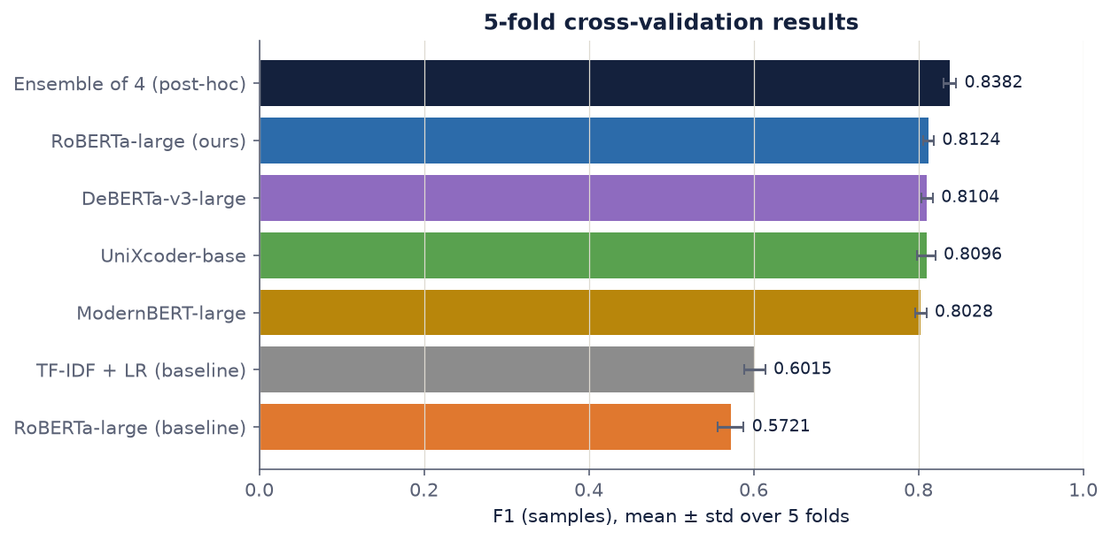
Every model with the recipe lands near 0.81
RESULTS · ALL METHODS
Same recipe, 4 encoders
0.8028 to 0.8124: within 0.01 of each other
Both baselines
0.5721 and 0.6015: 0.21 to 0.24 below ours
Ensemble of the 4
0.8382 when their probabilities are averaged (post-hoc)
Multi-label code comment classification · NLBSE’23
9 / 18
Notes:
This chart is the overview of every run, F1 (samples), mean ± standard deviation over the same 5 folds. Read it from the bottom: the two baselines, orange and grey, are around 0.57 to 0.60. Above them, four different encoders trained with our recipe: RoBERTa-large (ours) 0.8124, DeBERTa-v3-large 0.8104, UniXcoder-base 0.8096 and ModernBERT-large 0.8028. They are all within 0.01 of each other. This is the first hint that the recipe matters much more than the choice of backbone. At the top, an ensemble: we average the out-of-fold probabilities of the four transformer runs and re-tune the thresholds per fold. It reaches 0.8382. Be clear that this is post-hoc: it costs four models at inference time, and our deployed demo uses the single RoBERTa-large model. Transition: “Now the comparison the assignment asks for, in detail: our model against the baselines.”

Slide 10
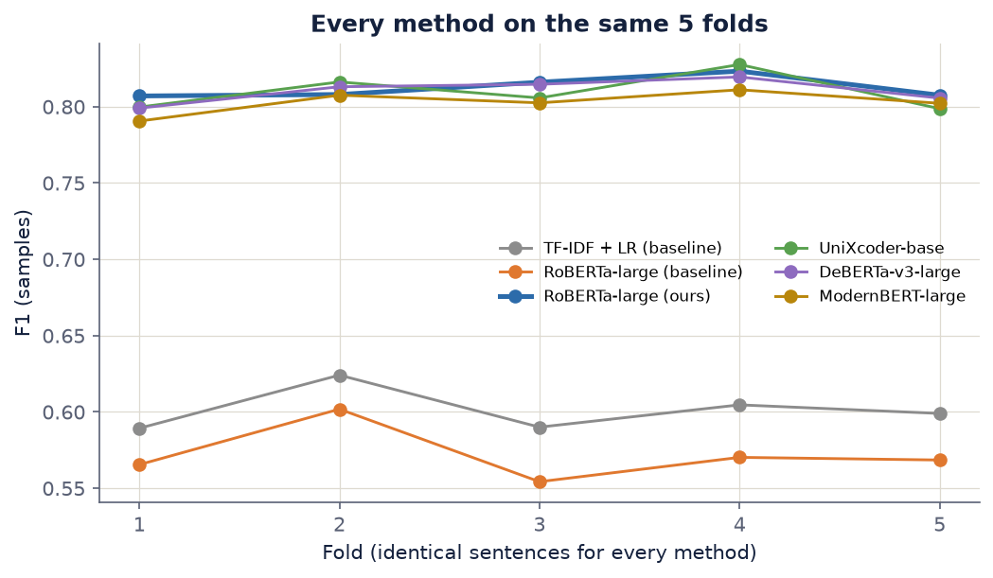
Better on every metric and every fold
RESULTS · VERSUS THE BASELINES
Method | F1 samples | F1 micro | F1 macro | PR-AUC | ROC-AUC | Jaccard | Exact | Hamming ↓
TF-IDF + LR | 0.6015 | 0.5871 | 0.5893 | 0.6194 | 0.9155 | 0.5470 | 0.3973 | 0.0594
RoBERTa baseline | 0.5721 | 0.6050 | 0.5743 | 0.6194 | 0.9177 | 0.5571 | 0.5129 | 0.0432
Ours | 0.8124 | 0.7973 | 0.7829 | 0.8198 | 0.9665 | 0.7790 | 0.6805 | 0.0260
Ours − RoBERTa baseline, per fold
+0.2415 · +0.2062 · +0.2617 · +0.2531 · +0.2390
mean +0.2403 · t = 25.39 · p = 1.4 × 10⁻⁵
Ours − TF-IDF + LR, per fold
+0.2177 · +0.1839 · +0.2260 · +0.2186 · +0.2085
mean +0.2110 · t = 28.84 · p = 8.6 × 10⁻⁶
Multi-label code comment classification · NLBSE’23
10 / 18
Notes:
This is the core comparison of the assignment. All values are means over the 5 folds. Table: our model wins on all eight metrics. Pick two to read aloud: exact match, where the whole label set must be right, goes from 0.51 (RoBERTa baseline) to 0.68; and Hamming loss, the share of wrong yes/no decisions, drops from 0.043 to 0.026. PR-AUC is useful because it does not depend on any threshold: it rises from 0.62 to 0.82, so the model ranks labels better, not only decides better. Bottom left: the differences fold by fold. Against the RoBERTa baseline the gain is between +0.21 and +0.26 on each fold; against TF-IDF between +0.18 and +0.23. Because the folds are shared, these are paired differences, and the t-tests are extremely significant. The chart on the right shows the same thing visually: our line (and the other recipe models) stays far above both baselines on every fold. Transition: “Where does such a large gain come from?”

Slide 11
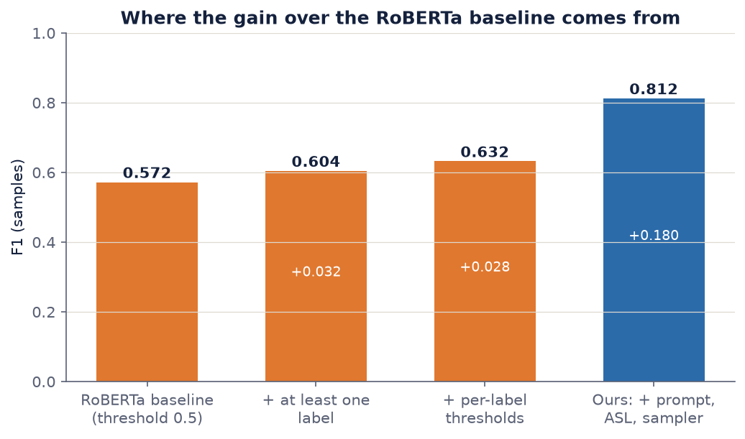
Training changes give most of the +0.24
RESULTS · WHERE THE GAIN COMES FROM
≈ +0.06
decision rules alone, applied to the baseline’s saved predictions: no retraining
≈ +0.18
prompt + Asymmetric Loss + sampler, measured together
Why the baseline trails TF-IDF
At threshold 0.5 it predicts no label for 13.6% of sentences (F1 = 0 each).
Multi-label code comment classification · NLBSE’23
11 / 18
Notes:
This slide decomposes the +0.24. We can isolate the decision rules without retraining, because we saved the RoBERTa baseline’s out-of-fold probabilities. Step 1, orange bar 1: the baseline as trained, threshold 0.5: 0.572. Step 2: force at least one label per sentence (take the most likely label if none passes the threshold): 0.604, +0.032. Step 3: tune one threshold per label as in our method: 0.632, another +0.028. So decision rules explain about +0.06. The remaining step, from 0.632 to 0.812, about +0.18, comes from the training changes: the context prompt, Asymmetric Loss and the weighted sampler. These three were changed together, so we cannot split this +0.18 between them; that is a limitation we state honestly. A threshold-independent check confirms the training itself is better: PR-AUC goes from 0.6194 to 0.8198. Box at the bottom right, the answer to “why is the RoBERTa baseline worse than TF-IDF?”: with binary cross-entropy and a fixed 0.5 threshold, it predicts no label at all for 13.6% of sentences, and each such sentence scores F1 = 0. It also predicts only 0.93 labels per sentence on average while the truth is 1.15. TF-IDF + LR tunes its thresholds. With the same threshold tuning the RoBERTa baseline reaches 0.6317, above TF-IDF’s 0.6015. Transition: “If the recipe matters so much, does the backbone matter at all?”

Slide 12
Four encoders end within 0.01 of each other
RESULTS · OTHER BACKBONES, SAME RECIPE
Backbone | F1 samples | Δ vs ours | Ours wins | p (t-test) | Params | Peak VRAM | CV time
RoBERTa-large (ours) | 0.8124 | — | — | — | 370.1M | 4.8 GB | 2 h 41 min
DeBERTa-v3-large | 0.8104 | −0.0020 | 4 / 5 | 0.40 | 448.7M | 5.4 GB | 3 h 46 min
UniXcoder-base | 0.8096 | −0.0028 | 3 / 5 | 0.50 | 131.6M | 1.8 GB | 1 h 01 min
ModernBERT-large | 0.8028 | −0.0096 | 5 / 5 | 0.03 | 409.7M | 5.1 GB | 2 h 30 min
Ensemble of the 4 | 0.8382 | +0.0258 | 0 / 5 | 1.5 × 10⁻⁴ | — | — | —
Recipe over backbone
Cheapest: UniXcoder-base
DeBERTa and UniXcoder are statistically tied with RoBERTa (p ≥ 0.40). Only ModernBERT is lower, and p = 0.03 on 5 folds is weak evidence.
Pretrained on code; same F1 with 2.8× fewer parameters, 2.6× less training time and 2.7× less memory.
Multi-label code comment classification · NLBSE’23
12 / 18
Notes:
We trained three more encoders with exactly the same recipe, folds and settings; only the backbone changes (LoRA target modules are chosen automatically for each architecture). Read the Δ column: DeBERTa-v3-large −0.002, UniXcoder-base −0.003, ModernBERT-large −0.010. The “Ours wins” column counts folds where RoBERTa is better: for DeBERTa and UniXcoder it is 4 and 3 out of 5, with p = 0.40 and 0.50, so these are ties. ModernBERT is lower on all 5 folds, p = 0.03, but with only 5 folds this is weak evidence. Conclusion one: once the recipe is right, the choice of encoder barely matters on this dataset. Conclusion two, practical: UniXcoder-base, a smaller model pretrained on source code, matches RoBERTa-large with 2.8 times fewer parameters, 2.6 times less training time (1 h 01 vs 2 h 41) and 2.7 times less GPU memory (1.8 vs 4.8 GB). For deployment it is the efficient choice. Last row: averaging the four models’ probabilities gives 0.8382, +0.026 over ours, better on all 5 folds (p = 1.5 × 10⁻⁴). The models make partly different errors, so combining them helps, at four times the inference cost. Transition: “One more design choice worth testing: the pooling.”

Slide 13

Mean pooling vs the first token: no real difference
ABLATION · POOLING
Sentence vector | F1 samples | F1 micro | F1 macro | PR-AUC | Exact match | CV time
Mean of tokens (ours) | 0.8124 ± 0.0064 | 0.7973 | 0.7829 | 0.8198 | 0.6805 | 2 h 41 min
First token <s> ([CLS]) | 0.8089 ± 0.0074 | 0.7950 | 0.7803 | 0.8176 | 0.6751 | 2 h 50 min
Per fold (mean − <s>)
Bootstrap, 6,738 sentences
McNemar, exact match
+0.0040 · −0.0086 · +0.0127 · +0.0042 · +0.0054
Δ F1 samples = +0.0036
496 sentences right only with mean, 460 only with <s>
95% CI [−0.0023, +0.0093] includes 0
mean +0.0035 · 4 / 5 folds · p = 0.36
p = 0.26
The gap (≈ 0.004) is smaller than the fold-to-fold spread (std ≈ 0.007). By language: Java −0.0057, Python +0.0078, Pharo +0.0071. Pooling is not where the gain comes from.
Multi-label code comment classification · NLBSE’23
13 / 18
Notes:
A natural question: why mean pooling plus an MLP head instead of the usual first token, [CLS], which is <s> in RoBERTa? We still fine-tune the encoder in both cases; the question is only how one sentence vector is built from the token vectors. Rationale for mean pooling: RoBERTa was pretrained without the next-sentence-prediction objective, so its first token is never trained as a sentence summary during pretraining; the mean uses every token, which seemed safer for very short sentences. To check, we trained the exact same configuration with the first token instead: same folds, seed, recipe and epochs. Only the pooling changes. Result: mean pooling is ahead by 0.0035 F1 (samples) and slightly ahead on almost every metric, but none of three tests is significant. Fold by fold it wins 4 of 5, paired t-test p = 0.36. A bootstrap over all 6,738 out-of-fold sentences gives a 95% interval from −0.0023 to +0.0093, which includes zero. On exact match the two models disagree on about 950 sentences, almost evenly split, McNemar p = 0.26. The gap is smaller than the normal fold-to-fold variation, and it is not even consistent across languages: the first token is better on Java. Conclusion: on this task the pooling choice does not matter measurably. This confirms that our +0.24 comes from the training recipe, not from the architecture. Caveat: each setting was trained once with one seed, so GPU non-determinism is part of the observed difference. Transition: “Let’s look inside the results: which labels and languages are hard?”

Slide 14
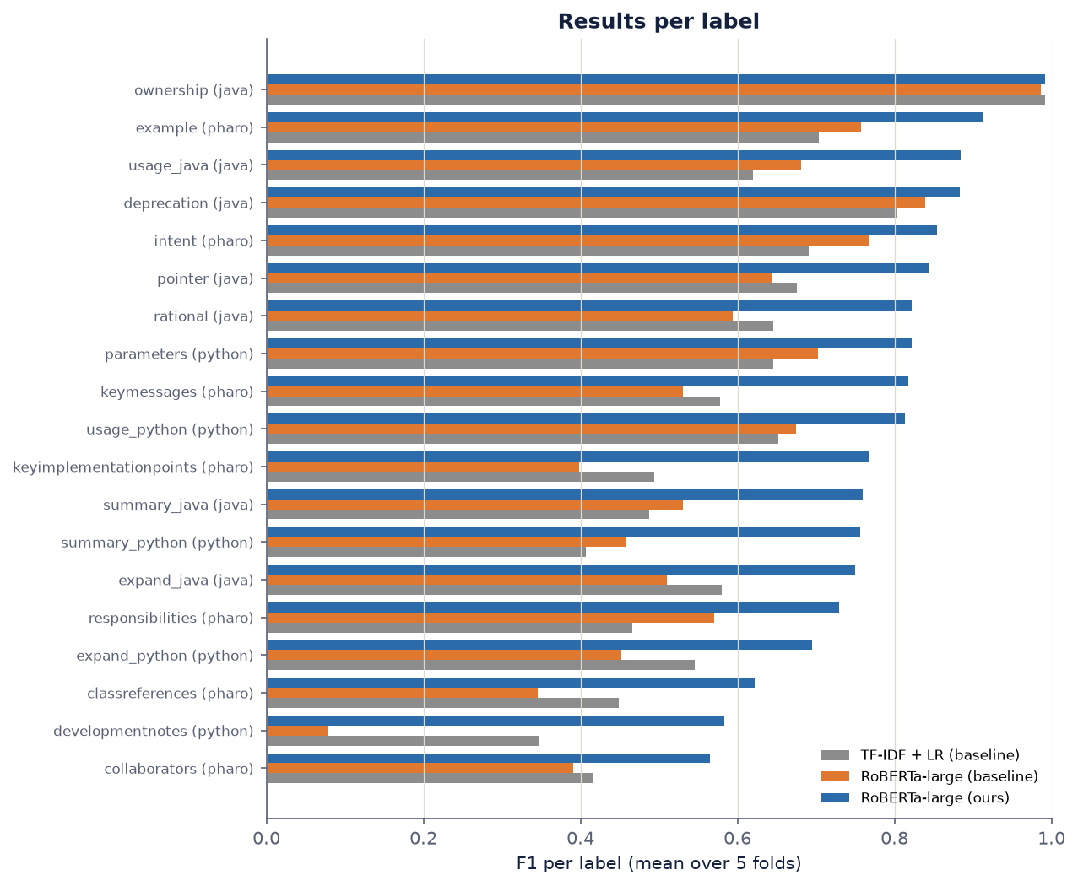
Python is the hardest language
ANALYSIS · LANGUAGES AND LABELS
MACRO F1 OVER EACH LANGUAGE’S LABELS
Method | Java | Python | Pharo
TF-IDF + LR | 0.6861 | 0.5197 | 0.5423
RoBERTa baseline | 0.6837 | 0.4733 | 0.5372
Ours · RoBERTa-large | 0.8478 | 0.7341 | 0.7529
UniXcoder-base | 0.8463 | 0.7357 | 0.7510
DeBERTa-v3-large | 0.8560 | 0.7219 | 0.7301
ModernBERT-large | 0.8459 | 0.7213 | 0.7162
Easiest labels
Hardest labels
ownership 0.99
example 0.91
collaborators 0.57
developmentnotes 0.58
Multi-label code comment classification · NLBSE’23
14 / 18
Notes:
Two views of the same results. Table, macro F1 per language: Java is the easiest for every method (0.85 for ours). Python is the hardest (0.73), Pharo is in between (0.75). Our recipe lifts all three languages by roughly 0.16 to 0.26 over the baselines. Among the backbones, DeBERTa is best on Java but weaker on Pharo, so no single encoder dominates every language. Chart on the right, F1 per label: blue is ours, orange the RoBERTa baseline, grey TF-IDF. Ours is the best on every label, tied only on ownership, which every method already gets right (0.99). Easiest: ownership 0.99 and example (Pharo) 0.91. Hardest: collaborators (Pharo, 127 sentences) 0.57 and developmentnotes (Python, 312 sentences) 0.58. The biggest jump is developmentnotes: the RoBERTa baseline scored only 0.08 on it, so it almost never predicted that label; with our recipe it reaches 0.58. classreferences, the rarest label with 77 sentences, goes from 0.35 to 0.62. These rare and vague labels are exactly what the loss and the sampler were designed for, but they remain the weakest point. Transition: “What kind of mistakes does the model still make?”

Slide 15
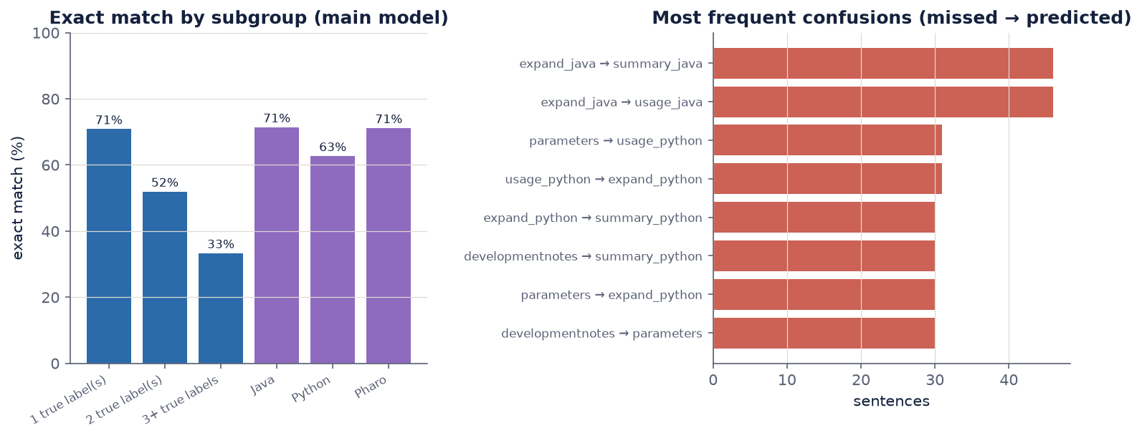
Errors sit between neighbouring categories
ANALYSIS · ERRORS OF THE MAIN MODEL
Overlapping meanings
More labels, harder
Slight over-prediction
expand_java → summary or usage: 46 each
exact match 70.9% → 52.0% → 33.3%
1.28 labels per sentence vs 1.15 true
Multi-label code comment classification · NLBSE’23
15 / 18
Notes:
Error analysis on the out-of-fold predictions of the main model, so every sentence is predicted by a model that never saw it. Left chart, exact match by subgroup: sentences with one true label are fully right 70.9% of the time (5,826 sentences); with two labels 52.0% (816); with three or four labels only 33.3% (96). By language, Java and Pharo are at about 71%, Python at 63%, consistent with the previous slide. Right chart, the most frequent confusions, read as “true label missed, other label predicted”. The top two are expand_java confused with summary_java and with usage_java, 46 sentences each. In Python, parameters, usage, expand and developmentnotes confuse each other about 30 times each. These categories are close in meaning: a sentence that “expands” on a class can also read as a summary or as usage advice, so the errors stay between neighbouring labels of the same language. Last point: the model predicts 1.28 labels per sentence while the truth has 1.15. Recall (0.857) is higher than precision (0.800). That is a direct result of choosing thresholds that maximize F1 (samples), which rewards catching a correct label more than it punishes one extra label. Transition: “Finally, how does this look for a real user? Our demo.”

Slide 16
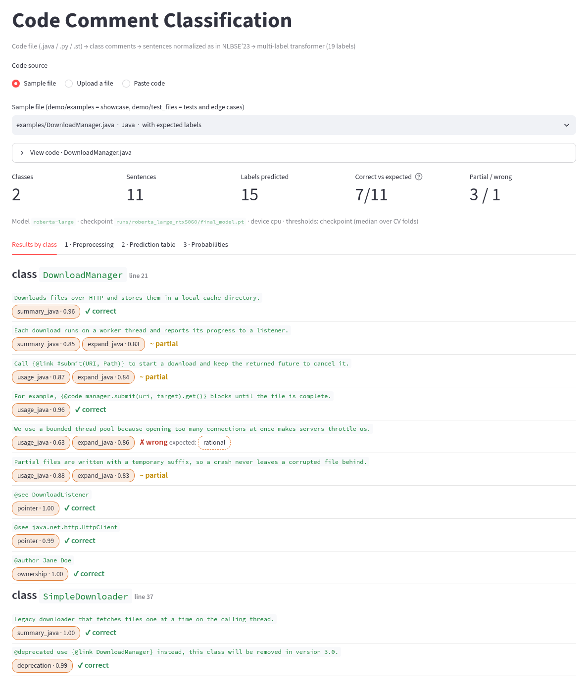
From a code file to labeled comments
DEMO
Input: a .java, .py or .st file, uploaded, pasted or picked from samples
Extract class comments: Javadoc before a class, Python docstrings via ast, Pharo Tonel and File Out
Normalize like the dataset: {@link Foo#bar()} becomes @link foo#bar
Classify with the final model and the median CV thresholds
Show labels with probabilities per class, checked against expected labels
54 / 86
53 / 94
exact match, 8 showcase files (63%)
exact match, 10 edge-case files (56%)
Multi-label code comment classification · NLBSE’23
16 / 18
Notes:
If time allows, switch to the live demo here: streamlit run demo/app.py. Otherwise use the screenshot. The dataset contains sentences, but a real user has a source file. The demo closes this gap in five steps. 1. The user uploads or pastes a Java, Python or Pharo file, or picks one of the sample files. 2. We extract only class comments, as in the dataset: the Javadoc right before a class, interface, enum or record; Python class docstrings parsed with the ast module; Pharo class comments in both the Tonel and File Out formats. Method comments and file headers are ignored. 3. We normalize the text exactly like the dataset: lowercase, keep a few symbols, so {@link Foo#bar()} becomes “@link foo#bar”. When we rebuild classes that are in the dataset, we reproduce its sentences character for character. 4. We build the same prompt and run the final model with the median thresholds of the five folds. 5. Results are grouped by class with label chips and probabilities, and compared with expected labels when we have them. Screenshot: DownloadManager.java. You can see correct predictions such as pointer for @see lines, ownership for @author and deprecation for @deprecated, plus partial matches and one wrong one, a rationale sentence. Mock data numbers: on our 8 showcase files the whole label set is right for 54 of 86 sentences (63%), and on 10 harder edge-case files for 53 of 94 (56%). This is somewhat below the cross-validated exact match of 0.68, as expected for classes the model has never seen. Be clear these expected labels were written by us following the dataset conventions, so they are illustrative, not a benchmark.

Slide 17
What these numbers do not show
LIMITATIONS
Thresholds tuned on validation
Sentence-level folds
Not the official protocol
Absolute scores are slightly optimistic; all methods but the RoBERTa baseline share this, so comparisons stay fair.
A class can appear in training and validation, and the prompt names it; class-level folds would be stricter.
NLBSE’23 scores 19 binary tasks on a fixed test split; our numbers are not directly comparable with published ones.
Five folds, one seed
Recipe tested as a whole
Demo labels are ours
Small differences, such as ModernBERT (p = 0.03) or pooling (p = 0.36), are weak evidence either way.
Prompt, loss and sampler changed together; their separate effects need more ablation runs.
Expected labels of the mock files are hand-written; the demo scores are illustrative only.
Multi-label code comment classification · NLBSE’23
17 / 18
Notes:
Present these proactively; it shows we understand our own evaluation. 1. Thresholds: we tune thresholds on the same validation fold we report on, so the absolute numbers are a bit optimistic. The TF-IDF baseline and all our transformer runs do the same, so the comparisons between them are fair. Only the RoBERTa baseline uses a fixed 0.5, and we showed it remains far behind even after we tune its thresholds post-hoc (0.6317). 2. Our folds split sentences, not classes. Two sentences of the same class comment can be in training and in validation, and we know neighbouring sentences often share labels. The prompt also contains the class name: 92.6% of validation sentences have their class in the training fold, and a simple rule that never reads the sentence, predicting the most frequent labels of that class, already reaches about 0.58 F1 (samples). A split grouped by class would be stricter and would probably lower all scores. 3. We did not use the official NLBSE’23 protocol, which treats the task as 19 separate binary problems scored on a fixed test split. So please do not compare our 0.81 directly with the competition leaderboard. F1 macro is our closest metric. 4. Five folds and one training per setting give limited statistical power. That is why we call ModernBERT’s small gap weak evidence and the pooling difference not significant. 5. The prompt, the loss and the sampler were changed together, so we know their combined effect (about +0.18) but not each one’s share. 6. The demo’s expected labels were written by us, so the demo scores illustrate behaviour; they are not a benchmark. Transition: “To sum up.”

Slide 18
The training recipe, not the architecture, drives the result
TAKEAWAYS
1
+0.240 F1 (samples) over plain fine-tuning of the same RoBERTa-large, and +0.211 over TF-IDF + LR, on 5 / 5 folds.
2
Four encoders tie within 0.01 under the same recipe; UniXcoder-base matches at about a third of the cost, and their ensemble reaches 0.8382.
3
Pooling does not matter: mean vs first token differs by 0.0035, p = 0.36.
Next: separate ablations of prompt, loss and sampler · class-level cross-validation · the official NLBSE’23 split · one model distilled from the ensemble
Thank you · Questions?
Notes:
Close in about one minute. Three takeaways. One: the answer to the assignment. Our recipe, a context prompt, Asymmetric Loss, a weighted sampler and per-label thresholds, improves the same RoBERTa-large by 0.24 F1 (samples) over the plain fine-tuned baseline and by 0.21 over the TF-IDF model, consistently on all five folds. Two: under that recipe, the backbone barely matters. Four very different encoders end within 0.01. The small code model UniXcoder-base matches RoBERTa-large at about a third of the parameters, time and memory, and combining all four gives the best score we measured, 0.8382. Three: we also checked the pooling design choice directly. Mean pooling versus the first token gives no significant difference, which again points to the training recipe as the source of the gain. Next steps follow from the limitations: run separate ablations for the prompt, the loss and the sampler; evaluate with a class-level split and on the official NLBSE’23 test split; and distil the ensemble into a single model for the demo. Everything is reproducible: one command trains all models, and all results and figures are in the repository. Thank you; we are happy to take questions. Likely questions and where to point: “why mean pooling?” → slide 13; “why is the RoBERTa baseline below TF-IDF?” → slide 11; “is the comparison fair?” → slides 6 and 17.

