Slide 1
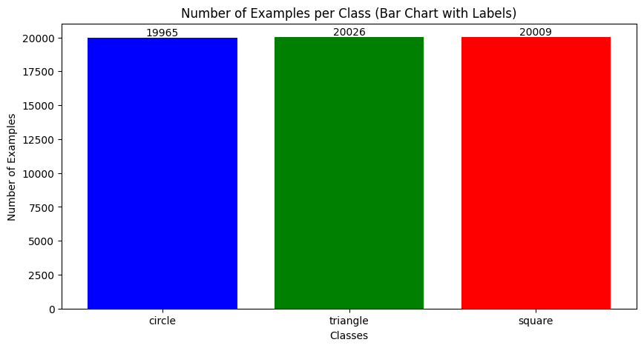
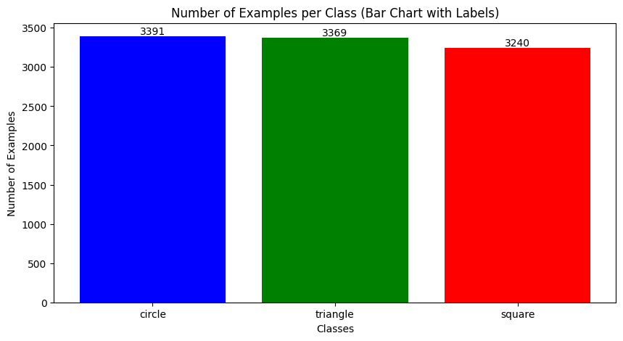
EDA 1 : Class balance
Train
Test

Slide 2
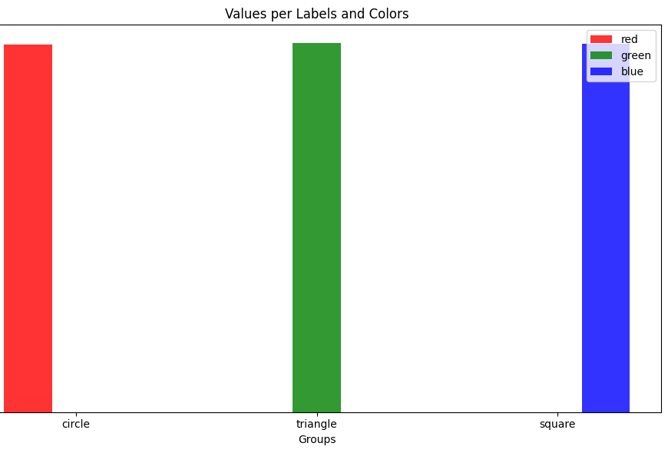
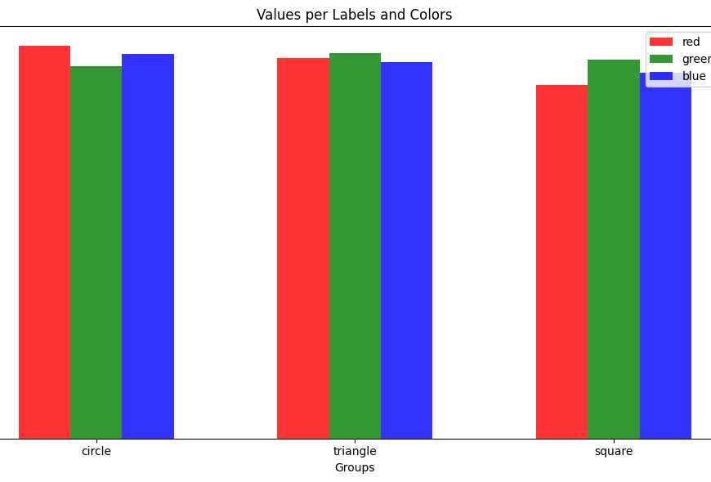
EDA 2: Color of each class
Train
Test
Insight: 100% data have only 1 channel color and missing color for training

Slide 3
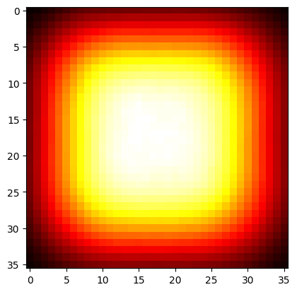
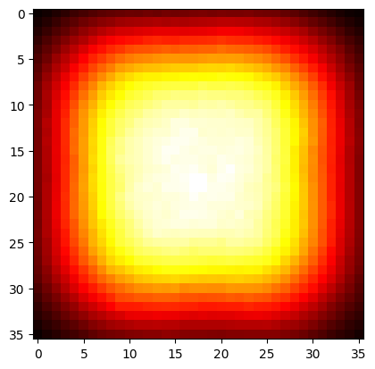
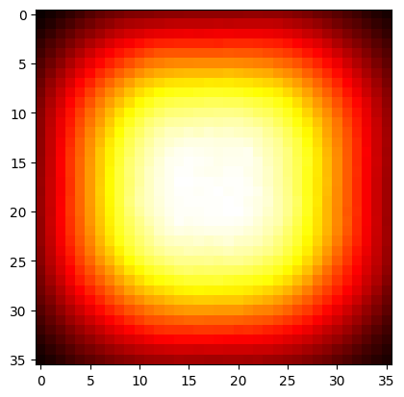
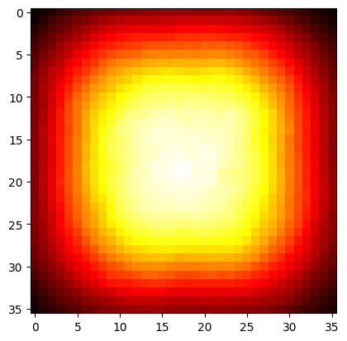
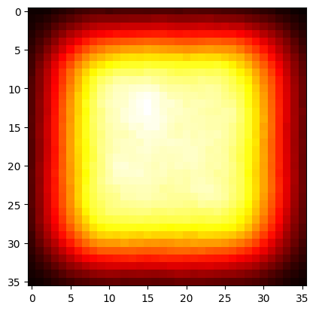
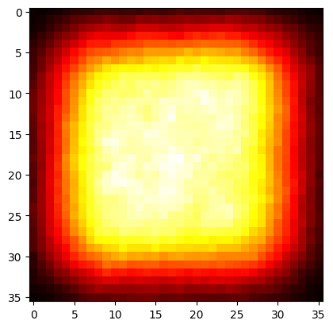
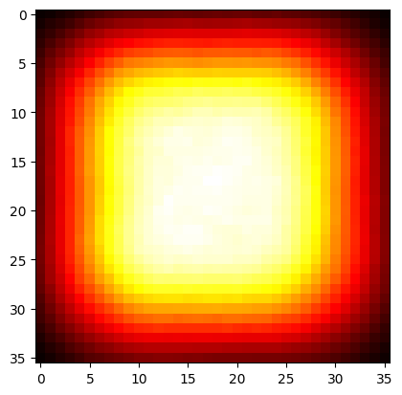
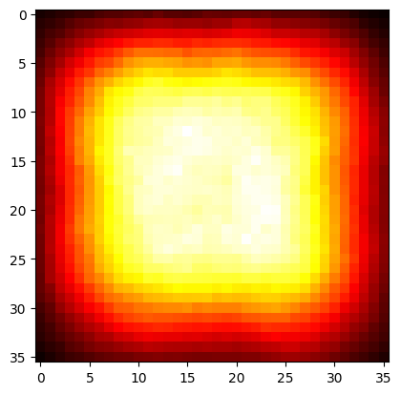
EDA 3: Insight: no different in position, but 'intensity' must be analysis more
Train
Test
All classes
Circle
Triangle
Square

Slide 4
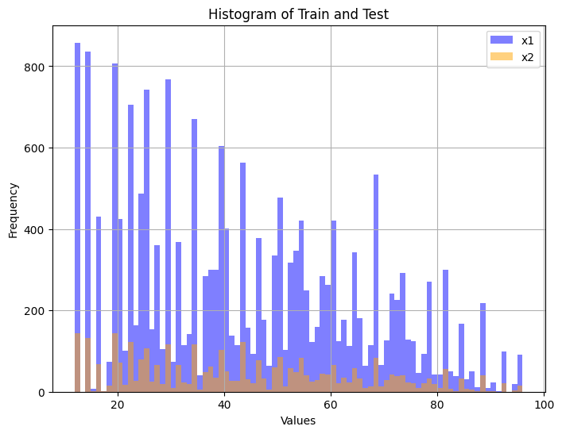
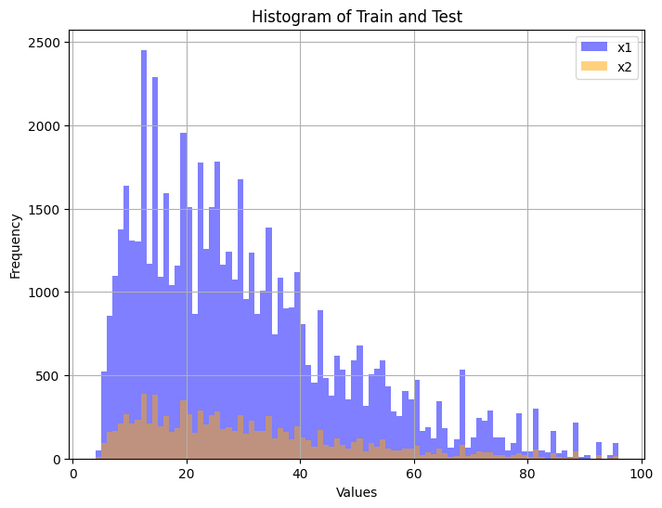
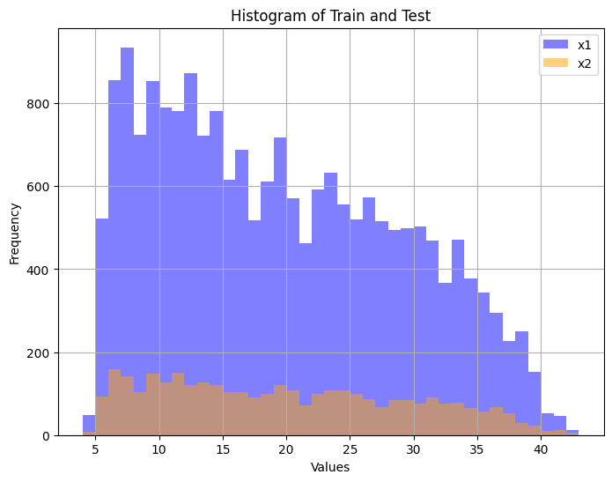
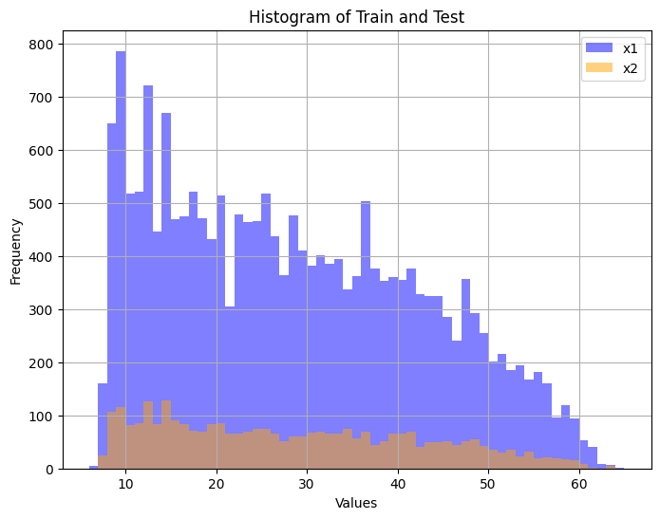
EDA 4: Different distribution for "brightness intensity" between train/test
All classes
Circle
Triangle
Square

Slide 5
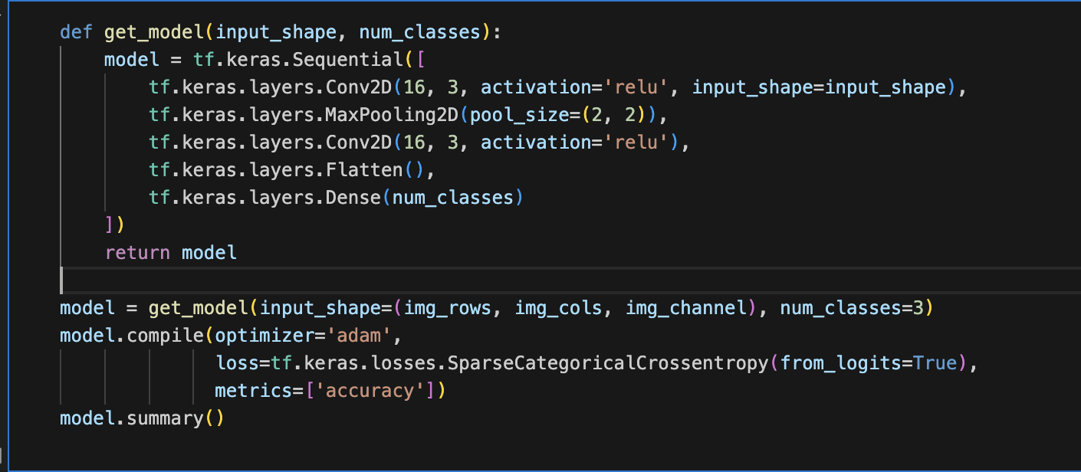
Model building
No padding, will lost information in rear through layers
No dropout, easy to become overfit with simple images
Not use common technique from paper : Conv + BatchNorm + Relu
Model not deep enough

Slide 6
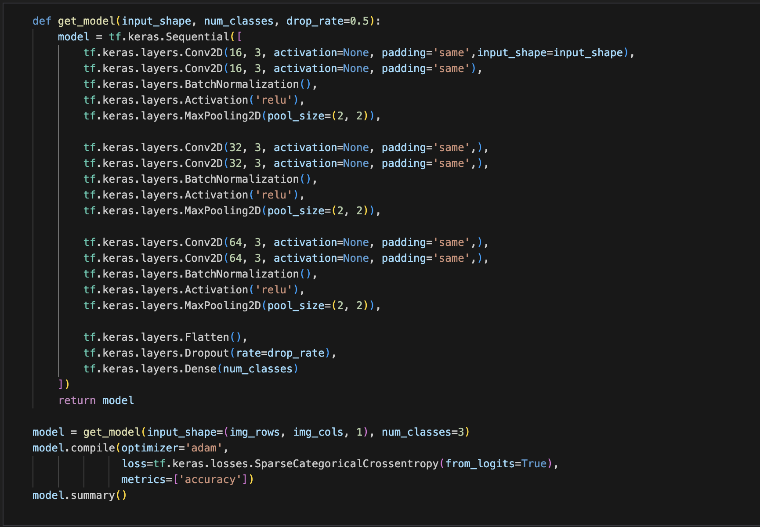
Model building
Train acc 99.75%, Test acc 99.96%

