Slide 1
Known Attributes of Dataset
Data is the same as data in Excercise 1, so that it have some features which are analyzed:
Shape distribution is balance
Color is only 1 channels of RGB for train, but 3 for test
Position distribution is Normal distribution with mean is center for all dataset
Need to analyze:
Cause we will transfer image to Black and White, so no need to analyze about color anymore
Only relation about center position - shape

Slide 2
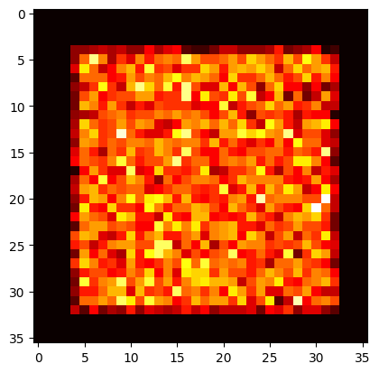
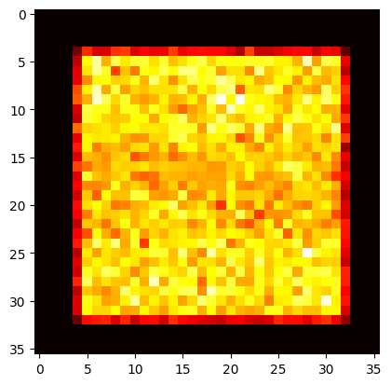
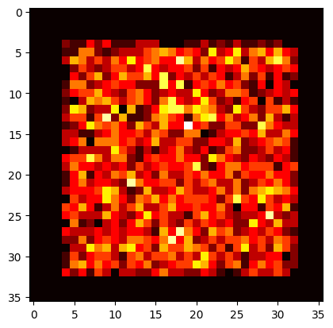
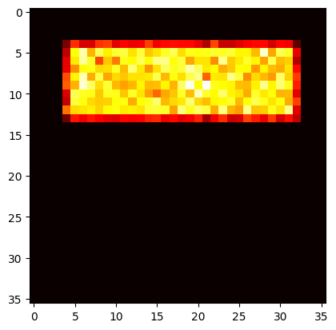
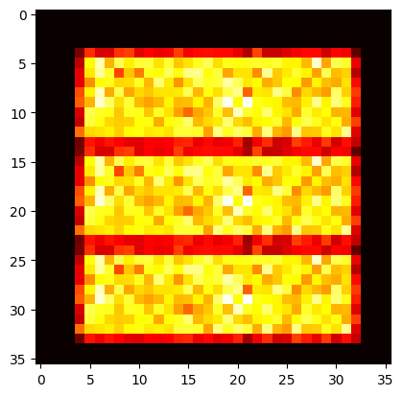
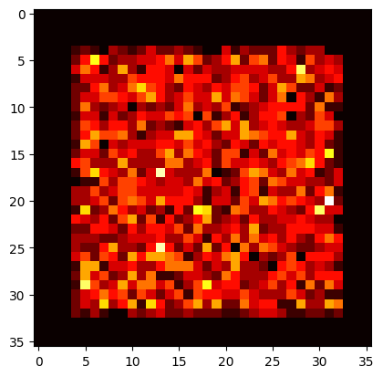
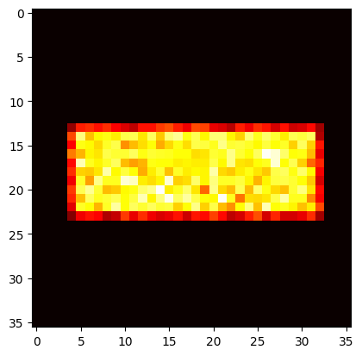
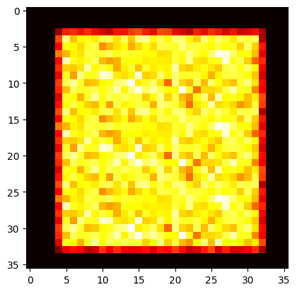
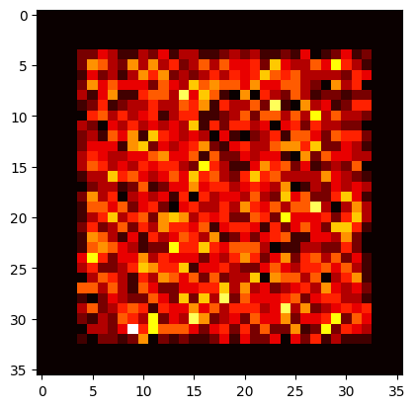
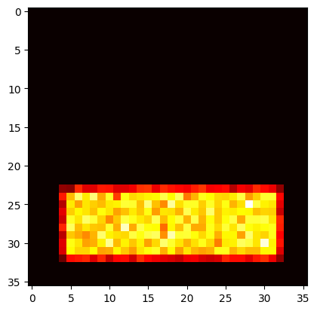
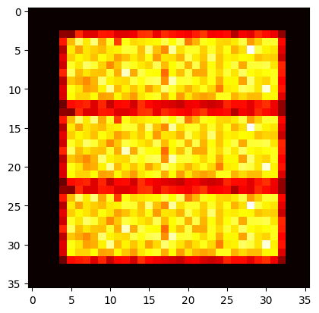
EDA: Position of train data is imbalance in y axis with shape => Augmentation more data
Test
Train
Train - aug
Test
Train
All classes
Circle
Triangle
Square

Slide 3
Model building
MAE | Marco’s base model + Base data | Marco’ base model + New data | Phuc’s model + New data
Train | 1.6262 | 1.0646 | 0.9511
Test | 3.0646 | 0.9846 | 0.3900
Data test too simple when compare with train data

Slide 4
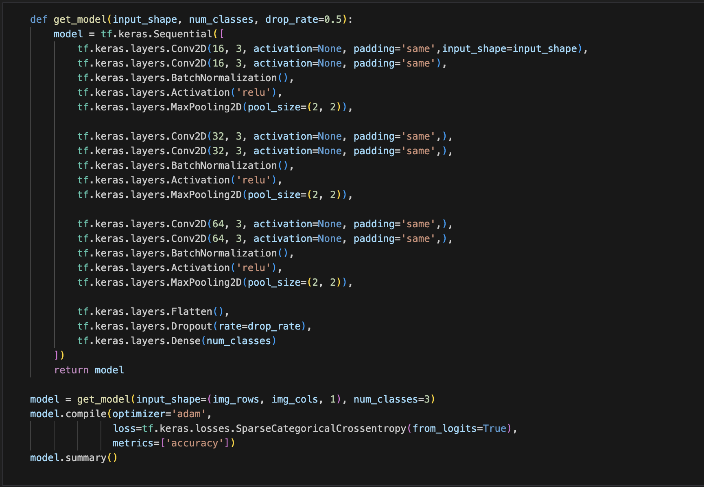
Model building
Train acc 99.75%, Test acc 99.96%

