Slide 1
Capstone 2: Eye for the Blind
UoA C4 - Phuc Thanh Nguyen

Slide 2
Contents
Introduction
Solution pipeline
Preprocessing text
Preprocessing images
Images to Feature maps
Model building
Model evaluation

Slide 3
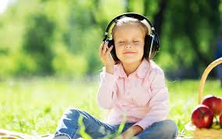
Introduction
Problem statement: Create a deep learning model which can explain the contents of an image in the form of speech through caption generation with an attention mechanism
Dataset: Flickr8K.
Usage: help blind people to understand any image with the help of speech.

Slide 4
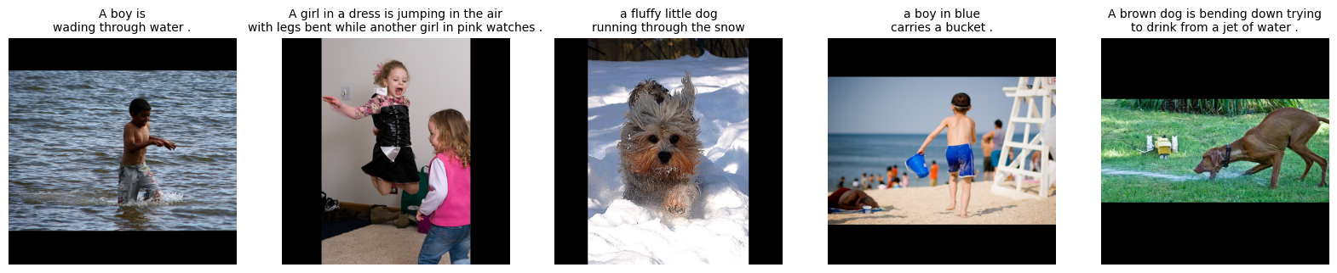
Introduction
Detail of dataset:
8K images
40K captions, each image include 5 caption
Max caption length after preprocessing: 39

Slide 5


II. Solution pipeline
Preprocess Image
Images to feature maps
Store feature maps
Preprocess Text
Dataset
Model evaluation
Model building

Slide 6
III. Preprocessing texts
Build tokenizer
Tokenize and padding
Build Tokenizer: maximum 5000 words, other word will be replace by <UNK>, with <start> and <end> add into begin and ending of each sentence, respectively
Padding: Pad 0 to get all sentences have same length (equal max length of dataset)

Slide 7
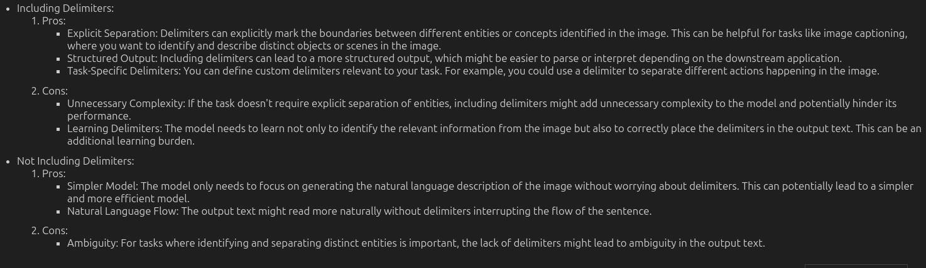
III. Preprocessing texts
How we build tokenizer: exclude all delimiters, and lowercase all words so for with 5000 words dictionary we could contains as much word as possible

Slide 8
IV. Preprocessing images
Resize image to size (299, 299)
Scale image to range [-1, 1]
Image is resize into (299, 299)
After that, scale image pixel value to range [-1,1]

Slide 9

V. Images to Feature maps
Extract feature map
Store on hard disk
Load Inception V3 model without head
Use this model to get feature map

Slide 10
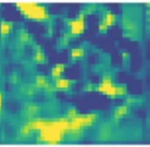
VI. Model building
Encoder
Attention
Decoder
Training
Get feature map through encoder and attention to get a new feature map focused on the most important information
From new feature map to text by Decoder (built from RNN family)

Slide 11
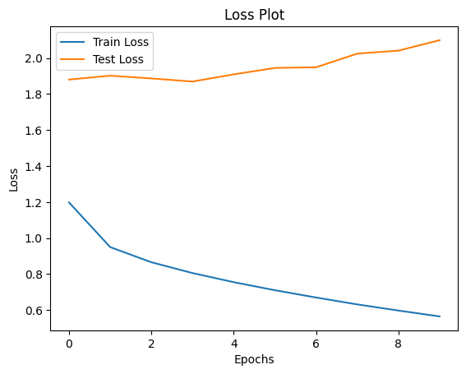
VI. Model evaluation
After training model for 10 epochs (due to limit of hardware), we use some metrics below to evaluate it.

Slide 12
VI. Model evaluation
After training model for 10 epochs (due to limit of hardware), we use greedy search and beam search to find the predict caption.

Slide 13
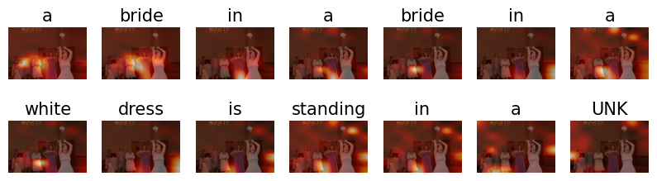
VI. Model evaluation

Slide 14
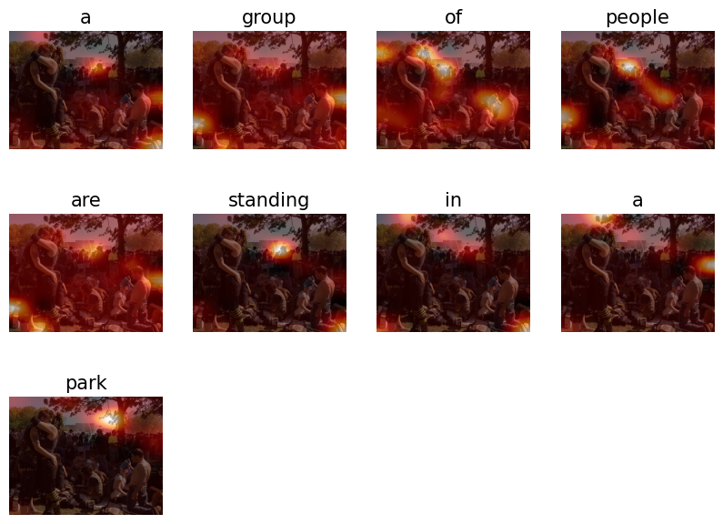
VI. Model evaluation

