Slide 1

Lending Case Club Study
Team Members:
Phuc Thanh Nguyen
Aishwarya K Shetty

Slide 2

Contents
Business Objectives
Steps for EDA data:
Data understanding for EDA
Data Cleaning and Manipulation
Analysis
Conclusion

Slide 3
I. Business objectives:
a. Business Understanding:
Lending Club (LC) is a consumer finance company which specializes in lending various types of loans to urban customers. When the company receives a loan application, the company must make a decision for loan approval based on the applicant’s profile.
Two types of risks are associated with the bank’s decision:
If the applicant is likely to repay the loan, then not approving the loan results in a loss of business to the company
If the applicant is not likely to repay the loan, i.e., he/she is likely to default, then approving the loan may lead to a financial loss for the company
When a person applies for a loan, there are two types of decisions that could be taken by the company:
Loan accepted: company approves the loan
Loan rejected: company rejects the loan

Slide 4
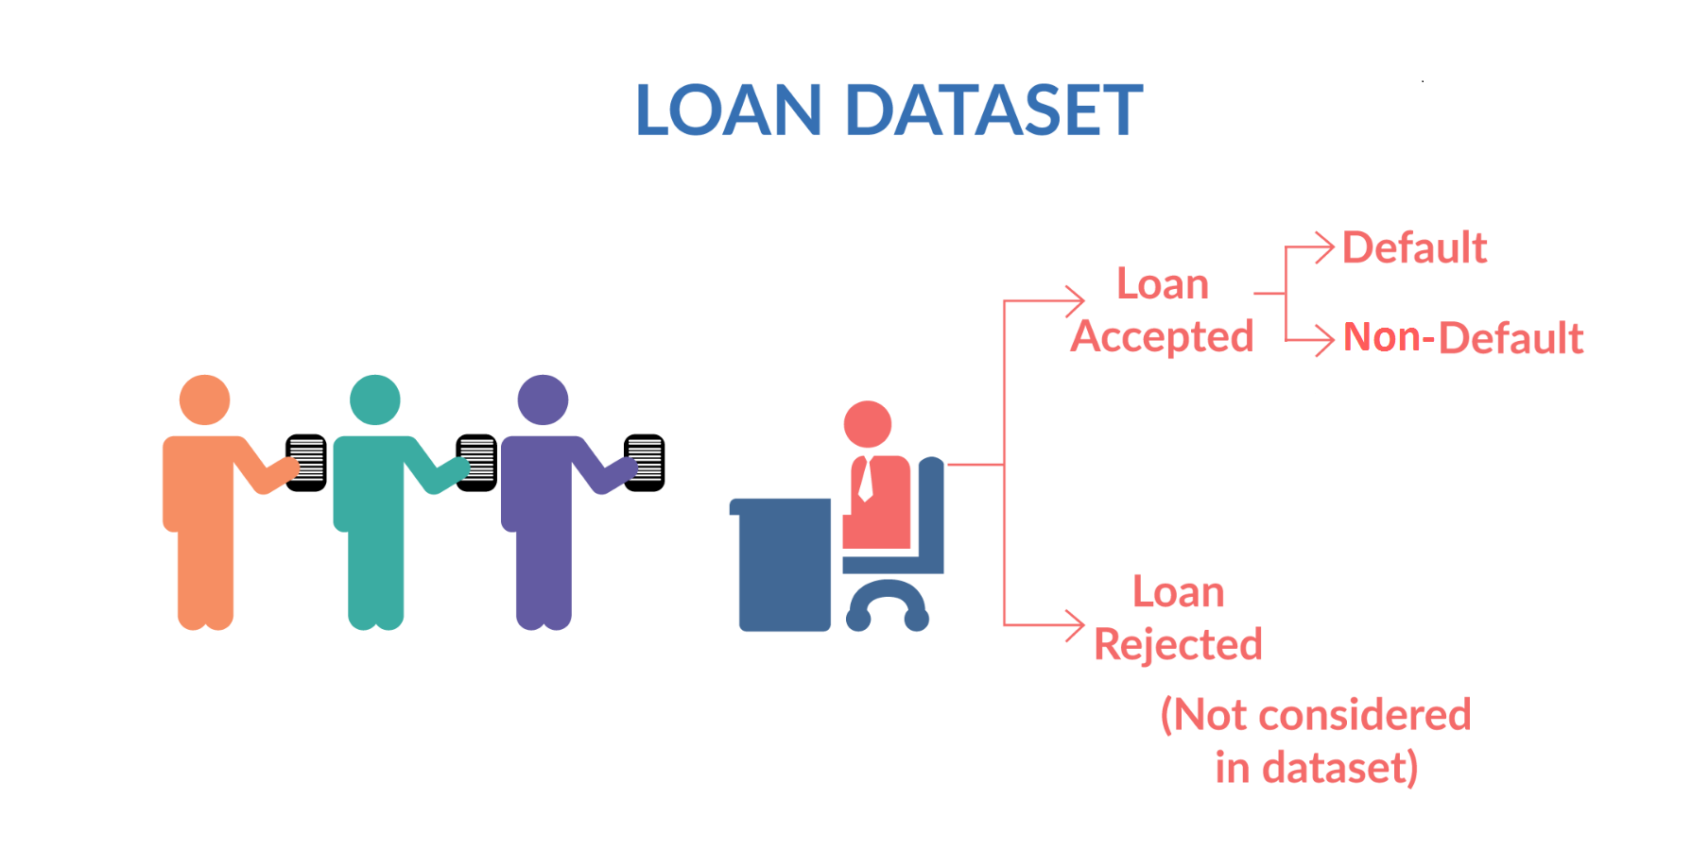
I. Business objectives:
a. Business Understanding:
If the company approves the loan, there are 3 possible scenarios described below:
Fully paid: Applicant has fully paid the loan (the principal and the interest rate)
Current: Applicant is in the process of paying the instalments, i.e., the tenure of the loan is not yet completed. These candidates are not labelled as 'defaulted'.
Charged-off: Applicant has not paid the instalments in due time for a long period of time, i.e., he/she has defaulted on the loan

Slide 5
I. Business objectives:
b. The objectives:
Borrowers who default cause the largest amount of loss to the lenders
If one can identify these risky loan applicants, then such loans can be reduced thereby cutting down the amount of credit loss.
Identification of such applicants using EDA is the aim of this case study.
The company wants to understand the driving factors (or driver variables) behind loan default, i.e., the variables which are strong indicators of default. The company can utilize this knowledge for its portfolio and risk assessment.

Slide 6
II. Steps for EDA data:
Data understanding for EDA
Understand and take the attributes will affect the loan
Data Cleaning and Manipulation
Cleaning outliers, fixing types and replace missing
Analysis
Analysis attributes and their affect to the default rate of loan
Conclusion
Summary what mostly affect the loan

Slide 7
III. Data understanding for EDA:
Data Understanding refers to the critical process of performing initial investigations on data so as to discover patterns, spot anomalies
We begin understanding the data by getting the shape(number of rows and columns ) in the data and the datatype of each column
We then displayed a few lines in the dataset to understand the general composition of the data

Slide 8
III. Data understanding for EDA:
The data have 111 attributes. However, 56 attributes don't have any recorded information, 9 attributes have the same values with each sample. The remain 57 attributes can cluster into 4 group:
Group 1: 24 attributes are related to customer behavior and not available at the time of loan application or the unique value for customer.
We remove this group
Group 2: Consumer attributes when they apply the loan
Group 3: The loan attributes
Group 4: Loan status, to determine if a person is default or not. This is the key or our EDA.

Slide 9
III. Data understanding for EDA:
Consumer attributes
Loan attributes
Loan status
Annual income
Employment Length
Employment Title
Home ownership
Past bankruptcies
Earliest credit line open
Address state
Zip code
DTI (loan payment/ income)
Verification status
Inquiry last 6 months
Issue date
Loan amount
Funded amount total
Funded amount by investor
Grade by LC
Sub grade by LC
Installment
Interest rate
Status of loan
As we see, the number of "Current" in loan status is very small (1k/39k samples). As "Current", it's hard to say if the borrower will likely to be default or not, so we don't use this
For easier to calculus the default rate, we define that if a person is "Charge off" (default), that mean 1, otherwise 0

Slide 10
IV. Data cleaning and manipulation:
Data cleaning is the process of fixing or removing incorrect, corrupted, incorrectly formatted, duplicate, or incomplete data within a dataset.
We began by removing the columns having all null values.
Post this we eliminated columns having single values as it would not be of any use for analysis
Then we filled missing values in the quantitative variables by their mode values
We then standardised the values in the rows. For example: the column int_rate was in the form of 10%, We removed the ‘%’ symbol associated with the int_rate so as to produce numeric values that would be helpful for analysis
We then performed outlier treatment on the data to eliminate abnormal values
We then examined the columns individually and recorded following observations
"desc" has description (text data) which we cannot do anything about it
id", "member_id", "url" doesnot affect the loan
Certain column are post approval features-delinq_2yrs','earliest_cr_line','last_credit_pull_d','last_pymnt_amnt', etc
Hence we removed these columns as they do not influence loans status

Slide 11
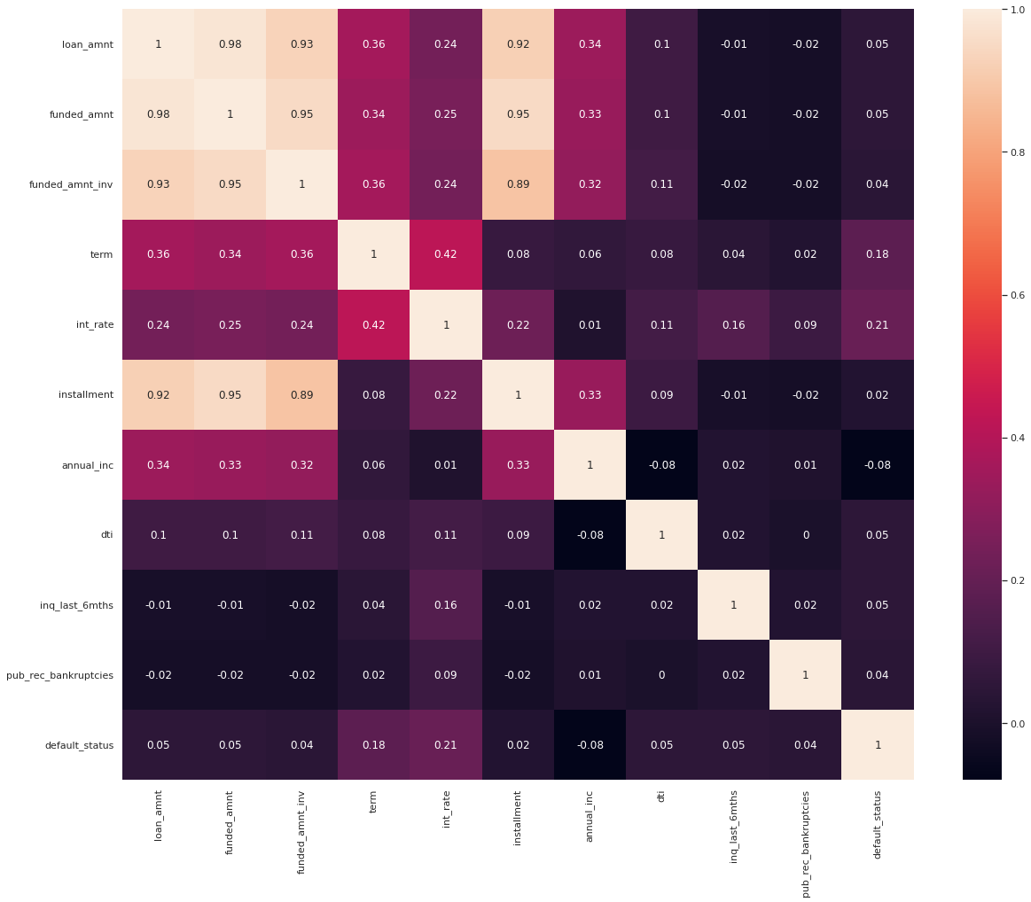
V. Data analysis:
We first look at correlation matrix to reduce the dimension of data to analysis
As we see, 'funded_amnt', 'funded_amnt_inv', 'installment' are highly correlation with "loan_amnt", so we remove them

Slide 12
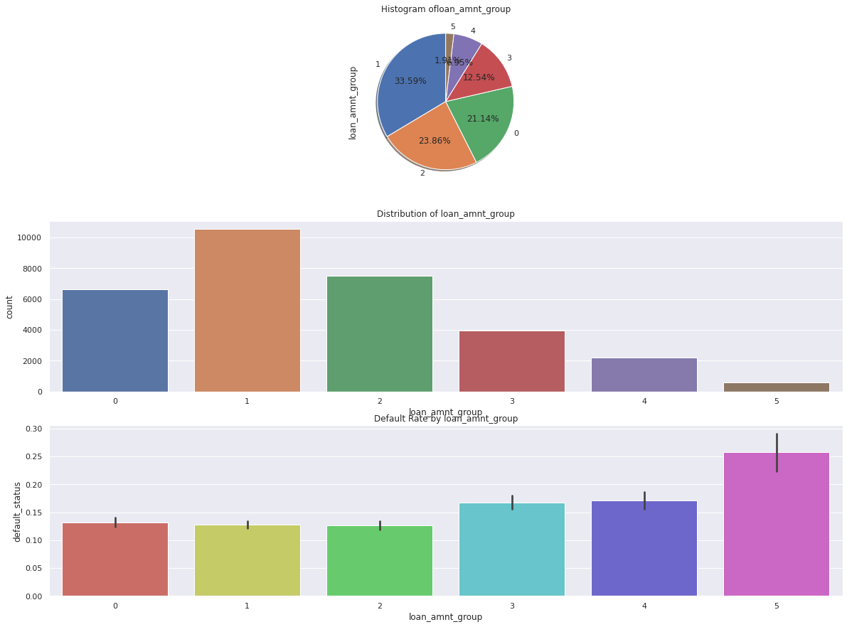
V. Data analysis:
loan_amnt
We derive loan amount to groups; each group have range 5k
The loan amount mostly in range 5k to 10k
The amount of loan affect the default rate, higher loan amount can get higher rate of default

Slide 13
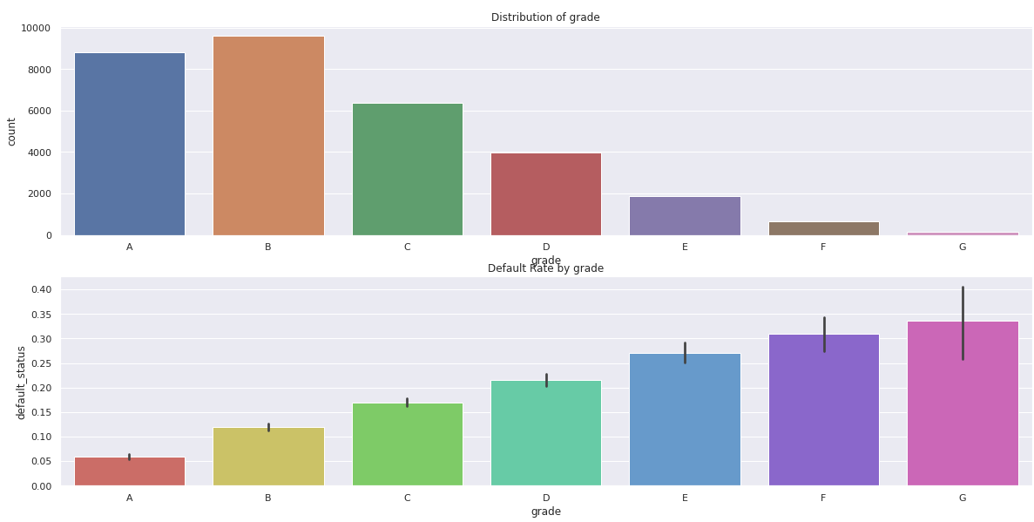
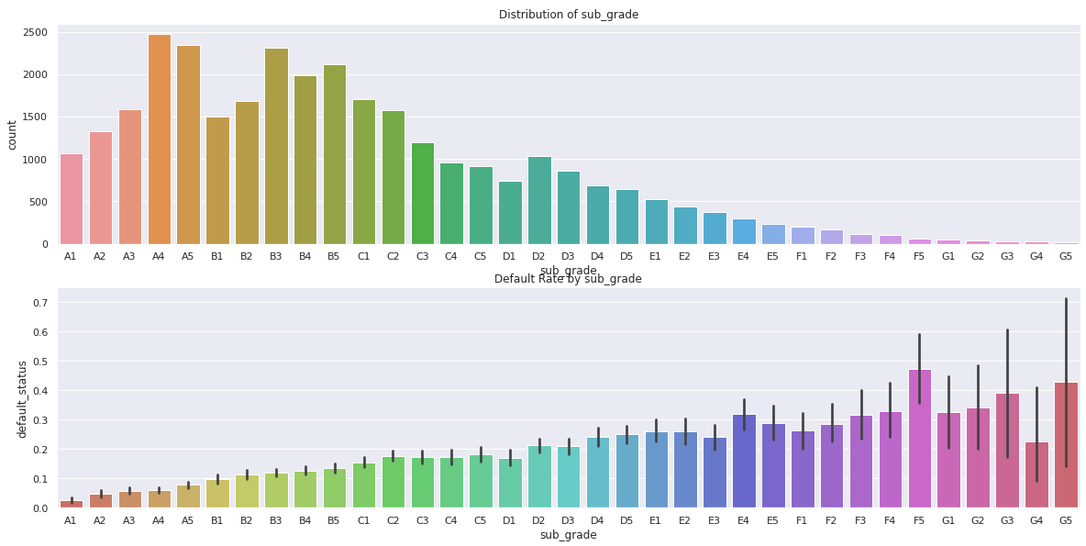
V. Data analysis:
grade
The grading system of LC work well: higher rank of loan profile, lower rate of default rate

Slide 14
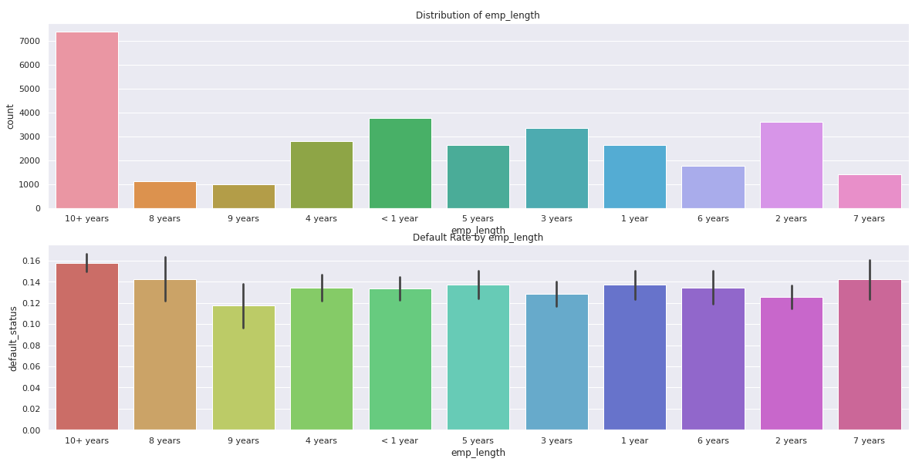
V. Data analysis:
emp_lenght
'10+ years' mean the average ages will be 30s.
They has good volume as well has higher default rate

Slide 15
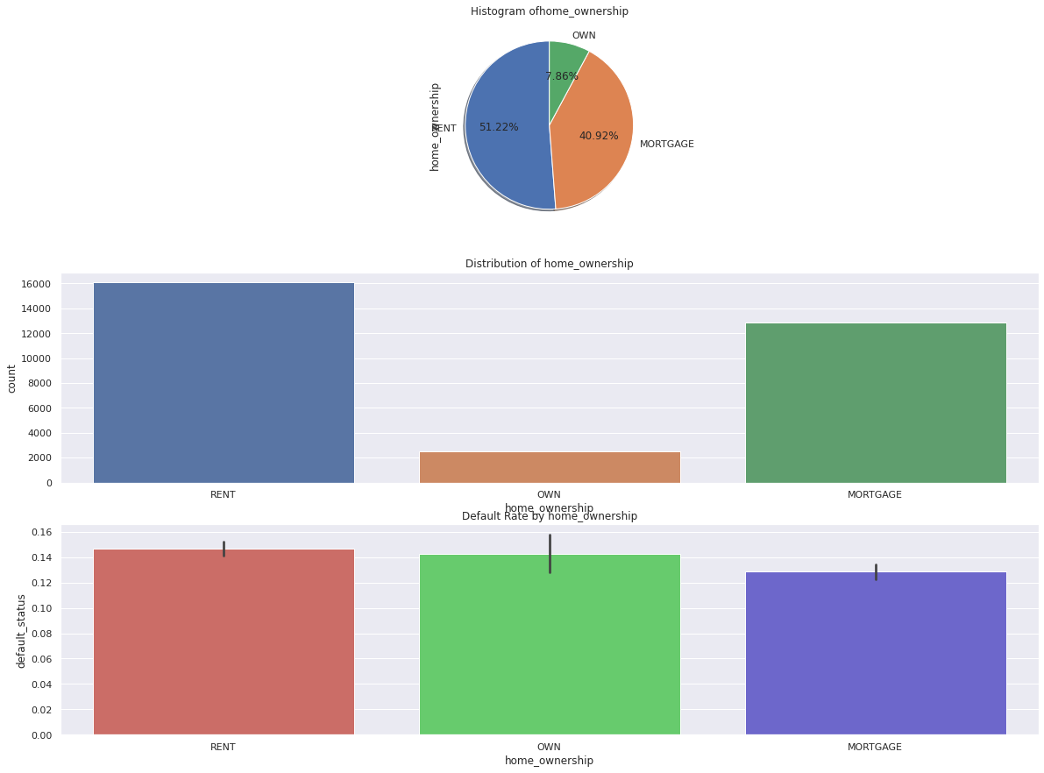
V. Data analysis:
home_ownership
People who already own home take less loan.
The home ownership not affect much default or not.
'Rent' and 'Own' have similar default rate
'Mortgage' group has slightly lower default rate

Slide 16
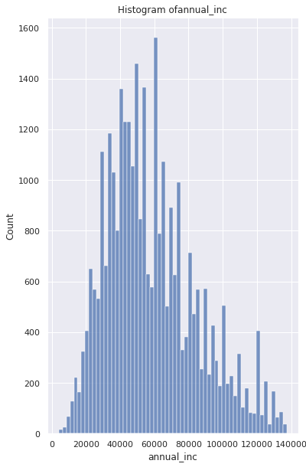
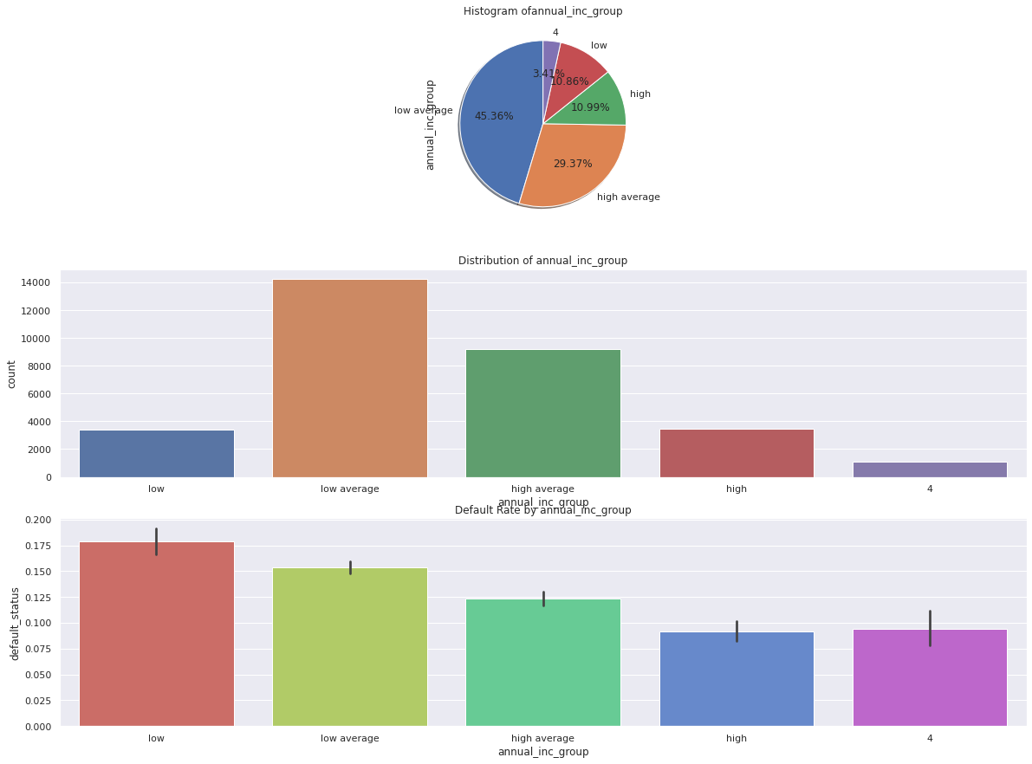
V. Data analysis:
annual_inc
We derives income to 4 groups: low, low average, high average and high
Lower incomes have higher default rate
Most of the loan come from people have low average income(30k-60k)

Slide 17
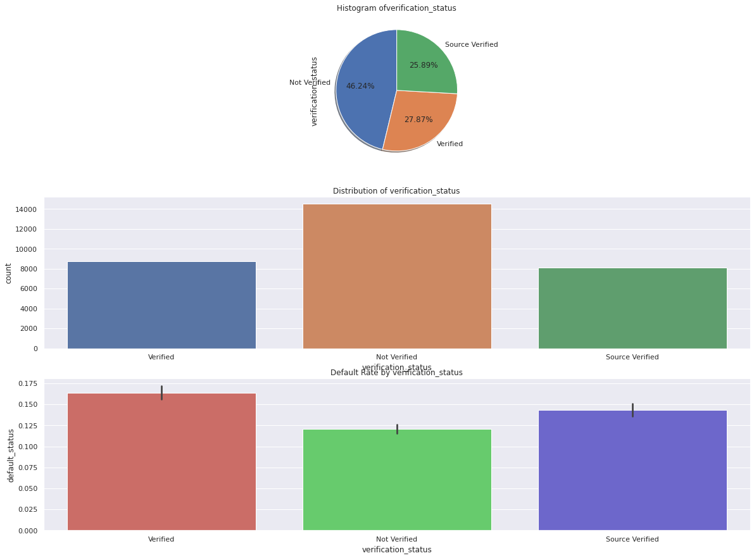
V. Data analysis:
verification_status
Strange finding: 'Not verified' has lower default rate than 'Verified', despite it have highest amount of sample.

Slide 18
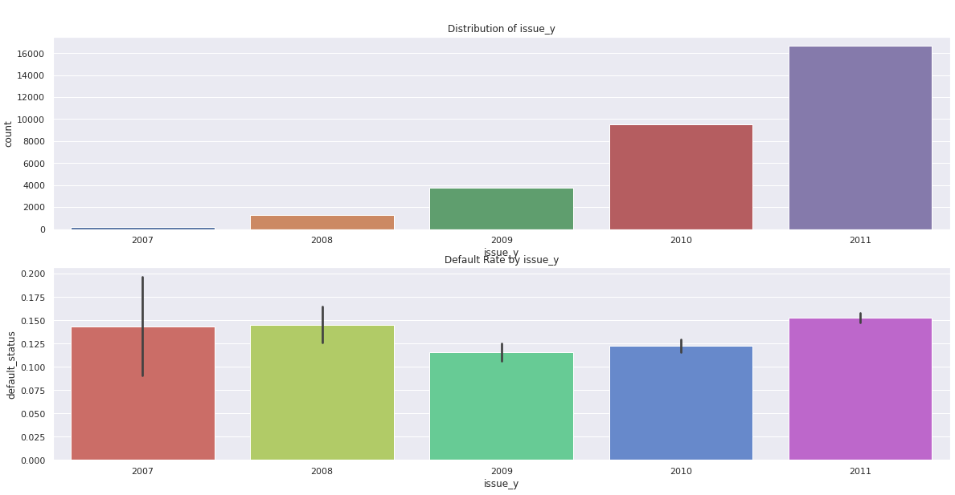
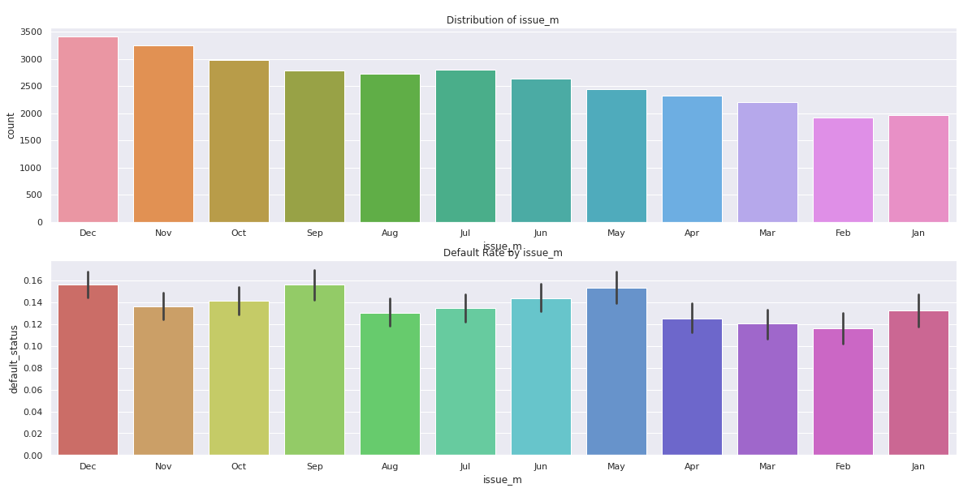
V. Data analysis:
issue_d
We derive issue date to year and month
The number of loans issued go up from 2007 to 2011 and the default rate went down during these year until 2011, where we see spike in default rate.
2010 has lower default rate People more likely to have loan in end years

Slide 19
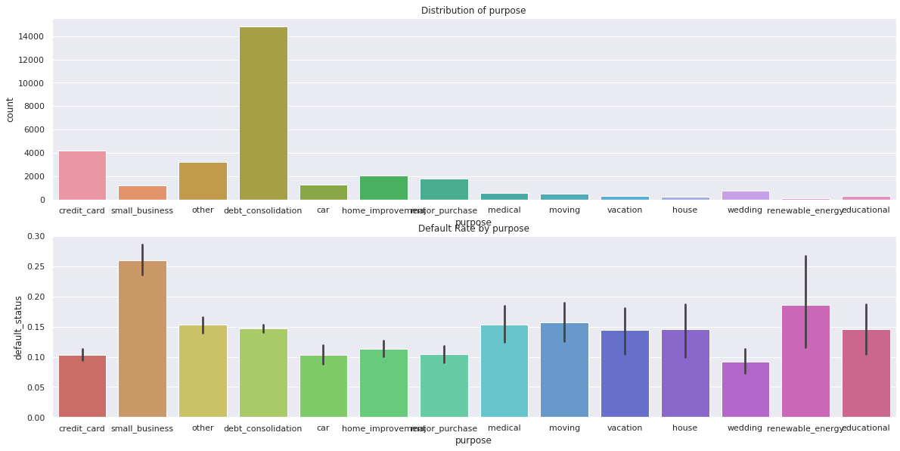
V. Data analysis:
purpose
debt_consolidation has the largest count on aprroved loan.
small_business loans have the highest default rates.
wedding has the lowest default rate.

Slide 20
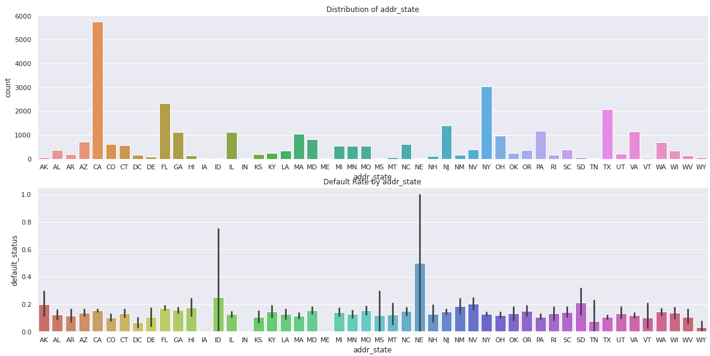
V. Data analysis:
addr_state
CA have highest loan amount, but very low default rate.
In other side, NE, SD have very few loan amount, but the default rate is very high.

Slide 21
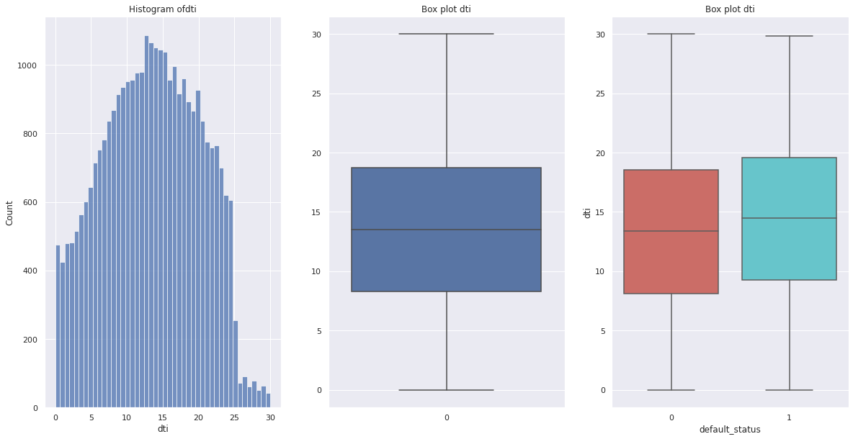
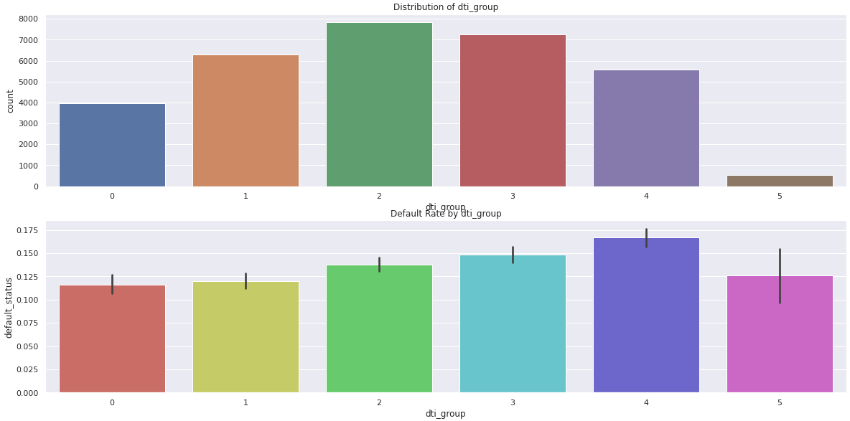
V. Data analysis:
dti
We derive DTI to range 5% each group
Most people have their loan amount from 5-20 percent DTI
Higher the DTI, higher the default rate It's risky to offer loan to customers with high DTI.

Slide 22
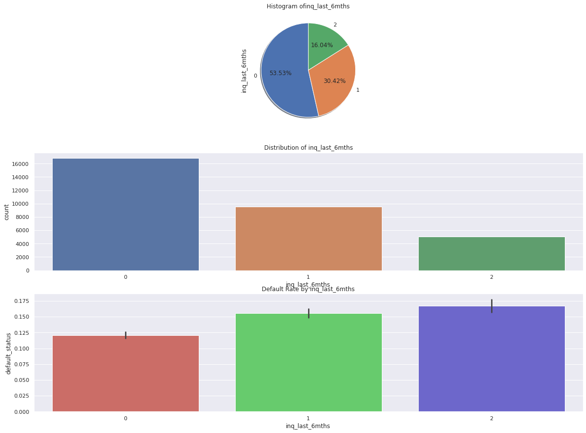
V. Data analysis:
inq_last_6mths
The people get loan mostly have no inquiry in 6 month, and they have lowest rate of default.
=> This mean the inquiry process of LC perform not good enough

Slide 23
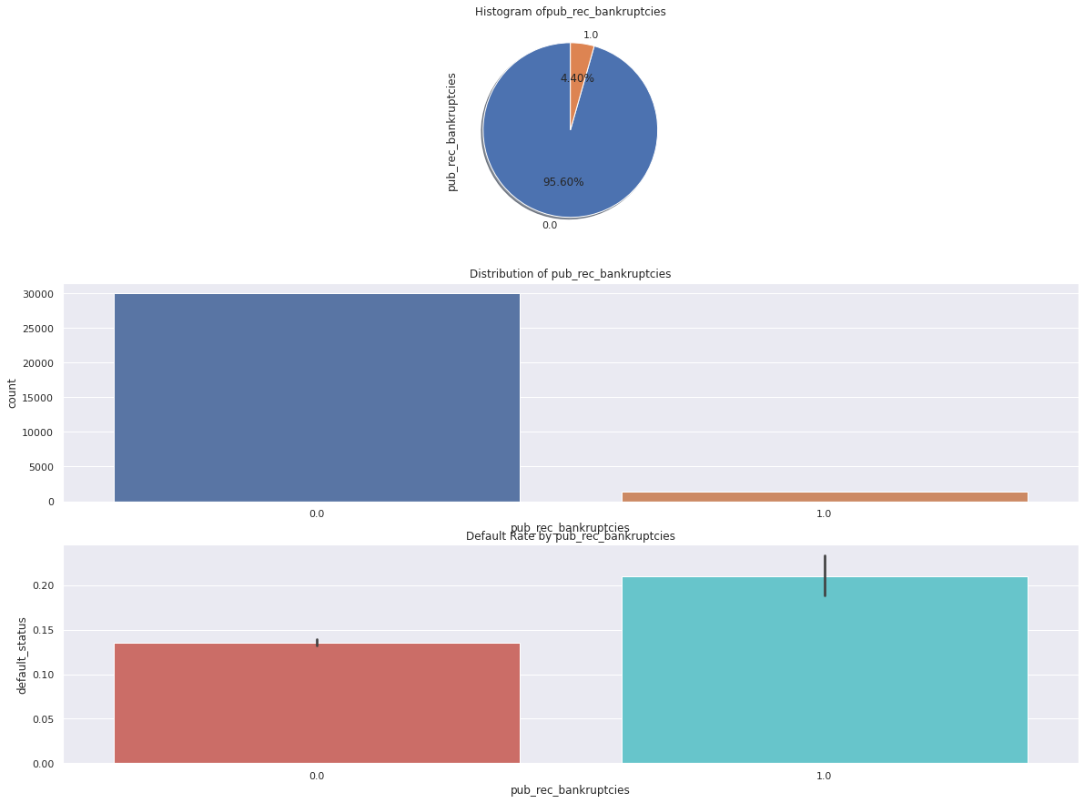
V. Data analysis:
pub_rec_bankruptcies
Higher the bankruptcies, the higher is the default rate

Slide 24
VI. Conclusion:
Person who don't own house likely to have the loan
The loan affect by interest rate, higher interest mean higher default rate
The loan mostly come from the people have annual income in range 30k to 60k.
When get a loan, there must be look at the amount of loan over their annual income, cause DTI show that if the ratio get higher, the default rate get higher too
A strange information found from data is the verification status which is not verified get lowest default rate
Mostly people have loan without any inquiry in 6 month, that mean the LC system need more attention about who could be customer
Some states like CA are a good market, some like NE are bad
The loan market is going up on the need of market, cause the number of loan go up every year, and people more likely to have loans in end-year months.

