Slide 1


Assignment: Uber Demand-Supply Gap
Student : Phuc Thanh Nguyen
Email : phucnguyenthanh.stu@gmail.com

Slide 2
I. Abstract
Problem statement: Uber is facing driver cancellation and non-availability of cabs to and from airport leading to impact on the business and loss of potential revenue.
Objective: To identify the root cause of the supply-demand gap of cabs to and from airport.
Data used for analysis:
The data used is only to and from airport
The span of the data is of 5 days.

Slide 3
II. Step of process
Data collection and cleaning Import the data
Identifying the data quality issues and clean the data
Format date and time variables
Extract new variables required for analysis
Data exploration and analysis
Analyze different variables
Analyze variables across different time slots
Identify the types of requests, time slots and locations that constitute for the supply demand gap.
Outcome and recommendations
Visualizing the problem
Presenting the observations
Recommendation to resolve the problem

Slide 4
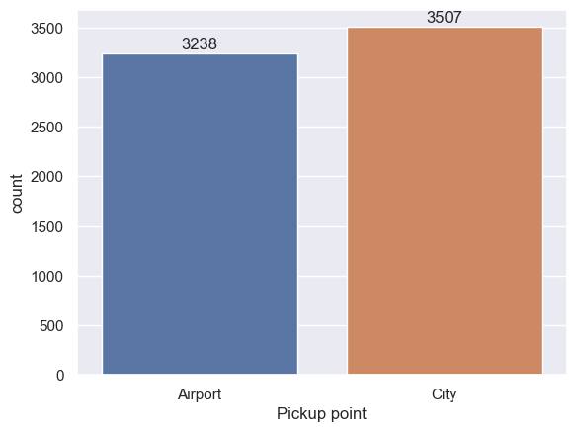
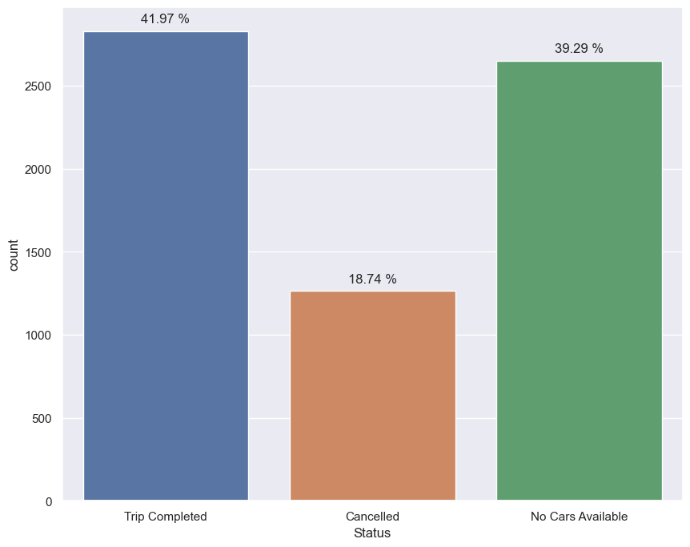
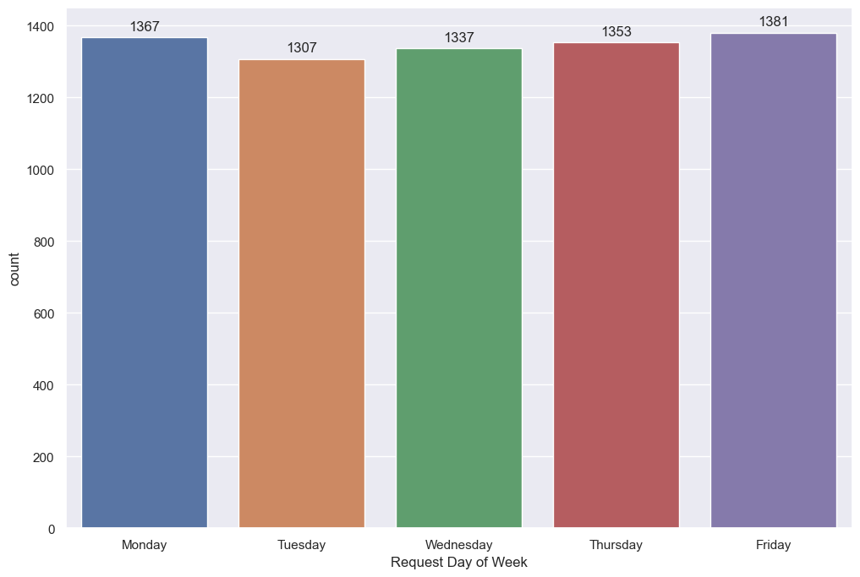
III. Analysis
Pickup locations between Airport and City seems quite balanced, and request for pickup at City get a little higher frequency.
Only 41.97% requests from city and airport gets completed
There isn't much difference in requests vs days of the week

Slide 5
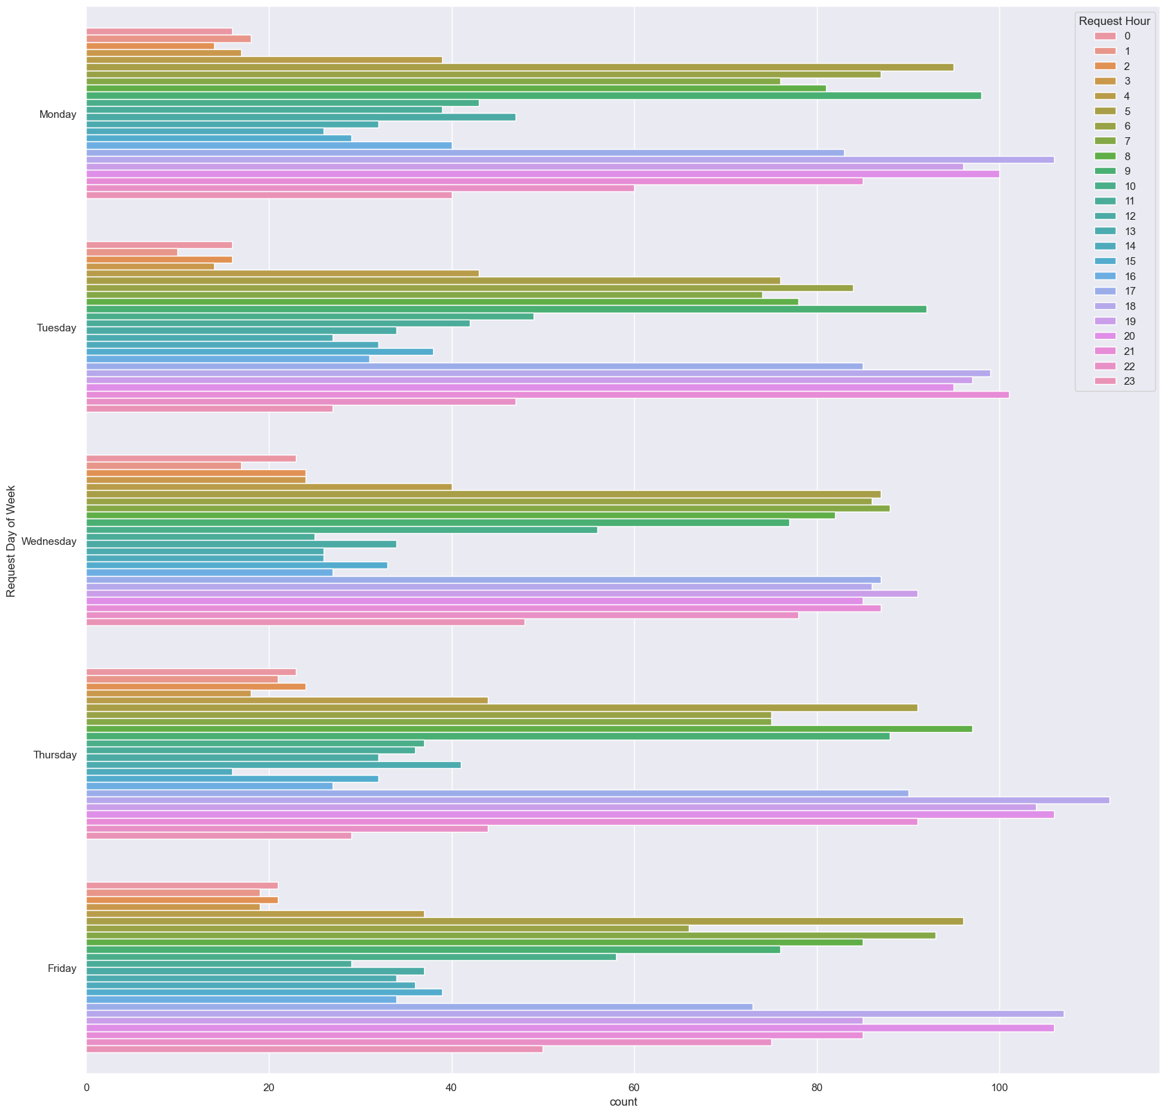
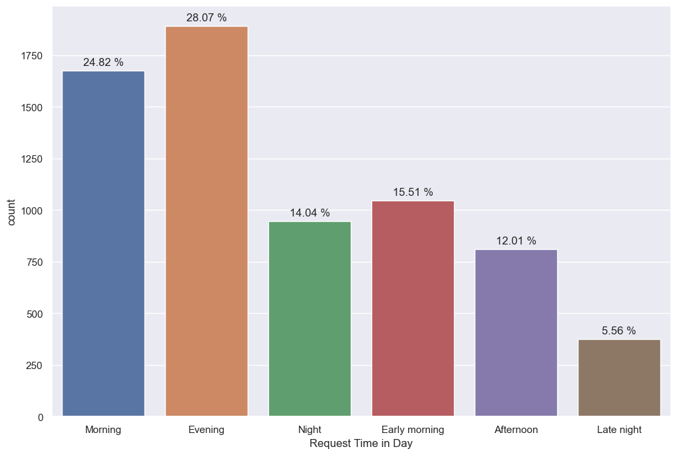
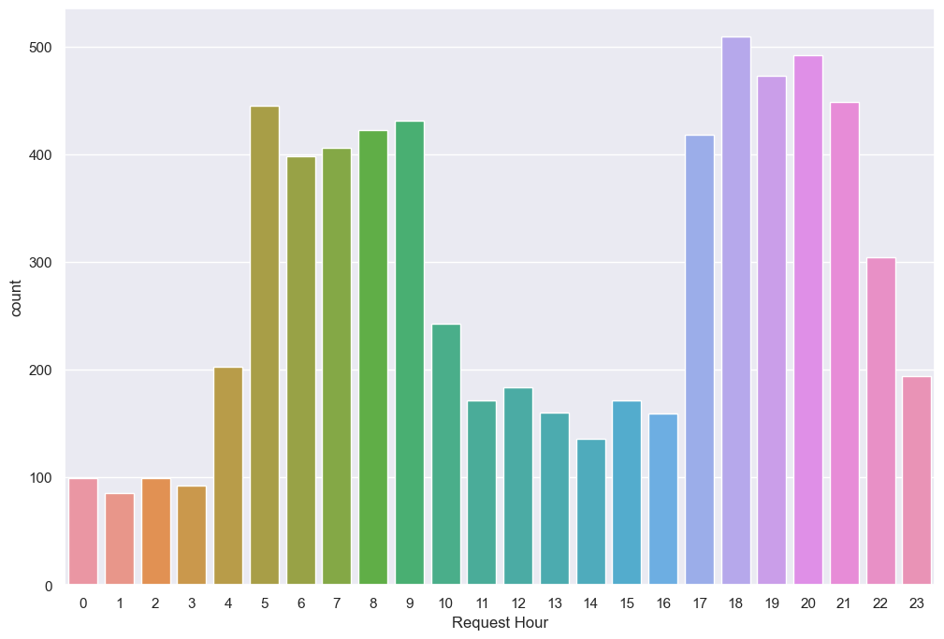
III. Analysis
All dates high request rates is around the same time: 5am to 9am and 5pm to 10 pm

Slide 6
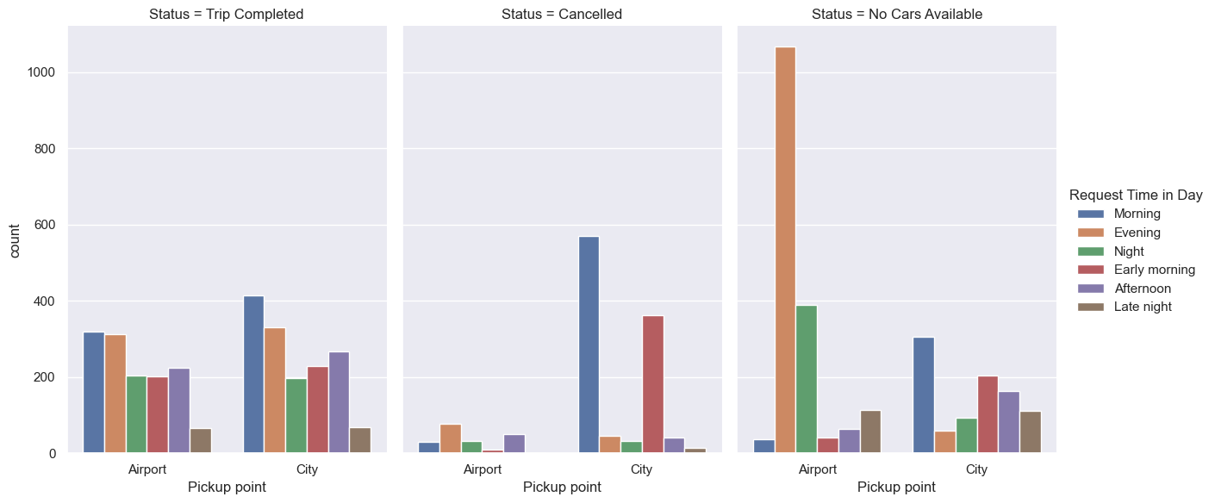
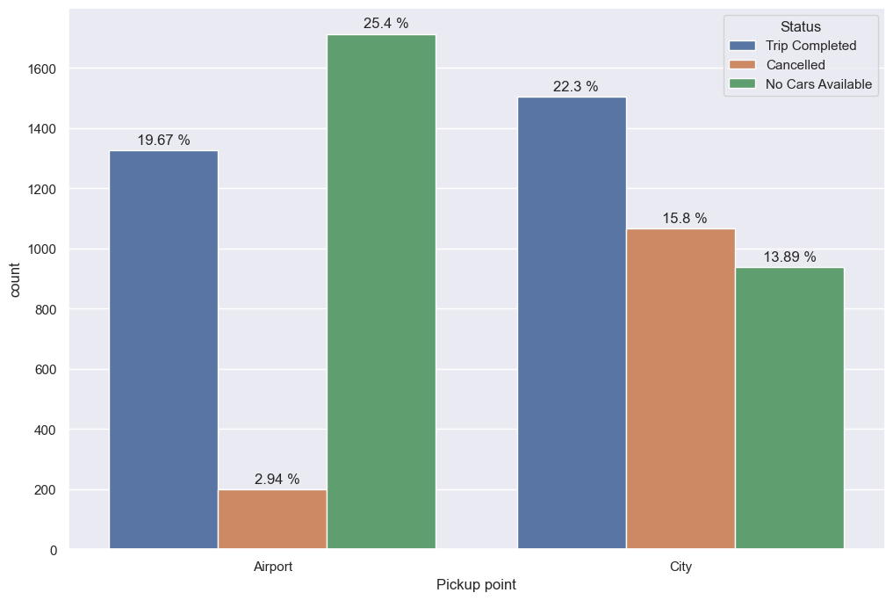
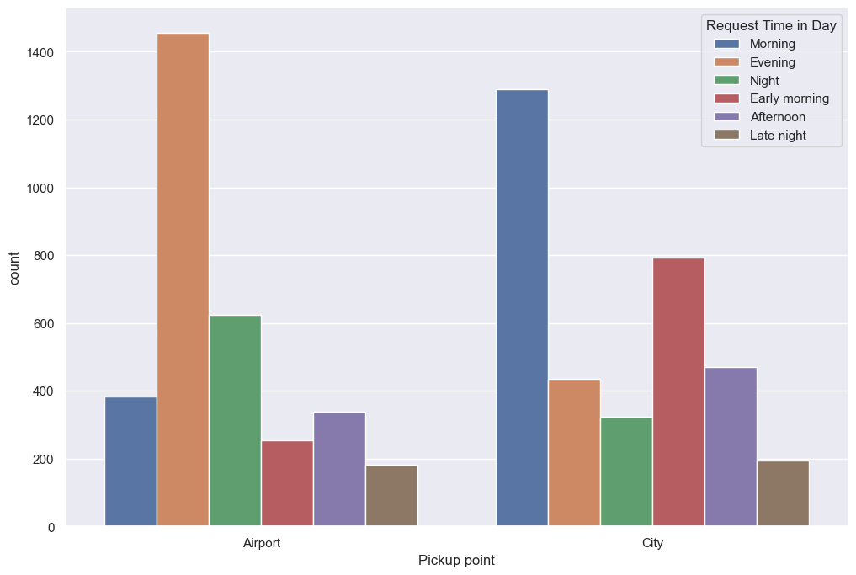
III. Analysis
Airport pickup point has most 'No car available'.
City pickup point has highest 'Cancelled' status
'Airport' - has the highest request in the 'evening' aligning to our 'no car available' status
'City'- has the highest request in the 'morning' aligning to our 'Cancelled' status.

Slide 7
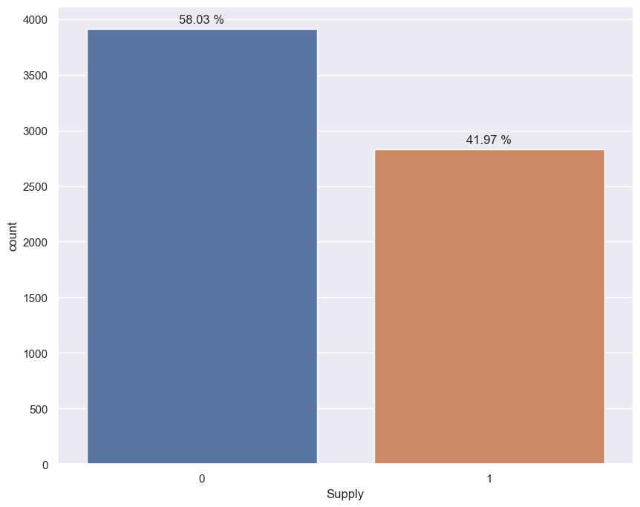
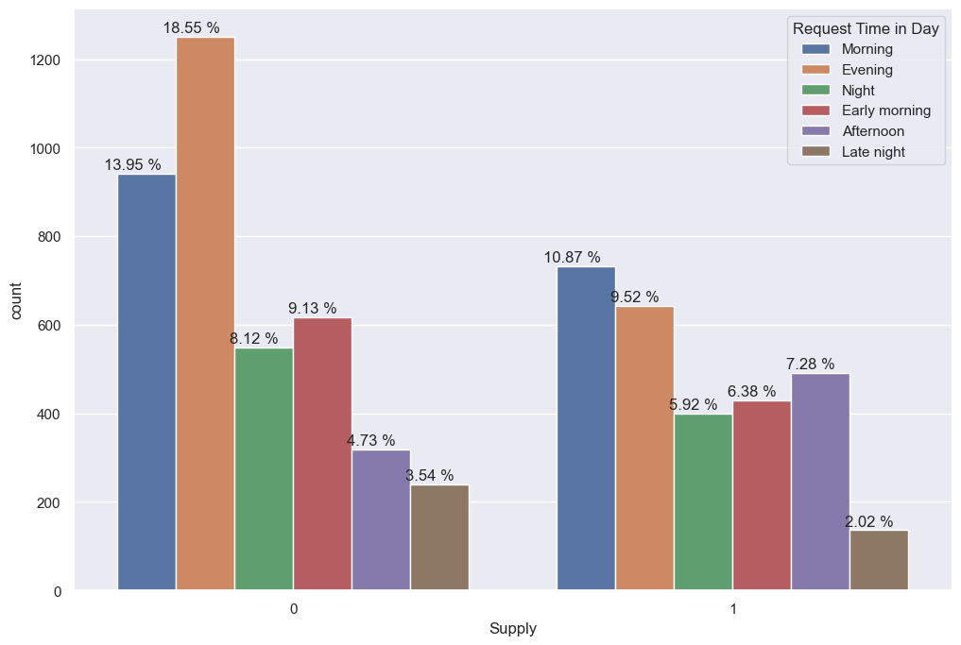
I. Abstract
From the total gap percentage(58.03%) -around 15% gap exist during morning and evenings.
The gap highest in the evening (18.55%) and morning (13.95%)

Slide 8
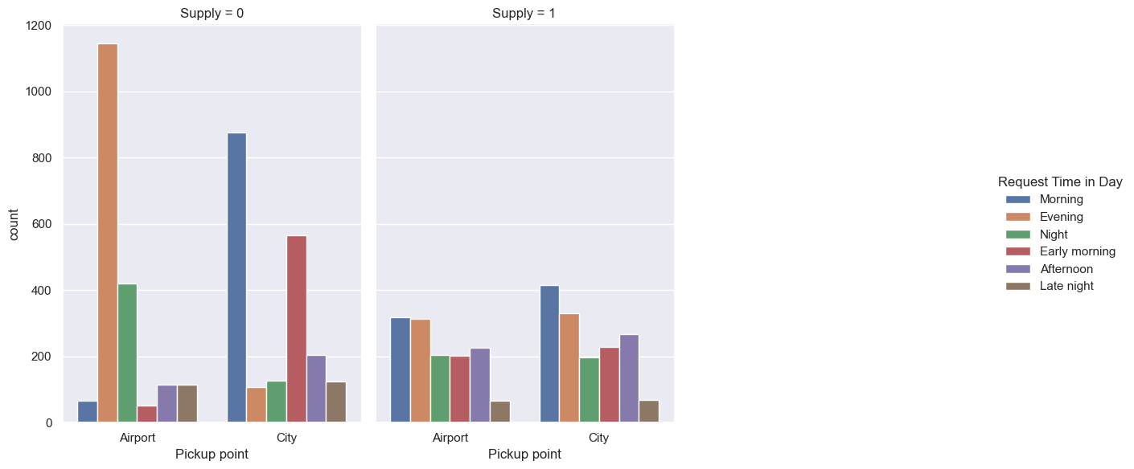
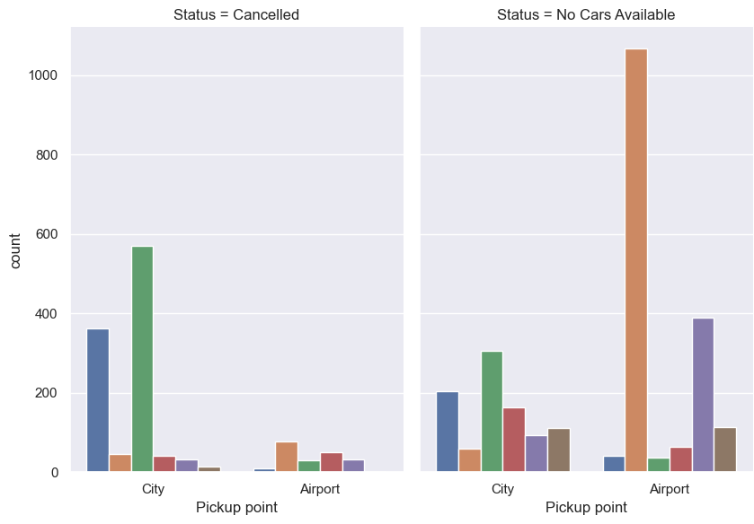
III. Analysis
Airport has highest gap at 17-21 hours which is evening hours, mostly due to “No car available”
City has highest gap at 7-12am hours which is morning hours, mostly due to “Cancelled”

Slide 9
IV. Reasons
The reason for the issue:
In the morning hours: Though there is high demand for cabs from city to airport, the vice versa is not true. Hence the driver tends to 'cancel' the request as getting a return trip from airport to city would be tough.
In the evening hours: Though there is high demand for cabs from airport to city, the vice versa is not true. Hence 'no cars available' in the airport is the hightest in the evening.
I. Abstract

Slide 10
V. Suggestions
Provide incentives for airport trips during peak time.
Assigning few extra cabs specially to the airport trips.
Fixing a base price for driver's idle time in the airport or to come back to the city without any passenger.
Impose penalty for cancellation of requests by the drivers. Set a threshold for the maximum cancellation per day.
Promote continuous trip to airport with incentives.
Promote advance booking to airports and at the same time keeping drivers updated will the flight schedule with help them plan their work and they can accept the request as per their work plan.

