Slide 1
Adaptive Debt Collection Routing
under Payment Uncertainty
MATHEMATICAL MODELLING PROJECT
Nguyen Thang Phuc (20252263M)
Dinh Thi Lan Huong (20261261M)
Supervisor: Prof. Viet Hung NGUYEN
Hanoi University of Science and Technology
November 2026
Notes:
Introduce the team and the topic: routing debt collection officers in Hanoi when payment outcomes are uncertain.

Slide 2
1. Introduction
Multi-officer, multi-day debt collection routing in Hanoi
A team of collection officers operates from a common branch over a finite planning horizon
Each customer has a target amount, an assumed payment probability, a service duration and a location
Daily routes start and end at the branch; travel + service time must fit the working hours
Customers may be revisited up to a maximum allowance; a collected amount is counted once
Objectives
Primary: maximize expected recovered money
Secondary: minimize total travel distance, preserving the primary value within a tolerance
Motivation
Nearby customers alone may miss larger recoveries; large debts alone may cause excessive travel or repeated failed visits.
Notes:
Explain the business setting and the two objectives. The motivation is the trade-off between distance and expected value.

Slide 3
2.1–2.2 Problem assumptions and notation
Assumptions
Symbol | Meaning
N, K, T | customers, officers, days
V = N ∪ {0} | nodes, 0 = branch
w_{i} | target amount (million VND)
p_{it} | payment probability
d_{ij}, τ_{ij} | distance (km), time (h); d_{ij} ≠ d_{ji}
s_{i} | service duration (h)
B_{kt} | working-time budget (8 h)
S_{i} | schedules {S ⊆ T : 1 ≤ |S| ≤ m_{i}}
v_{iS} | expected collection of schedule S
Success collects the full target w_{i}; failure collects nothing
p_{it}: payment probability on day t given no earlier payment; visits conditionally independent; p_{it} decreases with t
At most m_{i} = 2 visits, at most once per day, by one officer
Equal officer budgets; one route per active officer per day
A customer who has paid receives no further visits
Notes:
State the all-or-nothing payment assumption and the conditional probability p_it. The table lists the notation used in the model.

Slide 4
2.3–2.5 Decision variables, objective and constraints
x_{ijkt} arcs, y_{ikt} visits, z_{kt} route activation, λ_{iS} schedule selection, u_{ikt} MTZ positions
v_{iS} = w_{i} [1 − ∏_{t∈S} (1 − p_{it})]
Not additive over visits, so v_{iS} is precomputed for every schedule (H = 5, m_{i} = 2: 15 schedules)
max Z = Σ_{i∈N} Σ_{S∈S(i)} v_{iS} λ_{iS}
Secondary objective: keep Σ v_{iS} λ_{iS} ≥ Z* − ε max(1, |Z*|), ε = 10⁻⁶, and minimize Σ d_{ij} x_{ijkt}
Constraints (5)–(13)
Σ_{S} λ_{iS} ≤ 1 | one schedule
Σ_{k} y_{ikt} = Σ_{S} a_{tS} λ_{iS} | schedule ↔ visits
Σ_{j} x_{0jkt} = Σ_{i} x_{i0kt} = z_{kt} | branch
in-arcs = out-arcs = y_{ikt} | flow
Σ τ_{ij} x_{ijkt} + Σ s_{i} y_{ikt} ≤ B_{kt} z_{kt} | budget
MTZ (10)–(11) | subtours
z_{kt} ≥ z_{k+1,t} | symmetry
Notes:
The key modelling choice: expected collection is not additive over visits, so we select whole visit schedules with precomputed values. Then the routing constraints with MTZ subtour elimination.

Slide 5
2.6 Rolling-horizon operation
Payment outcomes are revealed day by day
State at the start of day t: paid customers P_{t} and visits made a_{it}; eligible A_{t} = {i ∉ P_{t}, a_{it} < m_{i}}
Static
Rolling horizon
Myopic
Executes the initial plan for the whole horizon; skips customers who have already paid, without inserting new ones
Each morning solves the remaining problem (customers A_{t}, days t, …, H, allowances m_{i} − a_{it}), executes only day t
Re-plans each morning but optimizes day t only (H = 1)
p_{it} is not re-estimated: it is already conditional on no earlier payment
The rolling horizon is not a fully adaptive stochastic model: each re-solve assumes no further re-planning
Notes:
Three operating policies. Static executes the plan, rolling horizon re-solves the remaining horizon each morning, myopic only plans today.

Slide 6
3. Solution methods
3.1 MILP with HiGHS
Metaheuristics (max 300 iterations, stop after 50 without improvement)
JuMP + HiGHS branch-and-cut; stops at gap 10⁻⁴ or time limit
Warm start: ALNS solution passed as MIP start; ALNS returned if HiGHS does not beat it (6 of 70 five-day runs)
GA: population 80, tournament 3, uniform crossover, mutation 0.03, elitism 4
Tabu search: greedy start by w_{i} p_{it} / (s_{i} + τ_{0i} + τ_{i0}); 40 sampled moves; tenure 15; aspiration
ALNS: removes ≈20% of visits; 4 destroy (random, worst-value, related, route), 2 repair (greedy, regret-2); roulette weights; simulated annealing acceptance
Shared heuristic framework
Assignment matrix G ∈ {0, …, |K|}^{n×H}
Route per officer-day: nearest neighbour + 2-opt on the asymmetric distance
Repair: keep m_{i} best days; drop smallest marginal loss until B_{kt} fits
Lexicographic comparison: Z first, then distance
Notes:
One exact approach and three metaheuristics sharing the same solution encoding and repair.

Slide 7
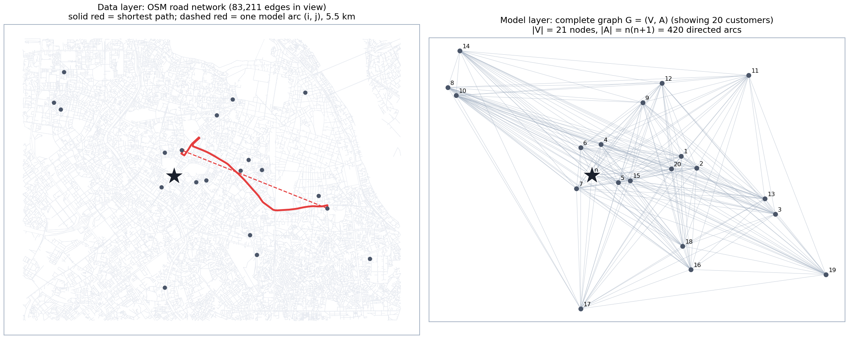
4.1 Dataset and test instances
Observed public data: OpenStreetMap road network, wards, populations, buildings, branch POI; graph of 57,242 nodes and 130,220 directed edges (6.6% one-way). Profiles from NVIDIA Nemotron-Personas-Vietnam.
Synthetic / assumed: locations by ward population; card shapes from UCI; p_{it} = h p₀(g)(1 − 0.3f_{i})(1 − δ(g))^{t−1}, h = 0.5/1/1.5. Instances n = 10–80, |K| = 2, B_{kt} = 8 h, m_{i} = 2.
Notes:
Two layers: the real OSM road network gives distances and times; the model works on a complete asymmetric graph. Separate what is observed from what is assumed.

Slide 8
4.5 Algorithm comparison
Mean gap over 10 runs (seed 2026+r); Phase 1 one day (30 s), Phase 2 five days (150 s)
Phase 2 | n = 30 | n = 50 | n = 80
HiGHS (gap %) | 0.00 | 1,264 | 16,594
HiGHS warm | 0.00 | 0.08 | 0.38
GA | 0.00 | 0.16 | 1.59
Tabu | 0.00 | 0.17 | 1.09
ALNS | 0.00 | 0.08 | 0.38
ALNS time (s) | 3.14 | 8.03 | 31.79
Tabu time (s) | 2.72 | 4.30 | 6.27
Up to 30 customers HiGHS proves optimality (10/10) and all metaheuristics find the same value
From n = 50 HiGHS hits the time limit after ≤ 4 nodes; its incumbent is poor but its bound is informative (heuristics within 0.1–3.7%)
ALNS: smallest gap and shortest routes; Tabu: fastest; 5× budget does not change the ranking
Notes:
Cold HiGHS gaps explode from n = 50 because of a poor incumbent, so they are left out of the chart. ALNS gives the smallest gap; Tabu is the fastest.

Slide 9
4.6 Static and rolling-horizon comparison
INS_S (n = 80), 20 common payment scenarios; difference vs static, million VND [95% CI]
Scenario | Method | Static | Rolling horizon | Myopic | km (R / M)
Low | ALNS | 283.51 | +4.9 [−3.0, 12.8] | +5.7 [−0.6, 11.9] | −5% / −12%
 | Tabu | 274.71 | +9.7 [−0.3, 19.8] | +14.3 [−2.3, 31.0] | −6% / −17%
Base | ALNS | 514.38 | +2.3 [−4.3, 8.8] | −6.4 [−21.1, 8.3] | −9% / −17%
 | Tabu | 490.49 | +4.4 [−13.2, 22.0] | +19.9 [3.7, 36.2] | −6% / −17%
High | ALNS | 735.90 | +4.9 [−8.1, 18.0] | −2.5 [−23.4, 18.4] | −8% / −16%
 | Tabu | 687.06 | +12.5 [−13.4, 38.4] | +47.7 [20.9, 74.4] | −7% / −19%
With ALNS
With Tabu
Rolling horizon collects 0.4–1.7% more (no CI excludes 0) and travels 5–9% less
Myopic re-planning collects significantly more in base and high scenarios (16/20): re-planning matters most when the plan it replaces is weak
Notes:
Highlighted cells are the only confidence intervals that exclude zero. Re-planning helps most when the original plan is weak.

Slide 10
5. Conclusion
Three lessons
A fast heuristic re-run every morning can replace a strong one run once: Tabu with myopic re-planning collected within 2% of the static ALNS plan, with 8–12% less travel and 5–10 times less computation.
The difficulty comes from linking the days: with 30 customers the one-day problem is solved at the root node, the five-day one needs 56 nodes; a decomposition by day is the natural way to scale.
HiGHS fails at finding good integer solutions, not at bounding: heuristic for the plan, MILP bound as its quality certificate.
Limitations and next steps
Synthetic accounts; p_{it} not calibrated; no congestion; full-or-nothing payments; up to 80 customers, two officers, 20 payment scenarios. Next: 100 scenarios on INS_M and INS_L; stronger subtour cuts or decomposition by day.
Notes:
Close with the three lessons and be honest about limitations.

Slide 11
THANK YOU!
Questions & discussion
github.com/PhucNT2511/Mathematic-modeling-project

