Slide 1
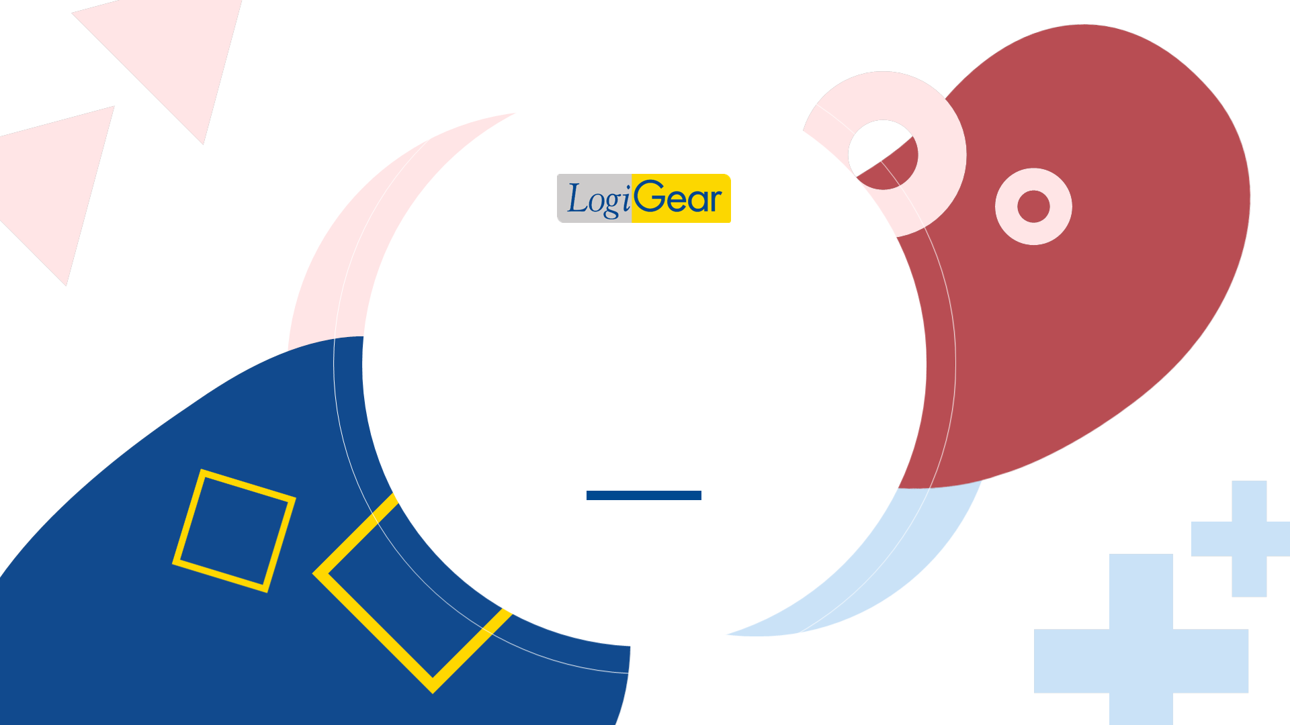
LOGIGEAR CERTIFIED TEST PROFESSIONAL I
BASIC SOFTWARE TESTING SKILLS

Slide 2
Agenda
Chapter 1: Software Development Life Cycles and Testing
Chapter 2: Software Testing Overview
Chapter 3: Test Requirements
Chapter 4: Test Design Techniques
Chapter 5: Working with a Test Case Management System
Chapter 6: Software Error
Chapter 7: Working with a Bug Management System
Chapter 8: Reporting Progress: Status Report
Chapter 9: Introduction to Mobile Application Testing
2

Slide 3
CHAPTER 1
Software Development Lifecycles (SDLC) and Testing
3

Slide 4
CHAPTER 1
SDLC and Testing
Waterfall Model
Spiral Model
V-Model
Concurrent Model
Agile Model
Other SDLC Models
Testing Phases and Milestones
DevOps and CI/CD
4
Notes:
In this chapter, we want to give an overview of various software development life cycles (SDLC). This is essential to software testing because with each type of SDLC comes with a different style of how software is developed. With each style, it requires different method of communication and documentation. Therefore, it will affect the software testing activities, when what test activities will begin.
Another very essential concept in this chapter is how test phases and milestone are defined and enforced. If the phases and milestone not well defined and rigorously enforced, then the SDLC is meaningless. More will be discussed later.

Slide 5
OBJECTIVES
An introduction to Common Software Development Life Cycle (SDLC) practices and how software testing fits in those contexts.
Understanding testing phases, milestones, checkpoints in a SDLC and their purposes
Learn about how each SDLC choice affects software testing and its implementation
Learn about DevOps and CI/CD
5
Notes:
The objectives in this slide speak for themselves. Not only we will describe each SDLC but we will also stress how software testing fits in each development style.
As indicated earlier, we have to clearly understand the phases and milestones concept (through clear and enforceable definitions). From there, we will institute checkpoints to qualify that the software is indeed reaches or passes the predefined phases and/or milestone.
Then we will discuss the implication on each SDLC on software testing activities.

Slide 6
SDLC and Testing
1.1- SDLC and Testing
1.2- Waterfall Model
1.3- Spiral Model
1.4- V-Model
1.5- Concurrent Model
1.6- Agile Model
1.7- Other SDLC Models
1.8- Testing Phases and Milestones
1.9- DevOps and CI/CD
6
Notes:
Khi phát triển phần mềm, người ta cần làm theo một life cycle cụ thể vì:
Một ứng dụng phần mềm rất lớn (nhiều source code), hay 1 software application cũng có thể integrate với nhiều application khác => việc xây dựng và quản lý phần mềm trở nên rất phức tạp
Mô hình phát triển phần mềm được dùng để quản lý các tài nguyên và con người (mọi người tham gia xây dựng phần mềm biết mình đang ở đâu, cần làm gì trong quá trình phát triển phần mềm)
Mỗi loại life cycle có một đặc điểm riêng, việc kiểm thử phần mềm trong các life cycle vì thế cũng khác nhau.
Ở các slide sau, chúng ta sẽ tìm hiểu việc kiểm thử phần mềm trong các các dự án dùng life cycles khác nhau thì khác nhau như thế nào.

Slide 7
SDLC and Testing
How testing is directly affected by the SDLC choice:
Documentation availability to test against
Time to test
Time to automate or produce effective automation
Knowledge and understanding of the application as we plan our tests
Amount of regression testing
7
Notes:
Khi phát triển phần mềm, người ta cần làm theo một life cycle cụ thể vì:
Một ứng dụng phần mềm rất lớn (nhiều source code), hay 1 software application cũng có thể integrate với nhiều application khác => việc xây dựng và quản lý phần mềm trở nên rất phức tạp
Mô hình phát triển phần mềm được dùng để quản lý các tài nguyên và con người (mọi người tham gia xây dựng phần mềm biết mình đang ở đâu, cần làm gì trong quá trình phát triển phần mềm)
Mỗi loại life cycle có một đặc điểm riêng, việc kiểm thử phần mềm trong các life cycle vì thế cũng khác nhau.
Ở các slide sau, chúng ta sẽ tìm hiểu việc kiểm thử phần mềm trong các các dự án dùng life cycles khác nhau thì khác nhau như thế nào.

Slide 8
SDLC and Testing
1.1- SDLC and Testing
1.2- Waterfall Model
1.3- Spiral Model
1.4- V-Model
1.5- Concurrent Model
1.6- Agile Model
1.7- Other SDLC Models
1.8- Testing Phases and Milestones
1.9- DevOps and CI/CD
8
Notes:
Trong phần này chúng ta sẽ tìm hiểu sự cần thiết của việc kiểm thử phần mềm và cách kiểm thử phần mềm trong các dự án dùng mô hình waterfall

Slide 9
Waterfall Model
Requirements Definition
verify
Functional Design
verify
Technical Design
The Waterfall model is a sequential software development model.
Transition between phases is done by a formal review.
The review is a checkpoint to see that you are on the right track.
verify
Coding
verify
Testing
verify
Deployment
9
Notes:
REMINDING:
What is waterfall model? The waterfall model is a sequential software development model which no overlapping phases. One phase does not start until the previous phase is completed and documents are stored in document control.
How does it make transition between phases? Transition between phases is done by a formal review. When a phase is done, it cannot be modified anymore.
What is the purpose of checkpoints? The review is a checkpoint to see that you are on the right track

Slide 10
Testing in Waterfall Model
Testing is not inherent to every phase of the Waterfall model.
Constant testing from the design, implementation and verification phases is required to validate the phases preceding them.
Testing phase: Only after coding phase, software testing begins. Different testing methods are available to detect the bugs that were committed during the previous phases. A number of testing tools and methods are already available for testing purposes.
10
Notes:
Where does testing involve?
Testing phase is related with Coding and Deployment phases. The testing phase starts after code generation phase. As a tester in this phase, you use several testing methods and testing types to test the software and report your working progress to your QA
When a new version is released, the testing phase finds bugs of this version. This task is repeated with all versions until the application comes into deployment phase.
Testing also takes care the application when it comes into the deployment phase by user acceptance testing, testing the product system and maintenance.
We will learn more about these in later slides.
Actually in waterfall there is no feedback that is why it is theory and not done.
Document heavy process. It the SDLC is waterfall style, all/most testing is verification directly from documentation. Common- especially in companies tied to test director/quality center.
Waterfall is back end testing. Expensive. Change is very risky. “test in quality” is bad. Build in Quality is good.
WHY IS TESTING NECESSARY IN WATERFALL MODEL?
Các phase trong waterfall do nhiều người đảm nhận và hoạt động gần như độc lập với nhau
Khi một phase kết thúc, phase sau sẽ lấy kết quả của phase trước để làm tiếp. Nếu phase trước làm sai, việc sửa chữa gần như là không thể
Ở waterfall, việc testing được thực hiện ở một phase sau khi code, việc phát hiện bug ở giai đoạn này là khá trễ và vì thế sửa rất tốn kém
Ngày nay, waterfall không được áp dụng rộng rãi trong việc phát triển phần mềm vì không phù hợp với bản chất của việc xây dựng phần mềm vốn nhiều bug, bug có thể xảy ra ở mọi nơi và cần được test càng sớm càng tốt.
Waterfall thích hợp với việc sản xuất hardware hơn do tính chất của việc sản xuất hardware đòi hỏi tính chính xác cao và khó sửa lỗi
Ngày nay, khi sử dụng waterfall, người ta cải tiến nó (cũng như cải tiến các loại mô hình khác) bằng cách thêm vào sự xuất hiện của QA. QA sẽ quản lý toàn bộ quy trình phát triển phần mềm về mặt chất lượng, đảm bảo từng phase trong mô hình làm đúng chức năng đã đề ra nhằm đạt được mục tiêu cao nhất là sản xuất được phần mềm đúng với yêu cầu, chất lượng cao thỏa mãn đông đảo người dùng.
QA làm việc chặt chẽ với những người tham gia trong từng phase.
Ngày nay, người ta cải tiến sự hạn chế của waterfall (thiếu sự liên lạc giữa các phase và ít test tại các phase đầu tiên) để có thể sử dụng nó hiệu quả hơn. QA does the constant testing from the design, implementation and verification phases is required to validate the phases preceding them.
General opinions:
Advantages: The SDLC appears to be very structured. In theory, it will be easily manage through a lot of documentations and checkpoints. You cannot start the next phase until the current phase is complete.
Disadvantages: This style requires a lot of documentation up front. The more time you do documentation the less time you have for design, code and testing. It is also very critical to changes while we known that software will change, the design will changes, and coding will change as we learn more about the software while we progress through each step of the way.

Slide 11
SDLC and Testing
1.1- SDLC and Testing
1.2- Waterfall Model
1.3- Spiral Model
1.4- V-Model
1.5- Concurrent Model
1.6- Agile
1.7- Other SDLC Models
1.8- Testing Phases and Milestones
1.9- DevOps and CI/CD
11

Slide 12
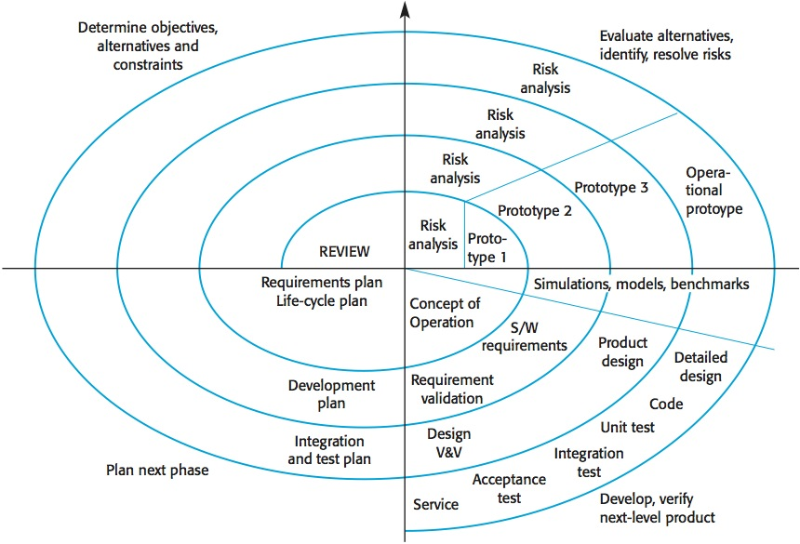
Spiral Model
12
Notes:
REMINDING:
The spiral model is a software development process combining elements of both design and prototyping-in-stages, in an effort to combine advantages of top-down and bottom-up concepts.
Each cycle is completed by a review. This review covers all products developed during the previous cycle, including the plans for the next cycle and the resources required to carry them out. The review’s major objective is to ensure that all concerned parties are mutually committed to the approach for the next phase.
Notes: This model of development combines the features of the prototyping model and the waterfall model. The spiral model is intended for large, expensive and complicated projects.
A typical cycle of the spiral
Each cycle of the spiral begins with the identification of:
1. the objectives of the portion of the product being elaborated (performance, functionality, ability to accommodate change, etc.);
2. the alternative means of implementing this portion of the product (design A, design B, reuse, buy, etc.); and
3. the constraints imposed on the application of the alternatives (cost, schedule, interface, etc.).
Each cycle is completed by a review. This review covers all products developed during the previous cycle, including the plans for the next cycle and the resources required to carry them out. The review’s major objective is to ensure that all concerned parties are mutually committed to the approach for the next phase
The steps in the spiral model can be generalized as follows:
1. The new system requirements are defined in as much detail as possible. This usually involves interviewing a number of users representing all the external or internal users and other aspects of the existing system.
2. A preliminary design is created for the new system.
3. A first prototype of the new system is constructed from the preliminary design. This is usually a scaled-down system, and represents an approximation of the characteristics of the final product.
4. A second prototype is evolved by a fourfold procedure:
- evaluating the first prototype in terms of its strengths, weaknesses, and risks;
- defining the requirements of the second prototype;
- planning and designing the second prototype;
- constructing and testing the second prototype.
Advantages: The spiral model promotes quality assurance through prototyping at each stage in systems development. This is a improved version of waterfall that allows iterations of smaller phases.
Disadvantages: Documentation is still heavily required in this style.

Slide 13
Testing in Spiral Model
Planned and structured releases
Usually has documentation to test against
Each spiral iteration can be thought of as a “mini-waterfall”; there are defined testing phases
Previous releases must be regression tested
13
Notes:
Notice of the point that testing phases are defined. This is essential to testing time as indicated earlier.
Also notice that as we progress through test testing phase, not only that we run new tests but we also have to rerun old tests. Rerun old tests by definition is regression testing.

Slide 14
SDLC and Testing
1.1- SDLC and Testing
1.2- Waterfall Model
1.3- Spiral Model
1.4- V-Model
1.5- Concurrent Model
1.6- Agile Model
1.7- Other SDLC Models
1.8- Testing Phases and Milestones
1.9- DevOps and CI/CD
14

Slide 15
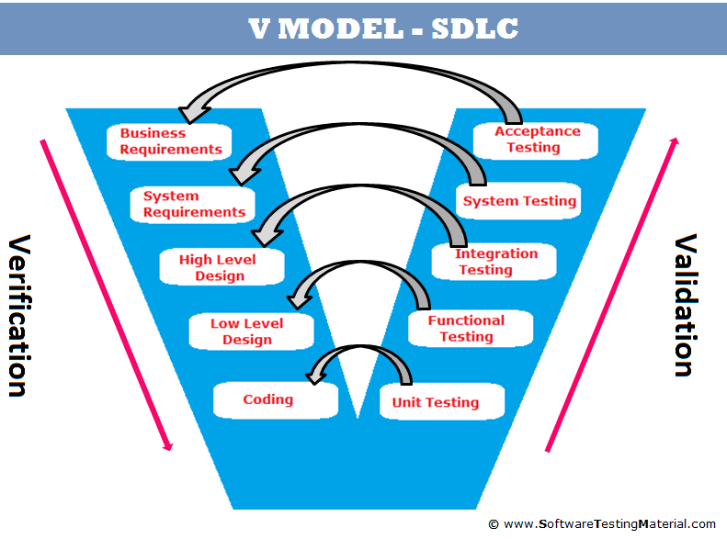
V-Model
15
Notes:
REMINDING:
V-model is a software development process which can be presumed to be the extension of the waterfall model. Instead of moving down in a linear way, the process steps are bent upwards after the coding phase, to form the typical V shape. The V-Model demonstrates the relationships between each phase of the development life cycle and its associated phase of testing.
The V-model deploys a well-structured method in which each phase can be implemented by the detailed documentation of the previous phase. Testing activities like test designing start at the beginning of the project well before coding and therefore saves a huge amount of the project time.
Note:
While this style is another improved version of waterfall, it brings in the clarity of Verification and Validation, both are quality engineering activities including testing.

Slide 16
Testing in V-Model
Validation: The assurance that a product, service, or system meets the needs of the customer and other identified stakeholders. (PMBOK Guide)
Verification: The evaluation of whether or not a product, service, or system complies with a regulation, requirement, specification, or imposed condition. (PMBOK Guide)
Do right things >> Validation
Do things right >> Verification
16
Notes:
Khác nhau giữa verification and validation:
VD: Khi đặt hàng, nhận hàng sẽ kiểm:
Đúng hàng không (verification) – the right product is built
Hàng có được làm đúng cách hay không (validation) – the (right) feature is working correctly or not (finding bug)
I. Verification Phase
1. Requirements analysis
In the Requirements analysis phase, the requirements of the proposed system are collected by analyzing the needs of the user(s). This phase is concerned about establishing what the ideal system has to perform. However it does not determine how the software will be designed or built. Usually, the users are interviewed and a document called the user requirements document is generated.
The user requirements document will typically describe the system’s functional, physical, interface, performance, data, security requirements etc as expected by the user. It is one which the business analysts use to communicate their understanding of the system back to the users. The users carefully review this document as this document would serve as the guideline for the system designers in the system design phase. The user acceptance tests are designed in this phase. See also Functional requirements, and Non-functional requirements
2. System Design
Systems design is the phase where system engineers analyze and understand the business of the proposed system by studying the user requirements document. They figure out possibilities and techniques by which the user requirements can be implemented. If any of the requirements are not feasible, the user is informed of the issue. A resolution is found and the user requirement document is edited accordingly.
The software specification document which serves as a blueprint for the development phase is generated. This document contains the general system organization, menu structures, data structures etc. It may also hold example business scenarios, sample windows, reports for the better understanding. Other technical documentation like entity diagrams, data dictionary will also be produced in this phase. The documents for system testing is prepared in this phase.
3. Architecture Design
The phase of the design of computer architecture and software architecture can also be referred to as high-level design. The baseline in selecting the architecture is that it should realize all which typically consists of the list of modules, brief functionality of each module, their interface relationships, dependencies, database tables, architecture diagrams, technology details etc. The integration testing design is carried out in this phase.
4. Module Design
The module design phase can also be referred to as low-level design. The designed system is broken up in to smaller units or modules and each of them is explained so that the programmer can start coding directly. The low level design document or program specifications will contain a detailed functional logic of the module, in pseudocode - database tables, with all elements, including their type and size - all interface details with complete API references- all dependency issues- error message listings- complete input and outputs for a module. The unit test design is developed in this stage.
II. Validation Phases
1. Unit Testing
In the V-model of software development, unit testing implies the first stage of dynamic testing process. According to software development expert Barry Boehm, a fault discovered and corrected in the unit testing phase is more than a hundred times cheaper than if it is done after delivery to the customer.
It involves analysis of the written code with the intention of eliminating errors. It also verifies that the codes are efficient and adheres to the adopted coding standards. Testing is usually white box. It is done using the Unit test design prepared during the module design phase. This may be carried out by software testers, software developers or both.
2. Integration Testing
In integration testing the separate modules will be tested together to expose faults in the interfaces and in the interaction between integrated components. Testing is usually black box as the code is not directly checked for errors. It is done using the integration test design prepared during the architecture design phase. Integration testing is generally conducted by software testers.
3. System Testing
System testing will compare the system specifications against the actual system. The system test design is derived from the system design documents and is used in this phase. Sometimes system testing is automated using testing tools. Once all the modules are integrated several errors may arise. Testing done at this stage is called system testing.
4. Final Implementation in Production

Slide 17
SDLC and Testing
1.1- SDLC and Testing
1.2- Waterfall Model
1.3- Spiral Model
1.4- V-Model
1.5- Concurrent Model
1.6- Agile Model
1.7- Other SDLC Models
1.8- Testing Phases and Milestones
1.9- DevOps and CI/CD
17

Slide 18
Concurrent Model
Analysis activity
None
Under
development
Awaiting
changes
Under
review
Under
revision
Baselined
Done
All activities concurrent but reside in different states
18
Notes:
REMINDING:
The concurrent development model is also called as concurrent engineering.
Concurrent process model can be represented schematically as a series of major technical activities, tasks and their associates states
Concurrent process model defines a series of events that will trigger transactions from one state to another for each of the activities in s/w engineering.
Note:
This model or style is introduced for completeness of the overall SDLC concept. Many software development teams are, nowadays, move to Agile as an improvement of the concurrent model. There is no need to worry too about this model/style.

Slide 19
Testing in Concurrent Model
Planning is concurrent to design; design is concurrent to development—everything is happening at the same time.
The whole project is not well planned or well structured.
Planning, design and development are most dynamic. Product is in constant change. Very difficult to test; impossible to effectively plan testing project.
Often no documentation to test against. Testing is ad hoc.
Coverage usually cannot be measured. Structured regression testing is impossible.
Bugs will be missed because of so much change and so little planning.
Risk analysis and reporting is crucial.
19
Notes:
Note:
Due to the dynamic nature of how the software is defined, designed and developed, it becomes a challenge for testing to effectively involve during the development cycle.
In this style, testing is often done at the backend as system testing.

Slide 20
SDLC and Testing
1.1- SDLC and Testing
1.2- Waterfall Model
1.3- Spiral Model
1.4- V-Model
1.5- Concurrent Model
1.6- Agile Model
1.7- Other SDLC Models
1.8- Testing Phases and Milestones
1.9- DevOps and CI/CD
20

Slide 21
Agile Model
Key principles of Agile:
Top priority is customer satisfaction
Welcome changing requirements, even late in the project
Deliver working software frequently
Business and development people should work together daily
Communicate face-to-face, whenever possible
Working software is the primary measure of progress
Teams constantly reflect on how to improve their processes and methods
(From http://www.agilemanifesto.org/principles.html)
21

Slide 22
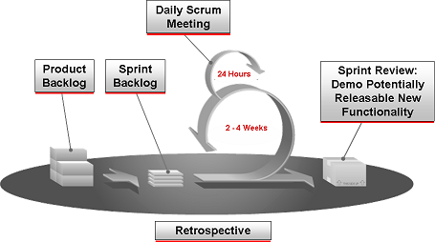
Agile Model
22

Slide 23
Agile Model
What is User Story?
User Story is a story about how the system is supposed to solve a problem or support a business process
A user story is a very high-level definition of a requirement, containing just enough information collected from client so that the developers can implement it.
User stories are simple enough that people can understand easily
Each User Story is written on a User Card (by collecting from client directly), stored in full documents or an ALM tool such as Rally, TFS or IBM Rational.
23
Notes:
23
ALM Tool: Application Lifecycle Management

Slide 24
Agile Model
Acceptance Criteria
An acceptance criterion is a set of accepted conditions or business rules which the functionality or feature should satisfy and meet, in order to be accepted by the Product Owner/Stakeholders.
Acceptance criteria define the boundaries of a user story, and are used to confirm when a story is completed and working as intended.
24
Notes:
24

Slide 25
Testing in Agile Model
Delivery cycles are short. Development is very focused. Diagrams, use cases, user stories, index cards, or discussions of functionality serve as “documentation” to test against.
Agile projects usually have more unit testing by developers.
Dynamic nature of development needs structured regression testing.
Testing is often exploratory, but focused.
Dynamic style or projects include much change but the change is discussed and side-effects noted.
25
Notes:
Note:
Do not confused developer-testing or unit testing as system testing. Developer-testing or unit testing is aimed to improve the quality of the code (at the coding level) delivered to QA. However, more testing must be done to validate the individual functionality as well as how the software works as a whole.
Test must be designed, often before the working functionalities are available for testing. Testing cycles are short.
While testing is exploratory or ad-hoc by nature, combining flexibility with structured testing and automation is essential.
(Automated) Regression testing is another essential element of testing in Agile style. Automated regression testing is implemented at two levels: Unit testing (designed and implemented by developers, run and rerun by developers as well as testers) and system testing (designed, implemented, run and rerun by testers).

Slide 26
SDLC and Testing
1.1- SDLC and Testing
1.2- Waterfall Model
1.3- Spiral Model
1.4- V-Model
1.5- Concurrent Model
1.6- Agile Model
1.7- Other SDLC Models
1.8- Testing Phases and Milestones
1.9- DevOps and CI/CD
26

Slide 27
Other SDLC Models
Rapid Application Development (RAD) Model
TDD – Test Driven Development, an XP practice
eXtreme Programming (XP)
Kanban
Lean Software Development (LSD)
…the list goes on
27
Notes:
Reality check:
As we are wrapping up the introduction of the SDLC models, it is essential to know that many software development organizations, they might say that the are applying certain model, in reality, they might be loosely apply the concept of that model. The most important fact is to determine how much time we have for testing, and when can we start doing what testing activities.
That brings us to the next topic which is the most important topic as it affect testing time in each SLDC model.
LSD: https://en.wikipedia.org/wiki/Lean_software_development

Slide 28
SDLC and Testing
1.1- SDLC and Testing
1.2- Waterfall Model
1.3- Spiral Model
1.4- V-Model
1.5- Concurrent Model
1.6- Agile Model
1.7- Other SDLC Models
1.8- Testing Phases and Milestones
1.9- DevOps and CI/CD
28

Slide 29
Phases & Milestones
Development Phase: A time block within SDLC. There are a number of activities that have to be done in this time block.
Examples of some Test Phases: Unit Test, Integration Test, System Test, User Acceptance Test, Release Test and Maintenance Test.
Development Milestone: A significant event in the software developing process in which, the software moves from one phase to another. The milestone let us know where the application is in SDLC
Criteria: Built or created from the standard of the project.
29
Notes:
REMINDING: Các giai đoạn và cột mốc trong quá trình phát triển phần mềm
VD về 1 phase: Quá trình học đại học là 4 năm (1 SDLC), thì năm đầu tiên sẽ là 1st phrase…Trong năm học đầu tiên đó bạn sẽ trải qua nhiều hoạt động ví dụ như nghe giảng bài, làm bài tập, nghiên cứu…để có thể thi đỗ kỳ thi kết thúc năm học thứ nhất. Cái mốc chuyển từ năm thứ nhất sang năm thứ 2 được xem như 1 milestone.
Milestone giúp chúng ta quản lý các phases.
Để pass được 1 milestone, phần mềm phải đạt một chuẩn nào đó, được gọi là criteria (Cũng như muốn kết thúc năm nhất, pass được qua năm thứ 2, sinh viên phải được trên 5 tất cả các môn thi chẳng hạn).

Slide 30
Testing Phases and Milestones
Test Phase | Pre – Alpha | Alpha | Beta | GM/Release
 | Unit | Integration | System | User Acceptance
Performed by | Developers | Developers/(Technical) Testers | Testers | Users
Definition | Test one unit of code at a time | Iteratively more complex system components integrated. Checking the units of code work together incrementally | Big bang. The entire product as it is intended to be used | Requirements-based testing by the project sponsor, testing the production system
Outcome | Fewer Bugs | Bug Finding | Bug Finding/QC | QC
Goals of Testing | To validate each module in isolation | To find bugs, to learn about the product, to validate the integration requirements | To find bugs, to validate the system requirements, data flow, scenarios, load | To validate user requirements
30

Slide 31
SDLC and Testing
1.1- SDLC and Testing
1.2- Waterfall Model
1.3- Spiral Model
1.4- V-Model
1.5- Concurrent Model
1.6- Agile Model
1.7- Other SDLC Models
1.8- Testing Phases and Milestones
1.9- DevOps and CI/CD
31

Slide 32
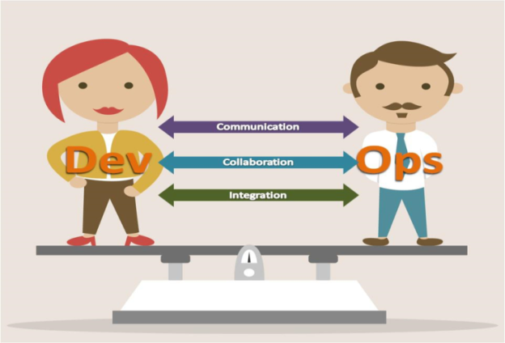
DevOps Overview
DevOps = “software DEVelopment” and “OPerationS”
DevOps is a software engineering culture and practice that aims at unifying software development (Dev) and software operation (Ops). The main characteristic of the DevOps movement is to strongly advocate automation and monitoring at all steps of software construction, from integration, testing, releasing to deployment and infrastructure management.
DevOps aims at shorter development cycles, increased deployment frequency, and more dependable releases, in close alignment with business objectives.
32
Notes:
The DevOps movement started to coalesce some time between 2007 and 2008, when IT operations and software development communities got vocal about what they felt was a fatal level of dysfunction in the industry.
They railed against the traditional software development model, which called for those who write the code to be organizationally and functionally apart from those who deploy and support that code.
Developers and IT/Ops professionals had separate (and often competing) objectives, separate department leadership, separate key performance indicators by which they were judged, and often worked on separate floors or even separate buildings. The result was siloed teams concerned only with their own fiefdoms, long hours, botched releases, and unhappy customers.
Surely there’s a better way, they said. So the two communities got together and started talking – with people like Patrick Dubois, Gene Kim, and John Willis driving the conversation.
What began in online forums and local meet-ups is now a major theme in the software zeitgeist, which is probably what brought you here! You and your team are feeling the pain caused by siloed teams and broken lines of communication within your company.
You’re using agile methodologies for planning and development, but still struggling to get that code out the door without a bunch of drama. You’ve heard a few things about DevOps and the seemingly magical effect it can have on teams and think “I want some of that magic.”
The bad news is that DevOps isn’t magic, and transformations don’t happen overnight. The good news is that you don’t have to wait for upper management to roll out a large-scale initiative. By understanding the value of DevOps and making small, incremental changes, your team can embark on the DevOps journey right away. Let’s look at each of these benefits in detail.
The DevOps movement started to coalesce some time between 2007 & 2008.
The DevOps movement inherits from the Agile System Administration movement and the Enterprise Systems Management (ESM) movement.
in 2009, Patrick Debois from Belgium and Andrew “Clay” Shafer from the US met and started talking up (and coined the term) DevOps, and then Patrick held the first DevOpsDays event in Ghent that lit the fuse.

Slide 33
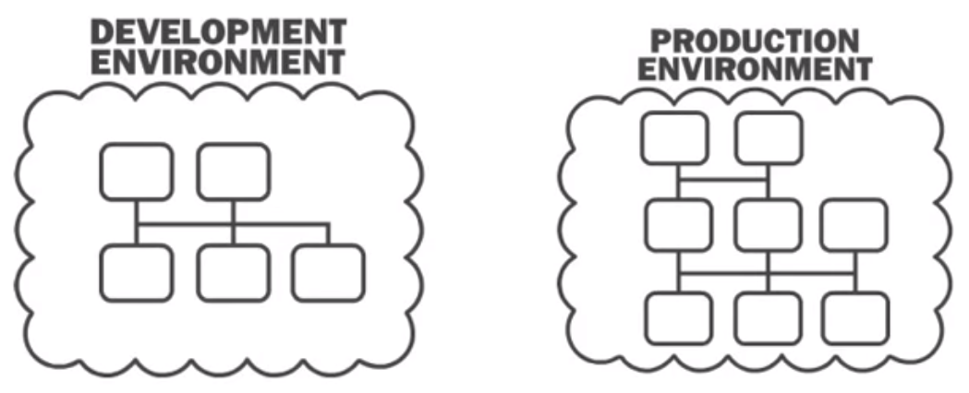
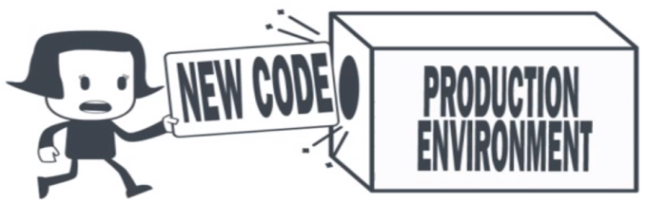
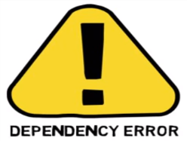
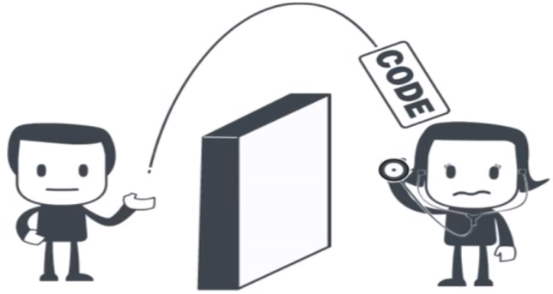
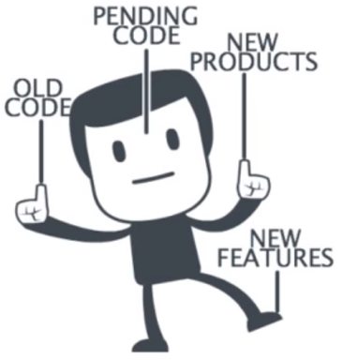

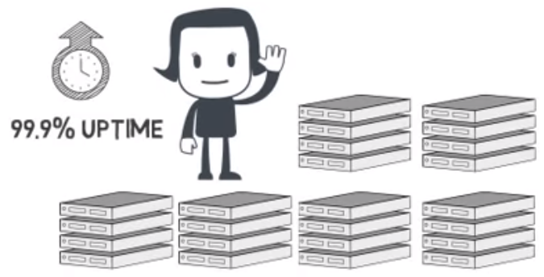
Life Before DevOps
33

Slide 34
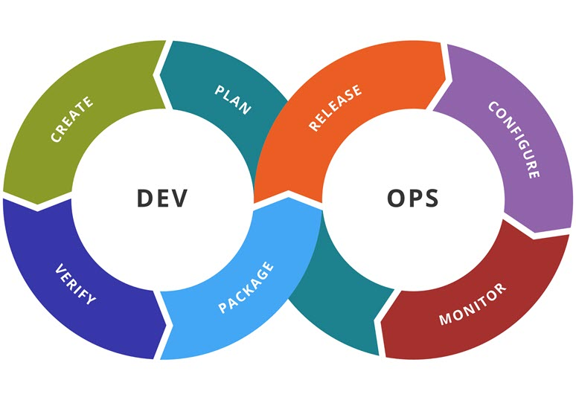
DevOps Goals
Improved deployment frequency;
Faster time to market;
Lower failure rate of new releases;
Shortened lead time between fixes;
Faster mean time to recovery (in the event of a new release crashing or otherwise disabling the current system).
34

Slide 35
Continuous Integration
Continuous Integration is a key aspect of rapid development:
Build often
Automated builds
Automated unit tests re-run
Automated build acceptance (smoke) testing
Automated functional/regression testing
35

Slide 36
CI / CD
CI / CD / CD
Continuous Integration: Developers practicing continuous integration merge their changes back to the main branch as often as possible.
Continuous Delivery: Continuous Delivery is an extension of Continuous Integration to make sure that the new changes can be deployed to testing / staging environment to go through automation test quickly in a sustainable way.
Continuous Deployment: Continuous Deployment goes one step further than Continuous Delivery. Every change that passes all stages of the production pipeline is released to customers. There's no human intervention.
36
Notes:
https://www.atlassian.com/continuous-delivery/ci-vs-ci-vs-cd

Slide 37
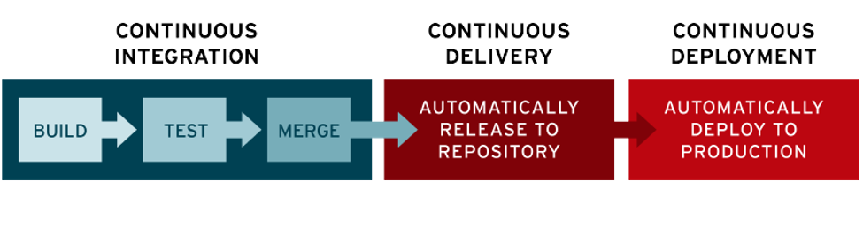
CI/CD
Continuous Integration – Continuous Delivery – Continuous Deployment
37
Notes:
https://www.atlassian.com/continuous-delivery/ci-vs-ci-vs-cd

Slide 38
SUMMARY
Depending on the type of application to be built and or customer’s requirement, we choose a suitable SDLC model.
There are several phases in the SDLC. In each phase, there are milestones and criteria for each milestone. The criteria, milestones and phases of the project help the product to be developed correctly, timely and effectively.
Depending on the SDLC, the testing and its implementation is affected, usually in time, knowledge about the application, documentation and amount of regression test done.
DevOps is a software engineering culture and practice, aiming at shorter development cycles, increased deployment frequency, and more dependable releases, in close alignment with business objectives.
38

Slide 39

Thank You!

