Slide 1
Object Oriented Programming
Demonstration of viruses
structure and its mechanism
Professor: PhD Nguyen Thi Thu Trang
Teaching Assistance: Nguyen Thi Minh Chau
Group 4: Tran Thai Phuc – 20184300
Nguyen Trong Nghia – 20184297
Nguyen Trinh Vu - 20184332

Slide 2
Member & Assignment
Tran Thai Phuc – 20184300
- Designing class diagram, slice
- Writing source code: package oop.globalict.project.gui
- Investigating virus-structure
Nguyen Trong Nghia – 20184297
- Designing use-case diagram, writing report
- Writing source code: Package oop.globalict.project.virus, oop.globalict.project.storage
- Investigating virus – infection progress
Nguyen Trinh Vu – 20184332
- Designing class diagram, slice
- Writing source code: package oop.globalict.project.gui
- Take demo video

Slide 3
Problem statement
Overview: COVID-19 has been spreading all over the world and there is the need of understanding different type of viruses, as well as their infection progress.
Requirement: design an application using JavaFX for showing virus’s structure and the progress of virus infecting the host cell.

Slide 4
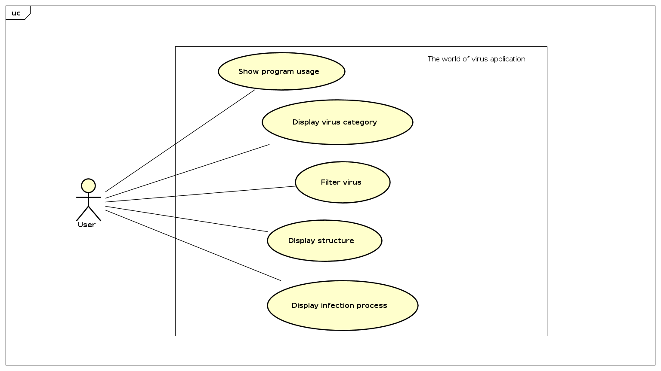
Use-case diagram

Slide 5
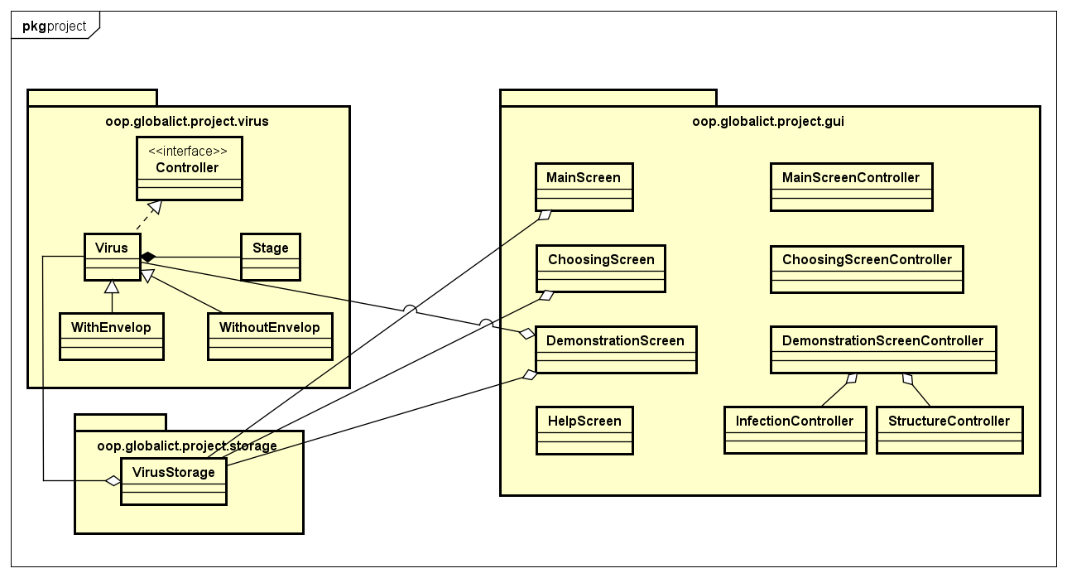
general Class diagram

Slide 6
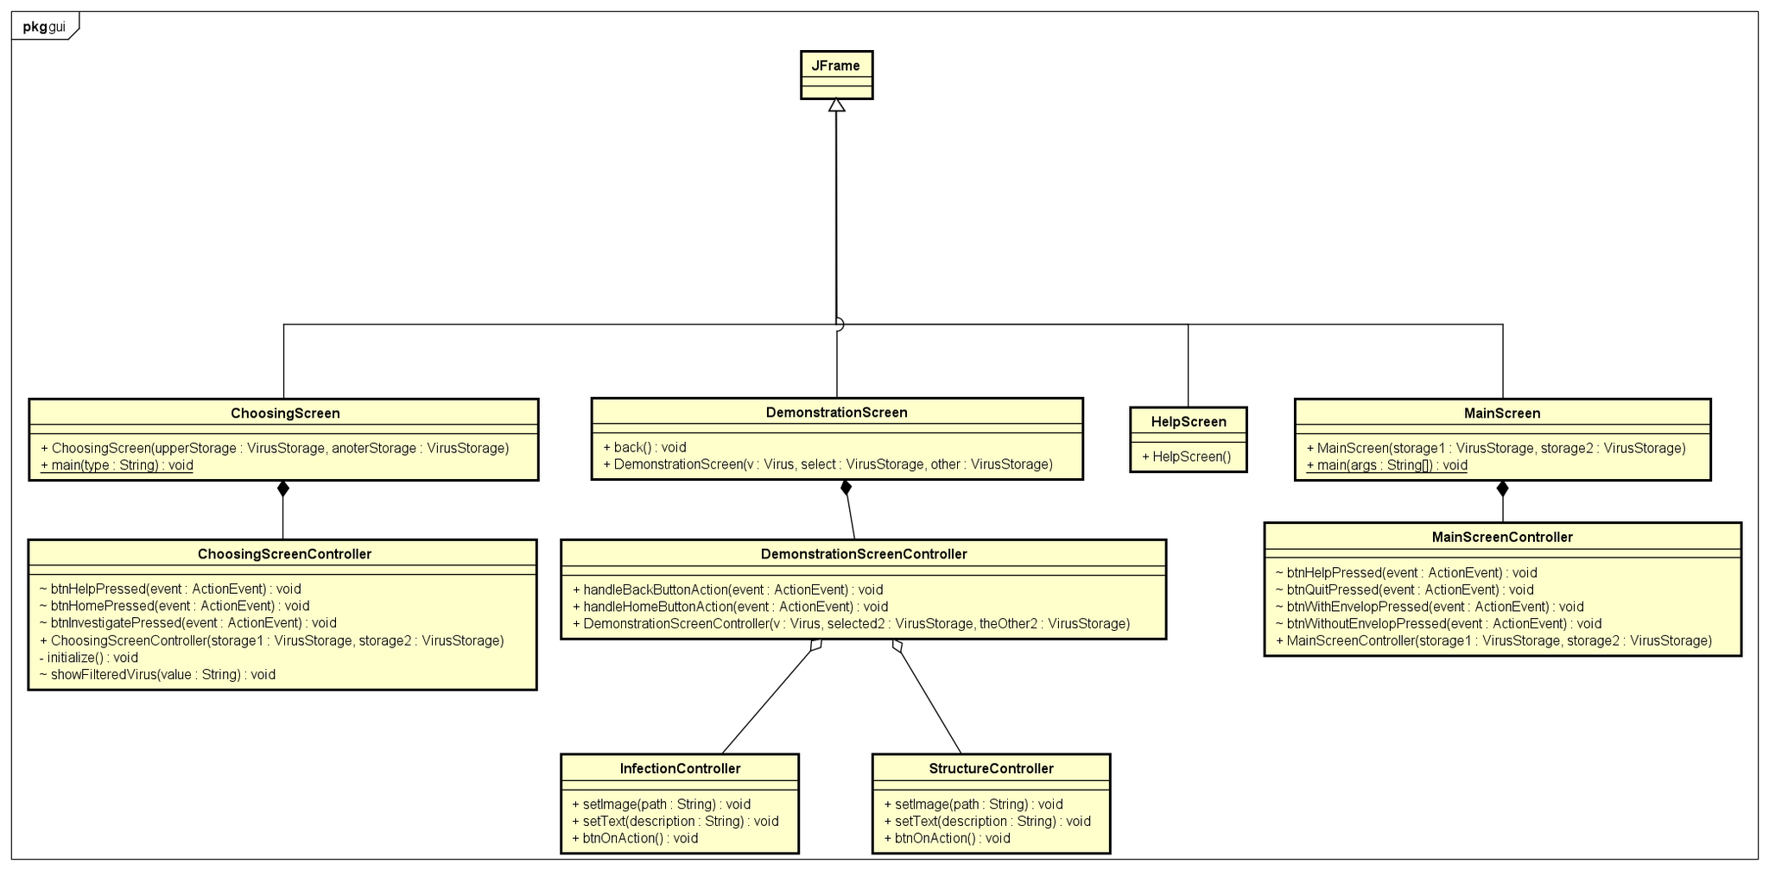
Class diagram for packages
Package oop.globalict.project.gui

Slide 7
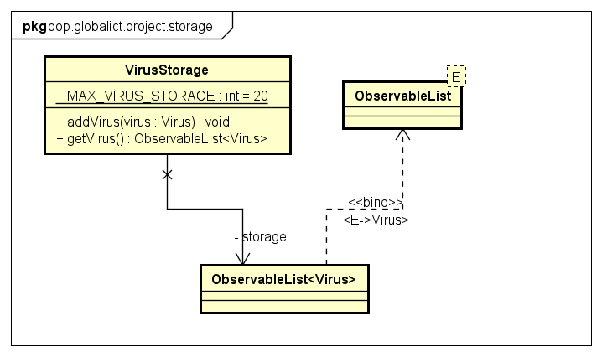
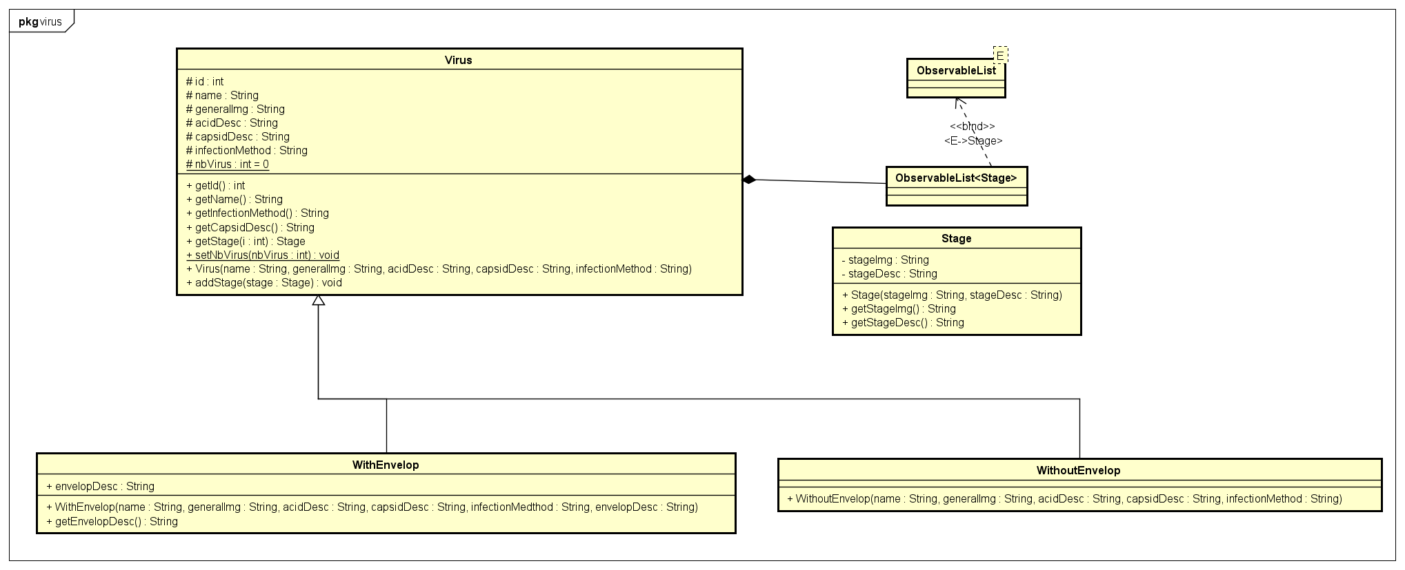
Class diagram for packages
Package oop.globalict.project.virus
Package oop.globalict.project.storage

Slide 8
Explanation of oop technique
1. Inheritance
Class Virus implements methods in Interface Controller(generalMechanism, generalStructure…)
2 Classes WithEnvelop and WithoutEnvelop are inherited from class Virus because they share the same attributes(capsidDesc, nucleicDesc…)
2. Polimorphism
WithEnvelop and WithoutEnvelop share the same methods inherited from Interface Controller but these methods act different ways, so we have to override these method
3. Asscociation/Aggregation/Composition
Stage is a part of Virus (Composition)
VirusStore has a list of Virus(Aggregation)
DemonstrationController has a StructureController and an InfectionController (Aggregation).

Slide 9
Demo videO
Link demo video: http://bit.ly/MrsTrangNo1

Slide 10
THANK YOU FOR LISTENNING

